Slide 1
Polymorphism Lab # 9

Slide 2
Polymorphism
The word polymorphism is a combination of two words poly and morphism. Poly means many and morphism means form.
In OOP polymorphism means that an object may behave differently in different conditions.
It allows a programmer to reuse and extend the code, the same code acts differently depending on the situation.
The user does not have to know the exact type of the object in advance.
The behavior of the object can be implemented at run time, it is called late binding or dynamic binding.
The polymorphism is implemented by using virtual function.

Slide 3
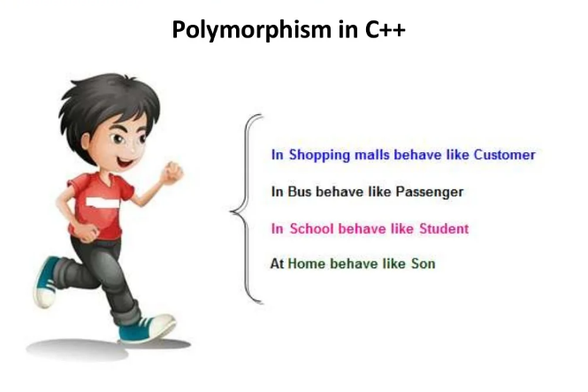
Real life Example

Slide 4
Types of polymorphism
Static polymorphism/Compile time
In this method the object is bound to the function call at the Compile time itself , it is also known as the early binding.
compile time polymorphism achieve only two ways these are
Method overloading
Method overriding
Dynamic polymorphism/ Run time
In this method the object is bound to the function call only at Run time, it is also known as the late binding.

Slide 5
Virtual Functions
Virtual means existing in effect but not in reality.
A type of function that appears to exist in some part of program but does not exist really is called virtual function.
virtual functions are used to implement polymorphism.
They enable the user to execute completely different functions by the same function call.
A virtual function is defined in the parent class and can be overridden in child classes.
it is defined by using the keyword virtual.

Slide 6
Class A {
Public:
virtual void show ( ) {
cout<<“Parent class A “ <<endl; }
};
class B : public A
{
public:
void show( )
{
cout<<“ Child class B “ <<endl;
}
};
Class C : public A {
public:
void show( ) {
cout<<“Child class C “ <<endl; }
};
main ( )
{
A obj1;
B obj2;
C obj3;
A *ptr;
ptr = &obj1;
ptr->show();
ptr = &obj2;
ptr-> show();
ptr = &obj3;
ptr->show();
}

Slide 7
Pure virtual Functions
A type of virtual function that has no body is known as pure virtual function. A function can be declared as pure virtual function by adding two things.
The keyword virtual at the start of the function declarator.
The =0 at the end of function declarator
The pure virtual function are used in the classes which are not used directly.
The user can inherit the class and then override the pure virtual function in the child class.

Slide 8
Abstract Classes
A type of class that contains any pure virtual function is called abstract class.
An abstract class cannot be used directly, it means that no object of an abstract class can be created.
However, a child class can inherit an abstract class and use it by overriding its pure virtual function.
The abstract classes are used to create a model class.
Any user who creates a new class by inheriting an abstract class has to override the pure virtual functions.
The child class also becomes an abstract class if any of the pure virtual functions is not overridden in child class.

Slide 9
Syntax of Abstract class
virtual return-type function-name ( ) = 0;
virtual it is a keyword used to declare a virtual function.
return-type it indicates the type of value return by the function.
function-name it indicates the name of the function.
= 0 it indicates that the function is a pure virtual function.

Slide 10
Class Parent
{
Public:
virtual void show ( ) = 0 ;
};
class child1 : public Parent
{
public:
void show( )
{
cout<<“ Child 1 class “ <<endl;
}
};
Class child2 : public Parent
{
public:
void show( )
{
cout<<“Child2 class “ <<endl;
}
};
main ( )
{
Parent *ptr[2];
ptr[0]= new child1;
ptr[1]= new child2;
Ptr[0]->show();
Ptr[1]-> show();
}

