Slide 1
Chapter 7
Defining Your Own Classes
Part 2
©The McGraw-Hill Companies, Inc. Permission required for reproduction or display.
4th Ed Chapter 7 - <number>

Slide 2
What you have learned so far:
1. Create classes & objects.
2. Variables in OOP- Data member, argument, parameter & local variable.
3. set & get method ( mutator & accessor)
4. Constructor
5. Matching Arguments & Parameters.
6. Overloaded Methods
7. Create UML Class diagram.
8. Class Constant
  9. Calling Methods of the Same Class.
  10. Overloaded Constructor
©The McGraw-Hill Companies, Inc. Permission required for reproduction or display.
4th Ed Chapter 4 - <number>

Slide 3
What you have learned so far:
11. Reserved word this
12. Passing Object to a Method
13. Returning an Object from a Method
©The McGraw-Hill Companies, Inc. Permission required for reproduction or display.
4th Ed Chapter 4 - <number>

Slide 4
Today you will learn about:
  Passing Objects to a Method.
    Object address in main memory.
    Pass by reference / pass the object address.
  Passing Object array to a Method.
©The McGraw-Hill Companies, Inc. Permission required for reproduction or display.
4th Ed Chapter 4 - <number>

Slide 5
Objectives
After you have read and studied this chapter, you should be able to
  Describe how objects are returned from methods
  Describe how the reserved word this is used
  Define overloaded methods and constructors
  Define class methods and variables
  Describe how the arguments are passed to the parameters using the pass-by-value scheme
  Document classes with javadoc comments
  Organize classes into a package
Notes:
Intro to OOP with Java, C. Thomas Wu
©The McGraw-Hill Companies, Inc.
A class is instantiable if we can create instances of it. For example, the JFrame class is instantiable. A class is noninstantiable if we cannot create its instances. The Math class is one example of noninstantiable classes. The main classes we have been writing are all noninstantiable. We will learn how to define instantiable classes in this lesson. A constructor is a special method that is used to initialize an instance of a class when it is first created.

Slide 6
Returning an Object from a Method
As we can return a primitive data value from a method, we can return an object from a method also.
We return an object from a method, we are actually returning a reference (or an address) of an object.
  This means we are not returning a copy of an object, but only the reference of this object
©The McGraw-Hill Companies, Inc. Permission required for reproduction or display.
4th Ed Chapter 7 - <number>
Notes:
Intro to OOP with Java, C. Thomas Wu
©The McGraw-Hill Companies, Inc.
We already know how to return an object from a method, because we have been returning a string from a method and a string is an object (an instance of the String class). However, String objects are treated much like primitive data. We will explore a little deeper into this topic.

Slide 7
Sample Object-Returning Method
Here's a sample method that returns an object:
Return type indicates the class of an object we're returning from the method.
public Fraction simplify( ) {
Fraction simp;
int num = getNumberator();
int denom = getDenominator();
int gcd = gcd(num, denom);
simp = new Fraction(num/gcd, denom/gcd);
return simp;
}
Return an instance of the Fraction class
©The McGraw-Hill Companies, Inc. Permission required for reproduction or display.
4th Ed Chapter 7 - <number>

Slide 8
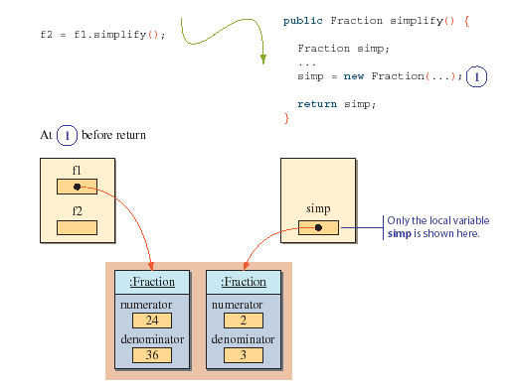
A Sample Call to simplify
©The McGraw-Hill Companies, Inc. Permission required for reproduction or display.
4th Ed Chapter 7 - <number>

Slide 9
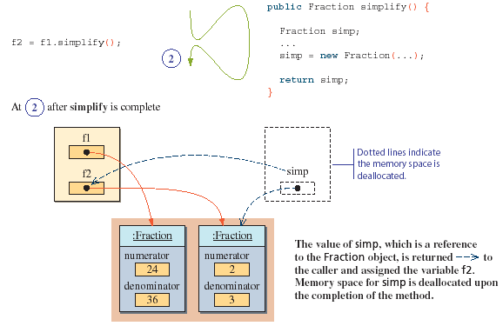
A Sample Call to simplify (cont'd)
©The McGraw-Hill Companies, Inc. Permission required for reproduction or display.
4th Ed Chapter 7 - <number>

Slide 10
Exercise
Create a class based on the following UML diagram
Customer
– name : String – account: Account
+ Customer( name:String) +getName() : String +setAccount (acct : Account): void +getAccount() : Account
©The McGraw-Hill Companies, Inc. Permission required for reproduction or display.
4th Ed Chapter 7 - <number>

Slide 11
Reserved Word this
The reserved word this is called a self-referencing pointer because it refers to an object from the object's method.
The reserved word this can be used in three different ways. We will see all three uses in this chapter.
: Object
this
©The McGraw-Hill Companies, Inc. Permission required for reproduction or display.
4th Ed Chapter 7 - <number>

Slide 12
The Use of this in the add Method
public Fraction add(Fraction frac) {
int a, b, c, d;
Fraction sum;
a = this.getNumerator(); //get the receiving
b = this.getDenominator(); //object's num and denom
c = frac.getNumerator(); //get frac's num
d = frac.getDenominator(); //and denom
sum = new Fraction(a*d + b*c, b*d);
return sum;
}
©The McGraw-Hill Companies, Inc. Permission required for reproduction or display.
4th Ed Chapter 7 - <number>
Notes:
Intro to OOP with Java, C. Thomas Wu
©The McGraw-Hill Companies, Inc.
The use of the reserved word this is option in this context. Calling a method of a class or accessing a data member of the class can be achieved without the reserved word this. Consider, for example,
class One {
public int m1( ) {
return 10;
}
public void m2( ) {
int num;
num = m1(); ← this is equivalent to num = this.m1();
}
}

Slide 13
The Calling Class
Fraction f1,f2,f3;
f1 = new Fraction(1,2);
f2 = new Fraction(3,4);
f3 = f1.add(f2);
System.out.println(“Sum of ” +f1.toString() + “and” +
f2.toString() + “is” +
f3.toString());
public String toString() {
return getNumerator() + “/” + getDenominator();
}
©The McGraw-Hill Companies, Inc. Permission required for reproduction or display.
4th Ed Chapter 7 - <number>
Notes:
Intro to OOP with Java, C. Thomas Wu
©The McGraw-Hill Companies, Inc.
The use of the reserved word this is option in this context. Calling a method of a class or accessing a data member of the class can be achieved without the reserved word this. Consider, for example,
class One {
public int m1( ) {
return 10;
}
public void m2( ) {
int num;
num = m1(); ← this is equivalent to num = this.m1();
}
}

Slide 14
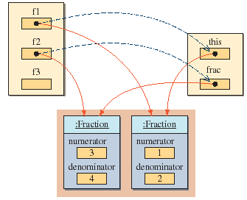
f1.add(f2)
Because f1 is the receiving object (we're calling f1's method), so the reserved word this is referring to f1.
©The McGraw-Hill Companies, Inc. Permission required for reproduction or display.
4th Ed Chapter 7 - <number>
Notes:
Intro to OOP with Java, C. Thomas Wu
©The McGraw-Hill Companies, Inc.

Slide 15
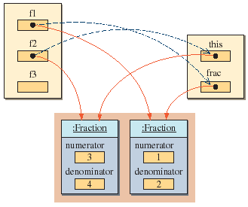
f2.add(f1)
This time, we're calling f2's method, so the reserved word this is referring to f2.
©The McGraw-Hill Companies, Inc. Permission required for reproduction or display.
4th Ed Chapter 7 - <number>

Slide 16
Using this to Refer to Data Members
In the previous example, we showed the use of this to call a method of a receiving object.
It can be used to refer to a data member as well.
class Person {
int age;
public void setAge(int val) {
this.age = val;
}
. . .
}
©The McGraw-Hill Companies, Inc. Permission required for reproduction or display.
4th Ed Chapter 7 - <number>
Notes:
Intro to OOP with Java, C. Thomas Wu
©The McGraw-Hill Companies, Inc.

Slide 17
Overloaded Methods
What is Overloaded Methods?
  Overloaded Methods are the methods that have the same name but different parameters.
©The McGraw-Hill Companies, Inc. Permission required for reproduction or display.
4th Ed Chapter 7 - <number>
Notes:
Intro to OOP with Java, C. Thomas Wu
©The McGraw-Hill Companies, Inc.
Notice that the difference in the return type alone is not enough to overload the methods. For example, the following declaration is invalid
public double convert(int num) { . . . }
public float convert(int num) { . . . }

Slide 18
Overloaded Methods
Methods can share the same name as long as
  they have a different number of parameters (Rule 1) or
  their parameters are of different data types when the number of parameters is the same (Rule 2)
public void myMethod(int x, int y) { ... }
public void myMethod(int x) { ... }
Rule 1
public void myMethod(double x) { ... }
public void myMethod(int x) { ... }
Rule 2
©The McGraw-Hill Companies, Inc. Permission required for reproduction or display.
4th Ed Chapter 7 - <number>
Notes:
Intro to OOP with Java, C. Thomas Wu
©The McGraw-Hill Companies, Inc.
Notice that the difference in the return type alone is not enough to overload the methods. For example, the following declaration is invalid
public double convert(int num) { . . . }
public float convert(int num) { . . . }

Slide 19
Exercise
Create a class name Number.
Number consists of two methods with same name called add().
The first add() consists of one integer parameter. The function of this method is to display its parameter value.
The second add() consists of two integer parameter. The function of this method is to display both of its parameters value.
©The McGraw-Hill Companies, Inc. Permission required for reproduction or display.
4th Ed Chapter 7 - <number>
Notes:
Intro to OOP with Java, C. Thomas Wu
©The McGraw-Hill Companies, Inc.
Notice that the difference in the return type alone is not enough to overload the methods. For example, the following declaration is invalid
public double convert(int num) { . . . }
public float convert(int num) { . . . }

Slide 20
Constructors, cont..
A constructors is a special method that have the following features:
  Same name as the class itself.
  2. Do not have a return type. - not even void.
  Constructors play the role to initialize the default value
  for all objects data members.
  4. Invoked using the new operator when an object is created.
  Best practice: initialize all the object data members’ value
  using constructor.

Slide 21
Overloaded Methods
What is Overloaded Constructors?
  Overloaded Constructors are the constructors that have the same name but different parameters.
©The McGraw-Hill Companies, Inc. Permission required for reproduction or display.
4th Ed Chapter 7 - <number>
Notes:
Intro to OOP with Java, C. Thomas Wu
©The McGraw-Hill Companies, Inc.
Notice that the difference in the return type alone is not enough to overload the methods. For example, the following declaration is invalid
public double convert(int num) { . . . }
public float convert(int num) { . . . }

Slide 22
Overloaded Constructor
The same rules apply for overloaded constructors
  this is how we can define more than one constructor to a class
public Person( ) { ... }
public Person(int age) { ... }
Rule 1
public Pet(int age) { ... }
public Pet(String name) { ... }
Rule 2
©The McGraw-Hill Companies, Inc. Permission required for reproduction or display.
4th Ed Chapter 7 - <number>
Notes:
Intro to OOP with Java, C. Thomas Wu
©The McGraw-Hill Companies, Inc.
Notice that the difference in the return type alone is not enough to overload the methods. For example, the following declaration is invalid
public double convert(int num) { . . . }
public float convert(int num) { . . . }

Slide 23
Why Multiple Constructors
Give the client programmer flexibility in creating instances.
The client programmer can pick one of the several constructors that is suitable.
public Fraction( ) { //creates 0/1
setNumerator(0);
setDenominator(1);
}
public Fraction(int number ) { //creates number/1
setNumerator(number);
setDenominator(1);
}
public Fraction(int num, int denom ) {
setNumerator(num);
setDenominator(denom);
}
©The McGraw-Hill Companies, Inc. Permission required for reproduction or display.
4th Ed Chapter 7 - <number>
Notes:
Intro to OOP with Java, C. Thomas Wu
©The McGraw-Hill Companies, Inc.
Notice that the difference in the return type alone is not enough to overload the methods. For example, the following declaration is invalid
public double convert(int num) { . . . }
public float convert(int num) { . . . }

Slide 24
Exercises
Define a Student class. A Student has name as a data member.
Define two constructors, one with no parameter and another with the studentName as its parameter.
Initialize the name to a default value Unknown for the zero-parameter constructor.
Assign the data member name with the parameter value for the constructor that has a parameter.
©The McGraw-Hill Companies, Inc. Permission required for reproduction or display.
4th Ed Chapter 7 - <number>
Notes:
Intro to OOP with Java, C. Thomas Wu
©The McGraw-Hill Companies, Inc.
Without using the reserved word this, we need to define the four constructors as follows (it forces us to repeat the same code):
public Fraction( ) { //creates 0/1
setNumerator(0);
setDenominator(1);
}
public Fraction(int number) { //creates number/1
setNumerator(number);
setDenominator(1);
}
public Fraction(Fraction frac) { //copy constructor
setNumerator(frac.getNumerator());
setDenominator(frac.getDenominator());
}
public Fraction(int num, int denom) {
setNumerator(num);
setDenominator(denom);
}

Slide 25
Exercises
Create a main class. In main class, create two objects as an instance from the Student class. The first object will call the first constructor (constructor without parameter ) and the second object will call the second constructor (the one with studentName as its parameter).
©The McGraw-Hill Companies, Inc. Permission required for reproduction or display.
4th Ed Chapter 7 - <number>
Notes:
Intro to OOP with Java, C. Thomas Wu
©The McGraw-Hill Companies, Inc.
Without using the reserved word this, we need to define the four constructors as follows (it forces us to repeat the same code):
public Fraction( ) { //creates 0/1
setNumerator(0);
setDenominator(1);
}
public Fraction(int number) { //creates number/1
setNumerator(number);
setDenominator(1);
}
public Fraction(Fraction frac) { //copy constructor
setNumerator(frac.getNumerator());
setDenominator(frac.getDenominator());
}
public Fraction(int num, int denom) {
setNumerator(num);
setDenominator(denom);
}

Slide 26
  Reserved word this
©The McGraw-Hill Companies, Inc. Permission required for reproduction or display.
4th Ed Chapter 7 - <number>

Slide 27
Using this to Refer to Data Members
this can be used to refer to a data member.
Use this when the local variable name or parameter have the same name with the data member.
class Person {
int age;
public void setAge(int age) {
this.age = age;
}
. . .
}
©The McGraw-Hill Companies, Inc. Permission required for reproduction or display.
4th Ed Chapter 7 - <number>
Notes:
Intro to OOP with Java, C. Thomas Wu
©The McGraw-Hill Companies, Inc.

Slide 28
Constructors and this
public Fraction( ) {
//creates 0/1
this(0, 1);
}
public Fraction(int number) {
//creates number/1
this(number, 1);
}
public Fraction(Fraction frac) {
//copy constructor
this(frac.getNumerator(),
frac.getDenominator());
}
public Fraction(int num, int denom) {
setNumerator(num);
setDenominator(denom);
}
To call a constructor from another constructor of the same class, we use the reserved word this.
©The McGraw-Hill Companies, Inc. Permission required for reproduction or display.
4th Ed Chapter 7 - <number>
Notes:
Intro to OOP with Java, C. Thomas Wu
©The McGraw-Hill Companies, Inc.
Without using the reserved word this, we need to define the four constructors as follows (it forces us to repeat the same code):
public Fraction( ) { //creates 0/1
setNumerator(0);
setDenominator(1);
}
public Fraction(int number) { //creates number/1
setNumerator(number);
setDenominator(1);
}
public Fraction(Fraction frac) { //copy constructor
setNumerator(frac.getNumerator());
setDenominator(frac.getDenominator());
}
public Fraction(int num, int denom) {
setNumerator(num);
setDenominator(denom);
}

Slide 29
Exercises
Create a class name Student that consist of data member age.
Create a method name setAge() that will receive the student age and set the age data member.
Create the following constructor that will call the setAge method:
  Student()
  Student(int studentAge)
©The McGraw-Hill Companies, Inc. Permission required for reproduction or display.
4th Ed Chapter 7 - <number>
Notes:
Intro to OOP with Java, C. Thomas Wu
©The McGraw-Hill Companies, Inc.
Without using the reserved word this, we need to define the four constructors as follows (it forces us to repeat the same code):
public Fraction( ) { //creates 0/1
setNumerator(0);
setDenominator(1);
}
public Fraction(int number) { //creates number/1
setNumerator(number);
setDenominator(1);
}
public Fraction(Fraction frac) { //copy constructor
setNumerator(frac.getNumerator());
setDenominator(frac.getDenominator());
}
public Fraction(int num, int denom) {
setNumerator(num);
setDenominator(denom);
}

Slide 30
Class Methods
We use the reserved word static to define a class method.
public static int gcd(int m, int n) {
//the code implementing the Euclidean algorithm
}
public static Fraction min(Fraction f1, Fraction f2) {
//convert to decimals and then compare
}
©The McGraw-Hill Companies, Inc. Permission required for reproduction or display.
4th Ed Chapter 7 - <number>

Slide 31
Call-by-Value Parameter Passing
When a method is called,
  the value of the argument is passed to the matching parameter, and
  separate memory space is allocated to store this value.
This way of passing the value of arguments is called a pass-by-value or call-by-value scheme.
Since separate memory space is allocated for each parameter during the execution of the method,
  the parameter is local to the method, and therefore
  changes made to the parameter will not affect the value of the corresponding argument.
©The McGraw-Hill Companies, Inc. Permission required for reproduction or display.
4th Ed Chapter 7 - <number>

Slide 32
Call-by-Value Example
class Tester {
  public void myMethod(int one, double two ) {
  one = 25;
    two = 35.4;
}
}
Tester tester;
int x, y;
tester = new Tester();
x = 10;
y = 20;
tester.myMethod(x, y);
System.out.println(x + " " + y);
10 20
produces
©The McGraw-Hill Companies, Inc. Permission required for reproduction or display.
4th Ed Chapter 7 - <number>

Slide 33
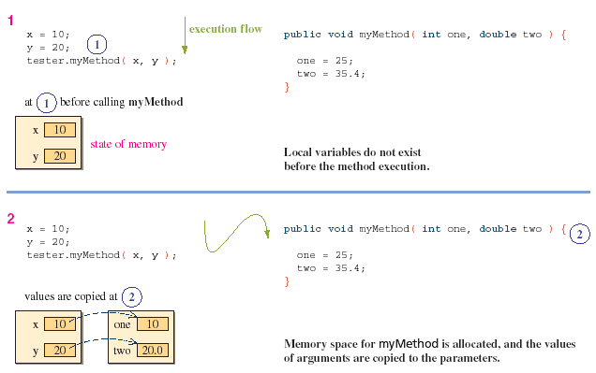
Memory Allocation for Parameters
©The McGraw-Hill Companies, Inc. Permission required for reproduction or display.
4th Ed Chapter 7 - <number>

Slide 34
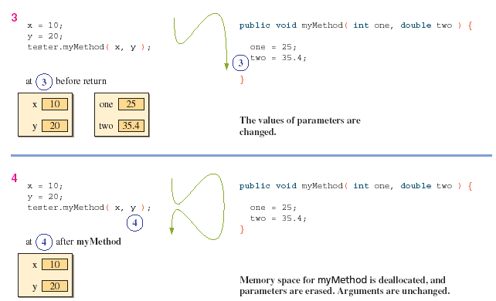
Memory Allocation for Parameters (cont'd)
©The McGraw-Hill Companies, Inc. Permission required for reproduction or display.
4th Ed Chapter 7 - <number>

Slide 35

Parameter Passing: Key Points
1. Arguments are passed to a method by using the pass-by- value scheme.
2. Arguments are matched to the parameters from left to right.The data type of an argument must be assignment-compatible with the data type of the matching parameter.
3. The number of arguments in the method call must match the number of parameters in the method definition.
4. Parameters and arguments do not have to have the same name.
5. Local copies, which are distinct from arguments,are created even if the parameters and arguments share the same name.
6. Parameters are input to a method, and they are local to the method.Changes made to the parameters will not affect the value of corresponding arguments.
©The McGraw-Hill Companies, Inc. Permission required for reproduction or display.
4th Ed Chapter 7 - <number>

Slide 36
Organizing Classes into a Package
For a class A to use class B, their bytecode files must be located in the same directory.
  This is not practical if we want to reuse programmer-defined classes in many different programs
The correct way to reuse programmer-defined classes from many different programs is to place reusable classes in a package.
A package is a Java class library.
©The McGraw-Hill Companies, Inc. Permission required for reproduction or display.
4th Ed Chapter 7 - <number>

Slide 37
Creating a Package
The following steps illustrate the process of creating a package name myutil that includes the Fraction class.
  1. Include the statement
    package myutil;
  as the first statement of the source file for the Fraction class.
  2. The class declaration must include the visibility modifier public as
        public class Fraction {
        ...
        }
  3. Create a folder named myutil, the same name as the package name. In Java, the package must have a one-to-one correspondence with the folder.
  4. Place the modified Fraction class into the myutil folder and compile it.
  5. Modify the CLASSPATH environment variable to include the folder that contains the myutil folder.
©The McGraw-Hill Companies, Inc. Permission required for reproduction or display.
4th Ed Chapter 7 - <number>

Slide 38
Using Javadoc Comments
Many of the programmer-defined classes we design are intended to be used by other programmers.
  It is, therefore, very important to provide meaningful documentation to the client programmers so they can understand how to use our classes correctly.
By adding javadoc comments to the classes we design, we can provide a consistent style of documenting the classes.
Once the javadoc comments are added to a class, we can generate HTML files for documentation by using the javadoc command.
©The McGraw-Hill Companies, Inc. Permission required for reproduction or display.
4th Ed Chapter 7 - <number>

Slide 39
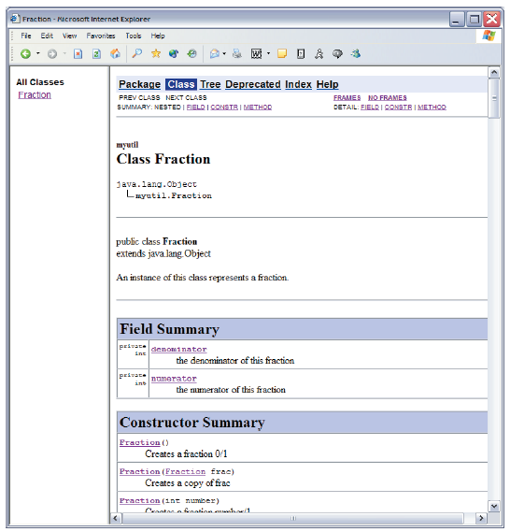
javadoc for Fraction
This is a portion of the HTML documentation for the Fraction class shown in a browser.
This HTML file is produced by processing the javadoc comments in the source file of the Fraction class.
©The McGraw-Hill Companies, Inc. Permission required for reproduction or display.
4th Ed Chapter 7 - <number>

Slide 40
javadoc Tags
The javadoc comments begins with /** and ends with */
Special information such as the authors, parameters, return values, and others are indicated by the @ marker
  @param
  @author
  @return
  etc
©The McGraw-Hill Companies, Inc. Permission required for reproduction or display.
4th Ed Chapter 7 - <number>

Slide 41
Example: javadoc Source
. . .
/**
* Returns the sum of this Fraction
* and the parameter frac. The sum
* returned is NOT simplified.
*
* @param frac the Fraction to add to this
* Fraction
*
* @return the sum of this and frac
*/
public Fraction add(Fraction frac) {
...
}
. . .
this javadoc
will produce
©The McGraw-Hill Companies, Inc. Permission required for reproduction or display.
4th Ed Chapter 7 - <number>
Notes:
Intro to OOP with Java, C. Thomas Wu
©The McGraw-Hill Companies, Inc.
In the command prompt window, we used the commands javac and java to compile and run Java programs, respectively. Similarly, to generate javadoc files, we use the javadoc command.
For example, to generate a javadoc file for the Fraction class, we enter
javadoc -private Fraction.java
We specify the -private option because we want to generate the documentation for all types of methods (so far, we have covered two of these—private and public). The private option generates the most complete documentation.

Slide 42
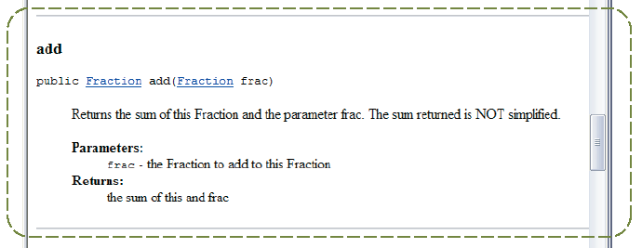
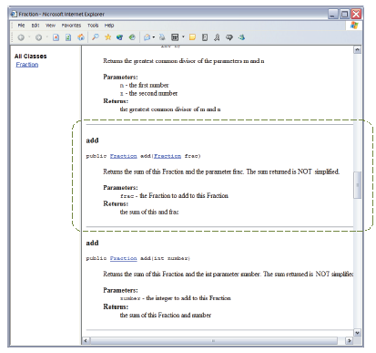
Example: javadoc Output
©The McGraw-Hill Companies, Inc. Permission required for reproduction or display.
4th Ed Chapter 7 - <number>

Slide 43
javadoc Resources
General information on javadoc is located at
  http://java.sun.com/j2se/javadoc
Detailed reference on how to use javadoc on Windows is located at
  http://java.sun.com/j2se/1.5/docs/tooldocs/windows/javadoc.html
©The McGraw-Hill Companies, Inc. Permission required for reproduction or display.
4th Ed Chapter 7 - <number>

Slide 44
Problem Statement
Problem statement:
Write an application that computes the total charges for the overdue library books. For each library book, the user enters the due date and (optionally) the overdue charge per day,the maximum charge, and the title. If the optional values are not entered, then the preset default values are used. A complete list of book information is displayed when the user finishes entering the input data.The user can enter different return dates to compare the overdue charges.
©The McGraw-Hill Companies, Inc. Permission required for reproduction or display.
4th Ed Chapter 7 - <number>
Notes:
Intro to OOP with Java, C. Thomas Wu
©The McGraw-Hill Companies, Inc.

Slide 45
Overall Plan
Tasks:
  Get the information for all books
  Display the entered book information
  Ask for the return date and display the total charge. Repeat this step until the user quits.
©The McGraw-Hill Companies, Inc. Permission required for reproduction or display.
4th Ed Chapter 7 - <number>
Notes:
Intro to OOP with Java, C. Thomas Wu
©The McGraw-Hill Companies, Inc.
As a part of the overall plan, we begin by identifying the main tasks for the program. Unlike the overall plan for the previous sample developments, we will use a pseudo code to express the top level logic of the program.

Slide 46
Required Classes
OverdueChecker
Scanner
BookTracker
LibraryBook
helper class
©The McGraw-Hill Companies, Inc. Permission required for reproduction or display.
4th Ed Chapter 7 - <number>
Notes:
Intro to OOP with Java, C. Thomas Wu
©The McGraw-Hill Companies, Inc.
The structure of this program is very simple. We will use two standard classes, one for input and output and another for generating random numbers.

Slide 47
Development Steps
We will develop this program in five steps:
  1. Define the basic LibraryBook class.
  2. Explore the given BookTracker class and integrate it with the LibraryBook class.
  3. Define the top-level OverdueChecker class. Implement the complete input routines.
  4. Complete the LibraryBook class by fully implementing the overdue charge computation.
  5. Finalize the program by tying up loose ends.
©The McGraw-Hill Companies, Inc. Permission required for reproduction or display.
4th Ed Chapter 7 - <number>
Notes:
Intro to OOP with Java, C. Thomas Wu
©The McGraw-Hill Companies, Inc.
The second and the third steps correspond to the two major tasks identified in the overall plan.

Slide 48
Step 1 Design
Develop the basic LibraryBook class.
The key design task is to identify the data members for storing relevant information.
We will include multiple constructors for ease of creating LibraryBook objects.
  Make sure that an instance will be initiated correctly no matter which constructor is used.
©The McGraw-Hill Companies, Inc. Permission required for reproduction or display.
4th Ed Chapter 7 - <number>
Notes:
Intro to OOP with Java, C. Thomas Wu
©The McGraw-Hill Companies, Inc.
In the first step, we determine a little more detailed control logic than the one stated in the overall plan. For each of the five identified functions, we will define a method: describeRules, generateSecretNumber, playGame, and prompt.

Slide 49
Step 1 Code
    Directory: Chapter7/Step1
    Source Files: LibraryBook.java
    Step1Main.java (test program)
Program source file is too big to list here. From now on, we ask
you to view the source files using your Java IDE.
©The McGraw-Hill Companies, Inc. Permission required for reproduction or display.
4th Ed Chapter 7 - <number>
Notes:
Intro to OOP with Java, C. Thomas Wu
©The McGraw-Hill Companies, Inc.
Please use your Java IDE to view the source files and run the program.

Slide 50
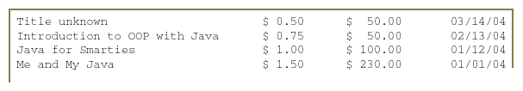
Step 1 Test
In the testing phase, we run the test main program Step1Main and confirm that we get the expected output:
©The McGraw-Hill Companies, Inc. Permission required for reproduction or display.
4th Ed Chapter 7 - <number>
Notes:
Intro to OOP with Java, C. Thomas Wu
©The McGraw-Hill Companies, Inc.
Run the program and verify that the topmost control loop is functioning correctly.

Slide 51
Step 2 Design
Explore the helper BookTracker class and incorporate it into the program.
Adjust the LibraryBook class to make it compatible with the BookTracker class.
©The McGraw-Hill Companies, Inc. Permission required for reproduction or display.
4th Ed Chapter 7 - <number>
Notes:
Intro to OOP with Java, C. Thomas Wu
©The McGraw-Hill Companies, Inc.
In order to verify whether our code is working correctly or not, we need to know what is the secret number. The easiest way to do this is to use a fixed number, such as 45, make the temporary generateRandomNumber to return this fixed number.

Slide 52
Step 2 Code
    Directory: Chapter7/Step2
    Source Files: LibraryBook.java
    Step2Main.java (test program)
©The McGraw-Hill Companies, Inc. Permission required for reproduction or display.
4th Ed Chapter 7 - <number>
Notes:
Intro to OOP with Java, C. Thomas Wu
©The McGraw-Hill Companies, Inc.
We implement the playGame and getNextGuess methods in this step.

Slide 53
Step 2 Test
In the testing phase, we run the test main program Step2Main and confirm that we get the expected output.
We run the program multiple times trying different variations each time.
©The McGraw-Hill Companies, Inc. Permission required for reproduction or display.
4th Ed Chapter 7 - <number>
Notes:
Intro to OOP with Java, C. Thomas Wu
©The McGraw-Hill Companies, Inc.
We need to verify the correctness of two methods: playGame and getNextGuess. Try all cases presented here and confirm that you get the expected responses.

Slide 54
Step 3 Design
We implement the top-level control class OverdueChecker.
The top-level controller manages a single BookTracker object and multiple LibraryBook objects.
The top-level controller manages the input and output routines
  If the input and output routines are complex, then we would consider designing separate classes to delegate the I/O tasks.
©The McGraw-Hill Companies, Inc. Permission required for reproduction or display.
4th Ed Chapter 7 - <number>
Notes:
Intro to OOP with Java, C. Thomas Wu
©The McGraw-Hill Companies, Inc.
Notice that we have one temporary statement to output the value of secretNumber. We include it for the testing purpose, i.e., we need to check the numbers generated are valid.

Slide 55
Step 3 Pseudocode
GregorianCalendar returnDate;
String reply, table;
double totalCharge;
inputBooks(); //read in all book information
table = bookTracker.getList();
System.out.println(table);
//try different return dates
do {
returnDate = read return date ;
totalCharge = bookTracker.getCharge(returnDate);
displayTotalCharge(totalCharge);
reply = prompt the user to continue or not;
} while ( reply is yes );
©The McGraw-Hill Companies, Inc. Permission required for reproduction or display.
4th Ed Chapter 7 - <number>
Notes:
Intro to OOP with Java, C. Thomas Wu
©The McGraw-Hill Companies, Inc.
The body of the inputBooks method is as follows:
while (isContinue()) {
title = readString("Title : ");
chargePerDay = readDouble("Charge per day: ");
maxCharge = readDouble("Maximum charge: ");
dueDate = readDate ("Due Date : ");
book = createBook(title, chargePerDay,
maxCharge, dueDate);
bookTracker.add(book);
}

Slide 56
Step 3 Code
    Directory: Chapter7/Step3
    Source Files: OverdueChecker.java
    LibraryBook.java
©The McGraw-Hill Companies, Inc. Permission required for reproduction or display.
4th Ed Chapter 7 - <number>
Notes:
Intro to OOP with Java, C. Thomas Wu
©The McGraw-Hill Companies, Inc.

Slide 57
Step 3 Test
Now we run the program multiple times, trying different input types and values.
We confirm that all control loops are implemented and working correctly.
  At this point, the code to compute the overdue charge is still a stub, so we will always get the same overdue charge for the same number of books.
After we verify that everything is working as expected,we proceed to the next step.
©The McGraw-Hill Companies, Inc. Permission required for reproduction or display.
4th Ed Chapter 7 - <number>
Notes:
Intro to OOP with Java, C. Thomas Wu
©The McGraw-Hill Companies, Inc.
As always, we run the final test by running the program numerous times trying out as many variations as possible. Before testing the generateSecretNumber method as a part of the final program, we will use a separate test driver to generate 1000 (or more) secret numbers and verify that they are valid.
class TestRandom {
public static void main (String[] args) {
int N = 1000, count = 0, number;
double X;
do {
count++;
X = Math.random();
number = (int) Math.floor( X * 100 ) + 1;
} while ( count < N && 1 <= number && number <= 100 );
if ( number < 1 || number > 100 ) {
System.out.println("Error: " + number);
} else {
System.out.println("Okay");
}
}
}

Slide 58
Step 4: Compute the Charge
To compute the overdue charge, we need two dates: the due date and the date the books are or to be returned.
The getTimeInMillis method returns the time elasped since the epoch to the date in milliseconds.
By subtracting this since-the-epoch milliseconds value of the due date from the same of the return date, we can find the difference between the two.
  If the difference is negative, then it’s not past due, so there’s no charge.
  If the difference is positive, then we convert the milliseconds to the equivalent number of days and multiply it by the per-day charge to compute the total charge.
©The McGraw-Hill Companies, Inc. Permission required for reproduction or display.
4th Ed Chapter 7 - <number>
Notes:
Intro to OOP with Java, C. Thomas Wu
©The McGraw-Hill Companies, Inc.

Slide 59
Step 4 Code
    Directory: Chapter7/Step3
    Source Files: OverdueChecker.java
    LibraryBook.java
©The McGraw-Hill Companies, Inc. Permission required for reproduction or display.
4th Ed Chapter 7 - <number>
Notes:
Intro to OOP with Java, C. Thomas Wu
©The McGraw-Hill Companies, Inc.

Slide 60
Step 4 Test
We run the program mutiple times again, possibly using the same set of input data.
We enter different input variations to try out all possible cases for the computeCharge method.
  Try cases such as the return date and due date are the same, the return date occurs before the due date, the charge is beyond the maximum, and so forth.
After we verify the program,we move on to the next step.
©The McGraw-Hill Companies, Inc. Permission required for reproduction or display.
4th Ed Chapter 7 - <number>
Notes:
Intro to OOP with Java, C. Thomas Wu
©The McGraw-Hill Companies, Inc.
As always, we run the final test by running the program numerous times trying out as many variations as possible. Before testing the generateSecretNumber method as a part of the final program, we will use a separate test driver to generate 1000 (or more) secret numbers and verify that they are valid.
class TestRandom {
public static void main (String[] args) {
int N = 1000, count = 0, number;
double X;
do {
count++;
X = Math.random();
number = (int) Math.floor( X * 100 ) + 1;
} while ( count < N && 1 <= number && number <= 100 );
if ( number < 1 || number > 100 ) {
System.out.println("Error: " + number);
} else {
System.out.println("Okay");
}
}
}

Slide 61
Step 5: Finalize / Extend
Program Review
  Are all the possible cases handled?
  Are the input routines easy to use?
  Will it be better if we allow different formats for entering the date information?
Possible Extensions
  Warn the user, say, by popping a warning window or ringing an alarm, when the due date is approaching.
  Provide a special form window to enter data
  (Note: To implement these extensions, we need techniques not covered yet.)
©The McGraw-Hill Companies, Inc. Permission required for reproduction or display.
4th Ed Chapter 7 - <number>
Notes:
Intro to OOP with Java, C. Thomas Wu
©The McGraw-Hill Companies, Inc.

