Slide 1
Chapter 8
Exceptions Handling
©The McGraw-Hill Companies, Inc. Permission required for reproduction or display.
4th Ed Chapter 8 - <number>
Notes:
Intro to OOP with Java, C. Thomas Wu
©The McGraw-Hill Companies, Inc.

Slide 2
Objectives
After you have read and studied this chapter, you should be able to
  Improve the reliability of code by incorporating exception-handling and assertion mechanisms.
  Implement the try-catch blocks for catching and handling exceptions.
  Write programmer-defined exception classes.
Notes:
Intro to OOP with Java, C. Thomas Wu
©The McGraw-Hill Companies, Inc.

Slide 3
Contents
Definition
Catching an Exceptions (try and catch)
Multiple Catch Block
The finally block
Types of Exceptions
©The McGraw-Hill Companies, Inc. Permission required for reproduction or display.
4th Ed Chapter 8 - <number>

Slide 4
Definition
An exception represents an error condition that can occur during the normal course of program execution.
When an exception occurs, or is thrown, the normal sequence of flow is terminated. The exception-handling routine is then executed; we say the thrown exception is caught.
©The McGraw-Hill Companies, Inc. Permission required for reproduction or display.
4th Ed Chapter 8 - <number>
Notes:
Intro to OOP with Java, C. Thomas Wu
©The McGraw-Hill Companies, Inc.
We can increase our programs’ reliability and robustness if we catch the exceptions ourselves using error recovery routines we develop.
One way to do this is to wrap the statements that may throw an exception with the try-catch control statement.

Slide 5
Definition
We can increase our programs’ reliability and robustness if we catch the exceptions ourselves using error recovery routines we develop.
One way to do this is to wrap the statements that may throw an exception with the try-catch control statement.
©The McGraw-Hill Companies, Inc. Permission required for reproduction or display.
4th Ed Chapter 8 - <number>
Notes:
Intro to OOP with Java, C. Thomas Wu
©The McGraw-Hill Companies, Inc.
We can increase our programs’ reliability and robustness if we catch the exceptions ourselves using error recovery routines we develop.
One way to do this is to wrap the statements that may throw an exception with the try-catch control statement.

Slide 6
Not Catching Exceptions
String inputStr;
int age;
inputStr = JOptionPane.showInputDialog(null, "Age:");
age = Integer.parseInt(inputStr);
Error message for invalid input
java.lang.NumberFormatException: ten
at java.lang.Integer.parseInt(Integer.java:405)
at java.lang.Integer.parseInt(Integer.java:454)
at Ch8Sample1.main(Ch8Sample1.java:20)
©The McGraw-Hill Companies, Inc. Permission required for reproduction or display.
4th Ed Chapter 8 - <number>
Notes:
Intro to OOP with Java, C. Thomas Wu
©The McGraw-Hill Companies, Inc.
Consider the given example. What would happen if the user enters a value such as the text 'ten' instead of 10? The parseInt method cannot convert such an input to an internal numerical format. This type of error is called an exception, and it will result in displaying an error message such as the one shown here. We say the parseInt method has thrown a NumberFormatException.

Slide 7
Catching an Exception
inputStr = JOptionPane.showInputDialog(null, "Age:");
try {
age = Integer.parseInt(inputStr);
} catch (NumberFormatException e){
JOptionPane.showMessageDialog(null, "’" + inputStr
+ "‘ is invalid\n"
+ "Please enter digits only");
}
try
catch
©The McGraw-Hill Companies, Inc. Permission required for reproduction or display.
4th Ed Chapter 8 - <number>
Notes:
Intro to OOP with Java, C. Thomas Wu
©The McGraw-Hill Companies, Inc.
This example shows a way to handle a thrown exception in our code, instead of letting the system handle it, as in the previous example. If any statement inside the try block throws an exception, then the statements in the matching catch block are executed. And the program continues the execution from the statement that follows this try-catch statement.

Slide 8
Catching an Exceptions
Statements in the try block are executed in sequence.
When one of the statements throws an exception, control is passed to the matching catch block and statements inside the catch block are executed.
©TheMcGraw-Hill Companies, Inc. Permission required for reproduction or display.

Slide 9
Catching an Exceptions
The execution then continues to the statement following the try-block statement, ignoring any remaining statements in the try block.
If no statements in the try block throw an exception, the catch block is ignored. Execution continues with the statement following the try-catch statement.
©TheMcGraw-Hill Companies, Inc. Permission required for reproduction or display.

Slide 10
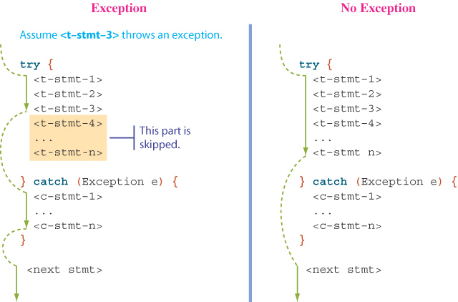
try-catch Control Flow
©The McGraw-Hill Companies, Inc. Permission required for reproduction or display.
4th Ed Chapter 8 - <number>
Notes:
Intro to OOP with Java, C. Thomas Wu
©The McGraw-Hill Companies, Inc.
This illustrates how the control flows when there is an exception and when there is no exception.
In the case when no statements in the try block throw an exception, then the catch block is skipped and execution continues with the next statement following the try-catch statement.
If any one of the statements throws an exception, the statements in the catch block are executed. Execution then continues to the statement following the try-catch statement, ignoring any remaining statements in the try block.

Slide 11
Multiple catch Blocks
A single try-catch block can include multiple catch blocks, one for each type of exception.
try {
age = Integer.parseInt(inputStr);
if (age < 0) {
throw new Exception (“Negative age is invalid”);
}
return age;
} catch (NumberFormatException e){
. . .
} catch (Exception e){
. . .
}
©The McGraw-Hill Companies, Inc. Permission required for reproduction or display.
4th Ed Chapter 8 - <number>
Notes:
Intro to OOP with Java, C. Thomas Wu
©The McGraw-Hill Companies, Inc.
In this example, we see two statements in the try block that can potentially throw exceptions. The parseInt method throws a NumberFormatException while the get method throws an ArrayIndexOutOfBoundsException when the argument id is outside the range of valid values.

Slide 12
Multiple catch Blocks
When there are multiple catch blocks in a try-catch statement, they are checked in sequence.
It is important to check more specialized exception classes before the more general exception classes.
When an exception is thrown, its matching catch block is executed and the other catch blocks are ignored.
©TheMcGraw-Hill Companies, Inc. Permission required for reproduction or display.

Slide 13
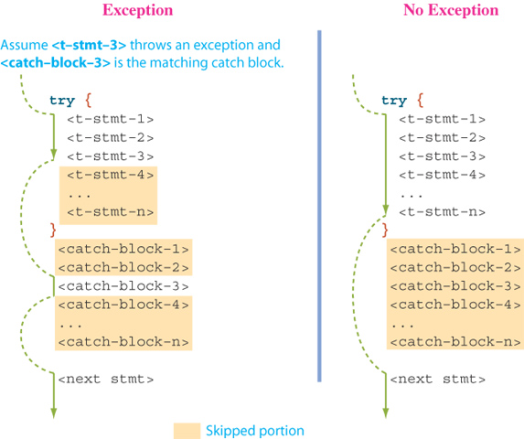
Multiple catch Control Flow
©The McGraw-Hill Companies, Inc. Permission required for reproduction or display.
4th Ed Chapter 8 - <number>
Notes:
Intro to OOP with Java, C. Thomas Wu
©The McGraw-Hill Companies, Inc.
Here's how the control flows when there are multiple catch blocks.
In the case when no statements in the try block throw an exception, then all catch blocks are skipped and execution continues with the next statement following the try-catch statement.
If any one of the statements throws an exception, the statements in the matching catch block are executed. Execution then continues to the statement following the try-catch statement, ignoring any remaining statements in the try block.

Slide 14
Exercise
©The McGraw-Hill Companies, Inc. Permission required for reproduction or display.
4th Ed Chapter 8 - <number>
Notes:
Intro to OOP with Java, C. Thomas Wu
©The McGraw-Hill Companies, Inc.
The finally block is not used often in introductory level programs, but we will introduce them here for the sake of complete coverage of the topic. For example, suppose we open a communication channel from our Java program to a remote web server to exchange data. If the data exchange is successfully completed in the try block, then we close the communication channel and finish the operation. If the data exchange is interrupted for some reason, an exception is thrown and the operation is aborted. In this case also, we need to close the communication channel, because leaving the channel open by one application blocks other applications from using it. The code to close the communication channel should therefore be placed in the finally block.

Slide 15
The finally Block
There are situations where we need to take certain actions regardless of whether an exception is thrown or not, we use the reserved word finally.
We place statements that must be executed regardless of exceptions in the finally block.
©The McGraw-Hill Companies, Inc. Permission required for reproduction or display.
4th Ed Chapter 8 - <number>
Notes:
Intro to OOP with Java, C. Thomas Wu
©The McGraw-Hill Companies, Inc.
The finally block is not used often in introductory level programs, but we will introduce them here for the sake of complete coverage of the topic. For example, suppose we open a communication channel from our Java program to a remote web server to exchange data. If the data exchange is successfully completed in the try block, then we close the communication channel and finish the operation. If the data exchange is interrupted for some reason, an exception is thrown and the operation is aborted. In this case also, we need to close the communication channel, because leaving the channel open by one application blocks other applications from using it. The code to close the communication channel should therefore be placed in the finally block.

Slide 16
The finally Block
try {
age = Integer.parseInt(inputStr);
if (age < 0) {
throw new Exception (“Negative age is invalid”);
}
return age;
} catch (NumberFormatException e){
. . .
} catch (Exception e){
. . .
} finally {
System.out.println (“DONE”);
}
©The McGraw-Hill Companies, Inc. Permission required for reproduction or display.
4th Ed Chapter 8 - <number>
Notes:
Intro to OOP with Java, C. Thomas Wu
©The McGraw-Hill Companies, Inc.
In this example, we see two statements in the try block that can potentially throw exceptions. The parseInt method throws a NumberFormatException while the get method throws an ArrayIndexOutOfBoundsException when the argument id is outside the range of valid values.

Slide 17
The finally Block
Even if there is a return statement inside the try block, the finally block is executed.
When the return statement is encountered in the try block, statements in the finally block are executed before actually returning from the method.
©TheMcGraw-Hill Companies, Inc. Permission required for reproduction or display.

Slide 18
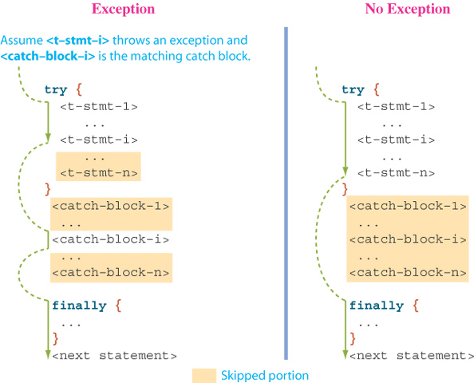
try-catch-finally Control Flow
©The McGraw-Hill Companies, Inc. Permission required for reproduction or display.
4th Ed Chapter 8 - <number>
Notes:
Intro to OOP with Java, C. Thomas Wu
©The McGraw-Hill Companies, Inc.
Here's how the control flows when there are multiple catch blocks and the finally block.
In the case when no statements in the try block throw an exception, then all catch blocks are skipped, but the statements in the finally block are executed. Execution continues with the next statement following the try-catch statement.
If any one of the statements throws an exception, the statements in the matching catch block are executed first and the statements in the finally block are executed next. Execution then continues to the statement following the try-catch statement, ignoring any remaining statements in the try block.

Slide 19
Propagating Exceptions
When a method may throw an exception, either directly or indirectly, we call the method an exception thrower.
Every exception thrower must be one of two types:
  catcher.
  propagator.
©TheMcGraw-Hill Companies, Inc. Permission required for reproduction or display.

Slide 20
Propagating Exceptions
An exception catcher is an exception thrower that includes a matching catch block for the thrown exception.
An exception propagator does not contain a matching catch block.
A method may be a catcher of one exception and a propagator of another.
©TheMcGraw-Hill Companies, Inc. Permission required for reproduction or display.

Slide 21
Propagating Exceptions
The following figure shows a sequence of method calls among the exception throwers.
Method D throws an instance of Exception. The green arrows indicate the direction of calls. The red arrows show the reversing of call sequence, looking for a matching catcher. Method B is the catcher.
The call sequence is traced by using a stack.
©TheMcGraw-Hill Companies, Inc. Permission required for reproduction or display.

Slide 22
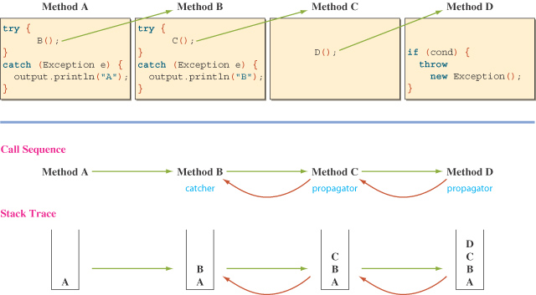
Sample Call Sequence
©The McGraw-Hill Companies, Inc. Permission required for reproduction or display.
4th Ed Chapter 8 - <number>
Notes:
Intro to OOP with Java, C. Thomas Wu
©The McGraw-Hill Companies, Inc.
This illustration shows a sequence of method calls among the exception throwers.
Method D throws an instance of Exception. The green arrows indicate the direction of calls. The red arrows show the reversing of call sequence, looking for a matching catcher. Method B is the catcher.
The call sequence is traced by using a stack.

Slide 23
Propagating Exceptions
Instead of catching a thrown exception by using the try-catch statement, we can propagate the thrown exception back to the caller of our method.
The method header includes the reserved word throws.
public int getAge( ) throws NumberFormatException {
. . .
int age = Integer.parseInt(inputStr);
. . .
return age;
}
©The McGraw-Hill Companies, Inc. Permission required for reproduction or display.
4th Ed Chapter 8 - <number>
Notes:
Intro to OOP with Java, C. Thomas Wu
©The McGraw-Hill Companies, Inc.
Using the try-catch statement is the first way to handle the exceptions. The second way is to propagate the thrown exception back to the caller of the method. The method that includes the statement that calls our method must either catch it or propagate it back to their caller.

Slide 24
Throwing Exceptions
We can write a method that throws an exception directly, i.e., this method is the origin of the exception.
Use the throw reserved to create a new instance of the Exception or its subclasses.
The method header includes the reserved word throws.
public void doWork(int num) throws Exception {
. . .
if (num != val) throw new Exception("Invalid val");
. . .
}
©The McGraw-Hill Companies, Inc. Permission required for reproduction or display.
4th Ed Chapter 8 - <number>
Notes:
Intro to OOP with Java, C. Thomas Wu
©The McGraw-Hill Companies, Inc.
It is possible to throw an exception from our own method.

Slide 25
Types of Exceptions
There are two types of exceptions:
  Checked.
  Unchecked.
A checked exception is an exception that is checked at compile time.
All other exceptions are unchecked, or runtime, exceptions. As the name suggests, they are detected only at runtime.
©TheMcGraw-Hill Companies, Inc. Permission required for reproduction or display.

Slide 26
Types of Exceptions
Some of the common runtime exceptions:
  NumberFormatException – an attempt to parse a string into number that has an illegal number format.
  AritmeticException – this is the result of a divide-by-zero operation for integer
    int i = 0;
    int j = 12/i;
  ArrayIndexOutOfBoundsException – An attempt to access an element of an array beyond the array’s size.
  FileNotFoundException – attempt to read from file that does not exist
©TheMcGraw-Hill Companies, Inc. Permission required for reproduction or display.

Slide 27
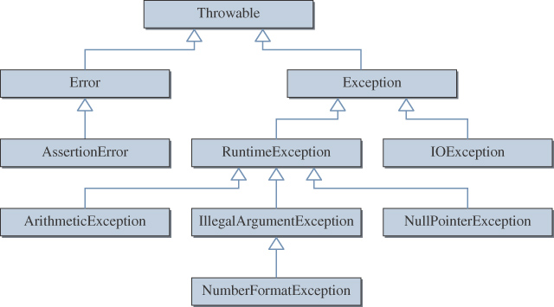
Throwable Hierarchy
There are over 60 classes in the hierarchy.
©The McGraw-Hill Companies, Inc. Permission required for reproduction or display.
4th Ed Chapter 8 - <number>
Notes:
Intro to OOP with Java, C. Thomas Wu
©The McGraw-Hill Companies, Inc.
The classes shown here are some of the more common classes in the Throwable class hierarchy. We will be seeing most of the Exception and its subclasses shown here in the later modules.

Slide 28
Programmer-Defined Exceptions
By defining our own exception class, we can pack more useful information
Programmer-Defined exceptions are created by extending the Exception class.
AgeInputException is defined as a subclass of Exception and includes public methods to access three pieces of information it carries: lower and upper bounds of valid age input and the (invalid) value entered by the user.
©The McGraw-Hill Companies, Inc. Permission required for reproduction or display.
4th Ed Chapter 8 - <number>
Notes:
Intro to OOP with Java, C. Thomas Wu
©The McGraw-Hill Companies, Inc.

Slide 29
Class AgeInputException extends Exception {
private int value;
. . .
}
©The McGraw-Hill Companies, Inc. Permission required for reproduction or display.
4th Ed Chapter 8 - <number>

Slide 30
Assertions
The syntax for the assert statement is
assert <boolean expression>;
where <boolean expression> represents the condition that must be true if the code is working correctly.
If the expression results in false, an AssertionError (a subclass of Error) is thrown.
©The McGraw-Hill Companies, Inc. Permission required for reproduction or display.
4th Ed Chapter 8 - <number>
Notes:
Intro to OOP with Java, C. Thomas Wu
©The McGraw-Hill Companies, Inc.

Slide 31
Sample Use #1
public double deposit(double amount) {
double oldBalance = balance;
balance += amount;
assert balance > oldBalance;
}
public double withdraw(double amount) {
double oldBalance = balance;
balance -= amount;
assert balance < oldBalance;
}
©The McGraw-Hill Companies, Inc. Permission required for reproduction or display.
4th Ed Chapter 8 - <number>
Notes:
Intro to OOP with Java, C. Thomas Wu
©The McGraw-Hill Companies, Inc.

Slide 32
Second Form
The assert statement may also take the form:
assert <boolean expression>: <expression>;
where <expression> represents the value passed as an argument to the constructor of the AssertionError class. The value serves as the detailed message of a thrown exception.
©The McGraw-Hill Companies, Inc. Permission required for reproduction or display.
4th Ed Chapter 8 - <number>
Notes:
Intro to OOP with Java, C. Thomas Wu
©The McGraw-Hill Companies, Inc.

Slide 33
Sample Use #2
public double deposit(double amount) {
double oldBalance = balance;
balance += amount;
assert balance > oldBalance :
"Serious Error – balance did not " +
" increase after deposit";
}
©The McGraw-Hill Companies, Inc. Permission required for reproduction or display.
4th Ed Chapter 8 - <number>
Notes:
Intro to OOP with Java, C. Thomas Wu
©The McGraw-Hill Companies, Inc.

Slide 34
Compiling Programs with Assertions
Before Java 2 SDK 1.4, the word assert is a valid nonreserved identifier. In version 1.4 and after, the word assert is treated as a regular identifier to ensure compatibility.
To enable the assertion mechanism, compile the source file using
javac –source 1.4 <source file>
©The McGraw-Hill Companies, Inc. Permission required for reproduction or display.
4th Ed Chapter 8 - <number>
Notes:
Intro to OOP with Java, C. Thomas Wu
©The McGraw-Hill Companies, Inc.

Slide 35
Running Programs with Assertions
To run the program with assertions enabled, use
java –ea <main class>
If the –ea option is not provided, the program is executed without checking assertions.
©The McGraw-Hill Companies, Inc. Permission required for reproduction or display.
4th Ed Chapter 8 - <number>
Notes:
Intro to OOP with Java, C. Thomas Wu
©The McGraw-Hill Companies, Inc.

Slide 36
Different Uses of Assertions
Precondition assertions check for a condition that must be true before executing a method.
Postcondition assertions check conditions that must be true after a method is executed.
A control-flow invariant is a third type of assertion that is used to assert the control must flow to particular cases.
©The McGraw-Hill Companies, Inc. Permission required for reproduction or display.
4th Ed Chapter 8 - <number>
Notes:
Intro to OOP with Java, C. Thomas Wu
©The McGraw-Hill Companies, Inc.
We will be seeing examples of using assertions in the sample programs later.

Slide 37
Problem Statement
Problem statement:
Implement a Keyless Entry System that asks for three pieces of information: resident’s name, room number, and a password.
  A password is a sequence of characters ranging in length from 4 to 8 and is unique to an individual dorm resident.
  If everything matches, then the system unlocks and opens the door.
  We assume no two residents have the same name.
  We use the provided support classes Door and Dorm.
  Sample resident data named samplelist.dat can be used for development.
©The McGraw-Hill Companies, Inc. Permission required for reproduction or display.
4th Ed Chapter 8 - <number>
Notes:
Intro to OOP with Java, C. Thomas Wu
©The McGraw-Hill Companies, Inc.

Slide 38
Overall Plan
Tasks:
  To begin our development effort, we must first find out the capabilities of the Dorm and Door classes.
  Also, for us to implement the class correctly, we need the specification of the Resident class.
In addition to the given helper classes and the Resident class, we need to design other classes for this application.
  As the number of classes gets larger, we need to plan the classes carefully.
©The McGraw-Hill Companies, Inc. Permission required for reproduction or display.
4th Ed Chapter 8 - <number>
Notes:
Intro to OOP with Java, C. Thomas Wu
©The McGraw-Hill Companies, Inc.
For this application, we are given two helper classes. In order to use the Dorm class, we must supply the Resident class whose specification is already set so it works correctly with the given Dorm class. The relationship between the Dorm and Resident is similar to the one between the DrawingBoard and the DrawableShape classes.

Slide 39
Design Document
Class | Purpose
Ch8EntranceMonitor | The top-level control object that manages other objects in the program. This is an instantiable main class.
Door | The given predefined class that simulates the opening of a door.
Dorm | The given predefined class that maintains a list of Resident objects.
Resident | This class maintains information on individual dorm residents. Specification for this class is provided to us.
InputHandler | The user interface class for handling input routines.
JOptionPane | The standard class for displaying messages.
©The McGraw-Hill Companies, Inc. Permission required for reproduction or display.
4th Ed Chapter 8 - <number>
Notes:
Intro to OOP with Java, C. Thomas Wu
©The McGraw-Hill Companies, Inc.
There will be a total of six key classes in this application. We will be designing three classes: Ch8EntranceMonitor, Resident, and InputFrame.

Slide 40
Class Relationships
InputFrame
Ch8EntranceMonitor
Dorm
(main class)
JOptionPane
Door
Resident
©The McGraw-Hill Companies, Inc. Permission required for reproduction or display.
4th Ed Chapter 8 - <number>
Notes:
Intro to OOP with Java, C. Thomas Wu
©The McGraw-Hill Companies, Inc.
Most relationships follow the client-service pattern, except the one between the InputFrame and Ch8EntranceMonitor follows the supervisor-subordinate pattern.

Slide 41
Development Steps
We will develop this program in three steps:
  Define the Resident class and explore the Dorm class. Start with a program skeleton to test the Resident class.
  Define the user interface InputHandler class. Modify the top-level control class as necessary.
  Finalize the code by making improvements and tying up loose ends.
©The McGraw-Hill Companies, Inc. Permission required for reproduction or display.
4th Ed Chapter 8 - <number>
Notes:
Intro to OOP with Java, C. Thomas Wu
©The McGraw-Hill Companies, Inc.

Slide 42
Step 1 Design
Explore the Dorm class
Implement the Resident class, following the given specification
Start with the skeleton main class
©The McGraw-Hill Companies, Inc. Permission required for reproduction or display.
4th Ed Chapter 8 - <number>
Notes:
Intro to OOP with Java, C. Thomas Wu
©The McGraw-Hill Companies, Inc.

Slide 43
Step 1 Code
    Directory: Chapter8/Step1
    Source Files: Resident.java
    Ch8EntranceMonitor.java
Program source file is too big to list here. From now on, we ask
you to view the source files using your Java IDE.
©The McGraw-Hill Companies, Inc. Permission required for reproduction or display.
4th Ed Chapter 8 - <number>
Notes:
Intro to OOP with Java, C. Thomas Wu
©The McGraw-Hill Companies, Inc.
Please use your Java IDE to view the source files and run the program.

Slide 44
Step 1 Test
The purpose of Step 1 testing is to verify that the Dorm class is used correctly to open a file and get the contents of the file.
To test it, we need a file that contains the resident information. A sample test file called testfile.dat is provided for testing purpose.
  This file contains information on four residents.
  This file was created by executing the SampleCreateResidentFile program, which you can modify to create other test data files.
©The McGraw-Hill Companies, Inc. Permission required for reproduction or display.
4th Ed Chapter 8 - <number>
Notes:
Intro to OOP with Java, C. Thomas Wu
©The McGraw-Hill Companies, Inc.

Slide 45
Step 2 Design
Design and implement the InputHandler class.
Modify the main class to incorporate the new class.
©The McGraw-Hill Companies, Inc. Permission required for reproduction or display.
4th Ed Chapter 8 - <number>
Notes:
Intro to OOP with Java, C. Thomas Wu
©The McGraw-Hill Companies, Inc.
.

Slide 46
Step 2 Code
    Directory: Chapter8/Step2
    Source Files: Resident.java
    Ch8EntranceMonitor.java
    InputHandler.java
©The McGraw-Hill Companies, Inc. Permission required for reproduction or display.
4th Ed Chapter 8 - <number>
Notes:
Intro to OOP with Java, C. Thomas Wu
©The McGraw-Hill Companies, Inc.

Slide 47
Step 2 Test
The purpose of Step 2 testing is to verify the correct behavior of an InputHandler.
We need to test both successful and unsuccessful cases.
  We must verify that the door is in fact opened when the valid information is entered.
  We must also verify that the error message is displayed when there’s an error in input.
    We should test invalid cases such as entering nonexistent name, corrent name but wrong password, not enetering all information, and so forth.
©The McGraw-Hill Companies, Inc. Permission required for reproduction or display.
4th Ed Chapter 8 - <number>
Notes:
Intro to OOP with Java, C. Thomas Wu
©The McGraw-Hill Companies, Inc.

Slide 48
Step 3: Finalize
Possible Extensions
  Improve the user interface with a customized form window for entering three pieces of information.
  Terminate the program when the administrator enters a special code
©The McGraw-Hill Companies, Inc. Permission required for reproduction or display.
4th Ed Chapter 8 - <number>
Notes:
Intro to OOP with Java, C. Thomas Wu
©The McGraw-Hill Companies, Inc.

