Slide 1
Modern Systems Analysis
and Design
Sixth Edition
Jeffrey A. Hoffer
Joey F. George
Joseph S. Valacich
Chapter 1
The Systems Development Environment

Slide 2
Learning Objectives
Define information systems analysis and design.
Describe the information Systems Development Life Cycle (SDLC).
Explain Rapid Application Development (RAD), prototyping, Computer Aided Software Engineering (CASE), and Service-Oriented Architecture (SOA).
Describe agile methodologies and eXtreme programming.
Explain Object Oriented Analysis and Design and the Rational Unified Process (RUP).
Chapter 1
Copyright © 2011 Pearson Education, Inc. Publishing as Prentice Hall

Slide 3
Introduction
Information Systems Analysis and Design
  Complex organizational process
  Used to develop and maintain computer-based information systems
  Used by a team of business and systems professionals
Chapter 1
Copyright © 2011 Pearson Education, Inc. Publishing as Prentice Hall

Slide 4
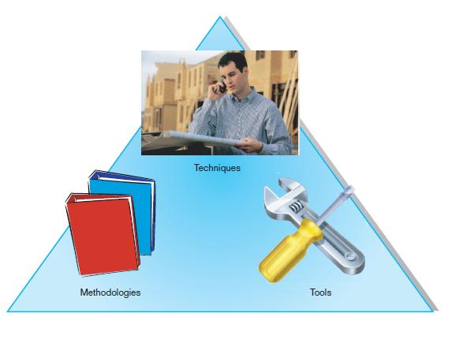
Introduction (Cont.)
FIGURE 1-1 An organizational approach to systems analysis and
design is driven by methodologies, techniques, and tools
Chapter 1
Copyright © 2011 Pearson Education, Inc. Publishing as Prentice Hall

Slide 5
A Modern Approach to Systems Analysis and Design
1950s: focus on efficient automation of existing processes
1960s: advent of 3GL, faster and more reliable computers
1970s: system development becomes more like an engineering discipline
Chapter 1
Copyright © 2011 Pearson Education, Inc. Publishing as Prentice Hall

Slide 6
A Modern Approach to Systems Analysis and Design (Cont.)
1980s: major breakthrough with 4GL, CASE tools, object oriented methods
1990s: focus on system integration, GUI applications, client/server platforms, Internet
The new century: Web application development, wireless PDAs, component-based applications
Chapter 1
Copyright © 2011 Pearson Education, Inc. Publishing as Prentice Hall

Slide 7
A Modern Approach to Systems Analysis and Design (Cont.)
Application Software
  Computer software designed to support organizational functions or processes
Systems Analyst
  Organizational role most responsible for analysis and design of information systems
Chapter 1
Copyright © 2011 Pearson Education, Inc. Publishing as Prentice Hall

Slide 8
Developing Information Systems
System Development Methodology is a standard process followed in an organization to conduct all the steps necessary to analyze, design, implement, and maintain information systems.
Chapter 1
Copyright © 2011 Pearson Education, Inc. Publishing as Prentice Hall

Slide 9
Systems Development Life Cycle (SDLC)
Traditional methodology used to develop, maintain, and replace information systems.
Phases in SDLC:
  Planning
  Analysis
  Design
  Implementation
  Maintenance
Chapter 1
Copyright © 2011 Pearson Education, Inc. Publishing as Prentice Hall

Slide 10
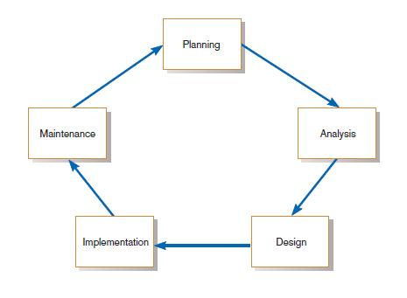
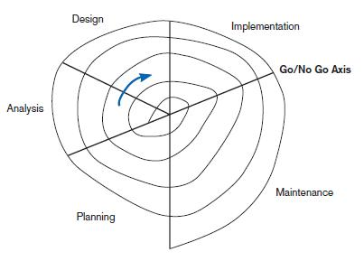
Standard and Evolutionary Views of SDLC
FIGURE 1-3 Evolutionary model
FIGURE 1-2
The systems development life cycle
Chapter 1
Copyright © 2011 Pearson Education, Inc. Publishing as Prentice Hall

Slide 11
Systems Development Life Cycle (SDLC) (Cont.)
Planning – an organization’s total information system needs are identified, analyzed, prioritized, and arranged
Analysis – system requirements are studied and structured
Chapter 1
Copyright © 2011 Pearson Education, Inc. Publishing as Prentice Hall

Slide 12
Systems Development Life Cycle (SDLC) (Cont.)
Design – a description of the recommended solution is converted into logical and then physical system specifications
Logical design – all functional features of the system chosen for development in analysis are described independently of any computer platform
Chapter 1
Copyright © 2011 Pearson Education, Inc. Publishing as Prentice Hall

Slide 13
Systems Development Life Cycle (SDLC) (Cont.)
Physical design – the logical specifications of the system from logical design are transformed into the technology-specific details from which all programming and system construction can be accomplished
Chapter 1
Copyright © 2011 Pearson Education, Inc. Publishing as Prentice Hall

Slide 14
Systems Development Life Cycle (SDLC) (Cont.)
Implementation – the information system is coded, tested, installed and supported in the organization
Maintenance – an information system is systematically repaired and improved
Chapter 1
Copyright © 2011 Pearson Education, Inc. Publishing as Prentice Hall

Slide 15
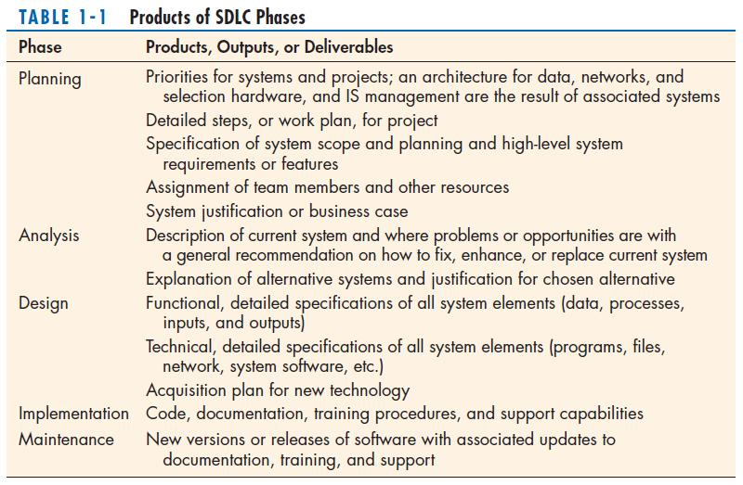
Chapter 1
Copyright © 2011 Pearson Education, Inc. Publishing as Prentice Hall

Slide 16
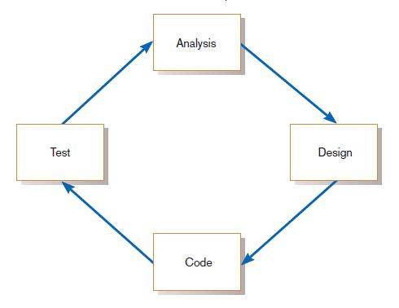
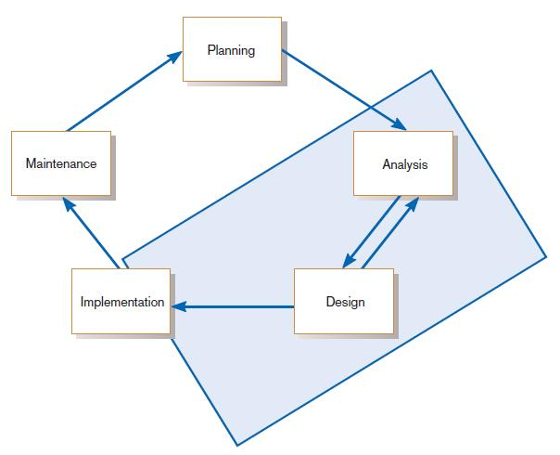
The Heart of the Systems Development Process
FIGURE 1-7
The analysis–design–code–test loop
FIGURE 1-8
The heart of systems development
Current practice combines analysis, design, and implementation into a single iterative and parallel process of activities.
Chapter 1
Copyright © 2011 Pearson Education, Inc. Publishing as Prentice Hall

Slide 17
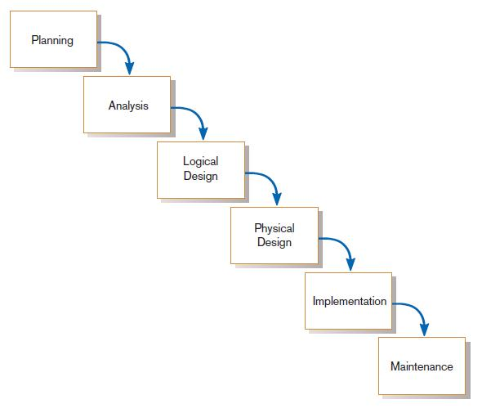
Traditional Waterfall SDLC
One phase begins when another completes, with little backtracking and looping.
FIGURE 1-9
A traditional waterfall SDLC
Chapter 1
Copyright © 2011 Pearson Education, Inc. Publishing as Prentice Hall

Slide 18
Problems with Waterfall Approach
System requirements “locked in” after being determined (can't change)
Limited user involvement (only in requirements phase)
Too much focus on milestone deadlines of SDLC phases to the detriment of sound development practices
Chapter 1
Copyright © 2011 Pearson Education, Inc. Publishing as Prentice Hall

Slide 19
Different Approaches to Improving Development
CASE Tools
Rapid Application Development (RAD)
Agile Methodologies
eXtreme Programming
Chapter 1
Copyright © 2011 Pearson Education, Inc. Publishing as Prentice Hall

Slide 20
Computer-Aided Software Engineering (CASE) Tools
Diagramming tools enable graphical representation.
Computer displays and report generators help prototype how systems “look and feel”.
Chapter 1
Copyright © 2011 Pearson Education, Inc. Publishing as Prentice Hall

Slide 21
Computer-Aided Software Engineering (CASE) Tools (Cont.)
Analysis tools automatically check for consistency in diagrams, forms, and reports.
A central repository provides integrated storage of diagrams, reports, and project management specifications.
Chapter 1
Copyright © 2011 Pearson Education, Inc. Publishing as Prentice Hall

Slide 22
Computer-Aided Software Engineering (CASE) Tools (Cont.)
Documentation generators standardize technical and user documentation.
Code generators enable automatic generation of programs and database code directly from design documents, diagrams, forms, and reports.
Chapter 1
Copyright © 2011 Pearson Education, Inc. Publishing as Prentice Hall

Slide 23
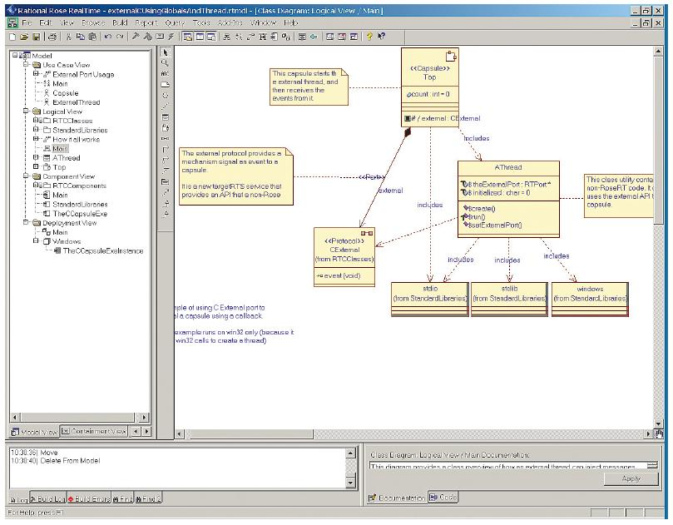
CASE Tools (Cont.)
FIGURE 1-10
A class diagram from IBM’s Rational Rose
(Source: IBM)
Chapter 1
Copyright © 2011 Pearson Education, Inc. Publishing as Prentice Hall

Slide 24
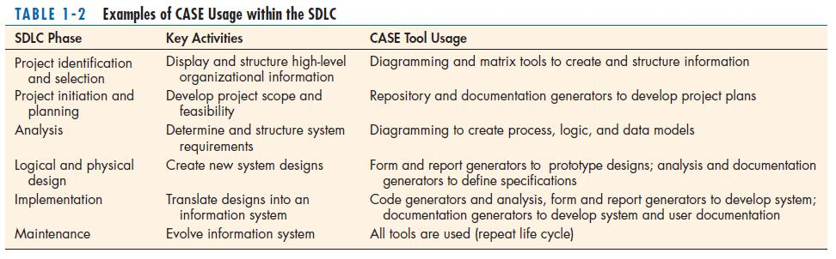
CASE Tools (Cont.)
Chapter 1
Copyright © 2011 Pearson Education, Inc. Publishing as Prentice Hall

Slide 25
Rapid Application Development (RAD)
Methodology to radically decrease design and implementation time
Involves: extensive user involvement, prototyping, JAD sessions, integrated CASE tools, and code generators
Chapter 1
Copyright © 2011 Pearson Education, Inc. Publishing as Prentice Hall

Slide 26
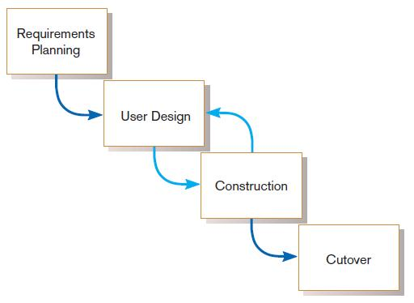
Rapid Application Development (RAD) (Cont.)
FIGURE 1-11
RAD life cycle
Chapter 1
Copyright © 2011 Pearson Education, Inc. Publishing as Prentice Hall

Slide 27
Service-Oriented Architecture (SOA)
An approach to systems development based on building complete systems through assembling software components, each of which model generic business functions
Chapter 1
Copyright © 2011 Pearson Education, Inc. Publishing as Prentice Hall

Slide 28
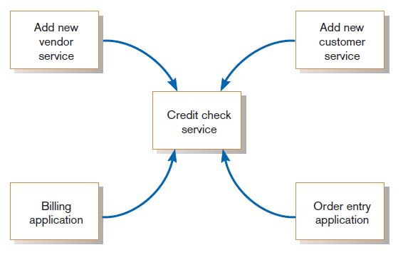
Service-Oriented Architecture (SOA)
(Cont.)
FIGURE 1-12
Illustration of a service, a credit check,
used by applications and other services
Chapter 1
Copyright © 2011 Pearson Education, Inc. Publishing as Prentice Hall

Slide 29
Agile Methodologies
Motivated by recognition of software development as fluid, unpredictable, and dynamic
Three key principles
  Adaptive rather than predictive
  Emphasize people rather than roles
  Self-adaptive processes
Chapter 1
Copyright © 2011 Pearson Education, Inc. Publishing as Prentice Hall

Slide 30
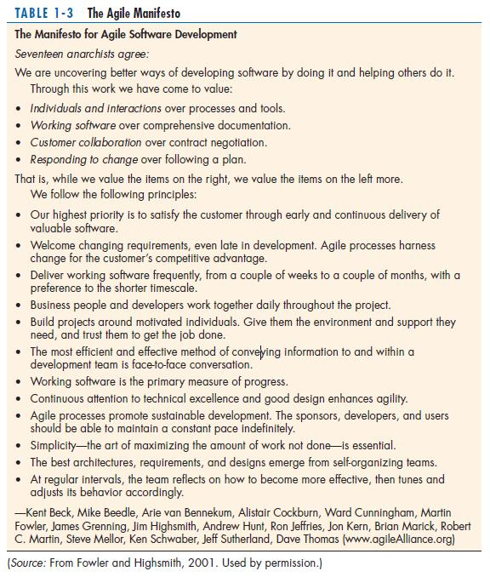
The Agile Methodologies group argues that software development methodologies
adapted from engineering generally do not fit with real-world software development.
Chapter 1
Copyright © 2011 Pearson Education, Inc. Publishing as Prentice Hall

Slide 31
When to use Agile Methodologies
If your project involves:
  Unpredictable or dynamic requirements
  Responsible and motivated developers
  Customers who understand the process and will get involved
Chapter 1
Copyright © 2011 Pearson Education, Inc. Publishing as Prentice Hall

Slide 32
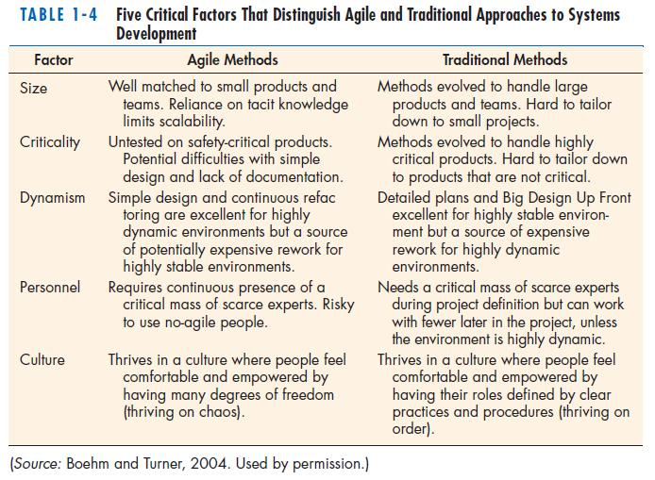
Chapter 1
Copyright © 2011 Pearson Education, Inc. Publishing as Prentice Hall

Slide 33
eXtreme Programming
Short, incremental development cycles
Automated tests
Two-person programming teams
Chapter 1
Copyright © 2011 Pearson Education, Inc. Publishing as Prentice Hall

Slide 34
eXtreme Programming (Cont.)
Coding and testing operate together
Advantages:
  Communication between developers
  High level of productivity
  High-quality code
Chapter 1
Copyright © 2011 Pearson Education, Inc. Publishing as Prentice Hall

Slide 35
Object-Oriented Analysis and Design (OOAD)
Based on objects rather than data or processes
Object: a structure encapsulating attributes and behaviors of a real-world entity
Chapter 1
Copyright © 2011 Pearson Education, Inc. Publishing as Prentice Hall

Slide 36
Object-Oriented Analysis and Design (OOAD) (Cont.)
Object class: a logical grouping of objects sharing the same attributes and behaviors
Inheritance: hierarchical arrangement of classes enable subclasses to inherit properties of superclasses
Chapter 1
Copyright © 2011 Pearson Education, Inc. Publishing as Prentice Hall

Slide 37
Rational Unified Process (RUP)
An object-oriented systems development methodology
RUP establishes four phase of development: inception, elaboration, construction, and transition.
Each phase is organized into a number of separate iterations.
Chapter 1
Copyright © 2011 Pearson Education, Inc. Publishing as Prentice Hall

Slide 38
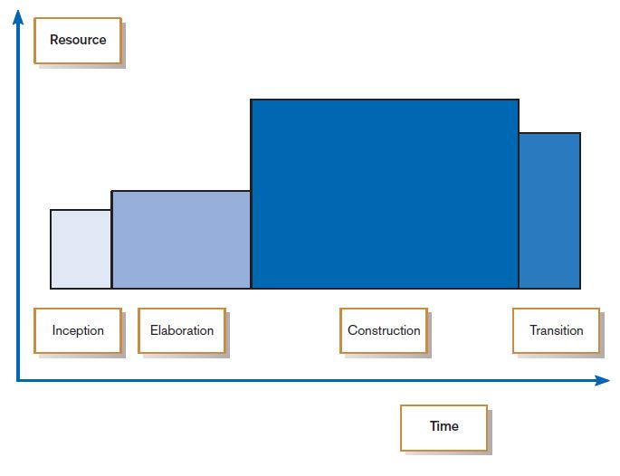
FIGURE 1-13
Phases of OOSAD-based development
Chapter 1
Copyright © 2011 Pearson Education, Inc. Publishing as Prentice Hall

Slide 39
Our Approach to Systems Development
The SDLC is an organizing and guiding principle in this book.
We may construct artificial boundaries or artificially separate activities and processes for learning purposes.
Our intent is to help you understand all the pieces and how to assemble them.
Chapter 1
Copyright © 2011 Pearson Education, Inc. Publishing as Prentice Hall

Slide 40
Summary
In this chapter you learned how to:
Define information systems analysis and design.
Describe the information Systems Development Life Cycle (SDLC).
Explain Rapid Application Development (RAD), prototyping, Computer Aided Software Engineering (CASE), and Service-Oriented Architecture (SOA).
Describe agile methodologies and eXtreme programming.
Explain Object Oriented Analysis and Design and the Rational Unified Process (RUP).
Chapter 1
Copyright © 2011 Pearson Education, Inc. Publishing as Prentice Hall

Slide 41

All rights reserved. No part of this publication may be reproduced, stored in a retrieval system, or transmitted, in any form or by any means, electronic, mechanical, photocopying, recording, or otherwise, without the prior written permission of the publisher. Printed in the United States of America.
Copyright © 2011 Pearson Education, Inc.
Publishing as Prentice Hall

