Slide 1
Modern Systems Analysis
and Design
Sixth Edition
Jeffrey A. Hoffer
Joey F. George
Joseph S. Valacich
Chapter 2
The Origins of Software

Slide 2
Learning Objectives
Explain outsourcing.
Describe six different sources of software.
Discuss how to evaluate off-the-shelf software.
Explain reuse and its role in software development.
Chapter 2
Copyright © 2011 Pearson Education, Inc. Publishing as Prentice Hall

Slide 3
Introduction
There are various sources of software for organizations.
There are criteria to evaluate software from different sources.
Chapter 2
Copyright © 2011 Pearson Education, Inc. Publishing as Prentice Hall

Slide 4
Systems Acquisition: Outsourcing
Outsourcing: Turning over responsibility of some or all of an organization's information systems applications and operations to an outside firm
Chapter 2
Copyright © 2011 Pearson Education, Inc. Publishing as Prentice Hall

Slide 5
Systems Acquisition: Outsourcing (Cont.)
Outsourcing Examples
  A company that runs payroll applications for clients
  A company that runs your applications at your site
Chapter 2
Copyright © 2011 Pearson Education, Inc. Publishing as Prentice Hall

Slide 6
Outsourcing (Cont.)
Reasons to outsource
  Cost-effective
  Take advantage of economies of scale
  Free up internal resources
  Reduce time to market
  Increase process efficiencies
  System development is a non-core activity for the organization
Chapter 2
Copyright © 2011 Pearson Education, Inc. Publishing as Prentice Hall

Slide 7
Sources of Software
Information technology services firm
Packaged software producers
Enterprise-wide solutions
Application service providers (ASPs)
Open source software
In-house developers
Chapter 2
Copyright © 2011 Pearson Education, Inc. Publishing as Prentice Hall

Slide 8
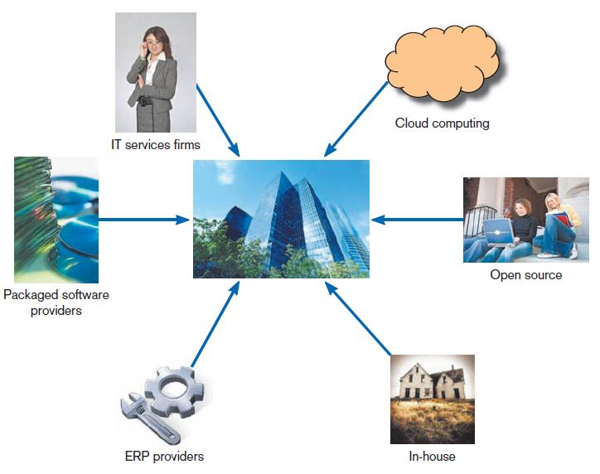
Sources of Software (Cont.)
FIGURE 2-1
Sources of Application Software
Chapter 2
Copyright © 2011 Pearson Education, Inc. Publishing as Prentice Hall

Slide 9
Information Technology (IT) Services Firms
Help companies develop custom information systems for internal use.
Develop, host, and run applications for customers.
Provide other services.
Chapter 2
Copyright © 2011 Pearson Education, Inc. Publishing as Prentice Hall

Slide 10
Packaged Software Producers
Serve many market segments.
Provide software ranging from broad-based packages (i.e. general ledger) to niche packages (i.e. day care management).
Chapter 2
Copyright © 2011 Pearson Education, Inc. Publishing as Prentice Hall

Slide 11
Packaged Software Producers (Cont.)
Software runs on all size computers, from microcomputers to large mainframes.
Prepackaged software is off-the-shelf, turnkey software (i.e. not customizable).
Off-the-shelf software at best meets 70 percent of organizations’ needs.
Chapter 2
Copyright © 2011 Pearson Education, Inc. Publishing as Prentice Hall

Slide 12
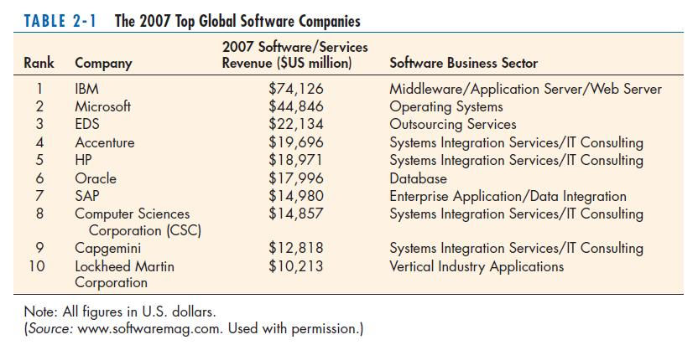
Packaged Software Producers (Cont.)
Chapter 2
Copyright © 2011 Pearson Education, Inc. Publishing as Prentice Hall

Slide 13
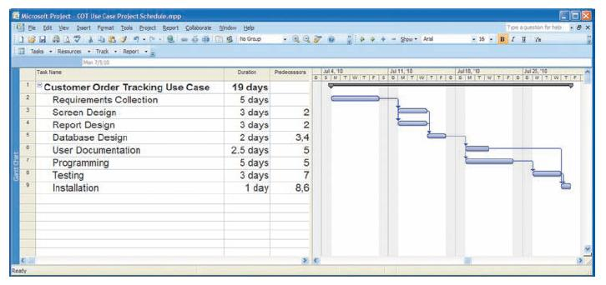
Prepackaged Software
Figure 2-2 Microsoft Project
Chapter 2
Copyright © 2011 Pearson Education, Inc. Publishing as Prentice Hall

Slide 14
Enterprise Solutions Software
Enterprise Resource Planning (ERP) systems integrate individual traditional business functions into modules enabling a single seamless transaction to cut across functional boundaries.
SAP AG is the leading vendor of ERP systems.
Chapter 2
Copyright © 2011 Pearson Education, Inc. Publishing as Prentice Hall

Slide 15
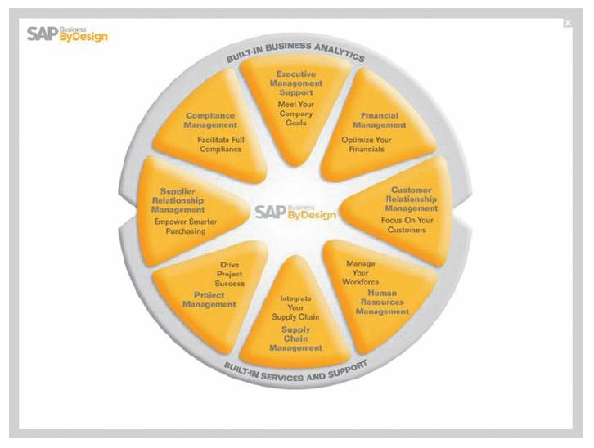
Enterprise Solutions Software (Cont.)
Figure 2-3 SAP’s Business ByDesign, a product designed for medium sized companies.
(Source: www.sap.com/usa/solutions/Sme/Businessbydesign/Flash/bsm/A1S.html)
Chapter 2
Copyright © 2011 Pearson Education, Inc. Publishing as Prentice Hall

Slide 16
Cloud Computing
The provision of computing resources, including applications, over the Internet, so customers do not have to invest in the computing infrastructure needed to run and maintain the resources
Chapter 2
Copyright © 2011 Pearson Education, Inc. Publishing as Prentice Hall

Slide 17
Open Source Software
Freely available including source code
Developed by a community of interested people
Performs the same functions as commercial software
Examples: Linux, mySQL, Firefox
Chapter 2
Copyright © 2011 Pearson Education, Inc. Publishing as Prentice Hall

Slide 18
In-House Development
If sufficient system development expertise with the chosen platform exists in-house, then some or all of the system can be developed by the organization’s own staff.
Hybrid solutions involving some purchased and some in-house components are common.
Chapter 2
Copyright © 2011 Pearson Education, Inc. Publishing as Prentice Hall

Slide 19
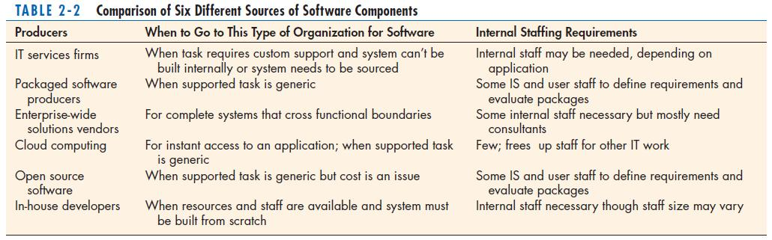
Sources of Software Components
Chapter 2
Copyright © 2011 Pearson Education, Inc. Publishing as Prentice Hall

Slide 20
Selecting Off-the-Shelf Software
Cost: comparing the cost of developing the same system in-house with the cost of purchasing or licensing the software package
Chapter 2
Copyright © 2011 Pearson Education, Inc. Publishing as Prentice Hall

Slide 21
Selecting Off-the-Shelf Software
Functionality: the tasks that the software can perform and the mandatory, essential, and desired system features
Chapter 2
Copyright © 2011 Pearson Education, Inc. Publishing as Prentice Hall

Slide 22
Selecting Off-the-Shelf Software
Vendor support: whether or how much support the vendor can provide and at what cost
Chapter 2
Copyright © 2011 Pearson Education, Inc. Publishing as Prentice Hall

Slide 23
Selecting Off-the-Shelf Software
Viability of vendor: can the software adapt to changes in systems software and hardware
Chapter 2
Copyright © 2011 Pearson Education, Inc. Publishing as Prentice Hall

Slide 24
Selecting Off-the-Shelf Software
Flexibility: how easy it is to customize the software
Documentation: is the user’s manual and technical documentation understandable and up-to-date
Chapter 2
Copyright © 2011 Pearson Education, Inc. Publishing as Prentice Hall

Slide 25
Selecting Off-the-Shelf Software
Response time: how long it takes the software package to respond to the user’s requests in an interactive session
Ease of installation: a measure of the difficulty of loading the software and making it operational
Chapter 2
Copyright © 2011 Pearson Education, Inc. Publishing as Prentice Hall

Slide 26
Validating Purchased Software Information
Use a variety of information sources:
  Collect information from vendor
  Software documentation
  Technical marketing literature
Chapter 2
Copyright © 2011 Pearson Education, Inc. Publishing as Prentice Hall

Slide 27
Request For Proposal (RFP)
Request for proposal (RFP) is a document provided to vendors to ask them to propose hardware and system software that will meet the requirements of a new system.
Chapter 2
Copyright © 2011 Pearson Education, Inc. Publishing as Prentice Hall

Slide 28
Request For Proposal (RFP) (Cont.)
Sometimes called a Request For Quote (RFQ)
Use a variety of information sources
Based on vendor bids, analyst selects best candidates.
Chapter 2
Copyright © 2011 Pearson Education, Inc. Publishing as Prentice Hall

Slide 29
Information Sources For RFP
Vendor’s proposal
Running software through a series of tests
Feedback from other users of the vendor’s product
Independent software testing services
Articles in trade publications
Chapter 2
Copyright © 2011 Pearson Education, Inc. Publishing as Prentice Hall

Slide 30
Reuse
The use of previously written software resources, especially objects and components, in new applications
Commonly applied to two different development technologies:
  Object-oriented development
  Component-based development
Chapter 2
Copyright © 2011 Pearson Education, Inc. Publishing as Prentice Hall

Slide 31
Reuse (Cont.)
Object-oriented development
  Object class encapsulates data and behavior of common organizational entities (e.g. employees)
Component-based development
  Components can be as small as objects or as large as pieces of software that handle single business functions.
Chapter 2
Copyright © 2011 Pearson Education, Inc. Publishing as Prentice Hall

Slide 32
Reuse (Cont.)
Object-oriented development reuse is the use of object classes in more than one application (e.g. Employee).
Chapter 2
Copyright © 2011 Pearson Education, Inc. Publishing as Prentice Hall

Slide 33
Reuse (Cont.)
Component-based development reuse is the assembly of an application from many different components at many different levels of complexity and size (e.g. Currency conversion).
Chapter 2
Copyright © 2011 Pearson Education, Inc. Publishing as Prentice Hall

Slide 34
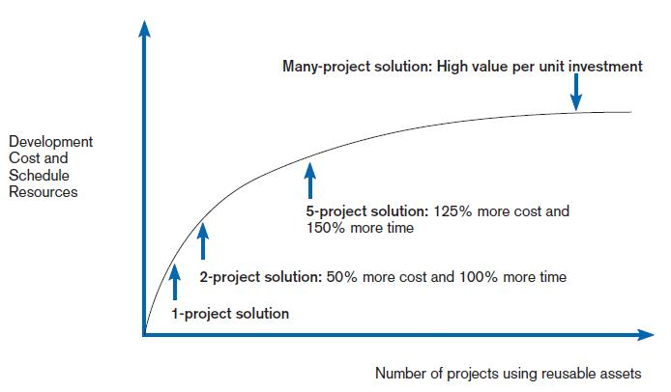
Costs and Benefits of Reuse
FIGURE 2-5
Investments necessary to achieve reusable components
(Source: Royce, 1998, used by permission.)
Chapter 2
Copyright © 2011 Pearson Education, Inc. Publishing as Prentice Hall

Slide 35
Approaches to Reuse
Ad-hoc: individuals are free to find or develop reusable assets on their own.
Facilitated: developers are encouraged to practice reuse.
Chapter 2
Copyright © 2011 Pearson Education, Inc. Publishing as Prentice Hall

Slide 36
Approaches to Reuse (Cont.)
Managed: the development, sharing, and adoption of reusable assets is mandated.
Designed: assets mandated for reuse as they are being designed for specific applications.
Chapter 2
Copyright © 2011 Pearson Education, Inc. Publishing as Prentice Hall

Slide 37
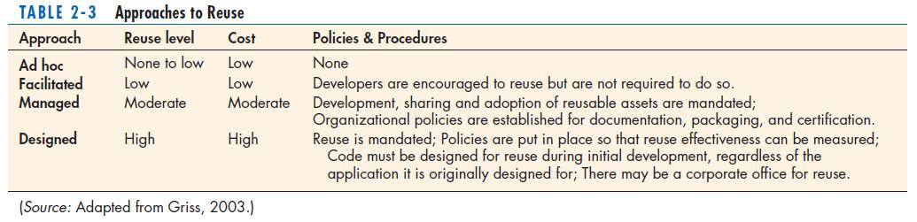
Approaches to Reuse (Cont.)
Chapter 2
Copyright © 2011 Pearson Education, Inc. Publishing as Prentice Hall

Slide 38
Summary
In this chapter you learned how to:
  Explain outsourcing.
  Describe six different sources of software.
  Discuss how to evaluate off-the-shelf software.
  Explain reuse and its role in software development.
Chapter 2
Copyright © 2011 Pearson Education, Inc. Publishing as Prentice Hall

Slide 39

All rights reserved. No part of this publication may be reproduced, stored in a retrieval system, or transmitted, in any form or by any means, electronic, mechanical, photocopying, recording, or otherwise, without the prior written permission of the publisher. Printed in the United States of America.
Copyright © 2011 Pearson Education, Inc.
Publishing as Prentice Hall

