Slide 1
Modern Systems Analysis
and Design
Sixth Edition
Jeffrey A. Hoffer
Joey F. George
Joseph S. Valacich
Chapter 3
Managing the Information Systems Project

Slide 2
Learning Objectives
Explain the process of managing an information systems project.
Describe the skills required to be an effective project manager.
List and describe the skills and activities of a project manager during project initiation, project planning, project execution, and project closedown.
Explain what is meant by critical path scheduling and describe the process of creating Gantt charts and network diagrams.
Explain how commercial project management software packages can be used to assist in representing and managing project schedules.
Chapter 3
Copyright © 2011 Pearson Education, Inc. Publishing as Prentice Hall

Slide 3
Importance of Project Management
Project management may be the most important aspect of systems development.
Effective PM helps to ensure
  The meeting of customer expectations.
  The satisfying of budget and time constraints.
PM skills are difficult and important to learn.
Chapter 3
Copyright © 2011 Pearson Education, Inc. Publishing as Prentice Hall

Slide 4
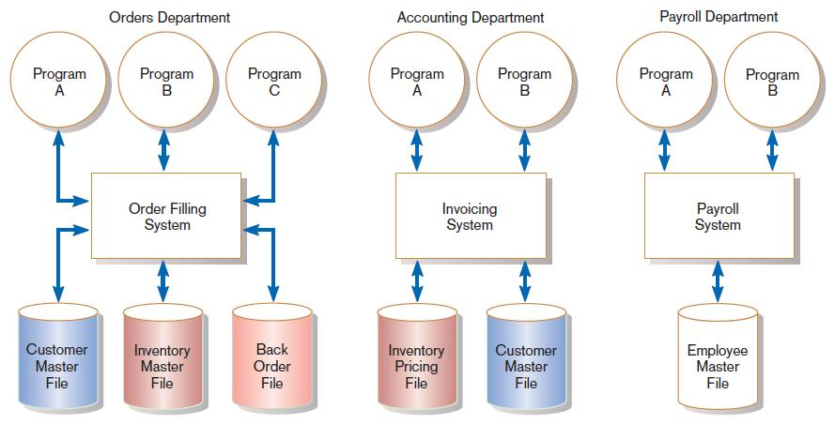
Pine Valley Application Project
FIGURE 3-1
Three computer applications at Pine Valley Furniture: Order filling, invoicing, and payroll
Source: Hoffer, Prescott, and Topi, 2009.
Chapter 3
Copyright © 2011 Pearson Education, Inc. Publishing as Prentice Hall

Slide 5
Deciding on Systems Projects
System Service Request (SSR)
  A standard form for requesting or proposing systems development work within an organization
Feasibility study
  A study that determines whether a requested system makes economic and operational sense for an organization
Chapter 3
Copyright © 2011 Pearson Education, Inc. Publishing as Prentice Hall

Slide 6
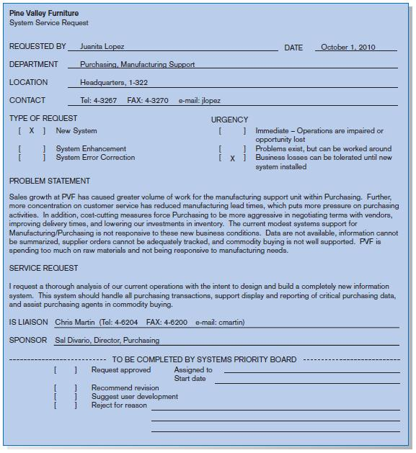
FIGURE 3-2
System Service Request for purchasing a fulfillment system with name and contact information of the person requesting the system, a statement of the problem, and the name and contact information of the liaison and sponsor.
Chapter 3
Copyright © 2011 Pearson Education, Inc. Publishing as Prentice Hall

Slide 7
Managing the Information Systems Project
Project
  A planned undertaking of related activities to reach an objective that has a beginning and an end
Project management
  A controlled process of initiating, planning, executing, and closing down a project
Chapter 3
Copyright © 2011 Pearson Education, Inc. Publishing as Prentice Hall

Slide 8
Managing the Information Systems Project (cont.)
Project manager
  Systems analyst with management and leadership skills responsible for leading project initiation, planning, execution, and closedown
Deliverable
  The end product of an SDLC phase
Chapter 3
Copyright © 2011 Pearson Education, Inc. Publishing as Prentice Hall

Slide 9
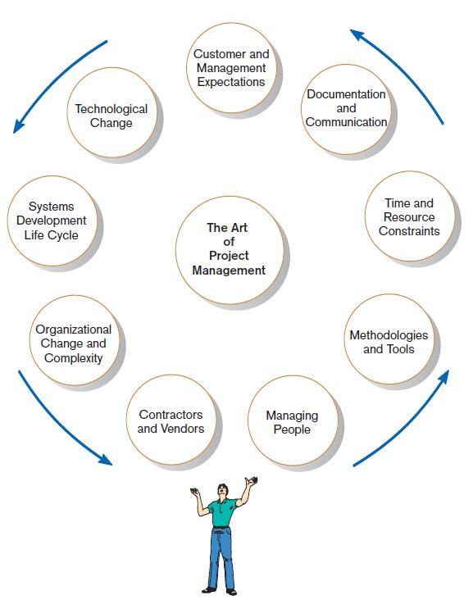
Project Management Activities
FIGURE 3-4
A project manager juggles numerous
activities
Chapter 3
Copyright © 2011 Pearson Education, Inc. Publishing as Prentice Hall

Slide 10
Phases of Project Management Process
Phase 1: Initiation
Phase 2: Planning
Phase 3: Execution
Phase 4: Closedown
Chapter 3
Copyright © 2011 Pearson Education, Inc. Publishing as Prentice Hall

Slide 11
PM Phase 1: Project Initiation
Assess size, scope and complexity, and establish procedures.
Establish:
  Initiation team
  Relationship with customer
  Project initiation plan
  Management procedures
  Project management environment
  Project workbook
Chapter 3
Copyright © 2011 Pearson Education, Inc. Publishing as Prentice Hall

Slide 12
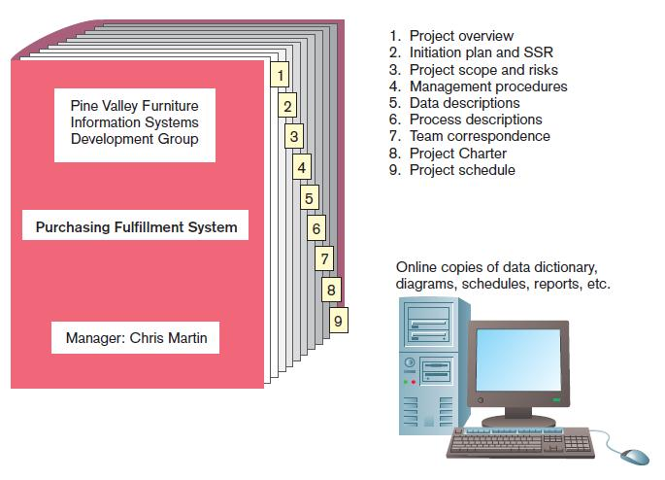
FIGURE 3-6
The project workbook for the Purchase Fulfillment System project contains nine key documents in both hard-copy and electronic form.
Chapter 3
Copyright © 2011 Pearson Education, Inc. Publishing as Prentice Hall

Slide 13
PM Phase 2: Project Planning
Define clear, discrete activities and the work needed to complete each activity
Tasks
  Define project scope, alternatives, feasibility
  Divide project into tasks
  Estimate resource requirements
  Develop preliminary schedule
  Develop communication plan
  Determine standards and procedures
  Identify and assess risk
  Create preliminary budget
  Develop a statement of work
  Set baseline project plan
Chapter 3
Copyright © 2011 Pearson Education, Inc. Publishing as Prentice Hall

Slide 14
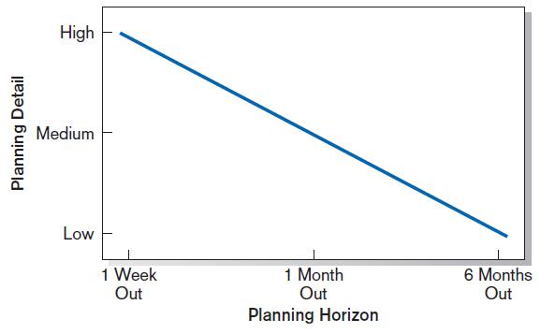
Planning Detail
FIGURE 3-8
Level of project planning detail should be high in the short term, with less detail as time goes on.
Chapter 3
Copyright © 2011 Pearson Education, Inc. Publishing as Prentice Hall

Slide 15
Some Components of Project Planning
Statement of Work (SOW)
  “Contract” between the IS staff and the customer regarding deliverables and time estimates for a system development project
The Baseline Project Plan (BPP)
  Contains estimates of scope, benefits, schedules, costs, risks, and resource requirements
Preliminary Budget
  Cost-benefit analysis outlining planned expenses and revenues
Chapter 3
Copyright © 2011 Pearson Education, Inc. Publishing as Prentice Hall

Slide 16
Some Components of Project Planning (cont.)
Work Breakdown Structure (WBS)
  Division of project into manageable and logically ordered tasks and subtasks
Scheduling Diagrams
  Gantt chart: horizontal bars represent task durations
  Network diagram: boxes and links represent task dependencies
Chapter 3
Copyright © 2011 Pearson Education, Inc. Publishing as Prentice Hall

Slide 17
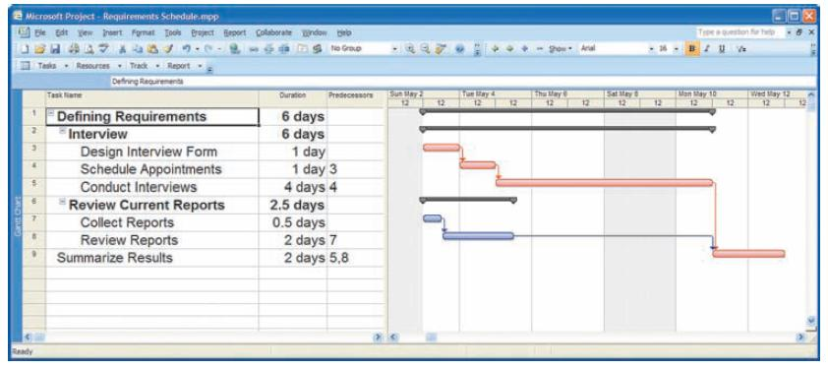
Scheduling Diagrams Gantt Chart
FIGURE 3-10
Gantt chart showing project tasks, duration times for those tasks, and predecessors
Special-purpose project management software is available for this.
Chapter 3
Copyright © 2011 Pearson Education, Inc. Publishing as Prentice Hall

Slide 18
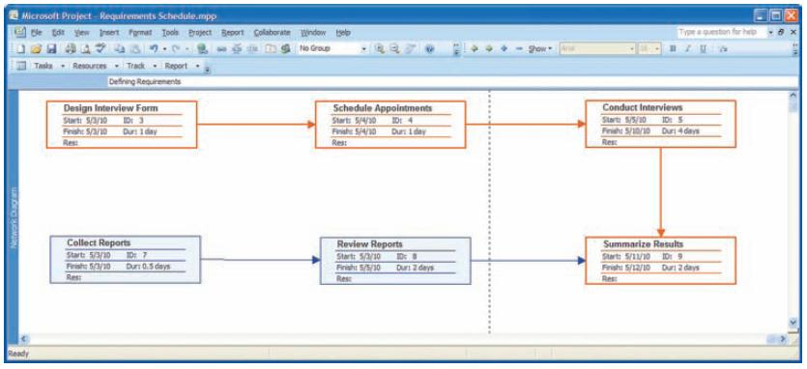
Scheduling Diagrams Network Diagram
FIGURE 3-13
A network diagram illustrating tasks with rectangles (or ovals) and the relationships and sequences of those activities with arrows
Special-purpose project management software is available for this.
Chapter 3
Copyright © 2011 Pearson Education, Inc. Publishing as Prentice Hall

Slide 19
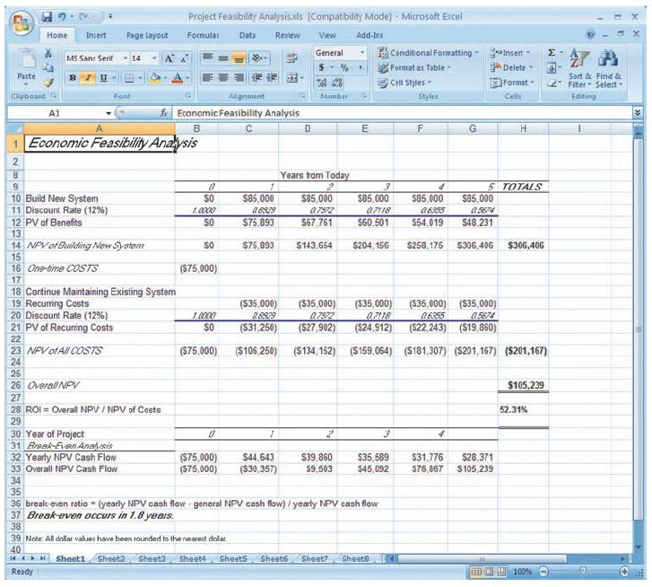
Preliminary Budget
FIGURE 3-15
A financial cost and benefit analysis for a systems development project
Spreadsheet software is good for this.
Chapter 3
Copyright © 2011 Pearson Education, Inc. Publishing as Prentice Hall

Slide 20
PM Phase 3: Project Execution
Plans created in prior phases are put into action.
Actions
  Execute baseline project plan
  Monitor progress against baseline plan
  Manage changes in baseline plan
  Maintain project workbook
  Communicate project status
Chapter 3
Copyright © 2011 Pearson Education, Inc. Publishing as Prentice Hall

Slide 21
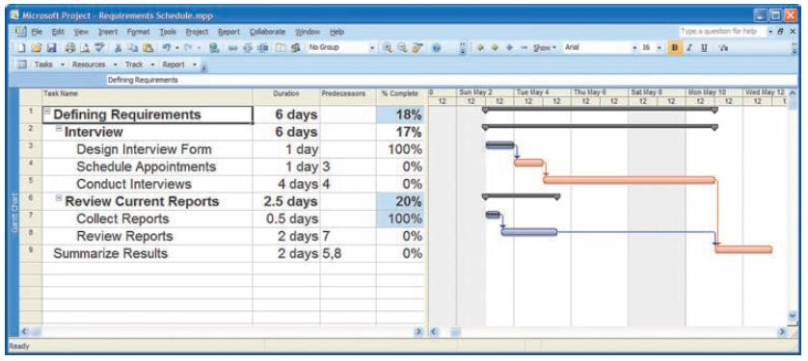
Monitoring Progress with a Gantt Chart
FIGURE 3-17
Gantt chart with tasks 3 and 7 completed
Red bars indicate critical path; lines through bars indicate percent complete.
Chapter 3
Copyright © 2011 Pearson Education, Inc. Publishing as Prentice Hall

Slide 22
Communication Methods
High Formality
  Project workbook
  Newsletters
  Status reports
  Specification documents
  Meeting minutes
Medium Formality
  Meetings
  Seminars and workshops
  Memos
Low Formality
  Bulletin boards
  Brown bag lunches
  Hallway discussions
Chapter 3
Copyright © 2011 Pearson Education, Inc. Publishing as Prentice Hall

Slide 23
PM Phase 4: Project Closedown
Bring the project to an end
Actions
  Close down the project.
  Conduct post-project reviews.
  Close the customer contract.
Chapter 3
Copyright © 2011 Pearson Education, Inc. Publishing as Prentice Hall

Slide 24
Representing and Scheduling Project Plans
Gantt Charts
Network Diagrams
PERT Calculations
Critical Path Scheduling
Project Management Software
Chapter 3
Copyright © 2011 Pearson Education, Inc. Publishing as Prentice Hall

Slide 25
Gantt Charts vs. Network Diagrams
Gantt charts
  Show task durations.
  Show time overlap.
  Show slack time in duration.
Network diagrams
  Show task dependencies.
  Do not show time overlap, but show parallelism.
  Show slack time in boxes.
Chapter 3
Copyright © 2011 Pearson Education, Inc. Publishing as Prentice Hall

Slide 26
Estimating Task Duration
PERT: Program Evaluation Review Technique
Technique that uses optimistic (o), pessimistic (p), and realistic (r) time estimates to determine expected task duration
Formula for Estimated Time:
  ET = (o + 4r + p)/6
Copyright © 2011 Pearson Education, Inc. Publishing as Prentice Hall

Slide 27
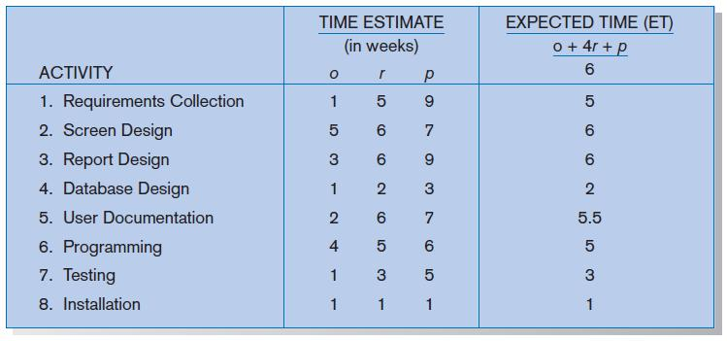
Example PERT Analysis
FIGURE 3-22
Estimated time calculations for the SPTS project
Copyright © 2011 Pearson Education, Inc. Publishing as Prentice Hall

Slide 28
Critical Path Scheduling
A scheduling technique whose order and duration of a sequence of task activities directly affect the completion
Critical path: the shortest time in which a project can be completed
Slack time: the time an activity can be delayed without delaying the project
Copyright © 2011 Pearson Education, Inc. Publishing as Prentice Hall

Slide 29
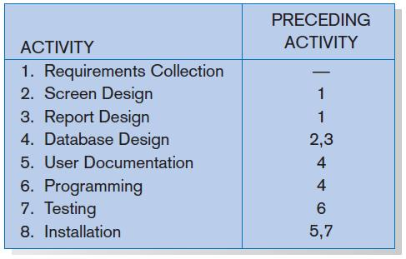
Critical Path Example
(dependencies between tasks)
PRECEDING ACTIVITIES indicate the activities that must be completed before the specified activity can begin.
FIGURE 3-23 Sequence of Activities within the SPTS project
Copyright © 2011 Pearson Education, Inc. Publishing as Prentice Hall

Slide 30
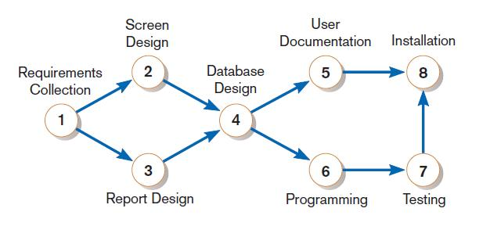
Critical Path Example
Network diagram shows dependencies
FIGURE 3-25
A network diagram that illustrates the activities (circles) and the sequence (arrows) of those activities
Chapter 3
Copyright © 2011 Pearson Education, Inc. Publishing as Prentice Hall

Slide 31
Determining the Critical Path
Calculate the earliest possible completion time for each activity by summing the activity times in the longest path to the activity. This gives total expected project time.
Calculate the latest possible completion time for each activity by subtracting the activity times in the path following the activity from the total expected time. This gives slack time for activities.
Critical path – contains no activities with slack time.
Chapter 3
Copyright © 2011 Pearson Education, Inc. Publishing as Prentice Hall

Slide 32
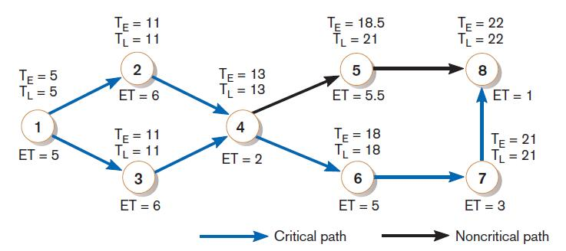
Critical Path Calculation
FIGURE 3-26
A network diagram for the SPTS project showing estimated times for each activity and the earliest and latest expected completion time for each activity
Early and late time calculations are determined and critical path established. (Note: Activity #5 can begin late without affecting project completion time).
Chapter 3
Copyright © 2011 Pearson Education, Inc. Publishing as Prentice Hall

Slide 33
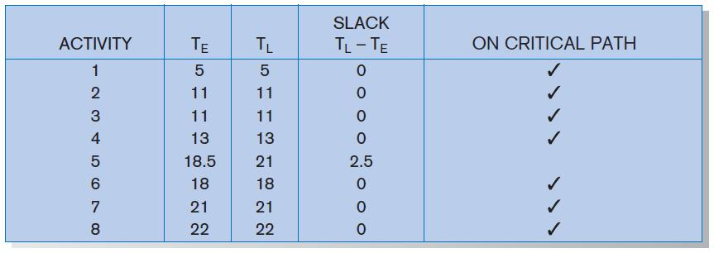
Critical Path Calculation (cont.)
FIGURE 3-27
Activity slack time calculations for the SPTS project; all activities except number 5 are on the critical path
Note the slack time in Activity #5.
Chapter 3
Copyright © 2011 Pearson Education, Inc. Publishing as Prentice Hall

Slide 34
Using Project Management Software
Many powerful software tools exist for assisting with project management.
Example: Microsoft Project can help with
  Entering project start date.
  Establishing tasks and task dependencies.
  Viewing project information as Gantt or Network diagrams.
Chapter 3
Copyright © 2011 Pearson Education, Inc. Publishing as Prentice Hall

Slide 35
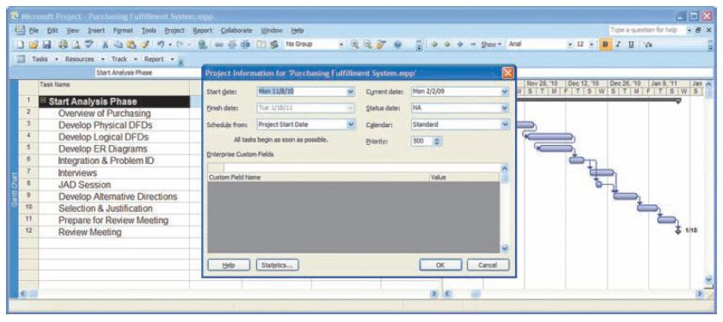
Project Start Date
FIGURE 3-28
Establishing a project starting date in Microsoft Project for Windows
Chapter 3
Copyright © 2011 Pearson Education, Inc. Publishing as Prentice Hall

Slide 36
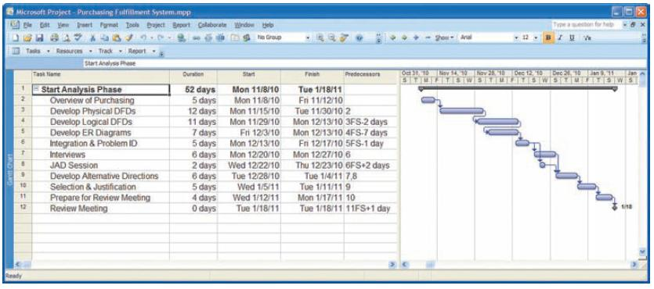
Entering Tasks
FIGURE 3-29
Entering tasks and assigning task relationships in Microsoft project
for Windows
Chapter 3
Copyright © 2011 Pearson Education, Inc. Publishing as Prentice Hall

Slide 37
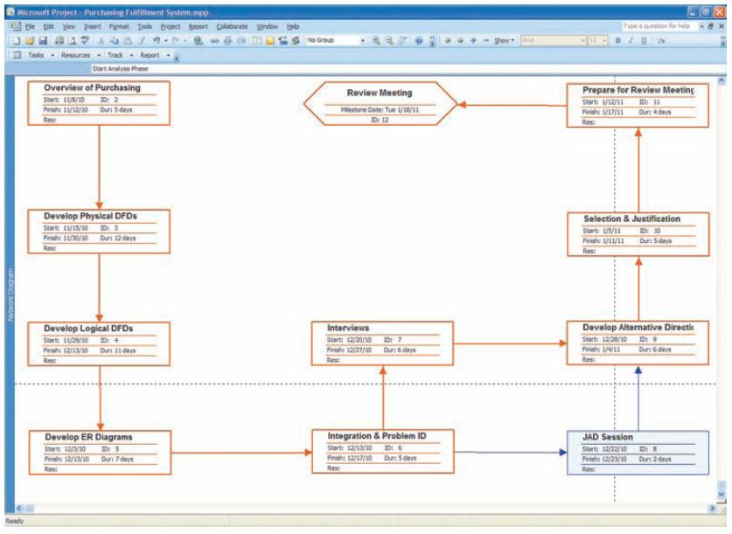
Viewing Network Diagram
FIGURE 3-30
Viewing project information as a network diagram in Microsoft Project for Windows
Hexagon shape indicates a milestone.
Red boxes and arrows indicate critical path (no slack).
Chapter 3
Copyright © 2011 Pearson Education, Inc. Publishing as Prentice Hall

Slide 38
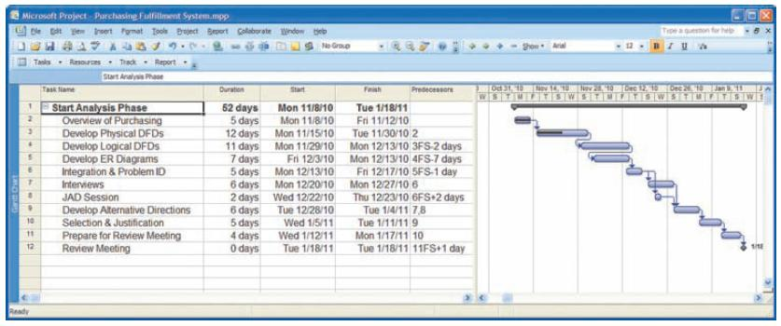
Viewing Gantt Chart
FIGURE 3-31
Gantt chart showing progress of activities (right frame) versus planned activities (left frame)
Black line at top indicates a summary activity (composed of subtasks).
Diamond shape indicates a milestone.
Chapter 3
Copyright © 2011 Pearson Education, Inc. Publishing as Prentice Hall

Slide 39
Summary
In this chapter you learned how to:
  Explain the process of managing an information systems project.
  Describe the skills required to be an effective project manager.
  List and describe the skills and activities of a project manager during project initiation, project planning, project execution, and project closedown.
  Explain what is meant by critical path scheduling and describe the process of creating Gantt charts and network diagrams.
  Explain how commercial project management software packages can be used to assist in representing and managing project schedules.
Chapter 3
Copyright © 2011 Pearson Education, Inc. Publishing as Prentice Hall

Slide 40

All rights reserved. No part of this publication may be reproduced, stored in a retrieval system, or transmitted, in any form or by any means, electronic, mechanical, photocopying, recording, or otherwise, without the prior written permission of the publisher. Printed in the United States of America.
Copyright © 2011 Pearson Education, Inc.
Publishing as Prentice Hall

