Slide 1
Modern Systems Analysis
and Design
Sixth Edition
Jeffrey A. Hoffer
Joey F. George
Joseph S. Valacich
Chapter 3 Appendix
Object-Oriented Analysis and Design:
Project Management

Slide 2
Learning Objectives
Describe the unique characteristics of an OOSAD project.
Chapter 3 Appendix
© 2011 Pearson Education, Inc. Publishing as Prentice Hall

Slide 3
Unique Characteristics of an OOSAD Project
Uses a more iterative design approach – such as prototyping or object-oriented analysis and design.
During the OOSAD process, the system evolves incrementally over the life of the project.
  A portion of the final system is constructed during each iteration phase.
Chapter 3 Appendix
© 2011 Pearson Education, Inc. Publishing as Prentice Hall

Slide 4
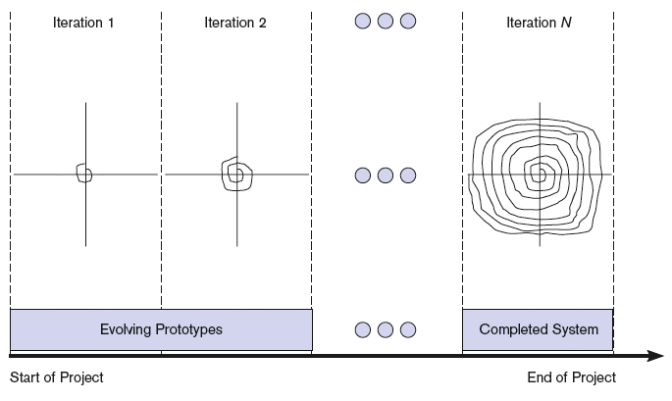
FIGURE 3-32 During the OOSAD process, the system evolves incrementally over the life of the project
Chapter 3 Appendix
© 2011 Pearson Education, Inc. Publishing as Prentice Hall

Slide 5
Unique Characteristics of an OOSAD Project (Cont.)
Define the system as a set of components
  Object-oriented development projects are developed using ongoing management and evolving system functionality.
Complete hard problems first
  The focus and ordering of system components change over the life of the project.
Chapter 3 Appendix
© 2011 Pearson Education, Inc. Publishing as Prentice Hall

Slide 6
Unique Characteristics of an OOSAD Project (Cont.)
Using iterations to manage the project
  The workflow of an iteration.
Don’t plan too much up front
  Planning estimation improves over time.
How many and how long are iterations?
  An OOSAD project typically has 6 to 9 iterations.
Chapter 3 Appendix
© 2011 Pearson Education, Inc. Publishing as Prentice Hall

Slide 7
Unique Characteristics of an OOSAD Project (Cont.)
Project activity focus changes over the life of a project
  As the project evolves, system functionality evolves.
Chapter 3 Appendix
© 2011 Pearson Education, Inc. Publishing as Prentice Hall

Slide 8
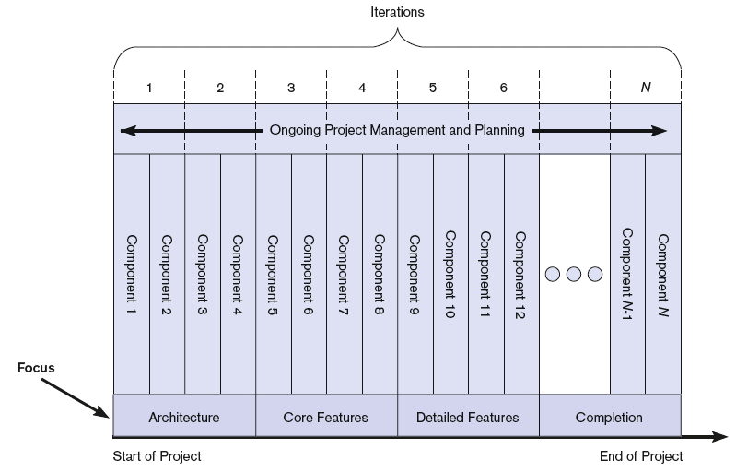
FIGURE 3-34
The focus and ordering of system components change over the life of the project
Chapter 3 Appendix
© 2011 Pearson Education, Inc. Publishing as Prentice Hall

Slide 9
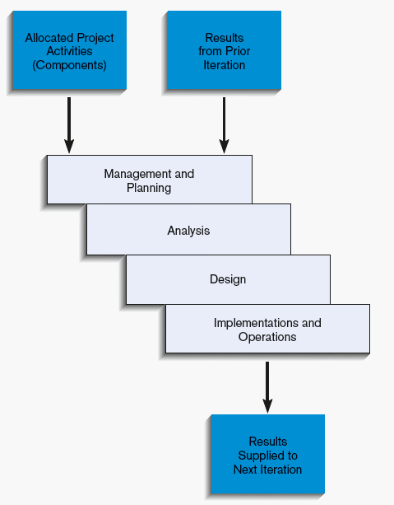
FIGURE 3-35
The workflow of an iteration
(Source: Based on Royce, 1998; George
et al., 2007.)
Chapter 3 Appendix
© 2011 Pearson Education, Inc. Publishing as Prentice Hall

Slide 10
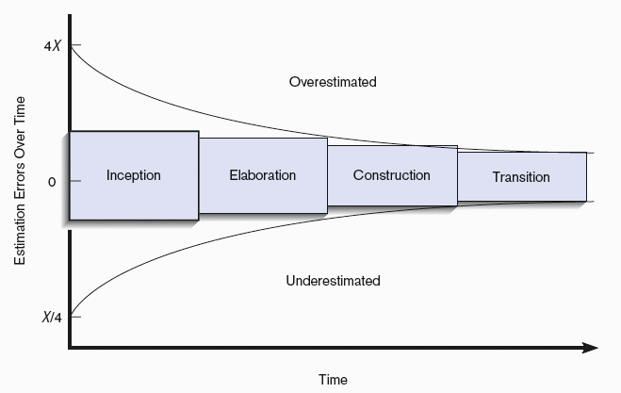
FIGURE 3-36
Planning estimation improves over time
(Source: Based on Royce, 1998; George
et al., 2007.)
Chapter
© 2011 Pearson Education, Inc. Publishing as Prentice Hall

Slide 11
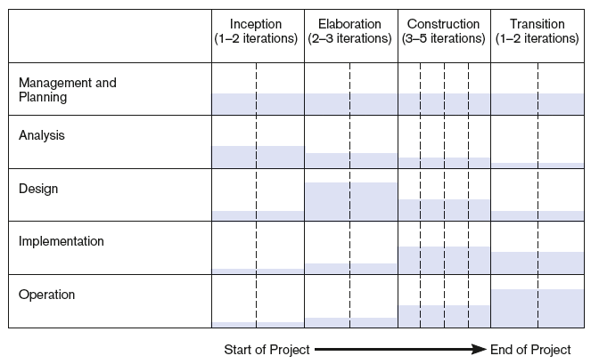
FIGURE 3-39
The level and focus of activity across the
systems development process change
from the start to the end of the project
Chapter
© 2011 Pearson Education, Inc. Publishing as Prentice Hall

Slide 12
Summary
In this appendix you learned how to:
Describe the unique characteristics of an OOSAD project.
Chapter
© 2011 Pearson Education, Inc. Publishing as Prentice Hall

Slide 13

All rights reserved. No part of this publication may be reproduced, stored in a retrieval system, or transmitted, in any form or by any means, electronic, mechanical, photocopying, recording, or otherwise, without the prior written permission of the publisher. Printed in the United States of America.
Copyright © 2011 Pearson Education, Inc.
Publishing as Prentice Hall

