Slide 1
Modern Systems Analysis
and Design
Sixth Edition
Jeffrey A. Hoffer
Joey F. George
Joseph S. Valacich
Chapter 4
Identifying and Selecting Systems Development Projects

Slide 2
Learning Objectives
Describe the project identification and selection process.
Describe corporate strategic planning and information systems planning process.
Explain the relationship between corporate strategic planning and information systems planning.
Chapter 4
Copyright © 2011 Pearson Education, Inc. Publishing as Prentice Hall

Slide 3
Learning Objectives (Cont.)
Describe how information systems planning can be used to assist in identifying and selecting systems development projects.
Analyze information systems planning matrices to determine affinity between information systems and IS projects and to forecast the impact of IS projects on business objectives.
Describe the three classes of Internet electronic commerce applications: Internet, intranets, and extranets.
Chapter 4
Copyright © 2011 Pearson Education, Inc. Publishing as Prentice Hall

Slide 4
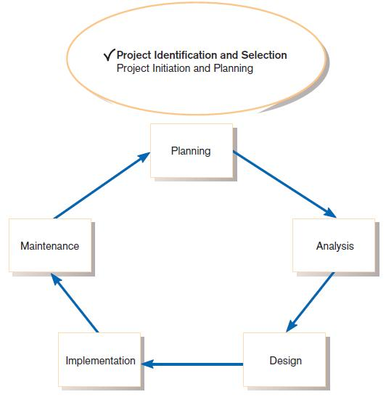
Identifying and Selecting Systems Development Projects
FIGURE 4-1
Systems development life cycle with
project identification and selection
highlighted
Chapter 4
Copyright © 2011 Pearson Education, Inc. Publishing as Prentice Hall

Slide 5
The Process of Identifying and Selecting IS Development Projects
Identifying potential development projects
  Identification from a stakeholder group.
    Each stakeholder group brings their own perspective and motivation to the IS decision.
Chapter 4
Copyright © 2011 Pearson Education, Inc. Publishing as Prentice Hall

Slide 6
The Process of Identifying and Selecting IS Development Projects
  Top-down source are projects identified by top management or by a diverse steering committee.
  Bottom-up source are project initiatives stemming from managers, business units, or the development group.
  The process varies substantially across organizations.
Chapter 4
Copyright © 2011 Pearson Education, Inc. Publishing as Prentice Hall

Slide 7
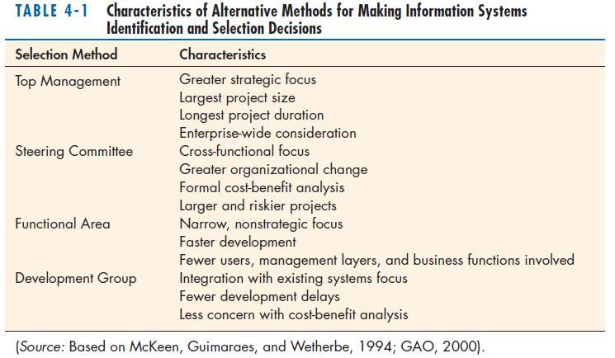
The Process of Identifying and Selecting IS Development Projects (Cont.)
Chapter 4
Copyright © 2011 Pearson Education, Inc. Publishing as Prentice Hall

Slide 8
The Process of Identifying and Selecting IS Development Projects (Cont.)
Classifying and ranking IS development projects
  Using value chain analysis or other evaluation criteria
  Value chain analysis: the process of analyzing an organization’s activities for making products and/or services to determine where value is added and costs are incurred
Chapter 4
Copyright © 2011 Pearson Education, Inc. Publishing as Prentice Hall

Slide 9
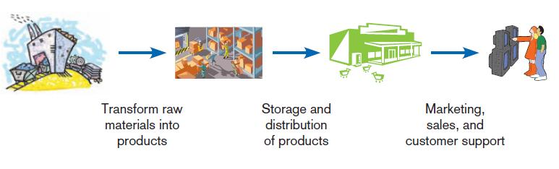
The Process of Identifying and Selecting IS Development Projects (Cont.)
FIGURE 4-2
Organizations can be thought of as a
value chain, transforming raw materials
into products for customers.
Chapter 4
Copyright © 2011 Pearson Education, Inc. Publishing as Prentice Hall

Slide 10
The Process of Identifying and Selecting IS Development Projects (Cont.)
Selecting IS development projects
  Based on various factors
  Both short- and long-term projects considered
  Most likely to achieve business objectives selected
  Is a very important and ongoing activity
Chapter 4
Copyright © 2011 Pearson Education, Inc. Publishing as Prentice Hall

Slide 11
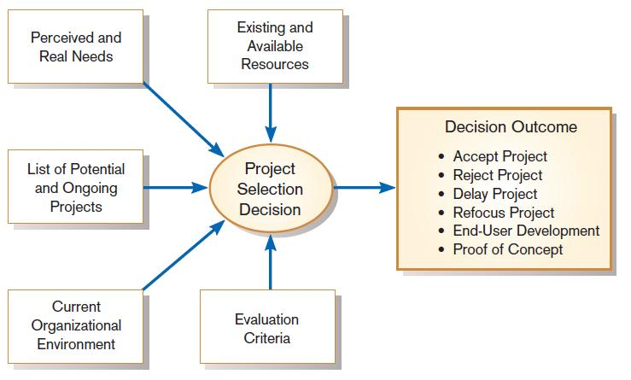
The Process of Identifying and Selecting IS Development Projects (Cont.)
FIGURE 4-3
Project selection decisions must consider numerous factors and can have numerous outcomes.
Chapter 4
Copyright © 2011 Pearson Education, Inc. Publishing as Prentice Hall

Slide 12
The Process of Identifying and Selecting IS Development Projects (Cont.)
One method for deciding among different projects or alternative designs is:
  For each requirement or constraint:
  Score = weight X rating
  Each alternative: sum scores across requirements/constraints.
  Alternative with highest score wins.
Chapter 4
Copyright © 2011 Pearson Education, Inc. Publishing as Prentice Hall

Slide 13
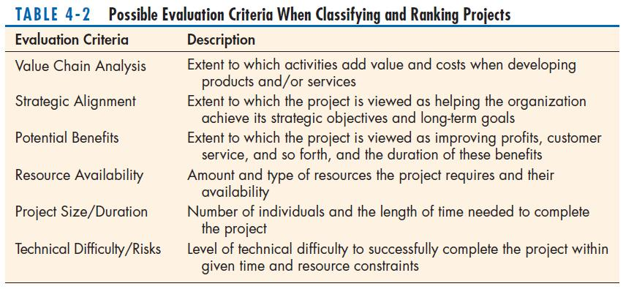
The Process of Identifying and Selecting IS Development Projects (Cont.)
Chapter 4
Copyright © 2011 Pearson Education, Inc. Publishing as Prentice Hall

Slide 14
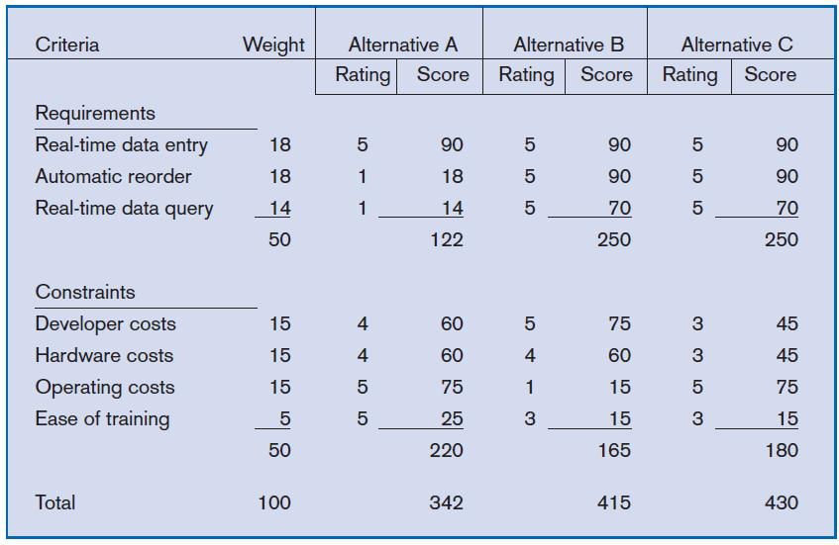
The Process of Identifying and Selecting IS Development Projects (Cont.)
FIGURE 4-4
Alternative projects and system design
decisions can be assisted using weighted
multicriteria analysis.
Chapter 4
Copyright © 2011 Pearson Education, Inc. Publishing as Prentice Hall

Slide 15
Deliverables and Outcomes
Primary deliverable from the first part of the planning phase is a schedule of specific IS development projects.
Outcome of the next part of the planning phase – project initiation and planning – is the assurance that careful consideration was given to project selection and each project can help the organization reach its goals.
Chapter 4
Copyright © 2011 Pearson Education, Inc. Publishing as Prentice Hall

Slide 16
Deliverables and Outcomes
Incremental commitment: a strategy in systems analysis and design in which the project is reviewed after each phase and continuation of the project is rejustified.
Chapter 4
Copyright © 2011 Pearson Education, Inc. Publishing as Prentice Hall

Slide 17
Corporate and Information Systems Planning
To benefit from a planning-based approach for identifying and selecting projects, an organization must :
  Analyze its information needs thoroughly.
  Plan its projects carefully.
Chapter 4
Copyright © 2011 Pearson Education, Inc. Publishing as Prentice Hall

Slide 18
Corporate Strategic Planning
Ongoing process that defines mission, objectives, and strategies of an organization
Chapter 4
Copyright © 2011 Pearson Education, Inc. Publishing as Prentice Hall

Slide 19
Corporate Strategic Planning
Corporate strategy involves:
  Mission statement
  Objective statements
  Description of competitive strategy
Chapter 4
Copyright © 2011 Pearson Education, Inc. Publishing as Prentice Hall

Slide 20
Corporate Strategic Planning (Cont.)
Mission statement: A statement that makes it clear what business a company is in
Chapter 4
Copyright © 2011 Pearson Education, Inc. Publishing as Prentice Hall

Slide 21
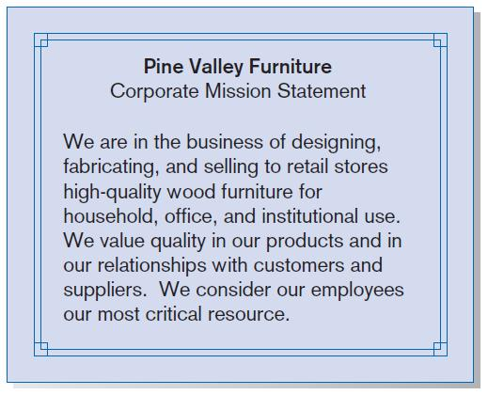
Corporate Strategic Planning (Cont.)
FIGURE 4-7
Mission statement (Pine Valley Furniture)
Chapter 4
Copyright © 2011 Pearson Education, Inc. Publishing as Prentice Hall

Slide 22
Corporate Strategic Planning (Cont.)
Objective statement: a series of statements that express an organization’s qualitative and quantitative goals for reaching a desired future position
Chapter 4
Copyright © 2011 Pearson Education, Inc. Publishing as Prentice Hall

Slide 23
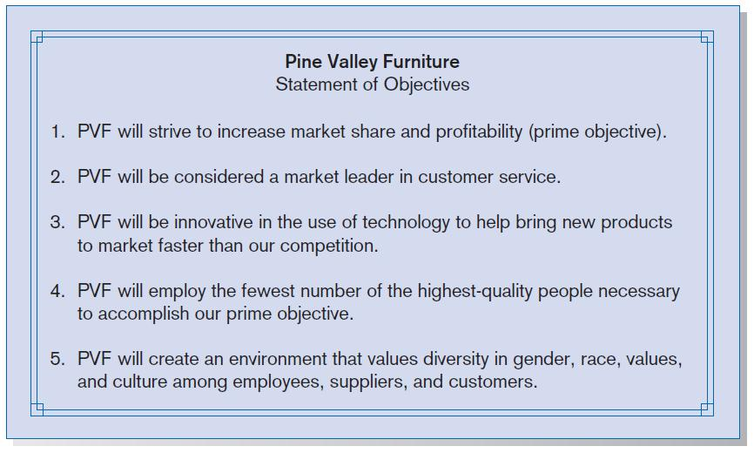
Corporate Strategic Planning (Cont.)
FIGURE 4-8
Statement of Corporate Objectives
(Pine Valley Furniture)
Chapter 4
Copyright © 2011 Pearson Education, Inc. Publishing as Prentice Hall

Slide 24
Corporate Strategic Planning (Cont.)
Competitive strategy: the method by which an organization attempts to achieve its mission and objectives
Main types:
  Low-cost producer
  Product differentiation
  Product focus or niche
Chapter 4
Copyright © 2011 Pearson Education, Inc. Publishing as Prentice Hall

Slide 25
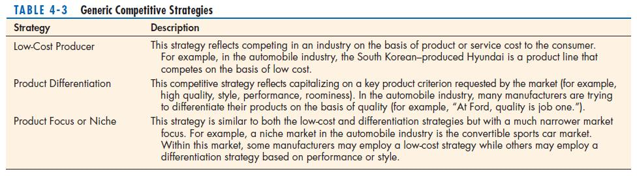
Corporate Strategic Planning (Cont.)
Chapter 4
Copyright © 2011 Pearson Education, Inc. Publishing as Prentice Hall

Slide 26
Information Systems Planning (ISP)
An orderly means of assessing the information needs of an organization and defining systems, databases, and technologies that will best meet those needs
ISP must be done in accordance with the organization's mission, objectives, and competitive strategy.
Chapter 4
Copyright © 2011 Pearson Education, Inc. Publishing as Prentice Hall

Slide 27
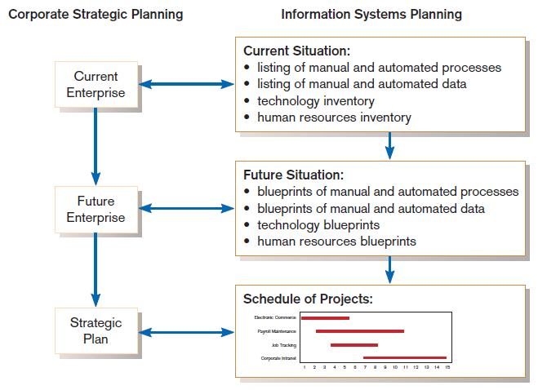
Information Systems Planning (Cont.)
FIGURE 4-10
Parallel activities of corporate strategic planning and information systems planning
Chapter 4
Copyright © 2011 Pearson Education, Inc. Publishing as Prentice Hall

Slide 28
Information Systems Planning (Cont.)
IS planning must be kept in line with corporate strategic planning.
Chapter 4
Copyright © 2011 Pearson Education, Inc. Publishing as Prentice Hall

Slide 29
Information Systems Planning (Cont.)
Top-down planning attempts to gain a broad understanding of information system needs of the entire organization and offers:
  Broader perspective.
  Improved integration.
  Improved management support.
  Better understanding.
Chapter 4
Copyright © 2011 Pearson Education, Inc. Publishing as Prentice Hall

Slide 30
Information Systems Planning (Cont.)
Bottom-up planning identifies IS development projects based on solving specific operational business problems or taking advantage of specific opportunities.
  Can be faster and less costly, so may be beneficial in certain circumstances.
Chapter 4
Copyright © 2011 Pearson Education, Inc. Publishing as Prentice Hall

Slide 31
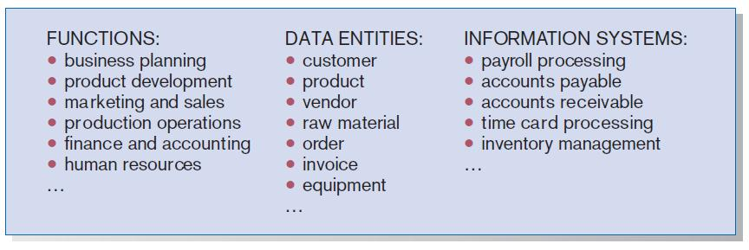
Business Functions, Data Entities, and Information Systems of PVF
FIGURE 4-11
Information systems planning information
(Pine Valley Furniture)
Chapter 4
Copyright © 2011 Pearson Education, Inc. Publishing as Prentice Hall

Slide 32
Information Systems Planning of Pine Valley Furniture (PVF)
Functional Decomposition: breaking high-level abstract information into smaller units for more detailed planning
Chapter 4
Copyright © 2011 Pearson Education, Inc. Publishing as Prentice Hall

Slide 33
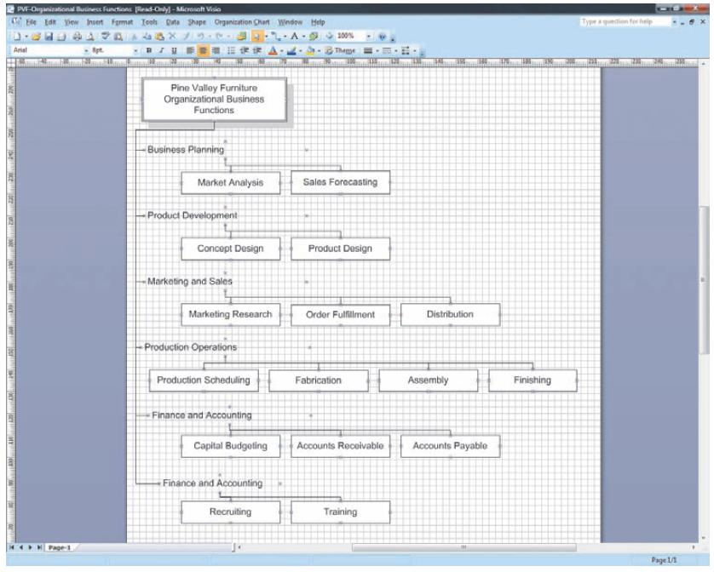
Information Systems Planning of Pine Valley Furniture (PVF)
FIGURE 4-12
Functional decomposition of information
systems planning information (Pine Valley Furniture)
Chapter 4
Copyright © 2011 Pearson Education, Inc. Publishing as Prentice Hall

Slide 34
Information Systems Planning of Pine Valley Furniture (PVF)
IS planning matrices describe relationships between pairs of organizational elements (location, function, business unit, objective, process, data, information system).
Chapter 4
Copyright © 2011 Pearson Education, Inc. Publishing as Prentice Hall

Slide 35
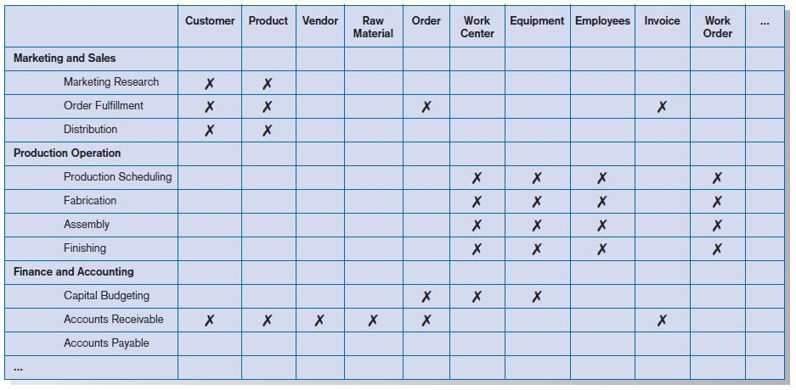
Information Systems Planning of Pine Valley Furniture (PVF)
FIGURE 4-13
Data Entity-to-Function matrix (Pine Valley Furniture)
Chapter 4
Copyright © 2011 Pearson Education, Inc. Publishing as Prentice Hall

Slide 36
IS Plan Components
Briefly describe mission, objectives, and strategy of the organization.
Provide summary of current and future processes, functions, data entities, and information needs of the enterprise.
Chapter 4
Copyright © 2011 Pearson Education, Inc. Publishing as Prentice Hall

Slide 37
IS Plan Components (Cont.)
Describe primary role IS will play in the organization to transform enterprise from current to future state.
Describe limitations imposed by technology and current levels of financial, technical, and personnel resources.
Chapter 4
Copyright © 2011 Pearson Education, Inc. Publishing as Prentice Hall

Slide 38
IS Plan Components (Cont.)
Summarize overall information systems needs in the company and set long-term strategies for filling the needs.
Show detailed inventory of present projects and systems and detailed plan for the current year.
Chapter 4
Copyright © 2011 Pearson Education, Inc. Publishing as Prentice Hall

Slide 39
IS Plan Components (Cont.)
Describe unknown but likely events that can affect the plan, presently known business change elements and their impact on the plan.
Chapter 4
Copyright © 2011 Pearson Education, Inc. Publishing as Prentice Hall

Slide 40
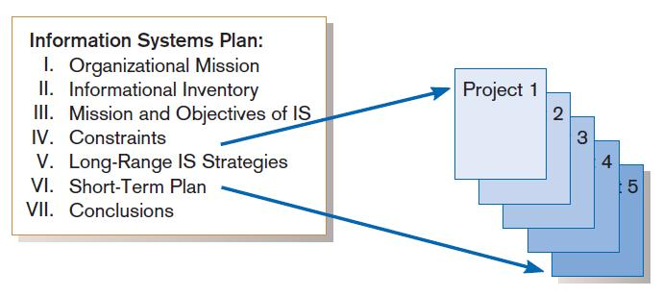
Information Systems (IS) Plan
FIGURE 4-16
Systems development projects flow from the information systems plan
Chapter 4
Copyright © 2011 Pearson Education, Inc. Publishing as Prentice Hall

Slide 41
Electronic Commerce Applications and Internet Basics
Electronic Commerce (EC): Internet-based communication to support day-to-day business activities
Internet: a large worldwide network of networks that use a common protocol to communicate with each other
Intranet: Internet-based communication to support business activities within a single organization
Chapter 4
Copyright © 2011 Pearson Education, Inc. Publishing as Prentice Hall

Slide 42
Electronic Commerce Applications and Internet Basics (Cont.)
Extranet: Internet-based communication to support business-to-business activities
Electronic data interchange (EDI): the use of telecommunications technologies to directly transfer business documents between organizations
Chapter 4
Copyright © 2011 Pearson Education, Inc. Publishing as Prentice Hall

Slide 43
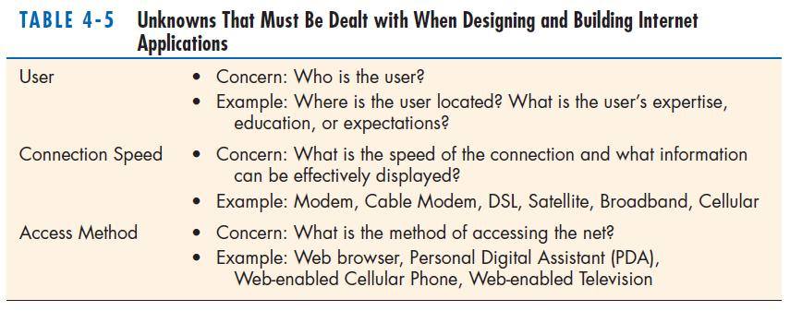
Electronic Commerce Applications and Internet Basics (Cont.)
Chapter 4
Copyright © 2011 Pearson Education, Inc. Publishing as Prentice Hall

Slide 44
Summary
In this chapter you learned how to:
  Describe the project identification and selection process.
  Describe corporate strategic planning and information systems planning.
  Explain the relationship between corporate strategic planning and IS planning.
Chapter 4
Copyright © 2011 Pearson Education, Inc. Publishing as Prentice Hall

Slide 45
Summary (Cont.)
  Describe how IS planning can assist in system development project identification and selection.
  Analyze IS planning matrices.
  Describe three classes of E-Commerce applications.
Chapter 4
Copyright © 2011 Pearson Education, Inc. Publishing as Prentice Hall

Slide 46

All rights reserved. No part of this publication may be reproduced, stored in a retrieval system, or transmitted, in any form or by any means, electronic, mechanical, photocopying, recording, or otherwise, without the prior written permission of the publisher. Printed in the United States of America.
Copyright © 2011 Pearson Education, Inc.
Publishing as Prentice Hall

