Slide 1
Modern Systems Analysis
and Design
Sixth Edition
Jeffrey A. Hoffer
Joey F. George
Joseph S. Valacich
Chapter 6
Determining System Requirements

Slide 2
Learning Objectives
Describe options for designing and conducting interviews and develop a plan for conducting an interview to determine system requirements.
Explain the advantages and pitfalls of observing workers and analyzing business documents to determine system requirements.
Chapter 6
Copyright © 2011 Pearson Education, Inc. Publishing as Prentice Hall

Slide 3
Learning Objectives (Cont.)
Explain how computing can provide support for requirements determination.
Participate in and help plan a Joint Application Design session.
Use prototyping during requirements determination.
Describe contemporary approaches to requirements determination.
Understand how requirements determination techniques apply to the development of electronic commerce applications.
Chapter 6
Copyright © 2011 Pearson Education, Inc. Publishing as Prentice Hall

Slide 4
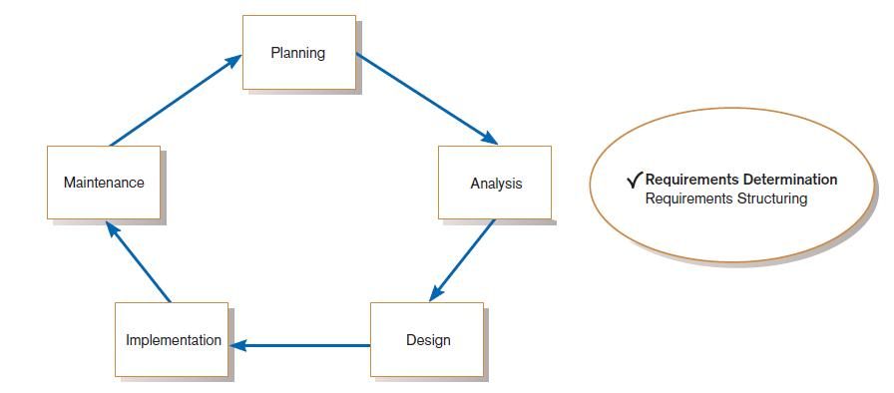
Performing Requirements Determination
FIGURE 6-1
Systems development life cycle with analysis phase highlighted
Chapter 6
Copyright © 2011 Pearson Education, Inc. Publishing as Prentice Hall

Slide 5
The Process of Determining Requirements
Good Systems Analyst Characteristics:
  Impertinence—question everything
  Impartiality—consider all issues to find the best organizational solution
  Relaxing constraints—assume anything is possible
  Attention to details—every fact must fit
  Reframing—challenge yourself to new ways
Chapter 6
Copyright © 2011 Pearson Education, Inc. Publishing as Prentice Hall

Slide 6
Deliverables and Outcomes
Deliverables for Requirements Determination:
  From interviews and observations —interview transcripts, observation notes, meeting minutes
  From existing written documents — mission and strategy statements, business forms, procedure manuals, job descriptions, training manuals, system documentation, flowcharts
Chapter 6
Copyright © 2011 Pearson Education, Inc. Publishing as Prentice Hall

Slide 7
Deliverables and Outcomes (Cont.)
  From computerized sources — Joint Application Design session results, CASE repositories, reports from existing systems, displays and reports from system prototype
Chapter 6
Copyright © 2011 Pearson Education, Inc. Publishing as Prentice Hall

Slide 8
Traditional Methods for Determining Requirements
Interviewing individuals
Interviewing groups
Observing workers
Studying business documents
Chapter 6
Copyright © 2011 Pearson Education, Inc. Publishing as Prentice Hall

Slide 9
Interviewing and Listening
One of the primary ways analysts gather information about an information systems project
Interview Guide is a document for developing, planning and conducting an interview.
Chapter 6
Copyright © 2011 Pearson Education, Inc. Publishing as Prentice Hall

Slide 10
Guidelines for Effective Interviewing
Plan the interview.
  Prepare interviewee: appointment, priming questions.
  Prepare agenda, checklist, questions.
Listen carefully and take notes (tape record if permitted).
Review notes within 48 hours.
Be neutral.
Seek diverse views.
Chapter 6
Copyright © 2011 Pearson Education, Inc. Publishing as Prentice Hall

Slide 11
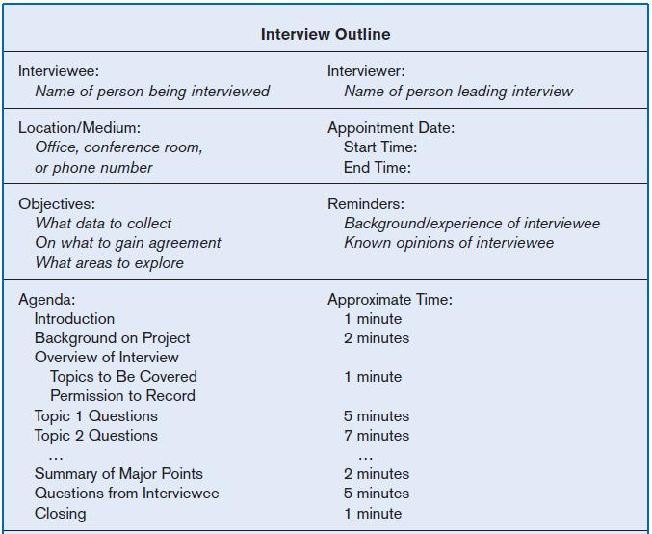
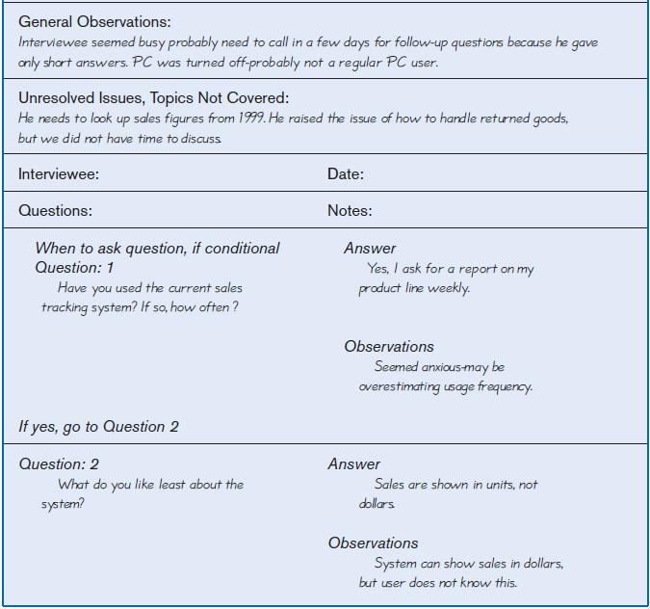
Interviewing and Listening (Cont.)
FIGURE 6-2 Typical interview guide
Chapter 6
Copyright © 2011 Pearson Education, Inc. Publishing as Prentice Hall

Slide 12
Choosing Interview Questions
Each question in an interview guide can include both verbal and non-verbal information.
  Open-ended questions: questions that have no prespecified answers
  Closed-ended questions: questions that ask those responding to choose from among a set of specified responses
Chapter 6
Copyright © 2011 Pearson Education, Inc. Publishing as Prentice Hall

Slide 13
Interviewing Groups
Drawbacks to individual interviews:
  Contradictions and inconsistencies between interviewees
  Follow-up discussions are time consuming
  New interviews may reveal new questions that require additional interviews with those interviewed earlier
Chapter 6
Copyright © 2011 Pearson Education, Inc. Publishing as Prentice Hall

Slide 14
Interviewing Groups (Cont.)
Interviewing several key people together
  Advantages
    More effective use of time
    Can hear agreements and disagreements at once
    Opportunity for synergies
  Disadvantages
    More difficult to schedule than individual interviews
Chapter 6
Copyright © 2011 Pearson Education, Inc. Publishing as Prentice Hall

Slide 15
Nominal Group Technique (NGT)
A facilitated process that supports idea generation by groups
Process
  Members come together as a group, but initially work separately.
  Each person writes ideas.
  Facilitator reads ideas out loud, and they are written on a blackboard or flipchart.
Chapter 6
Copyright © 2011 Pearson Education, Inc. Publishing as Prentice Hall

Slide 16
Nominal Group Technique (NGT)
  Group openly discusses the ideas for clarification.
  Ideas are prioritized, combined, selected, reduced.
NGT exercise used to complement group meetings or as part of JAD effort.
Chapter 6
Copyright © 2011 Pearson Education, Inc. Publishing as Prentice Hall

Slide 17
Directly Observing Users
Direct Observation
  Watching users do their jobs
  Obtaining more firsthand and objective measures of employee interaction with information systems
  Can cause people to change their normal operating behavior
  Time-consuming and limited time to observe
Chapter 6
Copyright © 2011 Pearson Education, Inc. Publishing as Prentice Hall

Slide 18
Analyzing Procedures and Other Documents
Document Analysis
  Review of existing business documents
  Can give a historical and “formal” view of system requirements
Chapter 6
Copyright © 2011 Pearson Education, Inc. Publishing as Prentice Hall

Slide 19
Analyzing Procedures and Other Documents (Cont.)
Types of information to be discovered:
  Problems with existing system
  Opportunity to meet new need
  Organizational direction
  Names of key individuals
  Values of organization
  Special information processing circumstances
  Reasons for current system design
  Rules for processing data
Chapter 6
Copyright © 2011 Pearson Education, Inc. Publishing as Prentice Hall

Slide 20
Analyzing Procedures and Other Documents (Cont.)
Useful document: Written work procedure
  For an individual or work group
  Describes how a particular job or task is performed
  Includes data and information used and created in the process
Chapter 6
Copyright © 2011 Pearson Education, Inc. Publishing as Prentice Hall

Slide 21
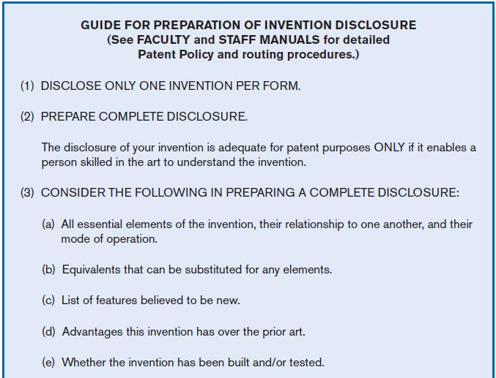
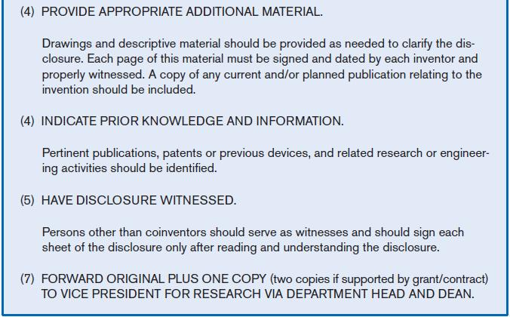
Analyzing Procedures and Other Documents (Cont.)
FIGURE 6-3 Example of a procedure
Chapter 6
Copyright © 2011 Pearson Education, Inc. Publishing as Prentice Hall

Slide 22
Analyzing Procedures and Other Documents (Cont.)
Potential Problems with Procedure Documents:
  May involve duplication of effort.
  May have missing procedures.
  May be out of date.
  May contradict information obtained through interviews.
Chapter 6
Copyright © 2011 Pearson Education, Inc. Publishing as Prentice Hall

Slide 23
Analyzing Procedures and Other Documents (Cont.)
Formal Systems: the official way a system works as described in organizational documentation (i.e. work procedure)
Informal Systems: the way a system actually works (i.e. interviews, observations)
Chapter 6
Copyright © 2011 Pearson Education, Inc. Publishing as Prentice Hall

Slide 24
Analyzing Procedures and Other Documents (Cont.)
Useful document: Business form
  Used for all types of business functions
  Explicitly indicate what data flow in and out of a system and data necessary for the system to function
  Gives crucial information about the nature of the organization
Chapter 6
Copyright © 2011 Pearson Education, Inc. Publishing as Prentice Hall

Slide 25
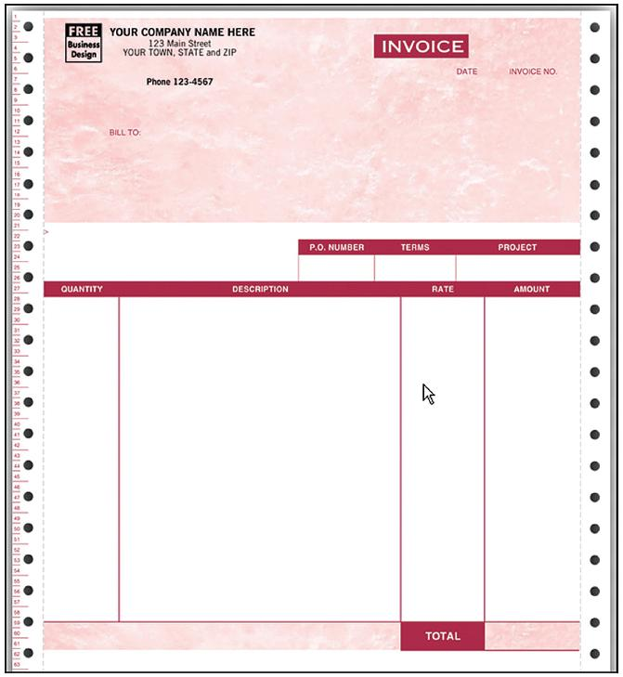
Analyzing Procedures and Other Documents (Cont.)
FIGURE 6-4
An example of a business form—An invoice form for QuickBooks, from jnk.btobsource.com. Reprinted by permission.
Source: http://jnk.btobsource.com/
NASApp/enduser/products/product_
detail.jsp?pc513050M#
Chapter 6
Copyright © 2011 Pearson Education, Inc. Publishing as Prentice Hall

Slide 26
Analyzing Procedures and Other Documents (Cont.)
Useful document: Report
  Primary output of current system
  Enables you to work backwards from the report to the data needed to generate it
Useful document: Description of current information system
Chapter 6
Copyright © 2011 Pearson Education, Inc. Publishing as Prentice Hall

Slide 27
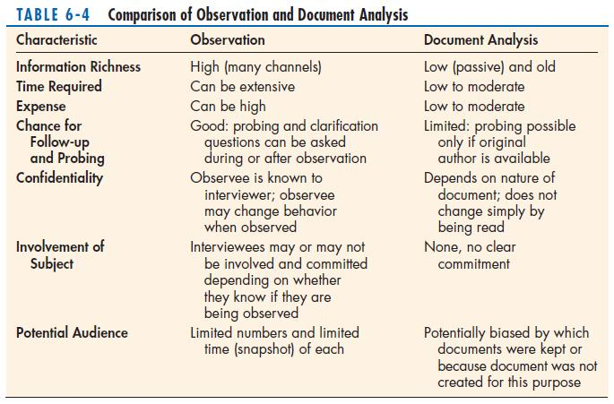
Analyzing Procedures and Other Documents (Cont.)
Chapter 6
Copyright © 2011 Pearson Education, Inc. Publishing as Prentice Hall

Slide 28
Contemporary Methods for Determining System Requirements
Joint Application Design (JAD)
  Brings together key users, managers, and systems analysts
  Purpose: collect system requirements simultaneously from key people
  Conducted off-site
Group Support Systems
  Facilitate sharing of ideas and voicing of opinions about system requirements
Chapter 6
Copyright © 2011 Pearson Education, Inc. Publishing as Prentice Hall

Slide 29
Contemporary Methods for Determining System Requirements (Cont.)
CASE tools
  Used to analyze existing systems
  Help discover requirements to meet changing business conditions
System prototypes
  Iterative development process
  Rudimentary working version of system is built
  Refine understanding of system requirements in concrete terms
Chapter 6
Copyright © 2011 Pearson Education, Inc. Publishing as Prentice Hall

Slide 30
Joint Application Design (JAD)
Intensive group-oriented requirements determination technique
Team members meet in isolation for an extended period of time
Highly focused
Resource intensive
Started by IBM in 1970s
Chapter 6
Copyright © 2011 Pearson Education, Inc. Publishing as Prentice Hall

Slide 31
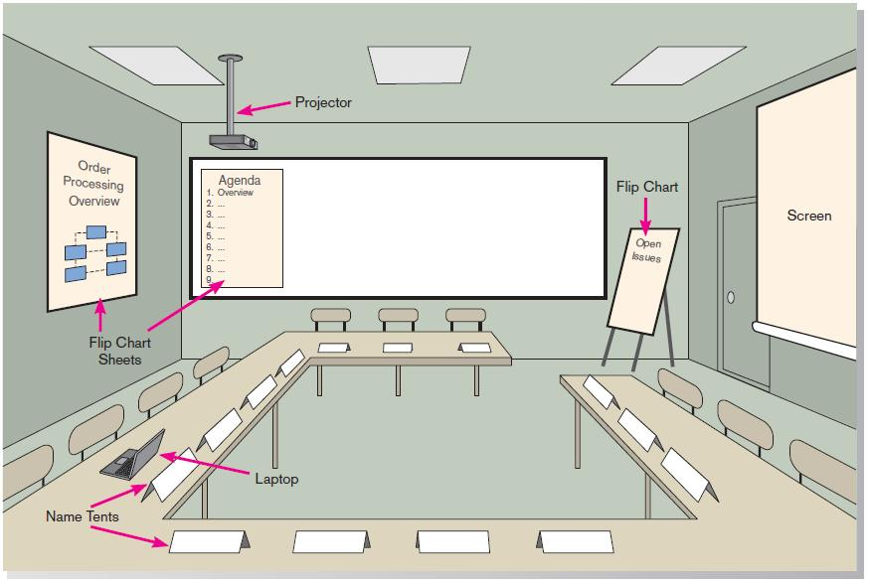
JAD (Cont.)
FIGURE 6-6 Illustration of the typical room layout for a JAD
Source: Based on Wood and Silver, 1995
Chapter 6
Copyright © 2011 Pearson Education, Inc. Publishing as Prentice Hall

Slide 32
JAD (Cont.)
JAD Participants:
  Session Leader: facilitates group process
  Users: active, speaking participants
  Managers: active, speaking participants
  Sponsor: high-level champion, limited participation
  Systems Analysts: should mostly listen
  Scribe: record session activities
  IS Staff: should mostly listen
Chapter 6
Copyright © 2011 Pearson Education, Inc. Publishing as Prentice Hall

Slide 33
JAD (Cont.)
End Result
  Documentation detailing existing system
  Features of proposed system
Chapter 6
Copyright © 2011 Pearson Education, Inc. Publishing as Prentice Hall

Slide 34
CASE Tools During JAD
Upper CASE tools are used
Enables analysts to enter system models directly into CASE during the JAD session
Screen designs and prototyping can be done during JAD and shown to users
Chapter 6
Copyright © 2011 Pearson Education, Inc. Publishing as Prentice Hall

Slide 35
Using Prototyping During Requirements Determination
Quickly converts requirements to working version of system
Once the user sees requirements converted to system, will ask for modifications or will generate additional requests
Chapter 6
Copyright © 2011 Pearson Education, Inc. Publishing as Prentice Hall

Slide 36
Using Prototyping During Requirements Determination (Cont.)
Most useful when:
  User requests are not clear.
  Few users are involved in the system.
  Designs are complex and require concrete form.
  There is a history of communication problems between analysts and users.
  Tools are readily available to build prototype.
Chapter 6
Copyright © 2011 Pearson Education, Inc. Publishing as Prentice Hall

Slide 37
Using Prototyping During Requirements Determination (Cont.)
Drawbacks
  Tendency to avoid formal documentation
  Difficult to adapt to more general user audience
  Sharing data with other systems is often not considered
  Systems Development Life Cycle (SDLC) checks are often bypassed
Chapter 6
Copyright © 2011 Pearson Education, Inc. Publishing as Prentice Hall

Slide 38
Radical Methods for Determining System Requirements
Business Process Reengineering (BPR): search for and implementation of radical change in business processes to achieve breakthrough improvements in products and services
Chapter 6
Copyright © 2011 Pearson Education, Inc. Publishing as Prentice Hall

Slide 39
Radical Methods for Determining System Requirements (Cont.)
Goals
  Reorganize complete flow of data in major sections of an organization.
  Eliminate unnecessary steps.
  Combine steps.
  Become more responsive to future change.
Chapter 6
Copyright © 2011 Pearson Education, Inc. Publishing as Prentice Hall

Slide 40
Identifying Processes to Reengineer
Identification of processes to reengineer
  Key business processes
    Structured, measured set of activities designed to produce specific output for a particular customer or market
    Focused on customers and outcome
    Same techniques are used as for requirements determination
Chapter 6
Copyright © 2011 Pearson Education, Inc. Publishing as Prentice Hall

Slide 41
Disruptive Technologies
Information technologies must be applied to radically improve business processes.
Disruptive technologies are technologies that enable the breaking of long-held business rules that inhibit organizations from making radical business changes.
Chapter 6
Copyright © 2011 Pearson Education, Inc. Publishing as Prentice Hall

Slide 42
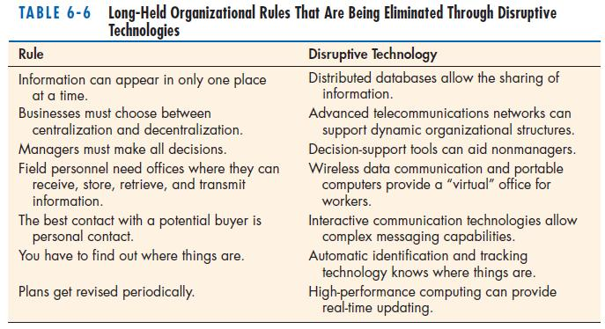
Disruptive Technologies (Cont.)
Chapter 6
Copyright © 2011 Pearson Education, Inc. Publishing as Prentice Hall

Slide 43
Requirements Determination using Agile Methodologies
Continual user involvement
  Replace traditional SDLC waterfall with iterative analyze – design – code – test cycle
Agile usage-centered design
  Focuses on user goals, roles, and tasks
The Planning Game
  Based on eXtreme programming
  Exploration, steering, commitment
Chapter 6
Copyright © 2011 Pearson Education, Inc. Publishing as Prentice Hall

Slide 44
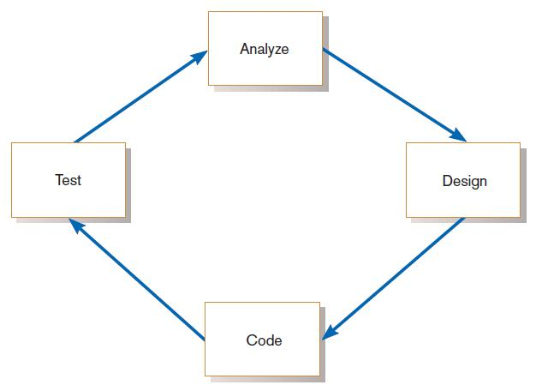
Continual User Involvement
FIGURE 6-11
The iterative analysis–design–code–test cycle
Chapter 6
Copyright © 2011 Pearson Education, Inc. Publishing as Prentice Hall

Slide 45
Agile Usage-Centered Design Steps
Gather group of programmers, analysts, users, testers, facilitator.
Document complaints of current system.
Determine important user roles.
Determine, prioritize, and describe tasks for each user role.
Group similar tasks into interaction contexts.
Associate each interaction context with a user interface for the system, and prototype the interaction context.
Step through and modify the prototype.
Chapter 6
Copyright © 2011 Pearson Education, Inc. Publishing as Prentice Hall

Slide 46
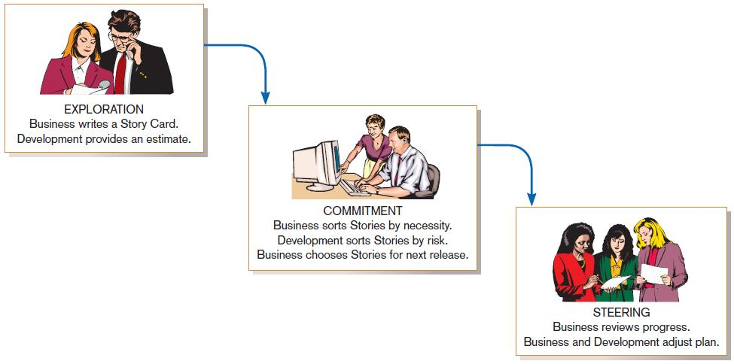
The Planning Game from eXtreme Programming
FIGURE 6-12
eXtreme Programming’s Planning Game
Chapter 6
Copyright © 2011 Pearson Education, Inc. Publishing as Prentice Hall

Slide 47
Electronic Commerce Applications: Determining System Requirements
Determining system requirements for Pine Valley furniture’s Webstore
  System layout and navigation characteristics
  Webstore and site management system capabilities
  Customer and inventory information
  System prototype evolution
Chapter 6
Copyright © 2011 Pearson Education, Inc. Publishing as Prentice Hall

Slide 48
Summary
In this chapter you learned how to:
  Describe interviewing options and develop interview plan.
  Explain advantages and pitfalls of worker observation and document analysis.
  Explain how computing can support requirements determination.
Chapter 6
Copyright © 2011 Pearson Education, Inc. Publishing as Prentice Hall

Slide 49
Summary (Cont.)
  Participate in and help plan Joint Application Design sessions.
  Use prototyping during requirements determination.
  Describe contemporary approaches to requirements determination.
  Understand how requirements determination techniques apply to the development of electronic commerce applications.
Chapter 6
Copyright © 2011 Pearson Education, Inc. Publishing as Prentice Hall

Slide 50

All rights reserved. No part of this publication may be reproduced, stored in a retrieval system, or transmitted, in any form or by any means, electronic, mechanical, photocopying, recording, or otherwise, without the prior written permission of the publisher. Printed in the United States of America.
Copyright © 2011 Pearson Education, Inc.
Publishing as Prentice Hall

