Slide 1
Modern Systems Analysis
and Design
Sixth Edition
Jeffrey A. Hoffer
Joey F. George
Joseph S. Valacich
Chapter 7 Appendix A
Object-Oriented Analysis and Design: Use Cases

Slide 2
Learning Objectives
Explain use cases and use case diagrams and how they can be used to model system functionality.
Discuss process modeling with use cases for electronic commerce application.
Chapter 7 Appendix A
© 2011 Pearson Education, Inc. Publishing as Prentice Hall

Slide 3
Use Cases
Use case is a depiction of a system’s behavior or functionality under various conditions as the system responds to requests from users.
Actor is an external entity that interacts with the system.
Chapter 7 Appendix A
© 2011 Pearson Education, Inc. Publishing as Prentice Hall

Slide 4
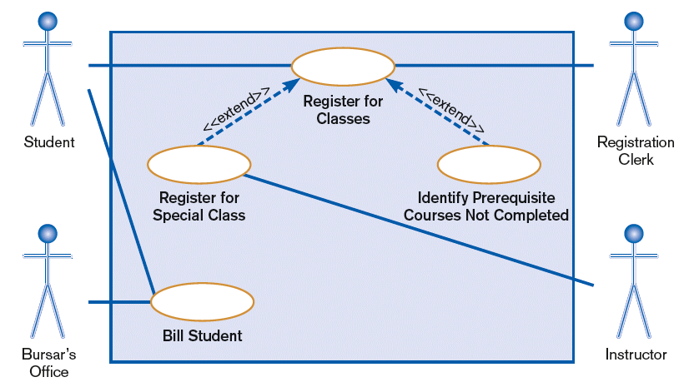
Use Cases (Cont.)
FIGURE 7-26
A use case diagram for a university registration system
Chapter 7 Appendix A
© 2011 Pearson Education, Inc. Publishing as Prentice Hall

Slide 5
Use Cases (Cont.)
Most actors represent user roles, but actors can also be external systems.
An actor is a role, not a specific user; one user may play many roles, and an actor may represent many users.
A use case model consists of actors and use cases.
Chapter 7 Appendix A
© 2011 Pearson Education, Inc. Publishing as Prentice Hall

Slide 6
Use Cases diagrams
Use case diagram: a picture showing system behavior along with the key actors that interact with the system
Abstract use case is when a use case is initiated by another use case.
A use case represents completely functionality.
Chapter 7 Appendix A
© 2011 Pearson Education, Inc. Publishing as Prentice Hall

Slide 7
Definitions and Symbols
Use Case
Actor
Boundary
Connection
Include relationship
Extend relationship
<<include>>
<<extend>>
Chapter 7 Appendix A
© 2011 Pearson Education, Inc. Publishing as Prentice Hall

Slide 8
Definitions and Symbols (Cont.)
Actor is a role, not an individual.
  Involved with the functioning of the system at some basic level
  Represented by stick figures
Use case represents a single system function.
  Represented as an eclipse
Chapter 7 Appendix A
© 2011 Pearson Education, Inc. Publishing as Prentice Hall

Slide 9
Definitions and Symbols (Cont.)
System boundary includes all the relevant use cases.
  A boundary is the dividing line between the system and its environment.
  Use cases are within the boundary.
  Actors are outside of the boundary.
  Represented as a box
Chapter 7 Appendix A
© 2011 Pearson Education, Inc. Publishing as Prentice Hall

Slide 10
Definitions and Symbols (Cont.)
Connection is an association between an actor and a use case.
  Depicts a usage relationship
  Connection does not indicate data flow
  Actors are connected to use cases with lines.
  Use cases are connected to each other with arrows.
Chapter 7 Appendix A
© 2011 Pearson Education, Inc. Publishing as Prentice Hall

Slide 11
Definitions and Symbols (Cont.)
Extend relationship is an association between two use cases where one adds new behaviors or actions to the other.
  Extends a use case by adding new behavior or actions.
  Specialized use case extends the general use case.
Chapter 7 Appendix A
© 2011 Pearson Education, Inc. Publishing as Prentice Hall

Slide 12
Definitions and Symbols (Cont.)
Include relationship is an association between two use cases where one use case uses the functionality contained in the other.
  Indicates a use case that is used (invoked) by another use case.
  Links to general purpose functions, used by many other use cases.
Chapter 7 Appendix A
© 2011 Pearson Education, Inc. Publishing as Prentice Hall

Slide 13
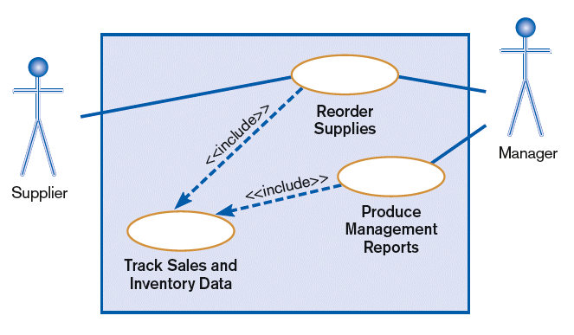
Definitions and Symbols (Cont.)
FIGURE 7-27
A use case diagram featuring an include relationship
Chapter 7 Appendix A
© 2011 Pearson Education, Inc. Publishing as Prentice Hall

Slide 14
Written Use Cases
Document containing detailed specifications for a use case
Contents can be written as simple text or in a specified format
Step-by-step description of what must occur in a successful use case
Chapter 7 Appendix A
© 2011 Pearson Education, Inc. Publishing as Prentice Hall

Slide 15
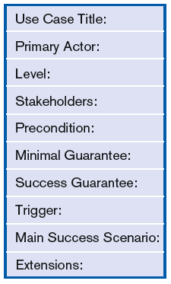
FIGURE 7-29
A template for writing use cases
(Source: Writing Effective Use Cases
by A. Cockburn, © 2001. Adapted by
permission of Pearson Education, Inc.,
Upper Saddle River, NJ 07458.)
Chapter 7 Appendix A
© 2011 Pearson Education, Inc. Publishing as Prentice Hall

Slide 16
Level of Use Case
Refers to degree of detail in the use case description
Five suggested levels (Cockburn)
  White – as seen from clouds
  Kite – “birds-eye view”
  Blue – sea-level view
  Fish – below sea-level
  Black – bottom of the sea
summary
detail
Chapter 7 Appendix A
© 2011 Pearson Education, Inc. Publishing as Prentice Hall

Slide 17
Sample Format for Written Use Case
Title – descriptive name, matches name in use case diagram
Primary actor – usually a user role
Stakeholders – any group or individual with an interest in the function of the use case
Chapter 7 Appendix A
© 2011 Pearson Education, Inc. Publishing as Prentice Hall

Slide 18
Sample Format for Written Use Case (Continued)
Precondition – conditions that must be satisfied in order to execute the use case
Minimal guarantee – outputs that can be expected if the service attempt failed
Success guarantee – outputs that can be expected if the service succeeds
Chapter 7 Appendix A
© 2011 Pearson Education, Inc. Publishing as Prentice Hall

Slide 19
Sample Format for Written Use Case (Continued)
Trigger – an event or action that initiates the use case
Main success scenario – description of sequence of interactions between actor and use case during the use case execution
Extensions – detailed description of how errors are dealt with
Chapter 7 Appendix A
© 2011 Pearson Education, Inc. Publishing as Prentice Hall

Slide 20
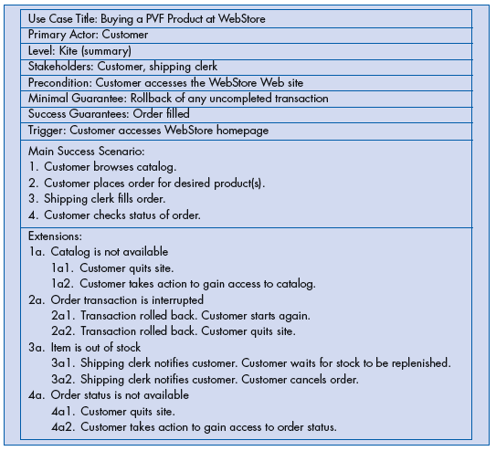
Use case at kite level
Chapter 7 Appendix A
© 2011 Pearson Education, Inc. Publishing as Prentice Hall

Slide 21
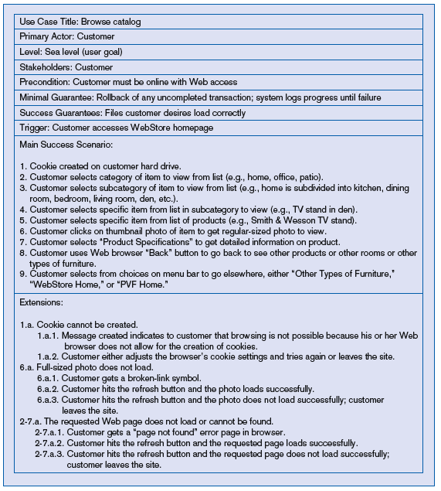
Use case at sea level
Corresponds with Step 1 of kite-level use case
Chapter 7 Appendix A
© 2011 Pearson Education, Inc. Publishing as Prentice Hall

Slide 22
Summary
In Appendix A you learned how to:
Explain use cases and use case diagrams.
Explain how they can be used to model system functionality.
Discuss process modeling with use cases for electronic commerce application.
Chapter 7 Appendix A
© 2011 Pearson Education, Inc. Publishing as Prentice Hall

Slide 23

All rights reserved. No part of this publication may be reproduced, stored in a retrieval system, or transmitted, in any form or by any means, electronic, mechanical, photocopying, recording, or otherwise, without the prior written permission of the publisher. Printed in the United States of America.
Copyright © 2011 Pearson Education, Inc.
Publishing as Prentice Hall

