Slide 1
Modern Systems Analysis
and Design
Sixth Edition
Jeffrey A. Hoffer
Joey F. George
Joseph S. Valacich
Chapter 7 Appendix B
Object-Oriented Analysis and Design: Activity Diagrams

Slide 2
Learning Objectives
Understand how to represent system logic with activity diagrams.
Chapter 7 Appendix B
© 2011 Pearson Education, Inc. Publishing as Prentice Hall

Slide 3
Process Modeling: Activity Diagrams
Activity Diagrams
  Show the conditional logic for the sequence of system activities needed to accomplish a business process.
  Clearly show parallel and alternative behaviors.
  Can be used to show the logic of a use case.
Chapter 7 Appendix B
© 2011 Pearson Education, Inc. Publishing as Prentice Hall

Slide 4
Use Activity Diagrams to:
Depict the flow of control from activity to activity.
Help in use case analysis to understand what actions need to take place.
Help in identifying extensions in a use case.
Model work flow and business processes.
Model the sequential and concurrent steps in a computation process.
Chapter 7 Appendix B
© 2011 Pearson Education, Inc. Publishing as Prentice Hall

Slide 5
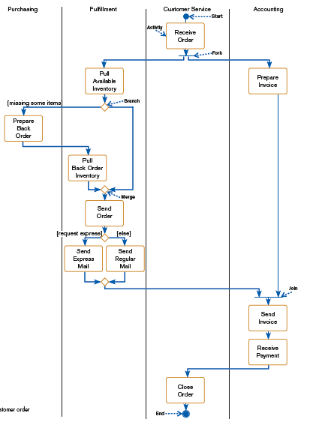
FIGURE 7-36
Activity diagram for a customer order
process
Chapter 7 Appendix B
© 2011 Pearson Education, Inc. Publishing as Prentice Hall

Slide 6
Process Modeling: Activity Diagrams (Cont.)
Elements of Activity Diagrams:
  Activity: a behavior that an object carries out while in a particular state
  Transition: a movement from one activity or state to another
  Branch: a diamond symbol containing a condition whose results provide transitions to different paths of activities
Chapter 7 Appendix B
© 2011 Pearson Education, Inc. Publishing as Prentice Hall

Slide 7
Process Modeling: Activity Diagrams (Cont.)
  Synchronization bar: horizontal or vertical bars denoting parallel or concurrent paths of activities
    Fork: the beginning of parallel activities
    Join: the end of parallel activities
  Swimlanes: columns representing different organizational units of the system
Chapter 7 Appendix B
© 2011 Pearson Education, Inc. Publishing as Prentice Hall

Slide 8
Summary
In this appendix you learned how to:
Understand how to represent system logic with activity diagrams.
Chapter 7 Appendix B
© 2011 Pearson Education, Inc. Publishing as Prentice Hall

Slide 9

All rights reserved. No part of this publication may be reproduced, stored in a retrieval system, or transmitted, in any form or by any means, electronic, mechanical, photocopying, recording, or otherwise, without the prior written permission of the publisher. Printed in the United States of America.
Copyright © 2011 Pearson Education, Inc.
Publishing as Prentice Hall

