Slide 1
Modern Systems Analysis
and Design
Sixth Edition
Jeffrey A. Hoffer
Joey F. George
Joseph S. Valacich
Chapter 7 Appendix C
Object-Oriented Analysis and Design: Sequence Diagrams

Slide 2
Learning Objectives
Understand how to represent system logic with sequence diagrams.
Chapter 7 Appendix C
© 2011 Pearson Education, Inc. Publishing as Prentice Hall

Slide 3
Dynamic Modeling: Sequence Diagrams
Sequence diagram: depicts the interactions among objects during a certain period of time
  May be presented either in a generic form or in an instance form.
  Generic form shows all possible sequences of interactions – sequences corresponding to all the scenarios of a use case.
  Instance form shows the sequence for only one scenario.
Chapter 7 Appendix C
© 2011 Pearson Education, Inc. Publishing as Prentice Hall

Slide 4
Dynamic Modeling: Sequence Diagrams (Cont.)
Elements of a sequence diagram
  Objects: represented by boxes at top of diagram
  Lifeline: the time during which an object exists
  Messages: means by which objects communicate with each other
Chapter 7 Appendix C
© 2011 Pearson Education, Inc. Publishing as Prentice Hall

Slide 5
Dynamic Modeling: Sequence Diagrams (Cont.)
Activation: the time period during which an object performs an operation
Synchronous message: a type of message in which the caller has to wait for the receiving object to finish executing the called operation before it can resume execution itself
Chapter 7 Appendix C
© 2011 Pearson Education, Inc. Publishing as Prentice Hall

Slide 6
Dynamic Modeling: Sequence Diagrams (Cont.)
Simple message: a message that transfers control from the sender to the recipient without describing the details of the communication
Asynchronous message: a message in which the sender does not have to wait for the recipient to handle the message
Chapter 7 Appendix C
© 2011 Pearson Education, Inc. Publishing as Prentice Hall

Slide 7
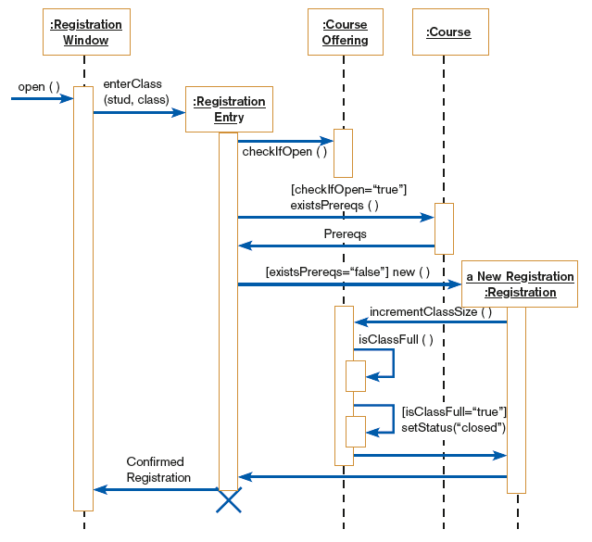
FIGURE 7-38
Sequence diagram for a class registration scenario without prerequisites
Chapter 7 Appendix C
© 2011 Pearson Education, Inc. Publishing as Prentice Hall

Slide 8
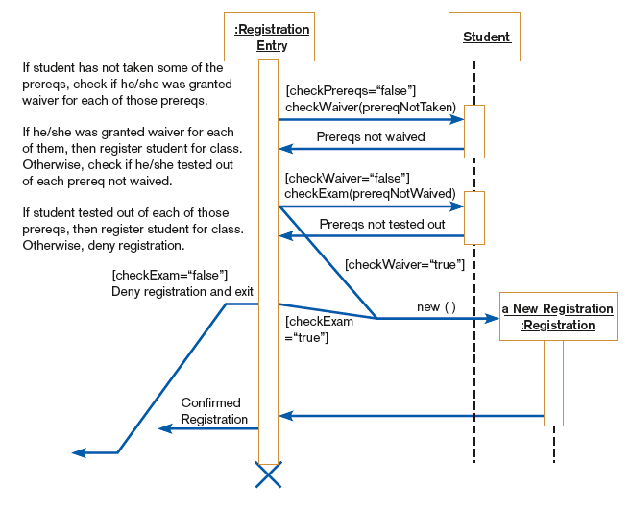
FIGURE 7-39
A generic sequence diagram for the prereq courses not completed use case
Chapter 7 Appendix C
© 2011 Pearson Education, Inc. Publishing as Prentice Hall

Slide 9
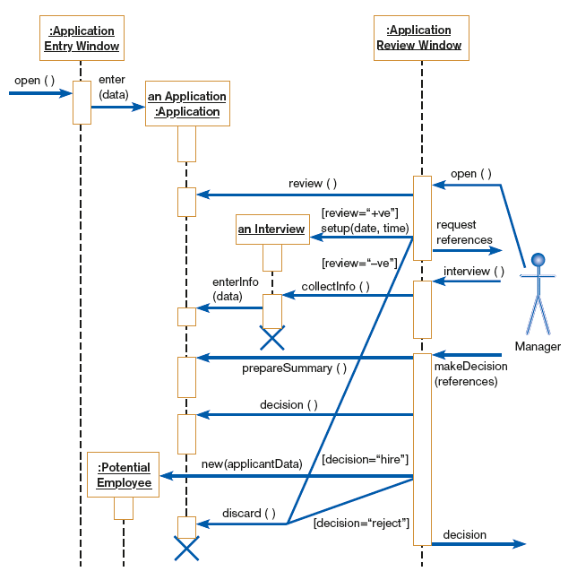
FIGURE 7-40
Sequence diagram for Hoosier Burger’s Hire employee use case
Chapter 7 Appendix C
© 2011 Pearson Education, Inc. Publishing as Prentice Hall

Slide 10
Summary
In this appendix you learned how to:
Understand how to represent system logic with sequence diagrams.
Chapter 7 Appendix C
© 2011 Pearson Education, Inc. Publishing as Prentice Hall

Slide 11

All rights reserved. No part of this publication may be reproduced, stored in a retrieval system, or transmitted, in any form or by any means, electronic, mechanical, photocopying, recording, or otherwise, without the prior written permission of the publisher. Printed in the United States of America.
Copyright © 2011 Pearson Education, Inc.
Publishing as Prentice Hall

