Slide 1
Modern Systems Analysis
and Design
Sixth Edition
Jeffrey A. Hoffer
Joey F. George
Joseph S. Valacich
Chapter 10
Designing Forms and Reports

Slide 2
Learning Objectives
Explain the process of designing forms and reports and the deliverables for their creation.
Apply the general guidelines for formatting forms and reports.
Use color and know when color improves the usability of information.
Format text, tables, and lists effectively.
Chapter 10
© 2011 Pearson Education, Inc. Publishing as Prentice Hall

Slide 3
Learning Objectives (Cont.)
Explain how to assess usability and describe how variations in users, tasks, technology, and environmental characteristics influence the usability of forms and reports.
Discuss guidelines for the design of forms and reports for Internet-based electronic commerce systems.
Chapter 10
© 2011 Pearson Education, Inc. Publishing as Prentice Hall

Slide 4
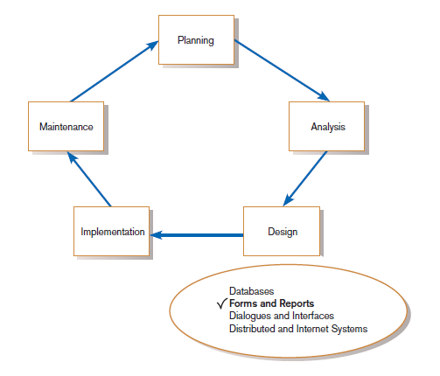
Designing Forms and Reports
FIGURE 10-1
Systems development life cycle with logical design phase highlighted
Chapter 10
© 2011 Pearson Education, Inc. Publishing as Prentice Hall

Slide 5
Designing Forms and Reports (Cont.)
Form: a business document that contains some predefined data and may include some areas where additional data are to be filled in
  An instance of a form is typically based on one database record.
Chapter 10
© 2011 Pearson Education, Inc. Publishing as Prentice Hall

Slide 6
Designing Forms and Reports (Cont.)
Report: a business document that contains only predefined data
  It is a passive document used solely for reading or viewing data.
A report typically contains data from many unrelated records or transactions.
Chapter 10
© 2011 Pearson Education, Inc. Publishing as Prentice Hall

Slide 7
Designing Forms and Reports (Cont.)
Common Types of Reports:
  Scheduled: produced at predefined time intervals for routine information needs
  Key-indicator: provides summary of critical information on regular basis
  Exception: highlights data outside of normal operating ranges
  Drill-down: provides details behind summary of key-indicator or exception reports
  Ad-hoc: responds to unplanned requests for non-routine information needs
Chapter 10
© 2011 Pearson Education, Inc. Publishing as Prentice Hall

Slide 8
The Process of Designing Forms and Reports
Is user-focused activity.
Follows a prototyping approach.
First steps are to gain an understanding of the intended user and task objectives by collecting initial requirements during requirements determination.
Chapter 10
© 2011 Pearson Education, Inc. Publishing as Prentice Hall

Slide 9
The Process of Designing Forms and Reports
Requirements determination:
  Who will use the form or report?
  What is the purpose of the form or report?
  When is the report needed or used?
  Where does the form or report need to be delivered and used?
  How many people need to use or view the form or report?
Chapter 10
© 2011 Pearson Education, Inc. Publishing as Prentice Hall

Slide 10
The Process of Designing Forms and Reports (Cont.)
Prototyping
  Initial prototype is designed from requirements.
  Users review prototype design and either accept the design or request changes.
  If changes are requested, the construction-evaluation-refinement cycle is repeated until the design is accepted.
Chapter 10
© 2011 Pearson Education, Inc. Publishing as Prentice Hall

Slide 11
The Process of Designing Forms and Reports (Cont.)
A coding sheet is an “old” tool for designing forms and reports, usually associated with text-based forms and reports for mainframe applications.
Visual Basic and other development tools provide computer aided GUI form and report generation.
Chapter 10
© 2011 Pearson Education, Inc. Publishing as Prentice Hall

Slide 12
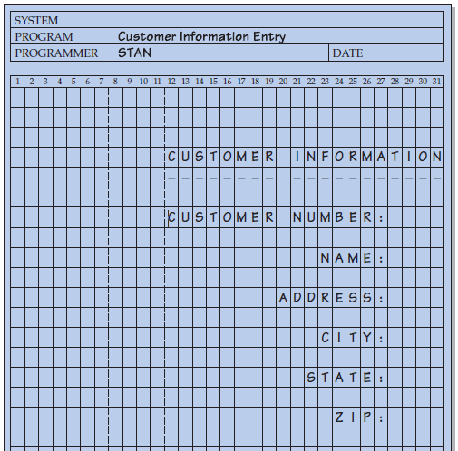
The Process of Designing Forms and Reports (Cont.)
FIGURE 10-2
The layout of a data input form
using a coding sheet
Chapter 10
© 2011 Pearson Education, Inc. Publishing as Prentice Hall

Slide 13
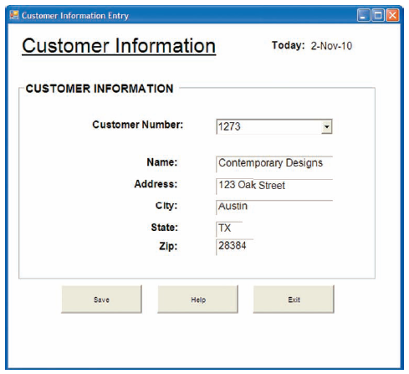
The Process of Designing Forms and Reports (Cont.)
FIGURE 10-3
A data input screen designed in
Microsoft’s Visual Basic .NET
Chapter 10
© 2011 Pearson Education, Inc. Publishing as Prentice Hall

Slide 14
Deliverables and Outcomes
Design specifications are the major deliverables and inputs to the system implementation phase.
Chapter 10
© 2011 Pearson Education, Inc. Publishing as Prentice Hall

Slide 15
Deliverables and Outcomes (Cont.)
Design specifications have three sections:
  Narrative overview: characterizes users, tasks, system, and environmental factors
  Sample design: image of the form (from coding sheet or form building development tool)
  Testing and usability assessment: measuring test/usability results (consistency, sufficiency, accuracy, etc.)
Chapter 10
© 2011 Pearson Education, Inc. Publishing as Prentice Hall

Slide 16
Formatting Forms and Reports
Meaningful titles — use clear, specific, version information, and current date
Meaningful information — include only necessary information, with no need to modify
Chapter 10
© 2011 Pearson Education, Inc. Publishing as Prentice Hall

Slide 17
Formatting Forms and Reports (Cont.)
Balanced layout — use adequate spacing, margins, and clear labels
Easy navigation system — show how to move forward and backward, and where you are currently
Chapter 10
© 2011 Pearson Education, Inc. Publishing as Prentice Hall

Slide 18
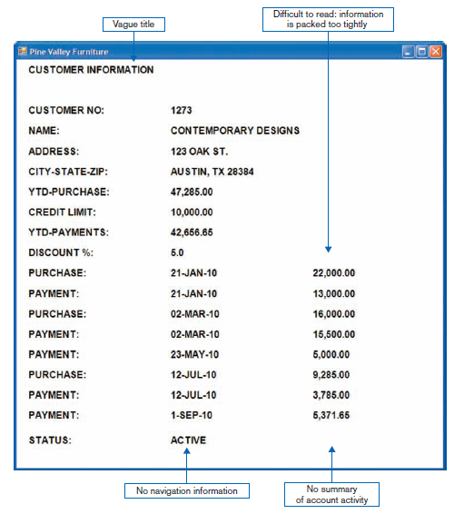
Formatting Forms and Reports (Cont.)
FIGURE 10-5
Contrasting customer information forms
(Pine Valley Furniture)
(a) Poorly designed form
Chapter 10
© 2011 Pearson Education, Inc. Publishing as Prentice Hall

Slide 19
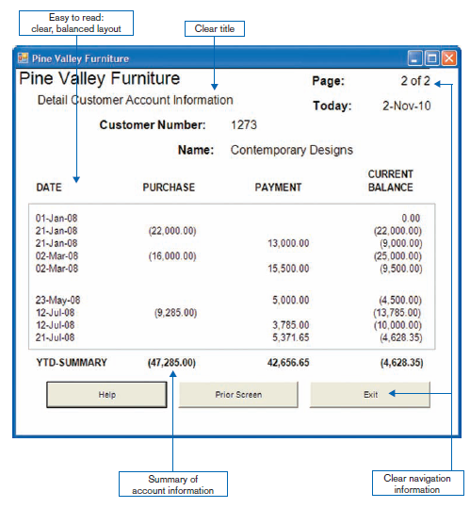
Formatting Forms and Reports (Cont.)
FIGURE 10-5 (continued)
(b) Improved design for form
Chapter 10
© 2011 Pearson Education, Inc. Publishing as Prentice Hall

Slide 20
Highlighting Information
Notify users of errors in data entry or processing.
Provide warnings regarding possible problems.
Draw attention to keywords, commands, high-priority messages, unusual data values.
Chapter 10
© 2011 Pearson Education, Inc. Publishing as Prentice Hall

Slide 21
Highlighting Information (Cont.)
Highlighting can include use of
  upper case
  bold
  italics
  underlining
  boxing
  size and color differences
  all capital letters
  blinking
  reverse video
  audible tones
  intensity differences
  offsetting nonstandard information
Chapter 10
© 2011 Pearson Education, Inc. Publishing as Prentice Hall

Slide 22
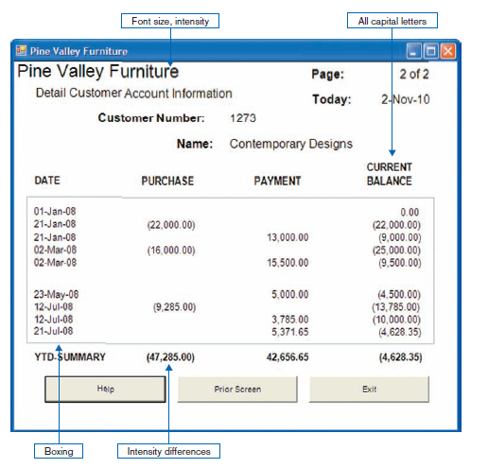
Highlighting Information (Cont.)
FIGURE 10-6
Customer account status display using various highlighting techniques
(Pine Valley Furniture)
Chapter 10
© 2011 Pearson Education, Inc. Publishing as Prentice Hall

Slide 23
Color vs. No Color
Benefits of Using Color
  Soothes or strikes the eye.
  Accents an uninteresting display.
  Facilitates subtle discriminations in complex displays.
  Emphasizes the logical organization of information.
  Draws attention to warnings.
  Evokes more emotional reactions.
Chapter 10
© 2011 Pearson Education, Inc. Publishing as Prentice Hall

Slide 24
Color vs. No Color (Cont.)
Problems from Using Color
  Color pairings may wash out or cause problems for some users.
  Resolution may degrade with different displays.
  Color fidelity may degrade on different displays.
  Printing or conversion to other media may not easily translate.
Chapter 10
© 2011 Pearson Education, Inc. Publishing as Prentice Hall

Slide 25
Displaying Text
Case: mixed upper and lower case, use conventional punctuation
Spacing: double spacing if possible, otherwise blank lines between paragraphs
Justification: left justify text, ragged right margins
Hyphenation: no hyphenated words between lines
Abbreviations: only when widely understood and significantly shorter than full text
Chapter 10
© 2011 Pearson Education, Inc. Publishing as Prentice Hall

Slide 26
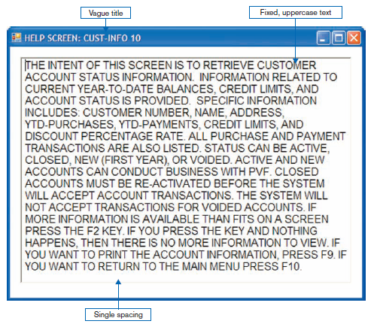
Displaying Text (Cont.)
FIGURE 10-7
Contrasting the display of textual help information
(a) Poorly designed help screen with many violations of the general guidelines for displaying text
Chapter 10
© 2011 Pearson Education, Inc. Publishing as Prentice Hall

Slide 27
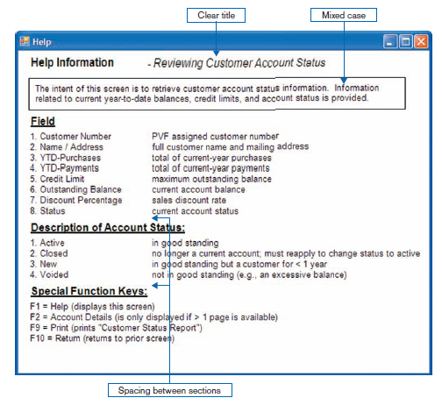
Displaying Text (Cont.)
FIGURE 10-7 (continued)
(b) An improved design for a help screen
Chapter 10
© 2011 Pearson Education, Inc. Publishing as Prentice Hall

Slide 28
Designing Tables and Lists
Labels
  All columns and rows should have meaningful labels.
  Labels should be separated from other information by using highlighting.
  Redisplay labels when the data extend beyond a single screen or page.
Chapter 10
© 2011 Pearson Education, Inc. Publishing as Prentice Hall

Slide 29
Designing Tables and Lists (Cont.)
Formatting columns, rows and text:
  Sort in a meaningful order.
  Place a blank line between every five rows in long columns.
  Similar information displayed in multiple columns should be sorted vertically.
  Columns should have at least two spaces between them.
Chapter 10
© 2011 Pearson Education, Inc. Publishing as Prentice Hall

Slide 30
Designing Tables and Lists (Cont.)
  Allow white space on printed reports for user to write notes.
  Use a single typeface, except for emphasis.
  Use same family of typefaces within and across displays and reports.
  Avoid overly fancy fonts.
Chapter 10
© 2011 Pearson Education, Inc. Publishing as Prentice Hall

Slide 31
Designing Tables and Lists (Cont.)
Formatting numeric, textual and alphanumeric data:
  Right justify numeric data and align columns by decimal points or other delimiter.
  Left justify textual data. Use short line length, usually 30 to 40 characters per line.
  Break long sequences of alphanumeric data into small groups of three to four characters each.
Chapter 10
© 2011 Pearson Education, Inc. Publishing as Prentice Hall

Slide 32
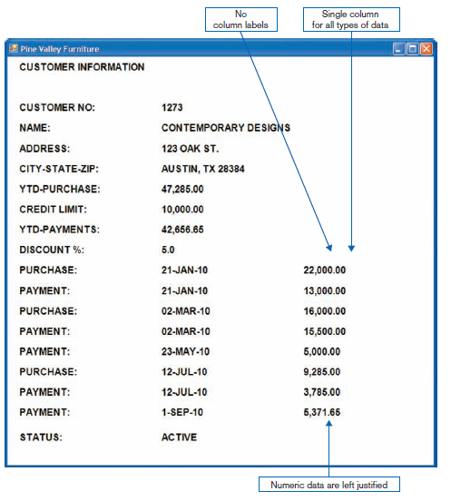
Designing Tables and Lists (Cont.)
FIGURE 10-8
Contrasting the display of tables and lists (Pine Valley Furniture)
(a) Poorly designed form
Chapter 10
© 2011 Pearson Education, Inc. Publishing as Prentice Hall

Slide 33
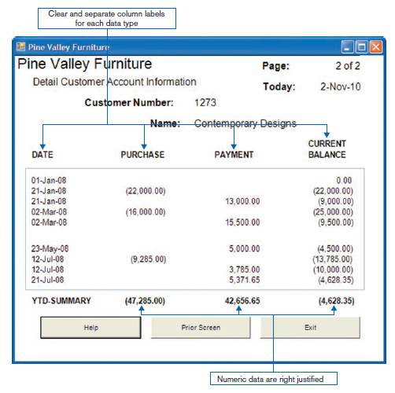
Designing Tables and Lists (Cont.)
FIGURE 10-8 (continued)
(b) Improved design for form
Chapter 10
© 2011 Pearson Education, Inc. Publishing as Prentice Hall

Slide 34
Designing Tables and Lists (Cont.)
Use tables for reading individual data values.
Use graphs for:
  Providing quick summary.
  Displaying trends over time.
  Comparing points and patterns of variables.
  Forecasting activity.
  Simple reporting of vast quantities of information.
Chapter 10
© 2011 Pearson Education, Inc. Publishing as Prentice Hall

Slide 35
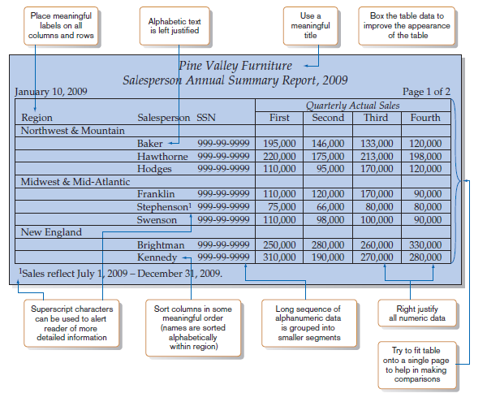
Designing Tables and Lists (Cont.)
FIGURE 10-9
Tabular report illustrating numerous design guidelines
(Pine Valley Furniture)
Chapter 10
© 2011 Pearson Education, Inc. Publishing as Prentice Hall

Slide 36
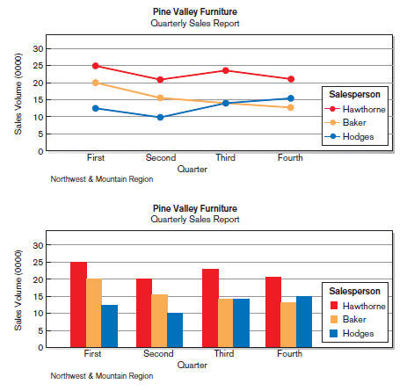
Designing Tables and Lists (Cont.)
FIGURE 10-10
Graphs for comparison
(a) Line graph
(b) Bar graph
Chapter 10
© 2011 Pearson Education, Inc. Publishing as Prentice Hall

Slide 37
Assessing Usability
Objective for designing forms, reports and all human-computer interactions is usability.
There are three characteristics:
  Speed — Can you complete a task efficiently?
  Accuracy — Does the output provide what you expect?
  Satisfaction — Do you like using the output?
Chapter 10
© 2011 Pearson Education, Inc. Publishing as Prentice Hall

Slide 38
Assessing Usability (Cont.)
Usability: an overall evaluation of how a system performs in supporting a particular user for a particular task.
Chapter 10
© 2011 Pearson Education, Inc. Publishing as Prentice Hall

Slide 39
Usability Success Factors
Consistency — of terminology, formatting, titles, navigation, response time
Efficiency — minimize required user actions.
Ease — self-explanatory outputs and labels.
Format — appropriate display of data and symbols.
Flexibility — maximize user options for data input according to preference.
Chapter 10
© 2011 Pearson Education, Inc. Publishing as Prentice Hall

Slide 40
Usability Success Factors (Cont.)
Characteristics for consideration:
  User: experience, skills, motivation, education, personality
  Task: time pressure, cost of errors, work durations
  System: platform
  Environment: social and physical issues
Chapter 10
© 2011 Pearson Education, Inc. Publishing as Prentice Hall

Slide 41
Measures of Usability
Time to learn
Speed of performance
Rate of errors
Retention over time
Subjective satisfaction
Layout of information should be consistent, both within and across applications
Chapter 10
© 2011 Pearson Education, Inc. Publishing as Prentice Hall

Slide 42
Measures of Usability (Cont.)
Layout of information should be consistent both within and across applications, whether information is delivered on screen display or on a hard-copy report.
Chapter 10
© 2011 Pearson Education, Inc. Publishing as Prentice Hall

Slide 43
Electronic Commerce Application: Designing Forms and Reports for Pine Valley Furniture Web Store
General guidelines for rapid deployment of Internet Web sites have resulted
Three possible solutions to the problem:
  Make it possible to design reasonably usable sites without having UI experience.
  Train more people in good Web design.
  Live with poorly designed sites that are hard to use.
Chapter 10
© 2011 Pearson Education, Inc. Publishing as Prentice Hall

Slide 44
Designing Forms and Reports at Pine Valley Furniture
PVF established the following guidelines:
  Use lightweight graphics.
  Establish forms and data integrity rules.
  Use template-based HTML.
Chapter 10
© 2011 Pearson Education, Inc. Publishing as Prentice Hall

Slide 45
Lightweight Graphics
Lightweight Graphics: the use of small, simple images to allow a Web page to more quickly be displayed
  Quick image download
  Quick feedback from the Web site will help to keep customers at the PVF WebStore longer
Chapter 10
© 2011 Pearson Education, Inc. Publishing as Prentice Hall

Slide 46
Forms and Data Integrity Rules
All forms that request information should be clearly labeled and provide adequate room for input.
Specific fields requiring specific information must provide a clear example.
Must designate which fields are optional, required, and which have a range of values.
Chapter 10
© 2011 Pearson Education, Inc. Publishing as Prentice Hall

Slide 47
Template-Based HTML
Template-based HTML: templates to display and process common attributes of higher-level, more abstract items
  Creates an interface that is very easy to maintain
  Advantageous to have a “few” templates that could be used for entire product line
  Not every product needs its own page
Chapter 10
© 2011 Pearson Education, Inc. Publishing as Prentice Hall

Slide 48
Summary
In this chapter you learned how to:
Explain the process of designing forms and reports and the deliverables for their creation.
Apply the general guidelines for formatting forms and reports.
Use color and know when color improves the usability of information.
Chapter 10
© 2011 Pearson Education, Inc. Publishing as Prentice Hall

Slide 49
Summary (Cont.)
Format text, tables, and lists effectively.
Explain how to assess usability and describe how variations in users, tasks, technology, and environmental characteristics influence the usability of forms and reports.
Discuss guidelines for the design of forms and reports for Internet-based electronic commerce systems.
Chapter 10
© 2011 Pearson Education, Inc. Publishing as Prentice Hall

Slide 50

All rights reserved. No part of this publication may be reproduced, stored in a retrieval system, or transmitted, in any form or by any means, electronic, mechanical, photocopying, recording, or otherwise, without the prior written permission of the publisher. Printed in the United States of America.
Copyright © 2011 Pearson Education, Inc.
Publishing as Prentice Hall

