Slide 1
Modern Systems Analysis
and Design
Sixth Edition
Jeffrey A. Hoffer
Joey F. George
Joseph S. Valacich
Chapter 12
Designing Distributed and Internet Systems

Slide 2
Learning Objectives
Define the key terms client/server architecture, local area network LAN, distributed database, and middleware.
Distinguish between file server and client/server environments and contrast how each is used in a LAN.
Describe alternative designs for distributed systems and their trade-offs.
Describe how standards shape the design of Internet-based systems.
Chapter 12
© 2011 Pearson Education, Inc. Publishing as Prentice Hall

Slide 3
Learning Objectives (Cont.)
Describe options for ensuring Internet design consistency.
Describe how site management issues can influence customer loyalty and trustworthiness as well as system security.
Discuss issues related to managing online data, including context development, online transaction processing (OLTP), online analytical processing (OLAP), and data warehousing.
Chapter 12
© 2011 Pearson Education, Inc. Publishing as Prentice Hall

Slide 4
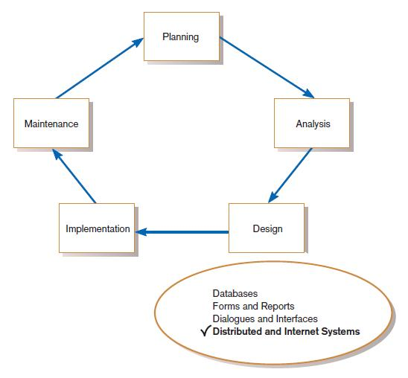
Designing Distributed and Internet Systems
FIGURE 12-1
Systems development life cycle (SDLC)
Chapter 12
© 2011 Pearson Education, Inc. Publishing as Prentice Hall

Slide 5
The Process of Designing Distributed and Internet Systems
Is similar to designing single-location systems.
Due to multi-location deployment, numerous design issues must be considered.
There is more opportunity for failure due to number of components.
Main issues involve ensuring reliability, availability, survivability, performance.
Chapter 12
© 2011 Pearson Education, Inc. Publishing as Prentice Hall

Slide 6
Deliverables and Outcome
Document that consolidates system design information:
  Description of each site.
  Description of data usage for each site.
  Description of business process for each site.
  Contrasts of alternative IS architectures for site, data and processing needs of each site.
Chapter 12
© 2011 Pearson Education, Inc. Publishing as Prentice Hall

Slide 7
Designing Distributed Systems
Distributed systems use:
  LAN-based file server architecture.
  Client/server architecture.
Chapter 12
© 2011 Pearson Education, Inc. Publishing as Prentice Hall

Slide 8
Designing Systems for
Local Area Networks (LANs)
LAN: the cabling, hardware, and software used to connect workstations, computers, and file servers located in a confined geographical area
  Typically within one building or campus
Chapter 12
© 2011 Pearson Education, Inc. Publishing as Prentice Hall

Slide 9
File Servers
File server: a device that manages file operations and is shared by each client PC attached to a LAN
Chapter 12
© 2011 Pearson Education, Inc. Publishing as Prentice Hall

Slide 10
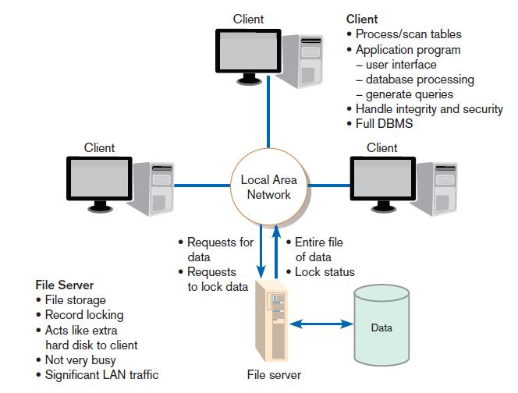
FIGURE 12-3
File server model
Chapter 12
© 2011 Pearson Education, Inc. Publishing as Prentice Hall

Slide 11
Limitations of File Servers
Excessive data movement
  Entire data tables must be transferred instead of individual records.
Need for powerful client workstations
  Each client workstation must devote memory to a full DBMS.
Decentralized data control
  Complicates record concurrency control, recovery, and security.
Chapter 12
© 2011 Pearson Education, Inc. Publishing as Prentice Hall

Slide 12
Designing Systems for a Client/Server Architecture
Client/server architecture: a LAN-based computing environment in which central database server or engine performs all database commands sent to it from client workstations, and application programs on each client concentrate on user interface functions
Chapter 12
© 2011 Pearson Education, Inc. Publishing as Prentice Hall

Slide 13
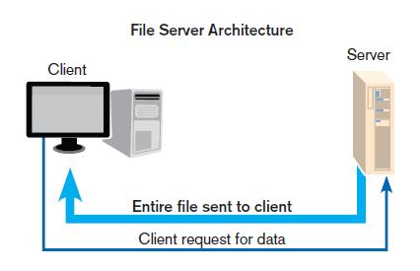
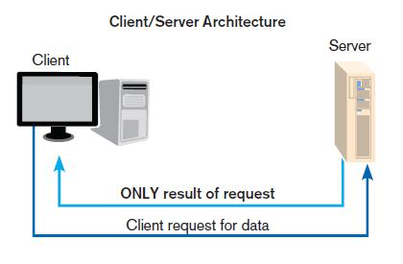
File Server vs. Client/Server
Chapter 12
© 2011 Pearson Education, Inc. Publishing as Prentice Hall

Slide 14
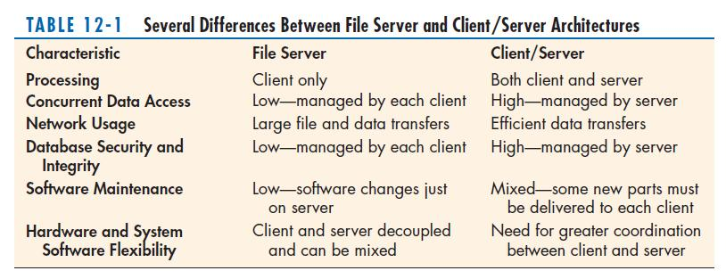
File Server vs. Client/Server (cont.)
Chapter 12
© 2011 Pearson Education, Inc. Publishing as Prentice Hall

Slide 15
Designing Systems for a Client/Server Architecture
Application processing is divided between client and server.
Client manages the user interface.
Database server is responsible for data storage and query processing.
Chapter 12
© 2011 Pearson Education, Inc. Publishing as Prentice Hall

Slide 16
Designing Systems for a Client/Server Architecture (Cont.)
Database engine: the (back-end) portion of the client/server database system running on the server that provides database processing and shared access functions
Chapter 12
© 2011 Pearson Education, Inc. Publishing as Prentice Hall

Slide 17
Designing Systems for a Client/Server Architecture (Cont.)
Client: the (front-end) portion of the client/server database system that provides the user interface and data manipulation functions
Chapter 12
© 2011 Pearson Education, Inc. Publishing as Prentice Hall

Slide 18
Designing Systems for a Client/Server Architecture (Cont.)
Application program interface (API): software building blocks that are used to ensure that common system capabilities, such as user interfaces and printing, as well as modules are standardized to facilitate data exchange between clients and servers
  Common API interface can be used by any kind of DBMS (MySQL, Sybase, or Oracle)
Chapter 12
© 2011 Pearson Education, Inc. Publishing as Prentice Hall

Slide 19
Client/Server Advantages and Cautions
Advantages
  Leverages benefits of microcomputer technology
  Processing performed close to data source
    Improves response time
    Reduces network traffic
  Facilitates use of GUIs
  Encourages acceptance of open systems
Chapter 12
© 2011 Pearson Education, Inc. Publishing as Prentice Hall

Slide 20
Client/Server Advantages and Cautions
Cautions
  Difficult migration from file server to client/server
  Compatibility issues
  Limited system design and performance monitoring tools
Chapter 12
© 2011 Pearson Education, Inc. Publishing as Prentice Hall

Slide 21
Advanced Forms of Client/Server Architectures
Application server: a computing server where data analysis functions primarily reside
Three-tiered client/server: advanced client/server architectures in which there are three logical and distinct applications – data management, presentation, and analysis – that are combined to create a single information system
Chapter 12
© 2011 Pearson Education, Inc. Publishing as Prentice Hall

Slide 22
Advanced Forms of Client/Server Architectures (Cont.)
Middleware: a combination of hardware, software, and communication technologies that bring data management, presentation, and analysis together into a three-tiered client/server environment.
Chapter 12
© 2011 Pearson Education, Inc. Publishing as Prentice Hall

Slide 23
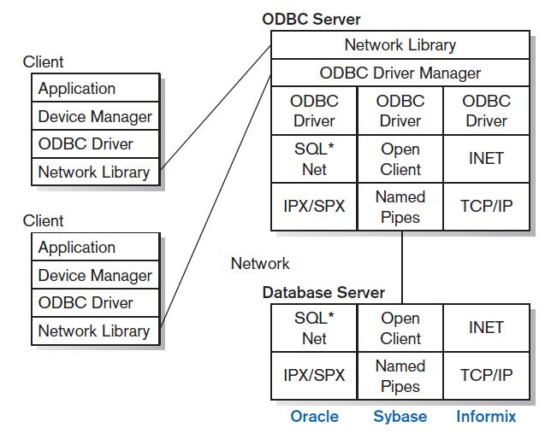
Middleware Environments
FIGURE 12-6
ODBC middleware environment
Chapter 12
© 2011 Pearson Education, Inc. Publishing as Prentice Hall

Slide 24
Advanced Forms of Client/Server Architectures (Cont.)
Applications can be partitioned in a way that best fits the organizational computing need
Easier customization: application code resides on application server, so change done only in one place
Easier maintenance: data analysis is separate from user interface, so changing one can be done independently of the other
Chapter 12
© 2011 Pearson Education, Inc. Publishing as Prentice Hall

Slide 25
Approaches to Designing Client/Server Architectures
Distributed Presentation
Remote Presentation
Remote Data Management
Distributed Function
Distributed Database
Distributed Processing
Chapter 12
© 2011 Pearson Education, Inc. Publishing as Prentice Hall

Slide 26
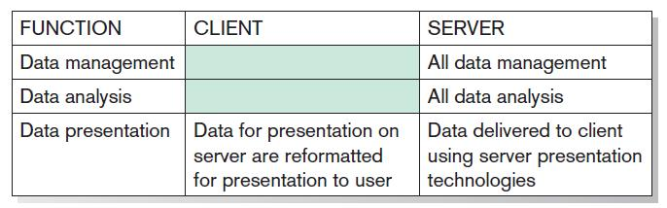
Distributed Presentation
Chapter 12
© 2011 Pearson Education, Inc. Publishing as Prentice Hall

Slide 27
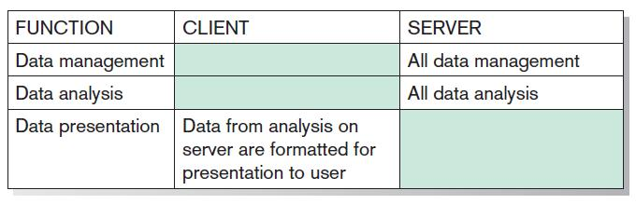
Remote Presentation
Chapter 12
© 2011 Pearson Education, Inc. Publishing as Prentice Hall

Slide 28
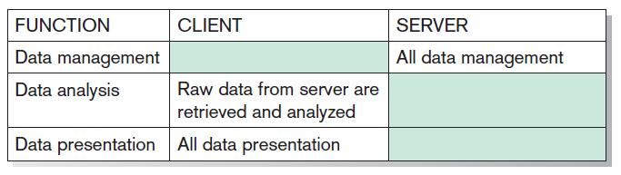
Remote Data Management
Chapter 12
© 2011 Pearson Education, Inc. Publishing as Prentice Hall

Slide 29
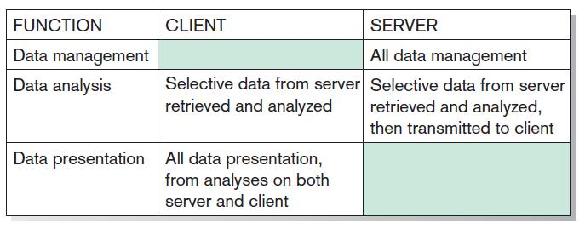
Distributed Function
Chapter 12
© 2011 Pearson Education, Inc. Publishing as Prentice Hall

Slide 30
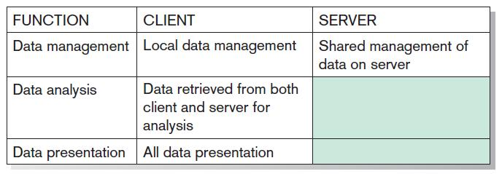
Distributed Database
Chapter 12
© 2011 Pearson Education, Inc. Publishing as Prentice Hall

Slide 31
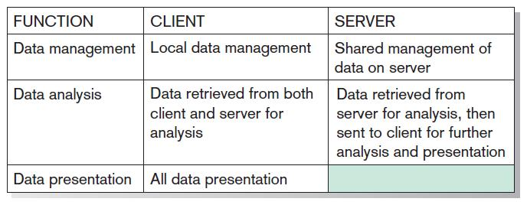
Distributed Processing
Chapter 12
© 2011 Pearson Education, Inc. Publishing as Prentice Hall

Slide 32
Designing Internet Systems
Most new system development focuses on Internet-base applications (for internal processing, business-to-business, and business-to-consumer).
Main design issues: standards, separating content from display, future evolution, site consistency, site management and online data management
Chapter 12
© 2011 Pearson Education, Inc. Publishing as Prentice Hall

Slide 33
Standards Drive the Internet
Internet design is simpler than client/server due to proliferation of standards.
Chapter 12
© 2011 Pearson Education, Inc. Publishing as Prentice Hall

Slide 34
Standards Drive the Internet (Cont.)
Types of Standards:
  Domain naming (BIND): a method for translating domain names into Internet Protocol (IP) addresses
    “B” refers to Berkeley, Ca. where first developed.
    See www.isc.org/products/BIND/bind-history.html
  Hypertext Transfer Protocol (HTTP): a communication protocol for exchanging information on the Internet
  Hypertext Markup Language (HTML): the standard language for representing content on the Web via command tags
Chapter 12
© 2011 Pearson Education, Inc. Publishing as Prentice Hall

Slide 35
Separating Content and Display
HTML has limitations due to format orientation of tags.
eXtensible Markup Language (XML): an Internet-authoring language that allows designers to create customized tags, enabling the definition, transmission, validation, and interpretation of data between applications
Chapter 12
© 2011 Pearson Education, Inc. Publishing as Prentice Hall

Slide 36
Future Evolution
Thin client: a client device designed so that most processing and data storage occur on the server
Use of wireless mobile devices
  Wireless Access Protocol (WAP): a wireless version of HTTP
  Wireless Markup Language (WML): a wireless version of HTML
Chapter 12
© 2011 Pearson Education, Inc. Publishing as Prentice Hall

Slide 37
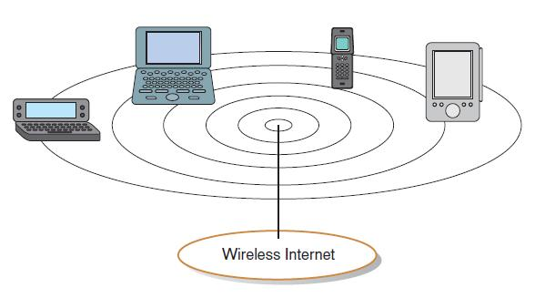
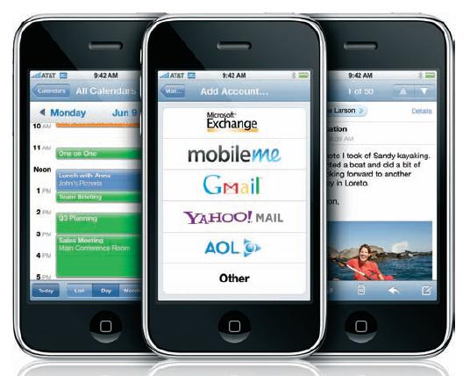
FIGURE 12-8
Thin clients used to access the Internet
FIGURE 12-9
Thin clients typically have a limited
screen size
Chapter 12
© 2011 Pearson Education, Inc. Publishing as Prentice Hall

Slide 38
Site Consistency
Professionalism requires a consistent look-and-feel across all pages of a Web site.
Cascading Style Sheets (CSSs): a set of style rules that tells a Web browser how to present a document
Chapter 12
© 2011 Pearson Education, Inc. Publishing as Prentice Hall

Slide 39
Site Consistency (Cont.)
eXtensible Style Language (XSL): a specification for separating style from content when generating HTML documents
  Methods for transforming XML documents into a generic comprehensive form
  Methods for formatting the generic comprehensive form into a device-specific form
Chapter 12
© 2011 Pearson Education, Inc. Publishing as Prentice Hall

Slide 40
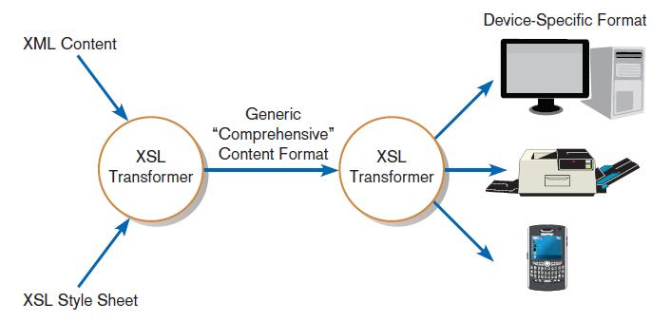
FIGURE 12-11
Combining XML data with XSL style sheet
to format content
Chapter 12
© 2011 Pearson Education, Inc. Publishing as Prentice Hall

Slide 41
Other Site Consistency Issues
Two key issues should be considered:
  Use unique titles.
  Choose words carefully.
Major problem is users do not know where they are going when they follow a hyperlink.
  You should have link titles to explain hyperlinks.
Chapter 12
© 2011 Pearson Education, Inc. Publishing as Prentice Hall

Slide 42
Design Issues Related to Site Management
Customer Loyalty and Trustworthiness
  Design quality
  Up-front disclosure
  Comprehensive, correct, and current content
  Connected to the rest of the Web
Chapter 12
© 2011 Pearson Education, Inc. Publishing as Prentice Hall

Slide 43
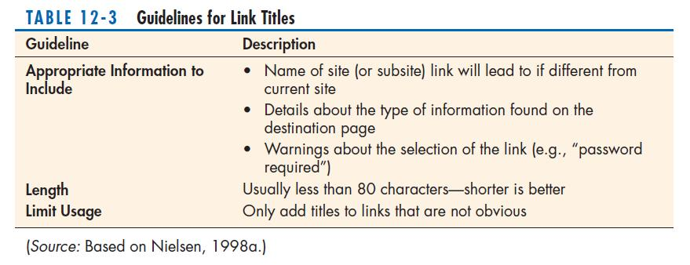
Link Titles
Chapter 12
© 2011 Pearson Education, Inc. Publishing as Prentice Hall

Slide 44
Customer Loyalty and Trustworthiness
Personalization: providing Internet content to a user based upon knowledge of that customer
Customization: Internet sites that allow users to customize the content and look of the site based on their personal preferences
Chapter 12
© 2011 Pearson Education, Inc. Publishing as Prentice Hall

Slide 45
Web Pages Must Live Forever
Customer Bookmarks
Links from Other Sites
Search Engine Referrals
Old Content Adds Value
System Security vs. Ease of Use
  “Remember my password”
  Use of cookies
Chapter 12
© 2011 Pearson Education, Inc. Publishing as Prentice Hall

Slide 46
Online Data Management
Context development: a method that helps analysts to better understand how a system fits within the existing business activities and data
Integration depth: a measurement of how far into the existing technology infrastructure a system penetrates
Organizational breadth: a measurement that tracks the core business functions affected by a system
Chapter 12
© 2011 Pearson Education, Inc. Publishing as Prentice Hall

Slide 47
Online Transaction Processing (OLTP)
Online transaction processing (OLTP): the immediate automated responses to the requests of users
Designed to handle multiple concurrent transactions.
Plays a large role in electronic commerce applications.
Chapter 12
© 2011 Pearson Education, Inc. Publishing as Prentice Hall

Slide 48
Online Analytical Processing (OLAP)
Online analytical processing (OLAP): the use of graphical software tools that provide complex analysis of data stored in a database
OLAP server is the chief component.
Good for time series and trend analysis.
Enables user to “drill-down” into the data.
Chapter 12
© 2011 Pearson Education, Inc. Publishing as Prentice Hall

Slide 49
Merging Transaction and Analytical Processing
Operational systems: systems that are used to interact with customers and run a business in real time
Informational systems: systems designed to support decision making based on a stable point-in-time or historical data
Chapter 12
© 2011 Pearson Education, Inc. Publishing as Prentice Hall

Slide 50
Data Warehousing
Data warehouse: a subject-oriented, integrated, time-variant, nonvolatile collection of data used in support of management decision making
Chapter 12
© 2011 Pearson Education, Inc. Publishing as Prentice Hall

Slide 51
Data Warehousing (Cont.)
Key features
  Subject-oriented: organized around key subjects
  Integrated: data are collected from many operational systems and made to conform to standards
  Time-variant: data contains a time dimension
  Nonvolatile: data cannot be updated by users
Chapter 12
© 2011 Pearson Education, Inc. Publishing as Prentice Hall

Slide 52
Data Warehousing (Cont.)
Four basic building steps:
  Extract data from various source system files and databases.
  Transform, integrate, and load the data.
  Data warehouse is a read-only environment.
  Users access via query languages and analytical tools.
Chapter 12
© 2011 Pearson Education, Inc. Publishing as Prentice Hall

Slide 53
Data Warehousing (Cont.)
Two level Architecture:
  Data warehouse and decision support environment
Three-level architecture:
  Operational systems and data
  An enterprise data warehouse
  Data marts
Chapter 12
© 2011 Pearson Education, Inc. Publishing as Prentice Hall

Slide 54
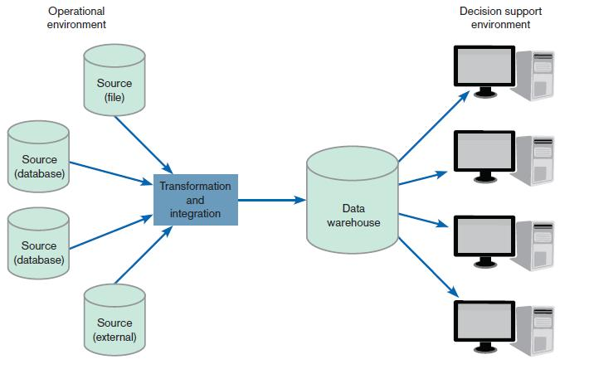
FIGURE 12-18
Generic two-tier data
warehouse architecture
Chapter 12
© 2011 Pearson Education, Inc. Publishing as Prentice Hall

Slide 55
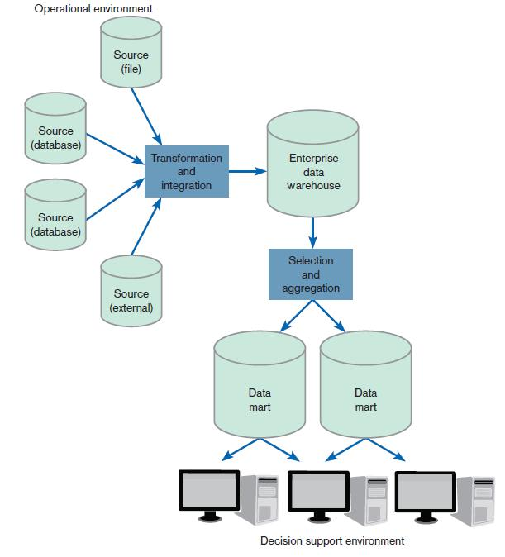
FIGURE 12-19
Three-tier warehouse architecture
Chapter 12
© 2011 Pearson Education, Inc. Publishing as Prentice Hall

Slide 56
Data Warehousing (Cont.)
Enterprise data warehouse (EDW): a centralized, integrated data warehouse that is the control point and single source of all data made available to end users for decision support applications throughout the entire organization
Data mart: a data warehouse that is limited in scope; its data are obtained by selecting and (where appropriate) summarizing data from the enterprise data warehouse
Chapter 12
© 2011 Pearson Education, Inc. Publishing as Prentice Hall

Slide 57
Web Site Content Management
Content management system (CMS): a special type of software application for collecting, organizing, and publishing Web site content
Chapter 12
© 2011 Pearson Education, Inc. Publishing as Prentice Hall

Slide 58
Electronic Commerce Application: Designing a Distributed Advertisement Server for PVF’s WebStore
Benefits for including advertising:
  Potential to increase revenue generated from the WebStore
  Potential to create cross-promotions and alliances with other online commerce systems
  Potential to provide customers with improved service when looking for additional products that accessorize PVF’s product line
Chapter 12
© 2011 Pearson Education, Inc. Publishing as Prentice Hall

Slide 59
Advertising on PVF’s WebStore
List of advertisement system concerns:
  Advertisement must be served quickly so that site performance is not affected.
  Advertisement must be uniform in size and resolution, so as not to disrupt the site layout.
  Advertisement links must not redirect the user’s browser away from the WebStore.
Chapter 12
© 2011 Pearson Education, Inc. Publishing as Prentice Hall

Slide 60
Designing the Advertising Component
Transactional requirements are to
  Determine which advertisements apply, based on where the user is in the WebStore.
  Personalize the advertisement if the identity of user and preferences are known.
  Check for any seasonal or promotional advertisements.
  Log the transaction.
Chapter 12
© 2011 Pearson Education, Inc. Publishing as Prentice Hall

Slide 61
Designing the Management Reporting Component
Queries for top-management:
  “How many women, when shopping for desks, clicked on an advertisement for lamps?”
  “How many advertisements were served to shoppers looking at filing cabinets?”
  “How many people clicked on the first advertisement they saw?”
  “How many people clicked on an advertisement and then purchased something from the WebStore?”
Chapter 12
© 2011 Pearson Education, Inc. Publishing as Prentice Hall

Slide 62
Summary
In this chapter you learned how to:
Define the key terms client/server architecture, local area network LAN, distributed database, and middleware.
Distinguish between file server and client/server environments and contrast how each is used in a LAN.
Describe alternative designs for distributed systems and their trade-offs.
Describe how standards shape the design of Internet-based systems.
Chapter 12
© 2011 Pearson Education, Inc. Publishing as Prentice Hall

Slide 63
Summary (Cont.)
Describe options for ensuring Internet design consistency.
Describe how site management issues can influence customer loyalty and trustworthiness as well as system security.
Discuss issues related to managing online data, including context development, online transaction processing (OLTP), online analytical processing (OLAP), and data warehousing.
Chapter 12
© 2011 Pearson Education, Inc. Publishing as Prentice Hall

Slide 64

All rights reserved. No part of this publication may be reproduced, stored in a retrieval system, or transmitted, in any form or by any means, electronic, mechanical, photocopying, recording, or otherwise, without the prior written permission of the publisher. Printed in the United States of America.
Copyright © 2011 Pearson Education, Inc.
Publishing as Prentice Hall

