Slide 1


Team Details
  Team name: UHI Team
  Team leader name: Ahmad Syafiq Kamil
  Problem Statement:
  “Urban heat data already exists, but it is not easily translated into location decisions, intervention choices, priorities for vulnerable residents, and accountable policy documents”

Slide 2
Brief about the idea
FROM HEAT MAPS TO POLICY ACTION
01 IDENTIFY
02 TEST
TEDUH is an AI agent that helps city governments identify the hottest and most vulnerable areas, assess potential interventions, and turn the findings into policy drafts.
Land Surface Temperature (LST) maps and a Heat Vulnerability Index (HVI).
Simulate trees, cool roofs, and green roofs.
03 PRIORITIZE
04 DRAFT
Planners can ask questions in Indonesian/ English. TEDUH connects data, models, simulations, evidence, and policy briefs in one workflow
Build intervention packages within budget and equity constraints.
A policy brief with traceable sources for every figure.
Residents: Roof Check feature 🡪 home-cooling recommendations

Slide 3
Opportunities
The Gap TEDUH Addresses
DATA WITHOUT A PATH TO POLICY
TOOLS ARE TOO TECHNICAL
UNEQUAL EXPOSURE TO RISK
Academic heat maps rarely inform detailed spatial plans, regional development plans, or local programs
Simulation and optimization often require specialized skills and software
Low-income residents, older adults, young children, and outdoor workers need to be prioritized
TEDUH’S Unique Value
One conversation: heat data → simulation → budget portfolio → policy brief;
Explicit equity: prioritize the highest Heat Vulnerability Index (HVI) quintile; default allocation of 60% of the budget.
Traceable figures: deterministic tools + number-provenance validation.
Citizen participation: photo-based Roof Check with safety-constrained recommendations

Slide 4
List of features offered by the solution
Heat map & HVI
Sub-district profile
AI agent chat (ID / EN)
LST, anomalies, NDVI, building cover, population density, and vulnerable groups.
Rankings, HVI components, and key drivers (SHAP).
Ask in plain Indonesian or English; answers highlight areas on the map.
Scenario simulation
Budget portfolio
Policy brief
Trees, cool roofs, and green roofs; indicative ΔLST results with literature-based range.
Intervention packages aligned with budgets and equity constraints.
Structured draft and PDF with a source for every figure.
Data sources & model card
Roof check
Privacy by design
Attribution, cross-validation metrics and limitations on /sumber-data.
Roof photo 🡪 Gemini Vision classification 🡪 rule-based recommendations
Roof photos are never stored; EXIF is stripped; location kept at kelurahan level.

Slide 5
Process flow diagram or Use-case diagram
1
2
3
4
5
ASK
ANALYZE
SIMULATE
OPTIMIZE
BRIEF
The planner enters an area, budget, or question.
The agent retrieves heat profiles, HVI, and key drivers.
The model estimates LST changes for intervention options.
The solver selects a package based on weighted benefits and equity constraints.
The validator checks number provenance; the brief is exported as a PDF.
Core principle: Gemini orchestrates and explains; every figure is calculated by deterministic Python tools, not freely generated by the language model

Slide 6
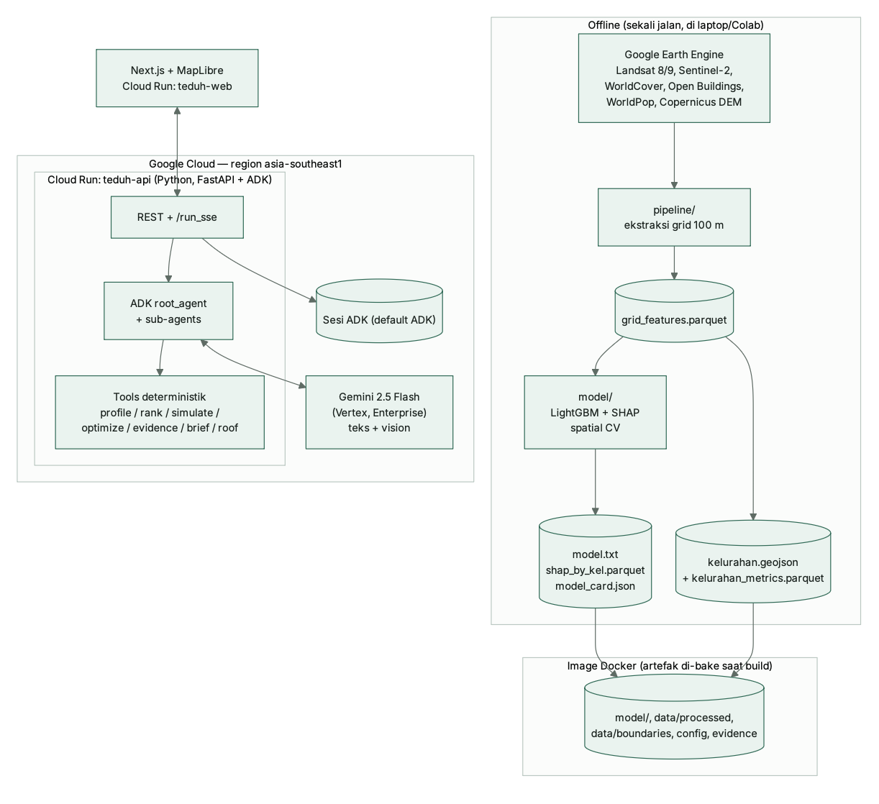
Architecture diagram of the proposed solution
OFFLINE PIPELINE · run once
GOOGLE CLOUD · asia-southeast1
USERS
Google Earth Engine
Landsat 8/9 · Sentinel-2 · WorldCover · Open Buildings · WorldPop · Copernicus DEM
Cloud Run · teduh-api (FastAPI + Google ADK)
Cloud Run · teduh-web
Next.js + MapLibre map, SSE chat, scenario panel, /cek-atap
teduh_coordinator
root agent · routes, never computes
Gemini 2.5 Flash
Vertex AI · text + vision
pipeline/ · 100 m grid
75,636 cells → 264 kelurahan + HVI
heat_​analyst
intervention_​planner
policy_​writer
roof_​inspector
Planner
Bappeda · Dinas · Lurah — map + chat
model/ · LightGBM + SHAP
monotonic constraints, spatial block CV
Deterministic Python tools → facts[ id, value, unit, source ]
find / profile / rank / explain_drivers · simulate_intervention · optimize_portfolio (OR-Tools CP-SAT) · get_evidence (verified only) · render_policy_brief + provenance validator · roof rules
Resident
Roof Check from a phone
Artifacts ≈ 14 MB
Parquet · GeoJSON · model card · evidence — baked into the Docker image
Policy brief PDF
every figure tagged [[F:id]] and traced to data, model or literature
REST /api/* + ADK /run_sse (streaming chat)
UI sliders and the agent call the same tool functions
image

Slide 7
Technologies to be used in the solution
AI & Agents
Data & Geospatial
Gemini 2.5 Flash on Vertex AI • Google ADK • Gemini vision
Google Earth Engine • Landsat 8/9 • Sentinel-2 • WorldCover • Open Buildings • WorldPop
ML & Explainability
LightGBM (monotonic) • SHAP • scikit-learn • spatial block cross-validation
Optimization
Google OR-Tools CP-SAT (budget + equity) • pymoo NSGA-II (roadmap)
Backend & Hosting
Python 3.12 • FastAPI • Cloud Run • Cloud Build • Secret Manager
Interface & Storage
Next.js • TypeScript • Tailwind • MapLibre • artifacts baked into the image
Evidence & Reporting
Verified evidence base • number-provenance validator • Markdown → PDF (WeasyPrint)
Model and region verified on Vertex AI: gemini-2.5-flash in asia-southeast1 (Singapore).

Slide 8
Estimated implementation cost (optional)
Running TEDUH for one pilot city · per month
Unit costs the optimizer uses
teduh-api · Cloud Run, 2 vCPU / 2 GiB, 1 warm instance
≈ USD 26
Shade tree, Tabebuya Ø > 20 cm
Kepgub DKI 811/2025
Rp 2,702,703
teduh-web · Cloud Run, 1 vCPU / 0.5 GiB, 1 warm instance
≈ USD 10
Tree handling (rootball, proxy)
Kepgub DKI 811/2025
Rp 1,950,000
Gemini 2.5 Flash · 1,000 planner questions
(~20k input + 1k output tokens each)*
≈ USD 9
Cool roof coating, per m²
assumption · vendor quote pending
Rp 95,000
Earth Engine pipeline · offline, once per season; open datasets
USD 0 licence
Green roof (extensive), per m²
assumption · vendor quote pending
Rp 600,000
Total, lower bound
≈ USD 45
Live example · Central Jakarta, Rp 50 bn
Agent built a 5-kelurahan cool-roof portfolio for Rp 49.9 bn, 100% of it in the top HVI quintile, reaching ≈ 9,200 vulnerable residents in cooled cells (indicative LST).
Google Cloud list prices: Cloud Run idle min-instance USD 0.0000025 per vCPU-second and per GiB-second; Gemini 2.5 Flash USD 0.30 / 2.50 per 1M input / output tokens. Excludes active-request time, the Tier-2 regional rate, tax and egress. *Token volume is an assumption, not a measurement.

Slide 9
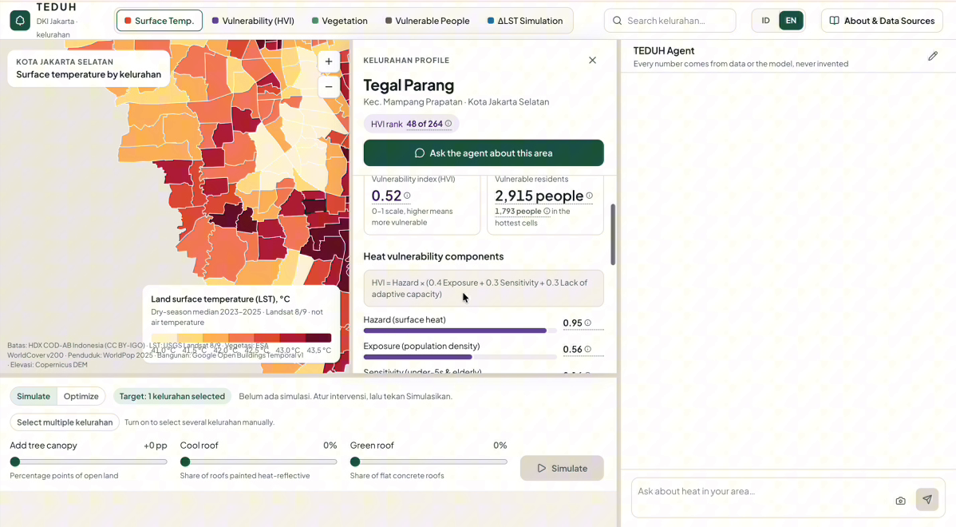
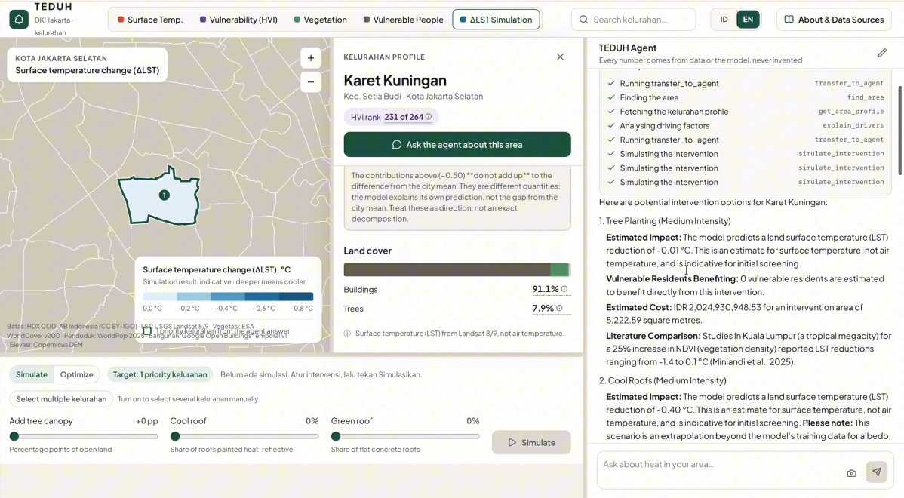
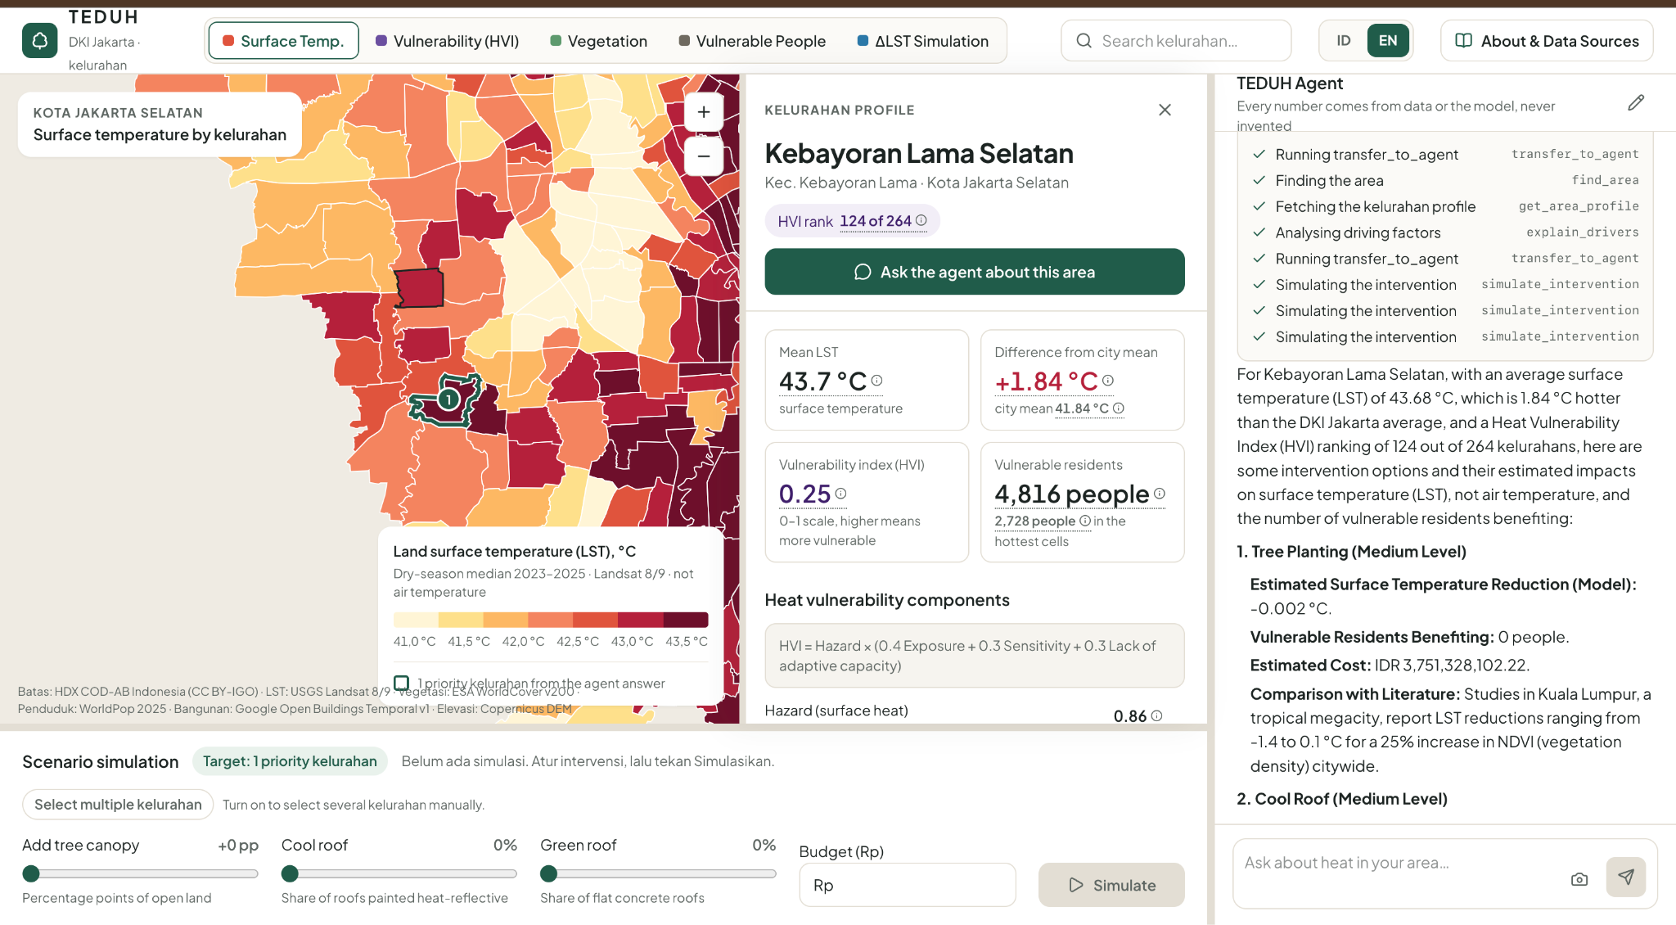
Snapshots of the prototype
Live on Cloud Run · captured from the deployed app (English UI)
Heat & vulnerability map + kelurahan profile
264 kelurahan, LST / HVI / NDVI / vulnerable-people layers; HVI rank and components.
Agent chat with visible tool calls
Simulation via simulate_intervention, each result paired with a verified literature range.

Slide 10
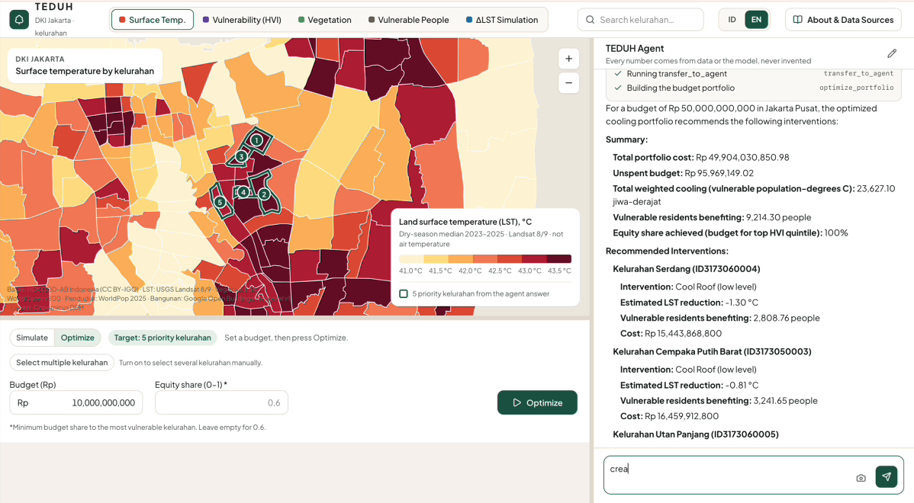
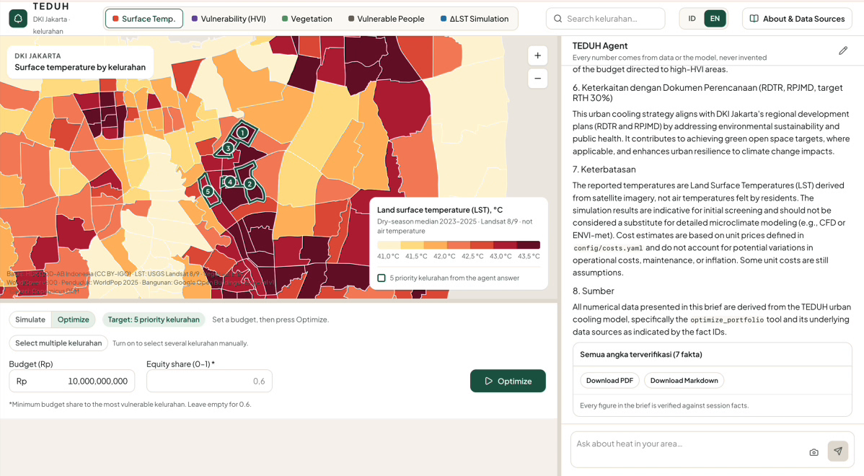
Snapshots of the prototype
From question to accountable policy document in one conversation
Budget portfolio with equity constraint
“Rp 50 bn for Central Jakarta” → OR-Tools picks 5 kelurahan; 100% to the top HVI quintile.
Policy brief: “all figures verified”
Draft for Bappeda with planning links, limitations and sources; download as PDF or Markdown.

Slide 11
Prototype Performance report/Benchmarking
0.755
mean R², spatial CV
folds 0.72 – 0.78
1.24 °C
RMSE
MAE 0.94 °C
+0.069
R² over linear baseline
0.686 → 0.755
75,636 cells × 264 kelurahan, dry season 2023–2025. Lat/lon deliberately excluded; random splits not reported because neighbouring 100 m cells leak.
0.54 % WorldPop vs Dukcapil population
0.14 °C BMKG vs GHCN air-temp cross-check
262 automated tests passing
100 % physics, provenance & budget/equity tests
Still below target: agent tool selection 65% (13/20, target 90%) · chat p50 9.4 s on a local run, 6.7–7.3 s warm on Cloud Run (target < 8 s) · Roof Check accuracy not yet measured (0 of 30 labelled photos).

Slide 12
Additional Details/Future Development (if any)
Next (P1)
Roadmap (P2)
Adoption & scale
Pareto optimisation (NSGA-II): cost vs cooling vs equity
Citizen Roof Check reports as an anonymous map layer
Before / after split-map for scenarios
Export the brief to Google Docs
Citizen heat reports to correct satellite data
Cool pavement from the OSM road network
Seasonal heat alerts for posyandu cadres
Air temperature at street level (PINN surrogate)
Pilot with one city government (DKI Jakarta or Depok)
Brief as an attachment to Musrenbang and RTH studies
Global datasets only: a new city needs boundaries + period
500+ Indonesian cities and regencies; SDG 3, 11, 13
Gaps we close first
Vendor quotes for cool and green roofs (the largest remaining assumption) · verify the 6 remaining literature entries (4 of 10 verified today) · collect 30 labelled roof photos to report Roof Check accuracy · lift agent tool selection to ≥ 90% and chat p50 latency under 8 s.

Slide 13
Provide links to your:
GitHub Public Repository : https://github.com/ahmadsyafiqkamil/teduh
Demo Video Link (3 Minutes) :
Final Product Link : https://teduh-web-ibnno2v3ma-as.a.run.app/

Slide 14


