Slide 1

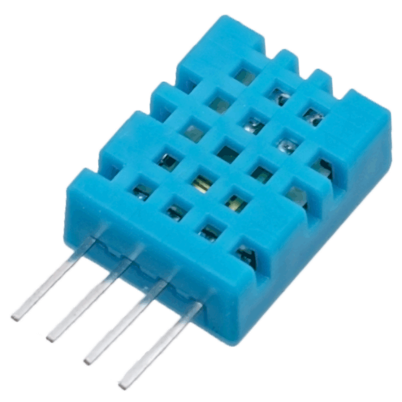
Greenhouse Control System
Presented by:
Ahmad Waseem

Slide 2
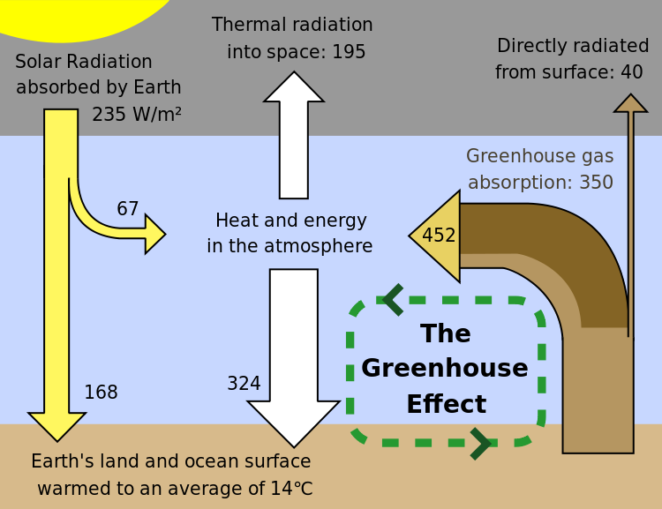
Greenhouse Effect

Slide 3
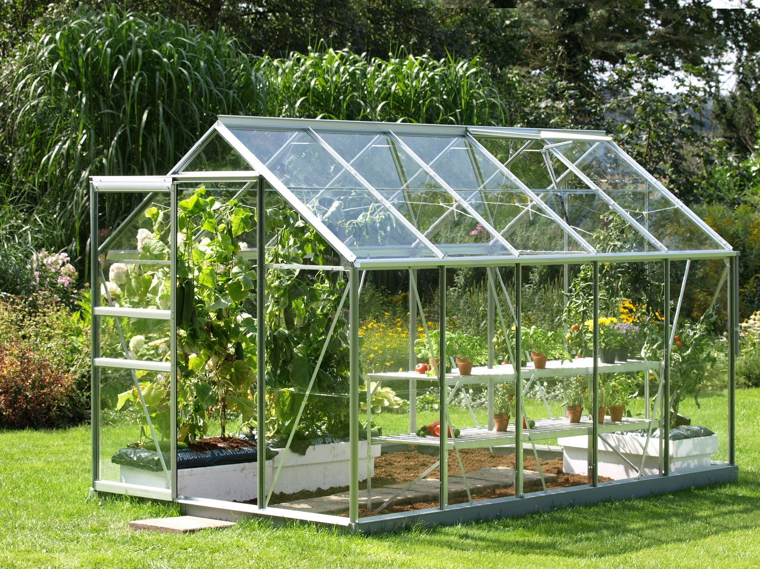
Greenhouse
Notes:
In today’s greenhouses, many parameter measurements are required to monitor and control for the good quality and productivity of plants. But to get the desired results there are some very important factors which come into play like Temperature, Humidity, Light and Water, which are necessary for a better plant growth. Keeping these parameters in mind I have built an Automatic Green House Controlling and Monitoring System. The system shall also demonstrate climatic changes which affect the plant in its productivity and quality etc.

Slide 4


Parameters
Notes:
The temperature sensor is used for sensing temperature. When temperature exceeds from a defined level or critical level, the system automatically turns on the fan and a message is also sent to the owner or the operator with information.
Humidity is measured by using the humidity sensor. If the humidity of the environment is below the defined levels, sprays are automatically turned on and if the humidity level exceeds from the defined level sprays are automatically turned off.
Light intensity is an important factor for the plant growth. If the light intensity is low then it affects the growth of the plants. To resolve the problem of low light, artificial lights are used.

Slide 5
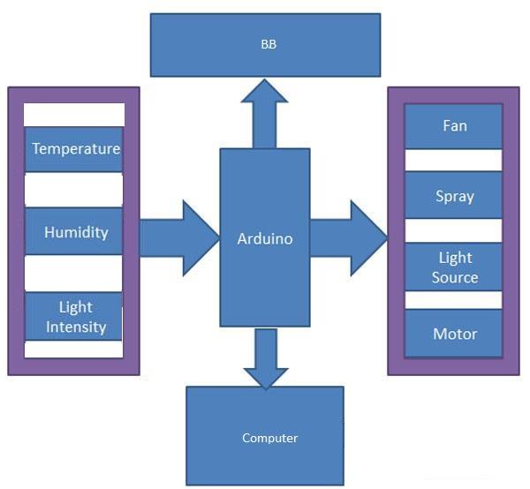

Block Diagram

Slide 6
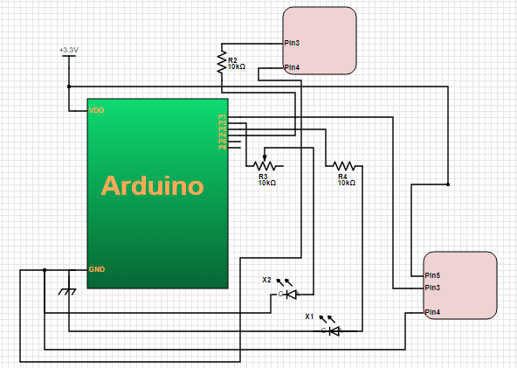

Circuit Diagram

Slide 7
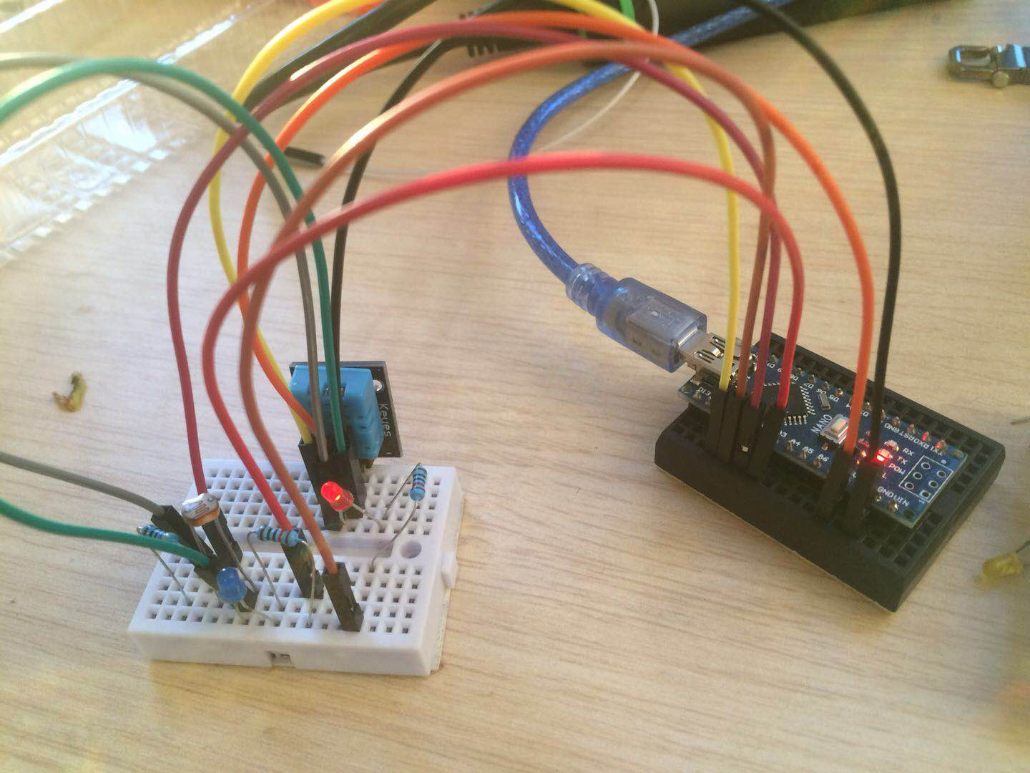
Project

Slide 8
References
www.sensaphone.com%2findustries%2fgreenhouse.php/RK=1/RS=pYQunF0yuw0lieaRDM9KEdiGIC8-
https://www.engineersgarage.com/contribution/green-house-monitoring-using-arduino
http://galleryhip.com%2fgreen-houses.html/RK=1/RS=GobHqVsrrxqhkQqyquNiQw0cfew
http://www.interiordesigninspiration.net%2foutgrowing-your-garden-greenhouse%2f/RK=1/RS=4udR7hyE0b2j11Qi61LDJrZmqpw

