Slide 1
IGAT
[1]
Internet Gaming Analysis & Trends
FYP Team
Ahmad Waseem 128209
Muneeb Zia 128241
Kainat Shaikh 128155
Supervised by
Ms. Asma Sattar

Slide 2
Outline
Gaming overview
IGAT Description
Related Projects
Project features
Tools, Technologies & Techniques
High Level Diagram

Slide 3
Gaming overview
Video games have a history of receiving a lot of disapproval.
Video games are a strong engine for economic growth.
When windows 8 was released it generate 14 billions dollars revenue in a quarter while the GTA 5 game sold more 54 millions of copies and earned more than 1.2 billion dollars just in three days.
In 2014, the industry sold over 135 million games and generated more than $22 billion in revenue.

Slide 4
IGAT Description
Gaming is a growing trend of 21st century in learning paradigm.
User have less information about its features.
Games according to user’s interest.
Game specification with categories.
Top recommendations for users.

Slide 5
Project Features
Web Based Portal
User reviews based rating
Categories
Sub Categories

Slide 6
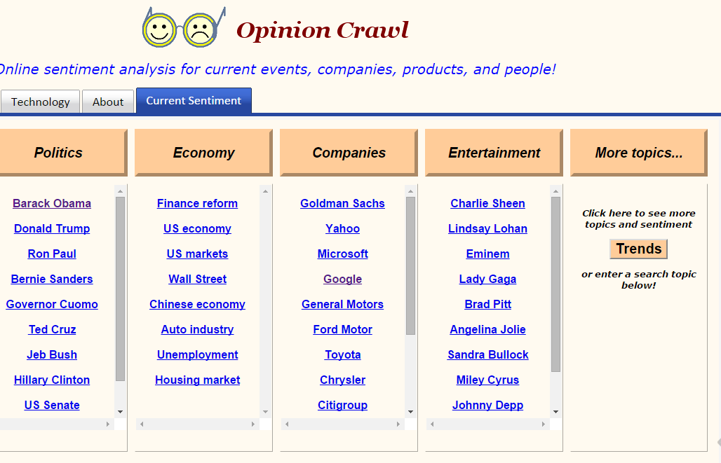
Related Projects
Opinion Mining
Opinion from social media
Aspect-based mining
Opinion Crawl
Web sentiment on topic
Graph showing responses
Images
News links
[4]
[5]

Slide 7
Project Scope
Console and PC based games
Web Crawling
User reviews based rating
Recommendations for users
[7]

Slide 8
Tools, Technologies & Techniques
Tools | Technologies | Techniques
Visual Studio | C# | BFC,HITS,FFC
 | SQL | VIPS
 |  | LSA
 |  | Item-to-Item Collaborative Filtering
Notes:
BFC->This algorithm aims in the uniform search across the neighbor nodes. It starts at the root node and searches the all the neighbor nodes at the same level.
HITS(Hypertext-induced Topic Selection)-> Link Analysis algorithm , It retrieve the relevant pages to search query, A base set is generated by augmenting the root set with all web pages that are linked from it and other that are linked form them.
FFC(Form Focused Crawling)->works better on productive path and avoids unproductive, limits the search to particular topics, learns features of links and go to paths that leads to valuable forms, there are three classifier page, link and form, page and link guides the search, form classifier used to filter out useless forms, Page and link helps to reach on those pages that are related to topics.
VIPS(Vision Based Page segmentation)-> this algorithm is used to detect web pages structure. It works for scraping the web data. It make visual tree block to maintain data. A DOM(document object model) model is used in this. It manages complex and XML data. XML are parsed to application in structured form. There will be markups and tags. It removes the tags and make them available as string.
LSA-> Text Preprocessing(separate words n sentences)-> Parsing(separate Parts of speech) -> Term Reduction(Removes meaningless words a,an) ->Sentiment Lexicon-> Singular Value Decomposition(separate +ve n –ve words) -> factor Analysis(+ve and –ve makes groups in matrices)
Sentiment Lexicon-> It is technique in which dictionary is maintained for those words which are mostly used in comments. These words are mostly used in gaming terms. It throws some words that are neither positive nor negative. It also works for synonyms.
Item-to-Item Collaborative Filtering->

Slide 9
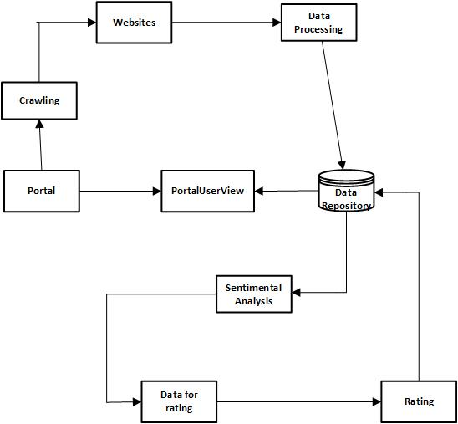
High Level System Diagram

Slide 10
References
[1]www.free-ppt-templates.com
[2]http://svn.gna.org/viewcvs/*checkout*/amaltheia/trunk/docs/documentation.html
[3]https://en.wikipedia.org/wiki/Fighting_game#/media/File:Street_Fighter_II.png
[4]https://lh5.ggpht.com/riDTcq2TuwhsCqBSBPbn5NDIKkAAsB9uaUYML4-9Q1jD-9119zUzEjELliH0zcrgNd5s=h900-rw
[5]http://www.fanpop.com/clubs/micketo/links
[6]http://pgwebdesign.net/blog/45-epic-dragon-art-pictures
[7]www.pushsquare.com/soulCaliber
[8]A. R. a. P. Thill, "Adaptive AI for Fighting Games," 2008.
[9]cmusphinx.sourceforge.net/

Slide 11
Questions

