Slide 1


Team Details
  Team name: SabiqLab
  Team leader name: Ahmad Wali Radhi
  Problem Statement: Survei Kesehatan Indonesia 2023: 56.9% of Indonesians aged 3 and over had a dental or oral problem in the past year, yet only 11.2% of them were treated by dental health workers. A Patient cannot tell how urgent it is, what it will cost, whether BPJS pays, or where to go.
Sources: SKI 2023 Dalam Angka, BKPK Kemenkes, Tabel 9.5 p. 324 (56.9%) and Tabel 9.7 p. 327 (57.0%); BKPK SKI 2023 oral health factsheet, Gambar 3 p. 2 (11.2%).

Slide 2
Brief about the idea
A Patient describes a toothache in their own words and leaves knowing how urgent it is, what it costs, and where to go
THE GAP · SKI 2023
WHAT FINDYOURDENT DOES
56.9%
of Indonesians aged 3+ had a dental or oral problem in the past year
1
Describe
Type or speak the complaint in Indonesian, a regional language or English. The complaint is never stored.
2
Guidance
Urgency tier, likely category, visit journey, cost estimate with why prices vary, and BPJS coverage. Red flags go straight to “Ke IGD sekarang”.
11.2%
of them were treated by dental health workers
3
Shortlist
Nearby Providers that can treat this complaint, with Testimonies and price signals.
57.0%
of people not treated by a dental health worker said they felt no need
4
Testimony
After the visit the Patient tells others. Gemini screens it against fixed rules; a proof of visit earns “Kunjungan terbukti”.
Sources: SKI 2023 Dalam Angka, BKPK Kemenkes, Tabel 9.5 p. 324 (56.9%) and Tabel 9.7 p. 327 (57.0%); BKPK SKI 2023 oral health factsheet, Gambar 3 p. 2 (11.2%). Product: docs/specs/README.md.

Slide 3
Opportunities
Others answer one part of the question; FindYourDent turns a complaint into a decision and a place Patients can trust
How different is it from any of the other existing ideas?
How will it be able to solve the problem?
USP of the proposed solution
Alodokter
Health articles, doctor chat and booking. Not a structured dental decision with cost and BPJS for this complaint.
Urgency tier answers “do I need to go?” for the 57.0% who felt no need.
“FindYourDent turns a toothache into a guided decision. A grounded Gemini agent explains urgency, the visit journey, cost and BPJS coverage, then shortlists Providers ranked by Patient Testimonies that FindYourDent owns, each one screened by AI and checked against proof of visit.”
Cost range and BPJS door before the visit, with why prices vary.
Halodoc
Paid chat with a doctor and medicine delivery. Does not route the complaint to the right kind of dental Provider.
Red-flag check sends emergencies to an IGD before any AI call.
Google Maps
Finds places with open star ratings. No urgency or cost, and reviews are not checked against a visit.
Testimonies FindYourDent owns
Shortlist of nearby Providers that can treat this complaint.
Checked against proof of visit
Ranking never paid
So what The moat is the Testimony data: first-hand, moderated, tied to a visit, and never for sale.
Differentiator: docs/specs/README.md. Competitor scope from public product pages; parity risk analysis in docs/hackathon-plan.md 1.1.

Slide 4
List of features offered by the solution
Eight features cover the Patient journey end to end, and the Provider side starts with a claimed page
1
Guidance card
2
Emergency Escalation
3
Voice input
4
Shortlist
Urgency, likely category, visit journey, procedures, cost estimate, BPJS and sources.
Deterministic red-flag check before Gemini; red “Ke IGD sekarang” card and the nearest IGD.
Speak the complaint for up to a minute, in Indonesian, a regional language or English.
Nearby Providers that can treat the complaint, with reasons, Testimonies and price signals.
5
Provider page
6
Moderation
7
Kunjungan terbukti
8
Claim and Price List
Facts, Testimonies and ratings, WhatsApp and phone; Google rating loads on tap.
Gemini checks fixed rules; fix-before-submit for phone numbers. Humans remove, AI never deletes.
A proof of visit marks a Testimony as a proven visit, the defence against buzzers.
Owner verifies with a SIP; Gemini reads the price list into rows the owner confirms.
Also live: shareable Guidance link without the complaint · Indonesian and English · live impact counter · directory by kota/kabupaten · sign-in only at “Kirim”
Specs 01 to 05 and 09, docs/specs/. Every feature listed is in the deployed build at findyourdent.com.

Slide 5
Process flow diagram or Use-case diagram
Safety runs first: a deterministic red-flag check decides before Gemini sees the complaint
Guidance
Complaint, typed or spoken
Red-flag check (deterministic)
no
Gemini Guidance: validated JSON
Guidance card + knowledge files
Shortlist and Provider page
yes
Red flag: “Ke IGD sekarang” + nearest IGD
Gemini call
Deterministic code
Testimony
Visit the Provider
Write a Testimony, sign in at Kirim
Gemini Moderation: which rules fired
Code decides: publish, fix or hold
Admin queue: humans can remove
Provider
Claim the page: SIP + phone check
Upload price list (PDF or photo)
Gemini extracts rows
Owner checks and confirms
Dated prices on page and Shortlist
Specs 01, 03 and 05 in docs/specs/; ADR-0004 (AI publishes, humans remove). The model can raise urgency but never lower it below a red flag.

Slide 6
Wireframes/Mock diagrams of the proposed solution
Mobile-first: one screen asks, one answers, one shows where to go
Segera: 1 to 3 days
Lihat
Maps
Likely problem
Ceritakan keluhan gigi Anda
Cost estimate
Lihat
Maps
Lihat panduan
Rekam pesan suara
BPJS Kesehatan
Lihat
Maps
Ask. Free text or voice; disclaimer and no-storage notice up front.
Answer. Urgency first, then problem, visits, cost and BPJS, with sources.
Go. Shortlist cards end in two actions: the Provider page or Google Maps.
Wireframes redrawn from the mockups in docs/design/mockups/html (Beranda, Panduan, Darurat, Tempat), built mobile-first at 360 px.

Slide 7
Architecture diagram of the proposed solution
Two Cloud Run services in Jakarta; only the private agent calls Gemini
Firebase Hosting
findyourdent.com, rewrites every path to fyd-web
asia-southeast2 · Jakarta
Gemini on Vertex AI (global)
3.8 Flash: Guidance and Shortlist reasons. 3.5 Flash-Lite: Moderation and price-list extraction
Cloud Run fyd-web
Public. React Router SSR and web API
Patient or Provider
Phone browser, Indonesian or English
Firebase Auth
Google sign-in, only at “Kirim”
Cloud Run fyd-agent
Private, ID token only. Google ADK + FastAPI
Agent Search
Grounding over guideline and BPJS documents; curated files as fallback
App Check
reCAPTCHA Enterprise guards the web API
Places API (New)
Provider search and details, under daily caps
Firestore
Written by fyd-web only. Never a complaint's text
Operations
Secret Manager · Cloud Scheduler + Workflows (warm agent) · Cloud Run Job · Monitoring uptime + alerts · Budget
Cloud Storage
Proof of visit, price-list uploads
Deployed build, 18 October 2026: README.md, infra/gcp/README.md, ADR-0003 (Gemini global endpoint), ADR-0008 (Hosting in front of Cloud Run). The browser never calls the agent, Places or Gemini.

Slide 8
Technologies to be used in the solution
Firebase at the edge, Firestore for data, Cloud Run for compute, Gemini for judgement
Firebase
Firestore
Cloud Run
Gemini
Hosting serves findyourdent.com and rewrites to Cloud Run. Auth signs Patients and Providers in with Google. App Check with reCAPTCHA Enterprise guards the web API.
In Jakarta: Providers, Testimonies, Moderation decisions and owner-confirmed price lists. Never a Patient’s complaint text.
In Jakarta: the public web service, and a private Google ADK agent service that only the web service can call. One warm agent instance during judging.
On Vertex AI: writes the Guidance card as validated structured output, moderates every Testimony before it is published, reads price lists into rows the owner confirms.
More Google Cloud
Google ADK · Agent Search · Places API (New) · Cloud Storage · Secret Manager · Cloud Scheduler · Workflows · Cloud Monitoring
Web
React Router v7 (SSR) · TypeScript · Tailwind v4 · shadcn/ui · i18next
Agent
Python 3.13 · FastAPI · Pydantic v2 · uv
Contracts and tests
JSON Schema (Ajv + generated Pydantic) · Vitest on Firebase emulators · pytest · Playwright · Biome · Ruff · GitHub Actions
docs/submission/brief-description.md (issue #109), README.md.

Slide 9
Estimated implementation cost
Judging traffic costs about USD 17 for 23 days, and daily quotas cap every paid API
USD, 300 SESSIONS, 16 OCT TO 7 NOV 2026 (COLUMN B2)
HARD CAPS SET IN THE PROJECT
Quota | Daily cap
Places Text Search | 160 calls
Places Get Place (details, reviews) | 83 calls
Places Autocomplete | 300 calls
Places Nearby, Photos | 0
Gemini 3.8 Flash input tokens | 2,000,000
Gemini 3.5 Flash-Lite input tokens | 1,000,000
Billing budget, whole account | IDR 1.65 M (~USD 100), alerts 50% and 90%
Total USD 16.75 with PPN. At 2,000 sessions: USD 37.77. The warm instance is the biggest line; Cloud Run’s free tier should cut it.
docs/research/cost-comparison-2026-10-17.md (list prices read 16 to 17 Oct 2026, ex-tax plus PPN 11%; no credits); infra/gcp/README.md daily caps. Places spend above free allowances capped at USD 10 a month (ADR-0005).

Slide 10
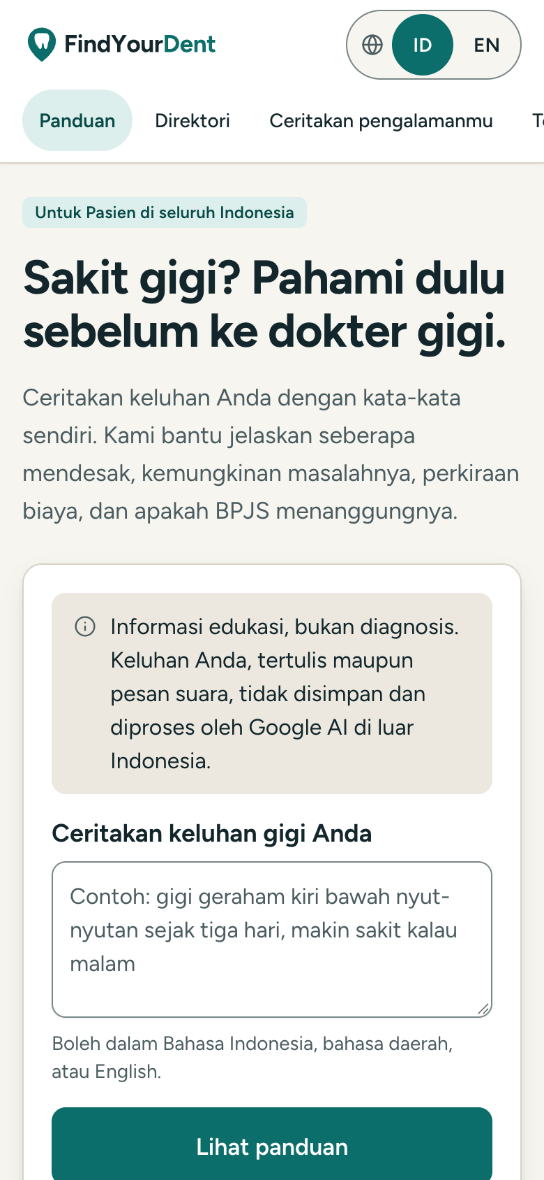
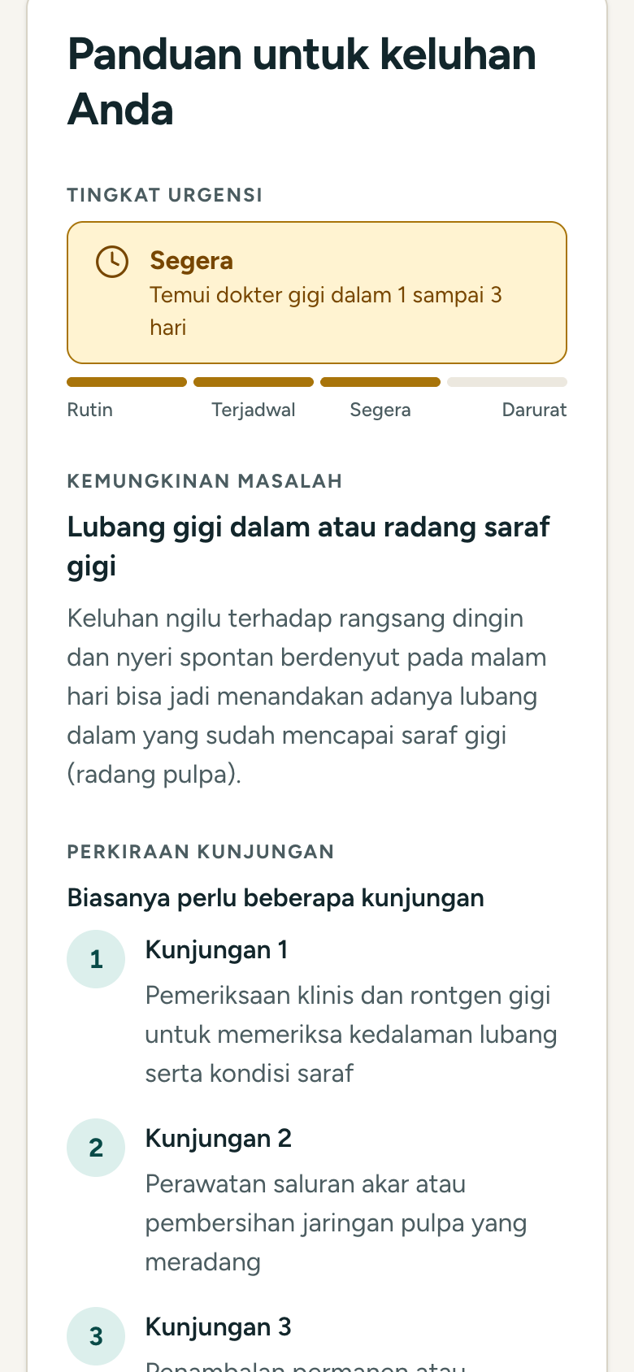
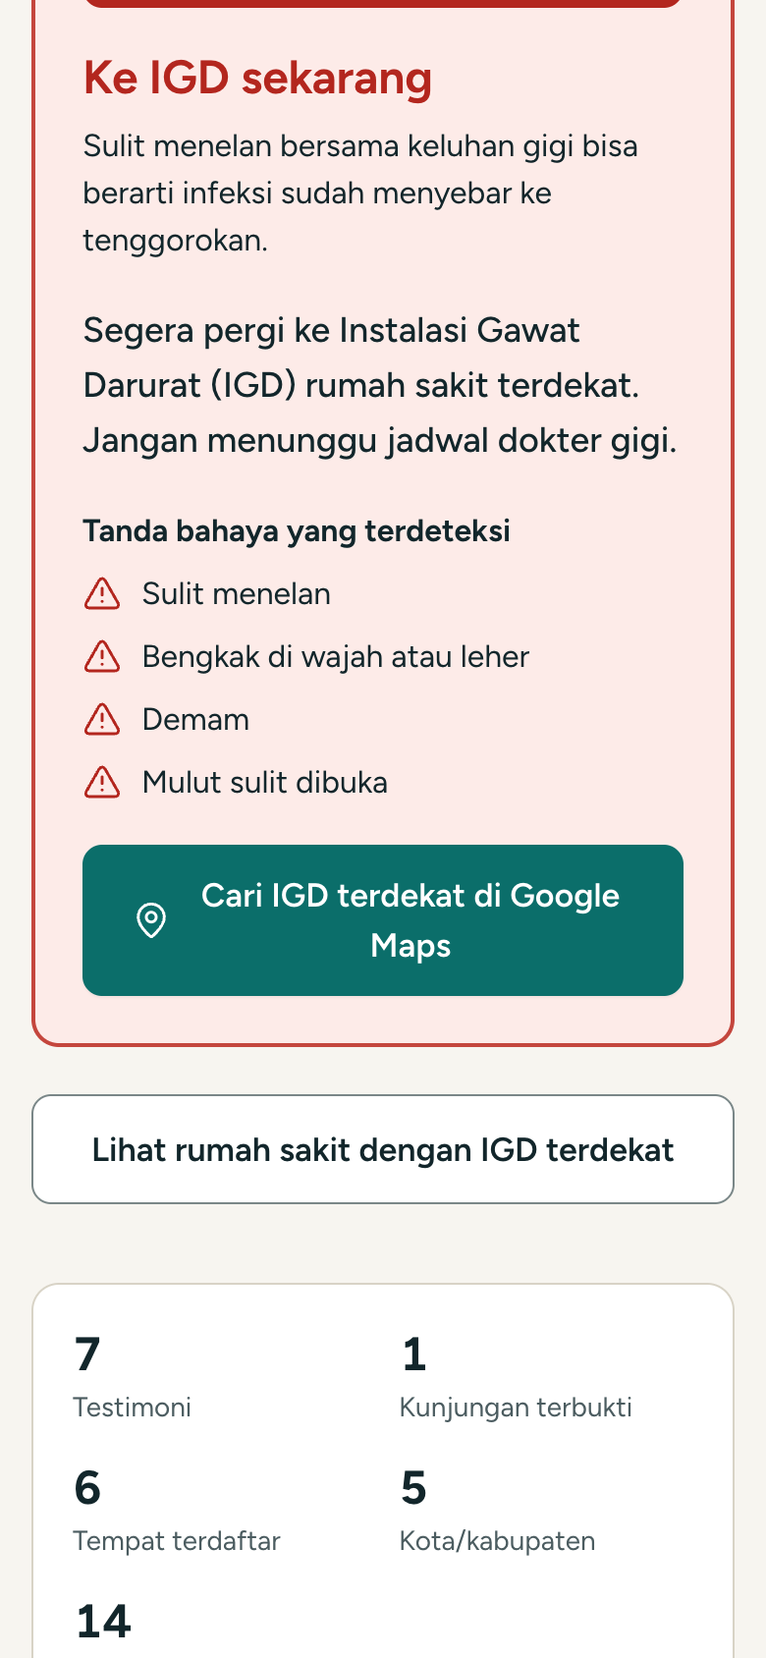
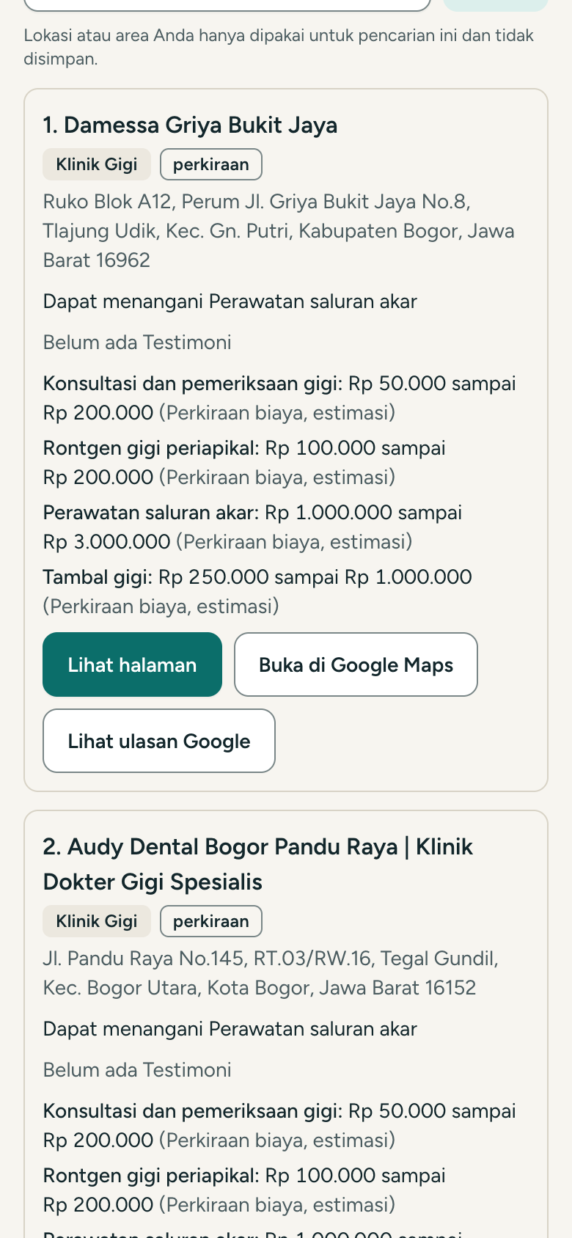
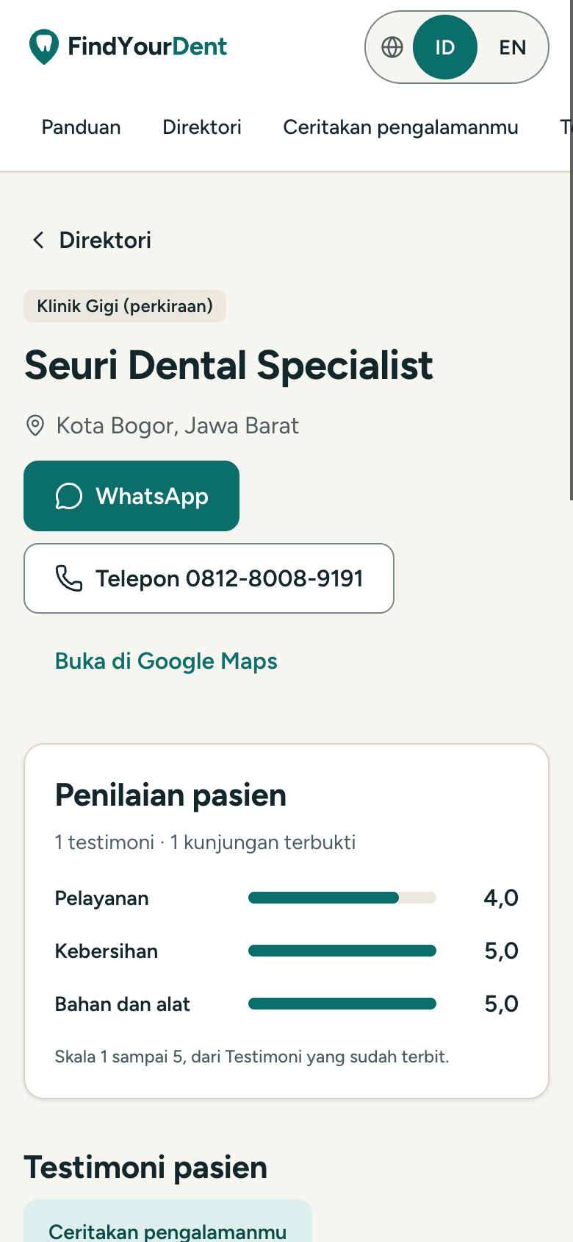
Snapshots of the prototype
The live build at findyourdent.com, captured at phone width
Home: describe the complaint
Guidance: urgency, problem, visits
Emergency: “Ke IGD sekarang”
Shortlist: who can treat it nearby
Provider page: Testimonies, ratings
Screenshots of https://findyourdent.com at 390 px (Chrome DevTools, mobile emulation), synthetic complaints. Testimonies shown are real Patient posts published through Moderation.

Slide 11
Prototype Performance report/Benchmarking
Every safety gate passes on the live build; urgency-tier accuracy is the one gate still failing
48/48
28/28
Metric (live models, 18 Oct 2026) | Result | Gate
Emergency recall, Guidance | 100% (8/8) | pass
Urgency-tier accuracy | 76% (28/37) | fail, ≥ 85%
Category / journey accuracy | 100% / 100%
BPJS accuracy | 87% (20/23)
Moderation decision accuracy | 96.7% (29/30) | pass, ≥ 90%
Moderation neutrality mismatches | 0 pairs | pass
Lighthouse mobile: a11y, practices, SEO | 100 / 100 / 100
Lighthouse performance, e2e tests | in progress (T19)
must-escalate phrases return “Ke IGD sekarang” without calling Gemini
ordinary complaints do not escalate (negations, slang, regional languages)
0
0
unsafe medicine advice across the 40-case Guidance evaluation
rule-breaking Testimonies published across 30 cases × 3 runs
Honest limits: 8 of the 9 urgency misses are more urgent than the label, the safe direction. Guidance labels are source-derived and agent-labelled, not yet reviewed by a licensed dentist.
README.md: Emergency Escalation results, Guidance evaluation (gemini-3.8-flash, evalset 2026-10-17.1), Moderation evaluation (gemini-3.5-flash-lite). Lighthouse via Chrome DevTools, 18 Oct 2026.

Slide 12
Additional Details/Future Development
Providers and clinics will pay for tools, never for rank
Revenue from Providers and clinics
Rules that do not bend
Next build
Verified-profile subscription with price-list hosting for claimed pages
Ranking is never paid; a claim does not change the Shortlist order
Lift urgency-tier accuracy past the 85% gate
Clinic intake: the shared Guidance link becomes the pre-visit note
No ads, promotion, discounts or per-lead fees, in line with KODEKGI and MKEK Fatwa 29/2021
A licensed dentist reviews the 40-case evalset
Payment Method on Testimonies (spec 07) for price signals
Providers can reply or report, never delete a Testimony
Proven Testimonies part 2 and buzzer defence (spec 09)
Education and navigation, not diagnosis or prescription
Kecamatan coverage and more cities
So what Trust is the product: if rank could be bought, the Testimonies would stop meaning anything.
Specs 05, 07 and 09 in docs/specs/; monetisation and ethics constraints in docs/hackathon-plan.md 1.2; Terms and About pages on findyourdent.com.

Slide 13
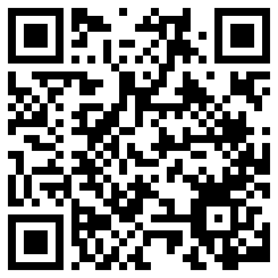
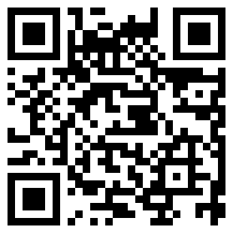
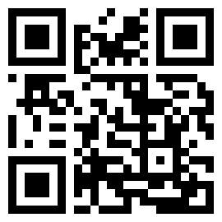
Provide links to your:
GitHub Public Repository: https://github.com/ahmadwaliradhi/findyourdent
Demo Video Link (3 Minutes): https://youtu.be/KsSCkUG_M00
Final Product Link: https://findyourdent.com
Code
Demo video
Live product
github.com/ahmadwaliradhi/findyourdent
youtu.be/KsSCkUG_M00
findyourdent.com
Each link opened in a logged-out browser before submission. The live demo stays up through the finalist announcement on 7 November 2026.

Slide 14
Sources and notes
SKI 2023 figures
Survei Kesehatan Indonesia 2023 Dalam Angka, BKPK Kemenkes, Bab 9: Tabel 9.5 p. 324, Tabel 9.7 p. 327. badankebijakan.kemkes.go.id/ski-2023-dalam-angka
11.2% treated
BKPK SKI 2023 oral health factsheet, Gambar 3 p. 2. repository.badankebijakan.kemkes.go.id/5534
Reading the 57.0%
Its denominator is everyone aged 3+ not treated by a dental health worker, including people with no dental problem (multiple response).
Cost
docs/research/cost-comparison-2026-10-17.md, USD list prices, ex-tax, PPN 11% as one line, no credits.
Evaluations
README.md results sections; evalsets in services/agent/evals/. Guidance labels agent-labelled, Moderation labels team-labelled.
Ethics
KODEKGI (Kode Etik Kedokteran Gigi Indonesia) and MKEK Fatwa 29/2021 on advertising by doctors and dentists.

Slide 15


