Slide 1
UML Diagrams
UML, which stands for Unified Modeling Language, is a way to visually represent the architecture, design, and implementation of complex software systems. When you’re writing code, there are thousands of lines in an application, and it’s difficult to keep track of the relationships and hierarchies within a software system. UML diagrams divide that software system into components and subcomponents.
What are the types of UML diagrams?
UML standards identify 13 types of diagrams that are divided into two groups.
Notes:
UML diagrams are classified into three categories that are given below:
Structural UML diagrams: show how the system is structured, including the classes, objects, packages, components, etc. in the system and the relationships between those elements.
Behavioral UML diagrams: These UML diagrams visualize how the system behaves and interacts with itself and with users, other systems, and other entities.
Interaction diagram: It is a subset of behavioral diagrams. It depicts the interaction between two objects and the data flow between them.
Structural UML diagrams:
Class diagram
Package diagram
Object diagram
Component diagram
Composite structure diagram
Deployment diagram
Behavioral UML diagrams:
Activity diagram
Use case diagram
State diagram
Communication diagram
Interaction overview diagram
Interaction UML diagrams:
Timing diagram
Sequence diagram
Collaboration diagram
Following are some object-oriented concepts that are needed to begin with UML:
Object: An object is a real-world entity. There are many objects present within a single system. It is a fundamental building block of UML.
Class: A class is a software blueprint for objects, which means that it defines the variables and methods common to all the objects of a particular type.
Abstraction: Abstraction is the process of portraying the essential characteristics of an object to the users while hiding irrelevant information. Basically, it is used to envision the functioning of an object.
Inheritance: Inheritance is the process of deriving a new class from the existing ones.
Polymorphism: It is a mechanism of representing objects having multiple forms used for different purposes.
Encapsulation: It binds the data and the object together as a single unit, enabling tight coupling between them.
UML-Building Blocks: UML is composed of three main building blocks, i.e., things, relationships, and diagrams. Building blocks generate one complete UML model diagram by rotating around several different blocks. It plays an essential role in developing UML diagrams. The basic UML building blocks are enlisted below:
Things
Relationships
Diagrams
Things: Anything that is a real-world entity or object is termed as thing. It can be divided into several different categories:
Structural things
Behavioral things
Grouping things
Annotational things

Slide 2
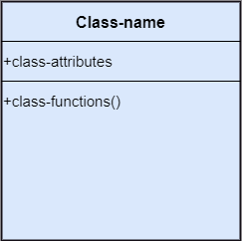
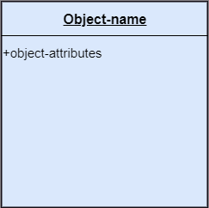

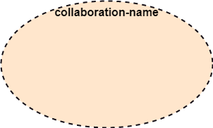
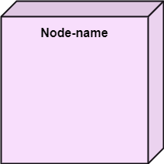
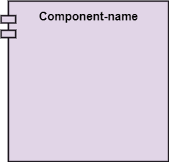
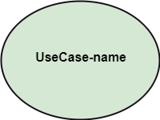
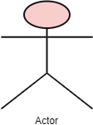
Structural Things
Notes:
[1] Class is a set of identical things that outlines the functionality and properties of an object. It also represents the abstract class whose functionalities are not defined.
[2] Object: An individual that describes the behavior and the functions of a system. The notation of the object is similar to that of the class; the only difference is that the object name is always underlined.
[3] Interface: A set of operations that describes the functionality of a class, which is implemented whenever an interface is implemented.
[4] Collaboration: It represents the interaction between things that is done to meet the goal. It is symbolized as a dotted ellipse with its name written inside it.
[5] Use case: Use case is the core concept of object-oriented modeling. It portrays a set of actions executed by a system to achieve the goal.
[6] Actor: It comes under the use of case diagrams. It is an object that interacts with the system, for example, a user.
[7] Component: It represents the physical part of the system.
[8] Node: A physical element that exists at run time.

Slide 3
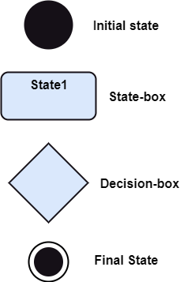
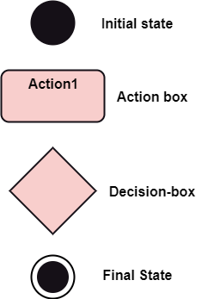
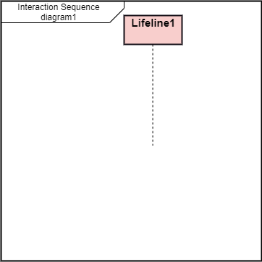
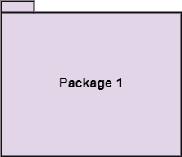
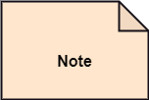
Behavioral Things
Notes:
[1] State Machine: It defines a sequence of states that an entity goes through in the software development lifecycle. It keeps a record of several distinct states of a system component.
[2]Activity Diagram: It portrays all the activities accomplished by different entities of a system. It is represented the same as that of a state machine diagram. It consists of an initial state, a final state, a decision box, and an action notation.
[3] Interaction Diagram: It is used to envision the flow of messages between several components in a system.
Grouping Things: It is a method that together binds the elements of the UML model. In UML, the package is the only thing, which is used for grouping.
[4] Package: is the only thing that is available for grouping behavioral and structural things.
Annotation Things: It is a mechanism that captures the remarks, descriptions, and comments of UML model elements. In UML, a note is the only Annotational thing.
[5] Note: It is used to attach the constraints, comments, and rules to the elements of the model. It is a kind of yellow sticky note.

Slide 4


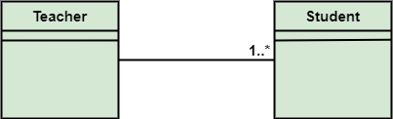
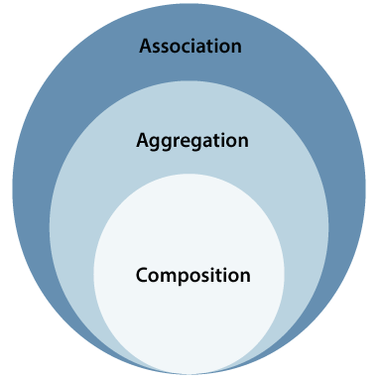
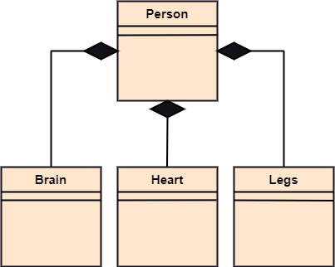
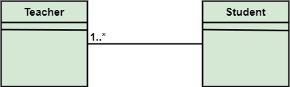
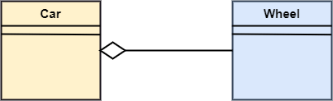
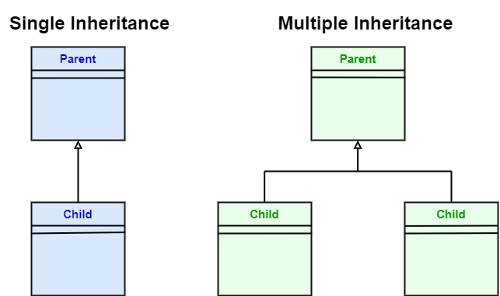
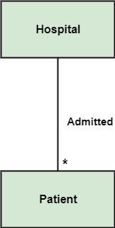
Relationships
It illustrates the meaningful connections between things. It shows the association between the entities and defines the functionality of an application.
Notes:
Dependency: Dependency is a kind of relationship in which a change in the target element affects the source element, or simply we can say the source element is dependent on the target element. It is one of the most important notations in UML. It depicts the dependency from one entity to another.
Association: A set of links that associates the entities to the UML model. It tells how many elements are actually taking part in forming that relationship. It is denoted by a dotted line with arrowheads on both sides to describe the relationship with the element on both sides. It can form several types of associations, such as one-to-one, one-to-many, many-to-one, and many-to-many. A ternary association is one that constitutes three links. It portrays the static relationship between the entities of two classes.
An association can be categorized into four types of associations, i.e., bi-directional, unidirectional, aggregation (composition aggregation), and reflexive, such that aggregation is a special form of association and composition is a special form of aggregation. The mostly used associations are unidirectional and bi-directional.
Example:
[1] A single teacher has multiple students.
[2] A single student can associate with many teachers.
[3] The composition and aggregation are two subsets of association. In both of the cases, the object of one class is owned by the object of another class; the only difference is that in composition, the child does not exist independently of its parent, whereas in aggregation, the child is not dependent on its parent i.e., standalone. An aggregation is a special form of association, and composition is a special form of aggregation.
Aggregation is a special form of association. It portrays a part-of-relationship. It forms a binary relationship, which means it cannot include more than two classes. It is also known as a Has-a relationship. It specifies the direction of an object contained in another object. In aggregation, a child can exist independent of the parent.
Example:
[4] Here we are considering a car and a wheel example. A car cannot move without a wheel. But the wheel can be independently used with the bike, scooter, cycle, or any other vehicle. The wheel object can exist without the car object, which proves to be an aggregation relationship.
Composition: In a composition relationship, the child depends on the parent. It forms a two-way relationship. It is a special case of aggregation. It is known as a Part-of relationship.
Example:
[5] the composition association relationship connects the Person class with Brain class, Heart class, and Legs class. If the person is destroyed, the brain, heart, and legs will also get discarded.
Aggregation VS Composition relationship:
Dependency: In an aggregation relationship, a child can exist independent of a parent. In a composition relationship, the child cannot exist independent of the parent.
Type of Relationship: aggregation constitutes a Has-a relationship. Composition constitutes Part-of relationship.
Type of Association: aggregation forms a weak association. composition forms a strong association.
Examples: AGG: A doctor has patients when the doctor gets transfer to another hospital, the patients do not accompany to a new workplace. COM: A hospital and its wards. If the hospital is destroyed, the wards also get destroyed.
Generalization: It portrays the relationship between a general thing (a parent class or superclass) and a specific kind of that thing (a child class or subclass). It is used to describe the concept of inheritance. It is denoted by a straight line followed by an empty arrowhead at one side.
Realization: It is a semantic kind of relationship between two things, where one defines the behavior to be carried out, and the other one implements the mentioned behavior. It exists in interfaces. It is denoted by a dotted line with an empty arrowhead at one side.
Multiplicity: It defines a specific range of allowable instances of attributes. In case a range is not specified, one is considered as a default multiplicity.
0..1 ➔ zero to one (optional)
n ➔ specific number
0…* ➔ zero to many
1…* ➔ one to many
m…n ➔ specific number range
[7] For example, multiple patients are admitted to one hospital.

Slide 5
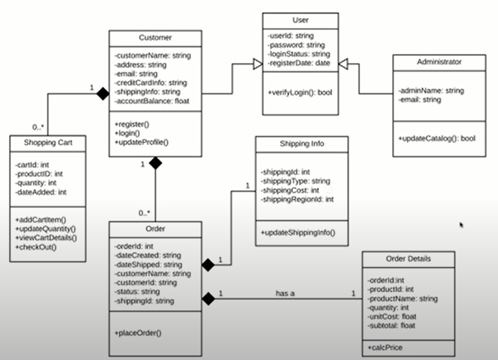
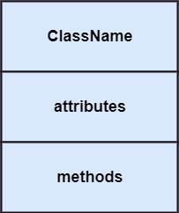
Class Diagrams
Notes:
Class Diagrams show the static structure of a system, including classes, their attributes and behaviors, and the relationships between each class. A class is represented by a rectangle that contains three compartments stacked vertically—the top compartment contains the class’s name and is mandatory, but the bottom two compartments give details about the class attributes and class operations or behaviors.
Visibility in the class diagram includes ➔
- Private
+ public
# protected
~ package/default
[2]
className
attributes ➔ -attribute:type
Methods ➔ method()
The superclass is the abstraction and hides the repetitive details for the subclasses and make it DRY.

Slide 6
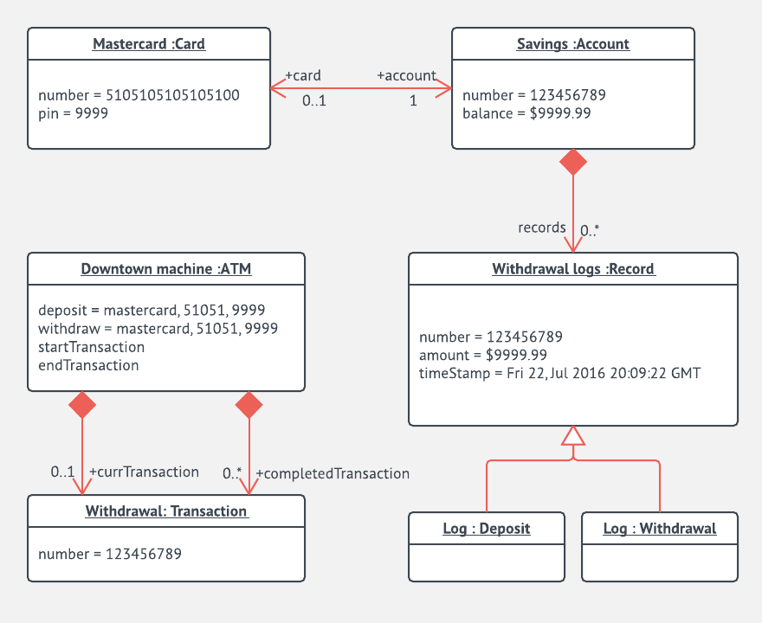
Object Diagrams
Notes:
Object diagrams describe the static structure of a system at a particular time. They can be used to test class diagrams for accuracy. Object diagrams show examples of data structures at a specific time. You could use a class diagram to show a structure and then use object diagrams as test cases to verify the completeness of your class diagram. Or you could create an object diagram to discover information about model elements and their links.

Slide 7
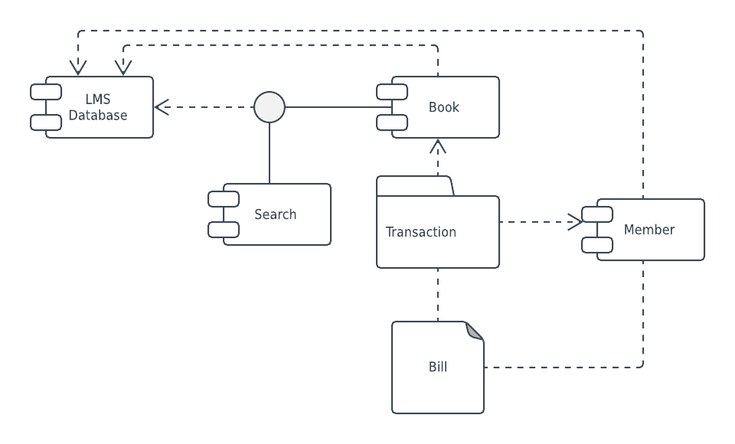
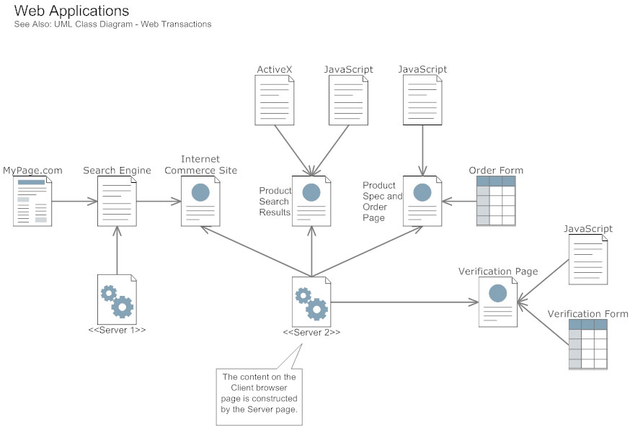
Component Diagrams
Notes:
A component diagram describes the organization of physical software components, including source code, run-time (binary) code, and executables is essentially a more specialized version of the class diagram—the same notation rules apply for both. A component diagram breaks a complex system down into smaller components and visualizes the relationship between those components.

Slide 8
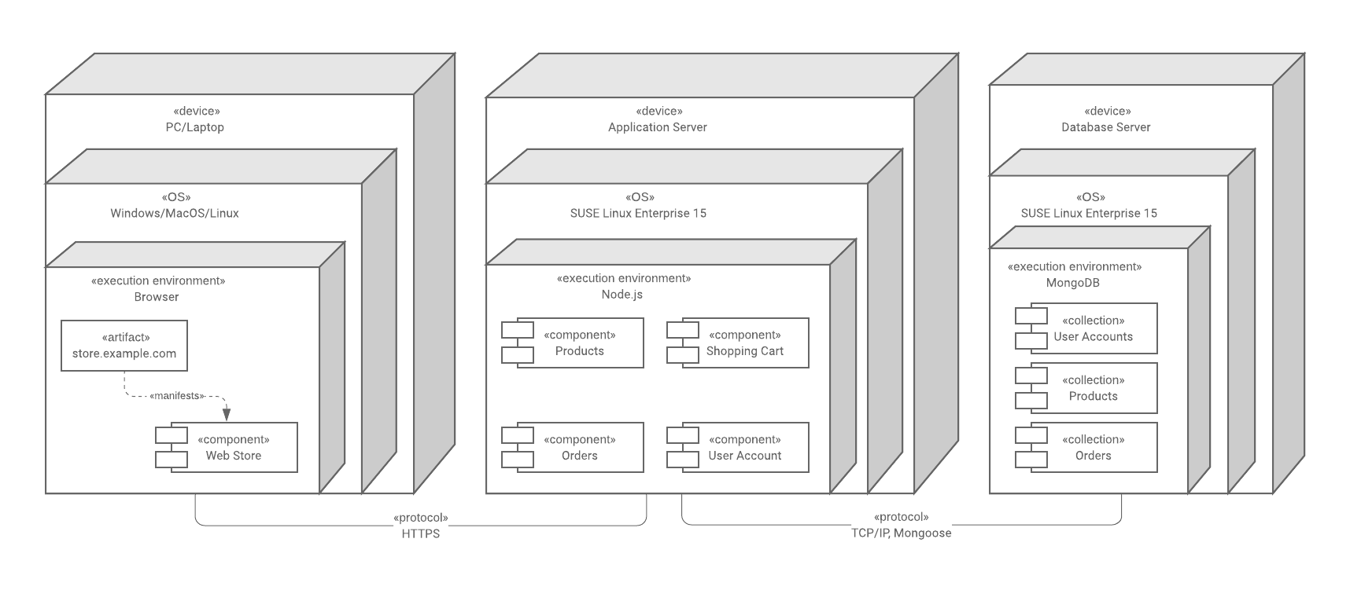
Deployment Diagrams
Notes:
Deployment diagrams show how software is deployed on hardware components in a system. These diagrams are most useful for systems engineers, and they usually show performance, scalability, maintainability, and portability. When hardware components are displayed in relation to each other, it’s easier to keep track of your entire hardware mesh and make sure that all elements are accounted for in a deployment.

Slide 9
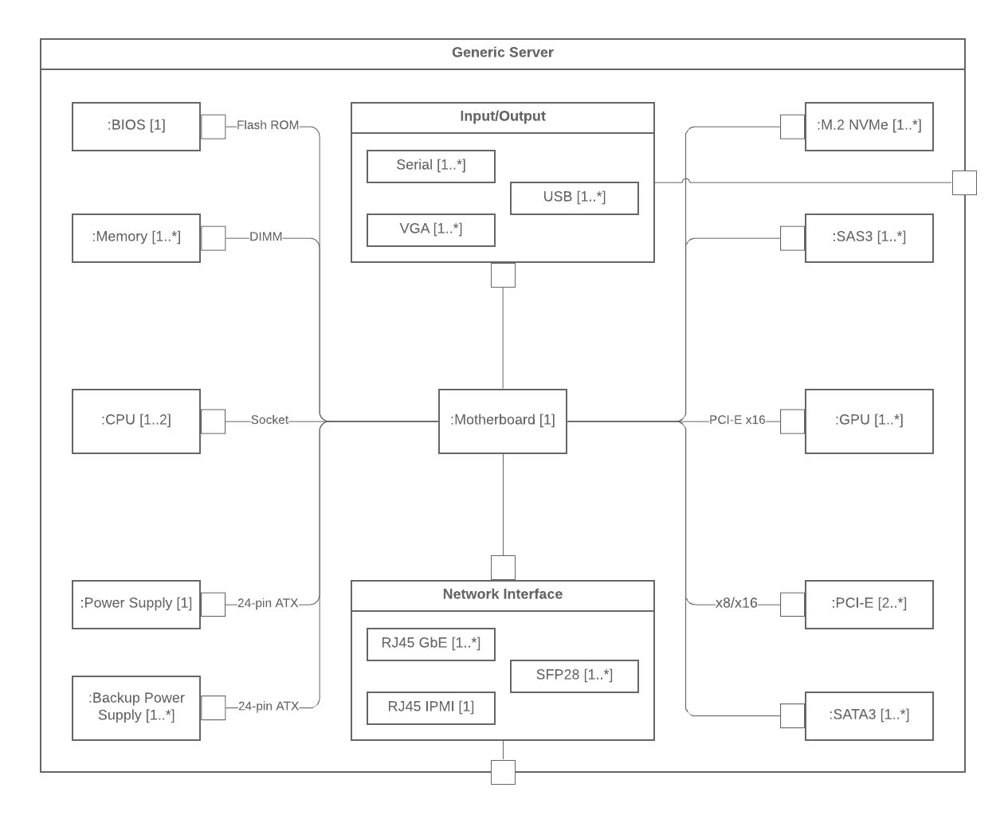
Composite Structure Diagrams
Notes:
Composite Structure Diagrams show the internal part of a class. They can also be used to show the behavior of collaboration or the classifier interactions with their environment through ports. They can easily depict the internal components of any hardware to more thoroughly understand the inner workings.

Slide 10
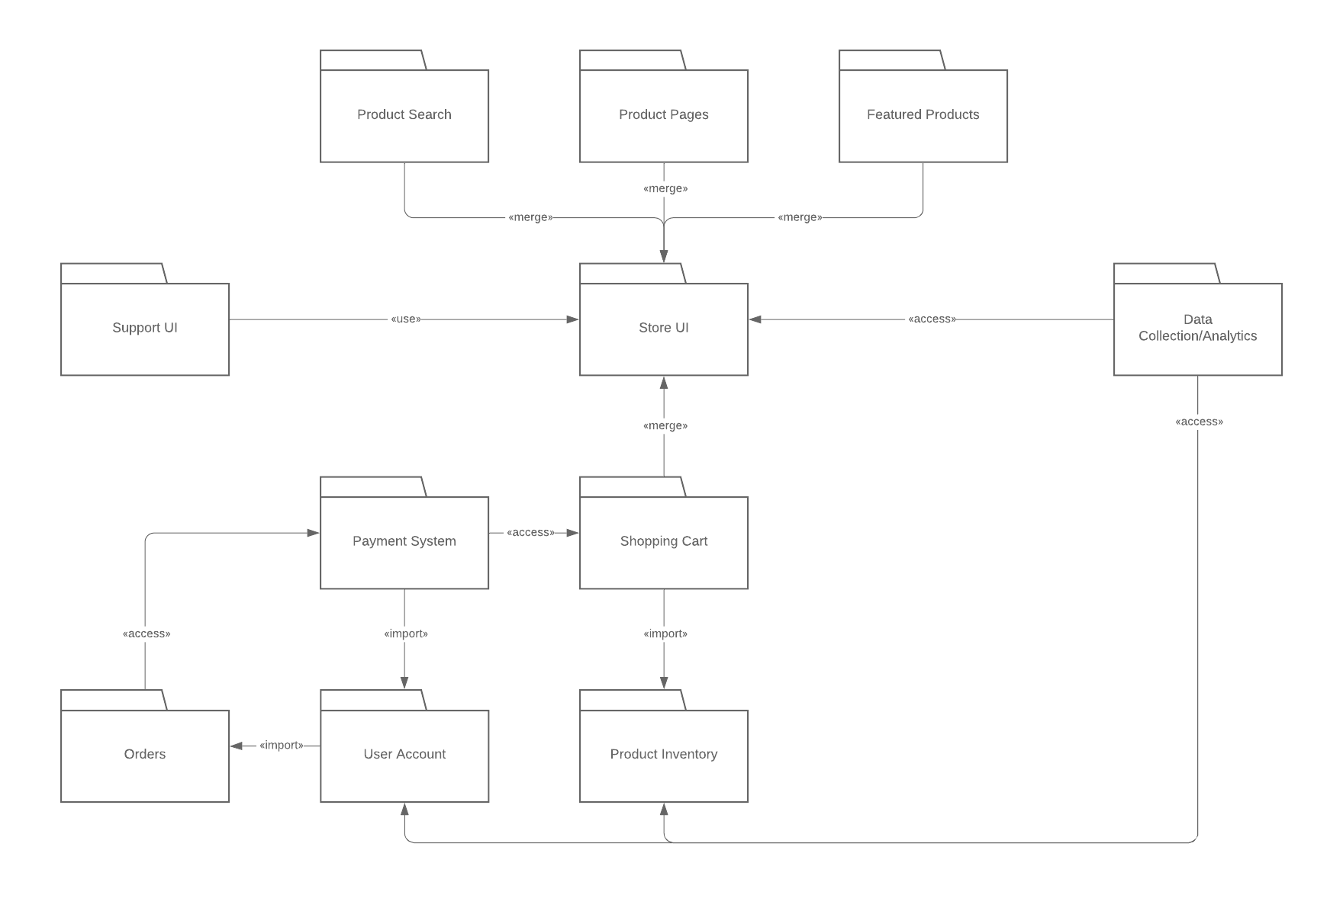
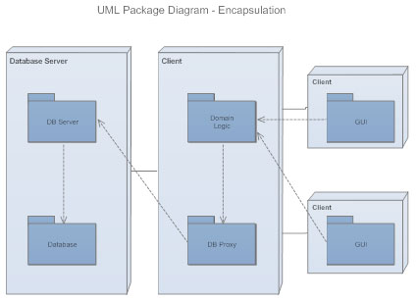
Package Diagrams
Notes:
Package diagrams are a subset of class diagrams, but developers sometimes treat them as a separate technique. Package diagrams organize elements of a system into related groups to minimize dependencies between packages. They are used to show dependencies between different packages in a system. A package, depicted as a file folder, organizes model elements, such as use cases or classes, into groups.

Slide 11
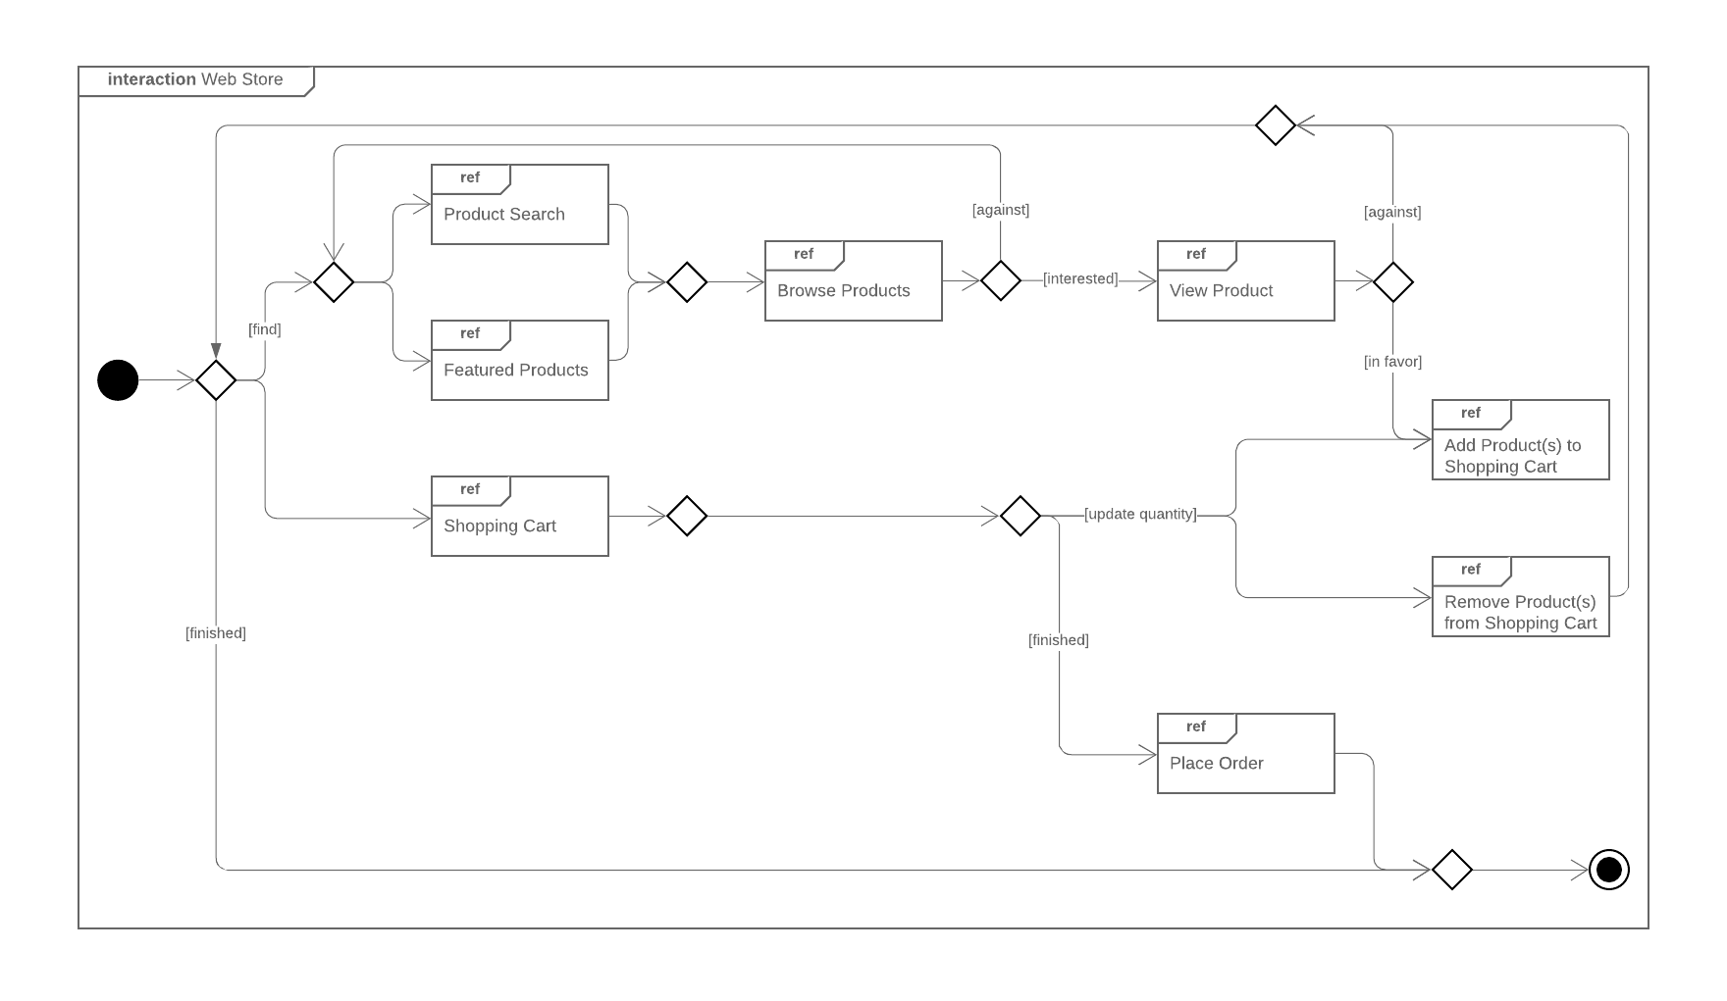
Interaction Overview Diagrams
Notes:
Interaction Overview Diagram overviews the flow of control between interacting nodes. They include initial nodes, flow final nodes, activity final nodes, decision nodes, merge nodes, fork nodes, and join nodes.
Timing Diagram: is a type of behavioral or interaction UML diagram that focuses on processes that take place during a specific period of time. They're a special instance of a sequence diagram, except time is shown to increase from left to right instead of top-down.

Slide 12
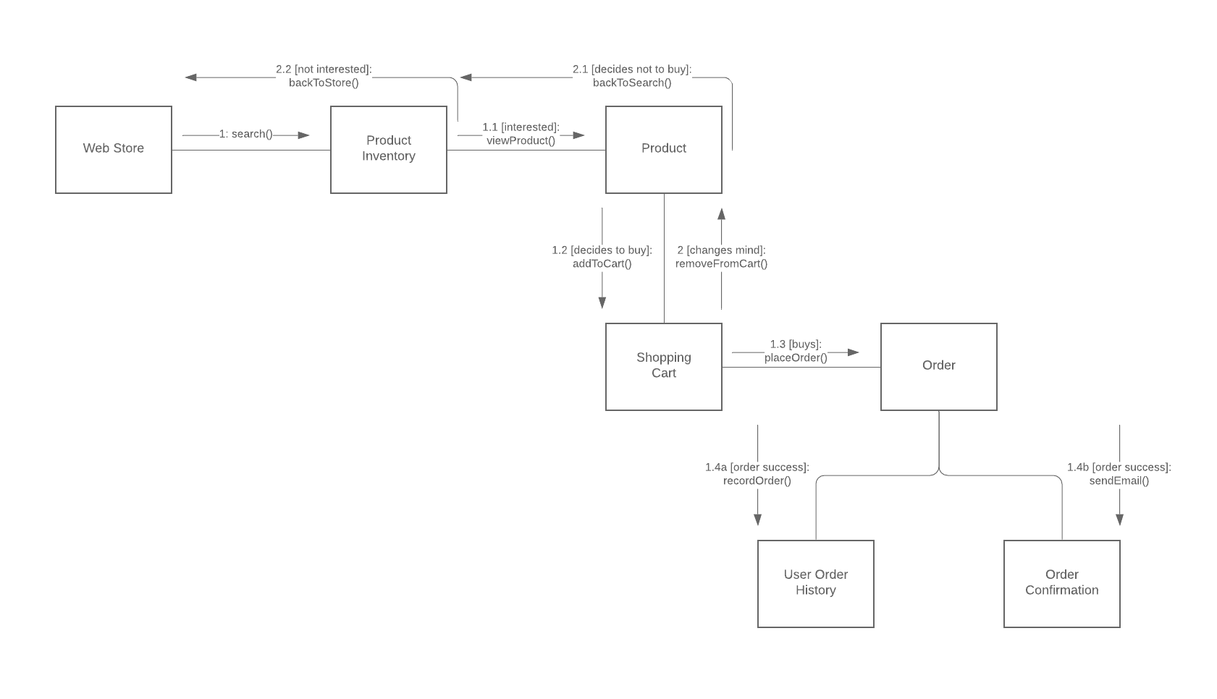
Communication Diagrams
Notes:
Communication diagrams, which used to be called collaboration diagrams, show how objects relate to each other. They model the way objects associate and connect through messages within an architectural design of a system. They can also show alternative scenarios within use cases or operations that require the collaboration of different objects and interactions.

Slide 13
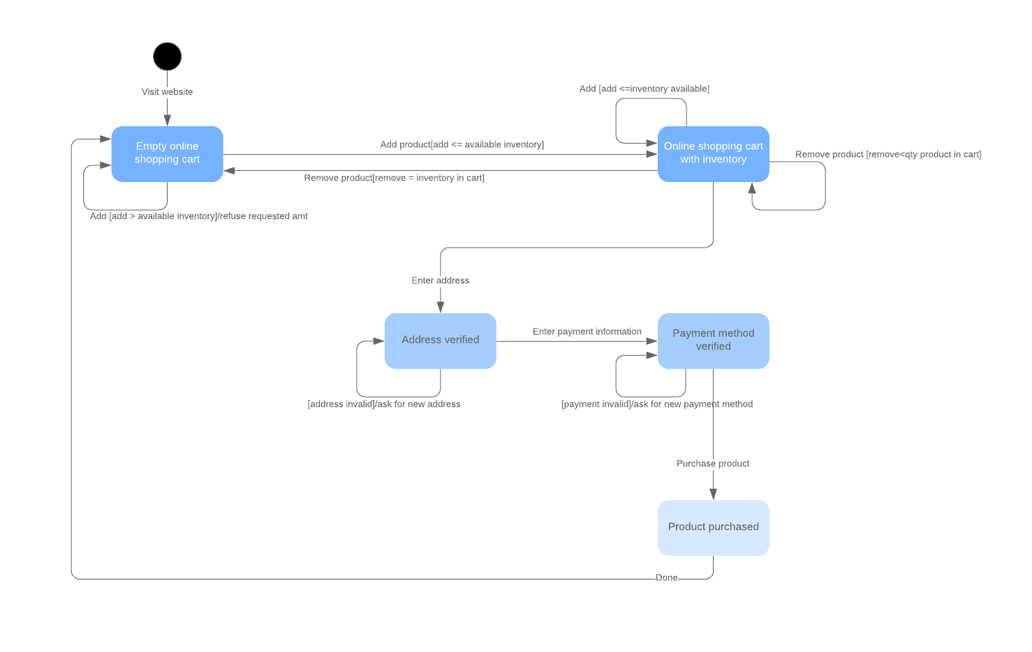
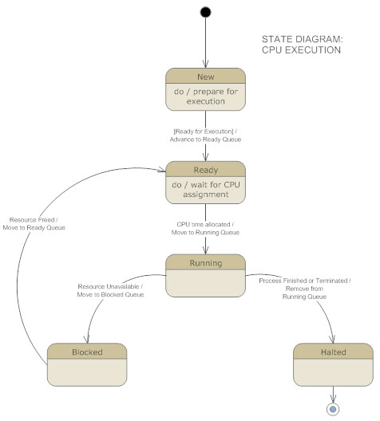
State Diagrams
Notes:
State diagrams, simply put, depict states and transitions. A state refers to the different combinations of information that an object can hold, and this UML diagram can visualize all possible states and the way the object transitions from one state to the next.

Slide 14
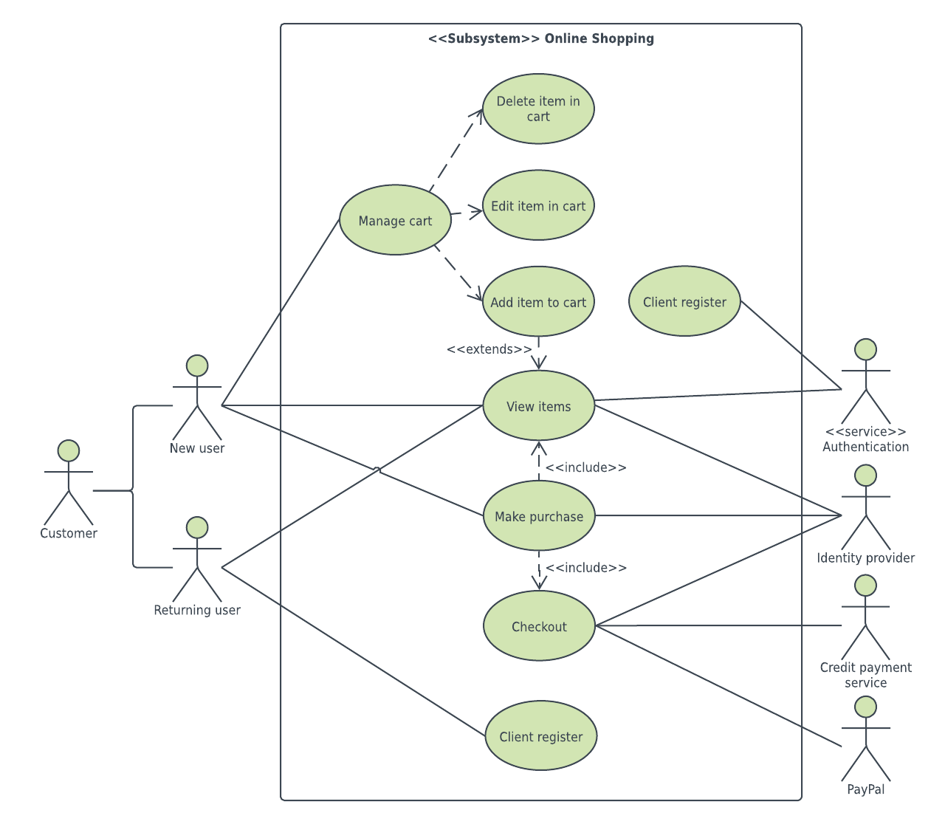
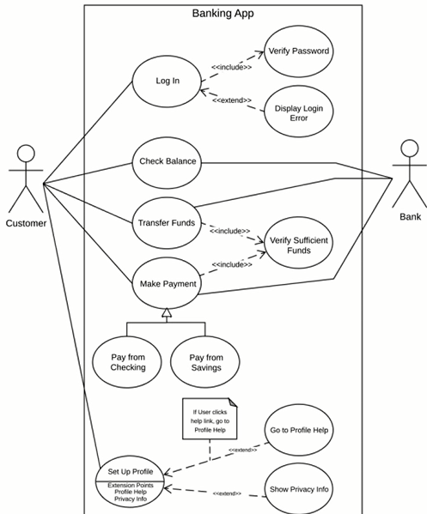
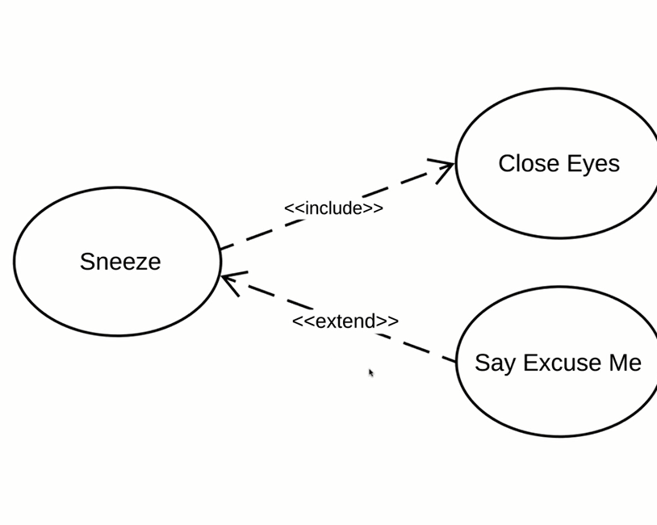
Use Case Diagrams
Notes:
Use case diagrams model how users, displayed as stick figures called “actors,” interact with the system. This type of UML diagram should be a high-level overview of the relationships between actors and systems, so it can be a great tool for explaining your system to a non-technical audience.
Primary Actors: initiates the use of the system, e.g customer. (should be at the left of the system)
Secondary Actors: Reactionary, e.g bank (only acts when customer does sth) (should be at the right of the system).
<<extend>> when the base use case is executed, extend use case, will be run sometimes if certain criteria are met. (you have the option to extend the base use case)
Example: login & display login error (only happens when a customer enters a wrong password).
<<include>> shows dependencies between a base use case and an included use case, in another word a base use case needs included use case in order to be completed.
Example: login & verify a password (every time a customer logs in, our banking app verifies the password automatically).
We also have use case with extension points, a generalization between an actor and sub-actors and a note on the association.

Slide 15
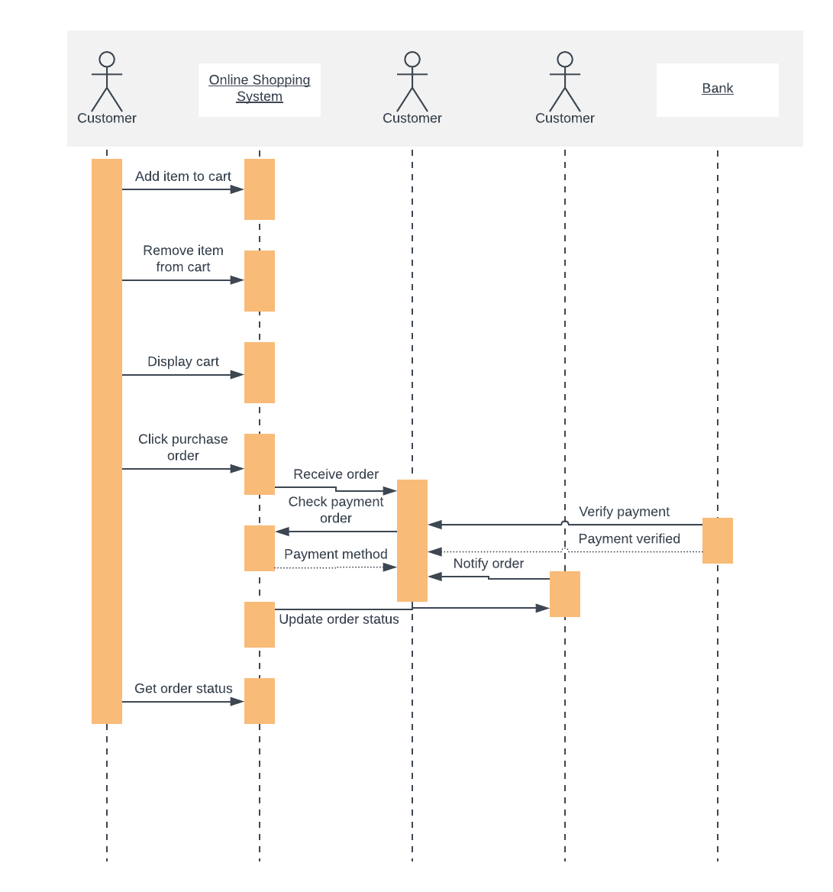
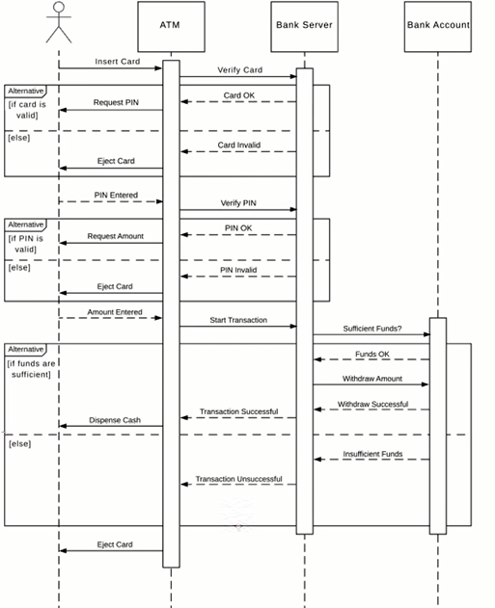
Sequence Diagrams
Notes:
A sequence diagram describes interactions among classes in terms of an exchange of messages over time as lifelines, sometimes referred to as an event diagram or an event scenario, and shows the order in which objects interact. This way, you can visually represent simple runtime scenarios.
The alternative frame simplifies a choice between two objects, e.g a card is valid and it’s not valid.
Actorsare external objects and they do not need the activation box.

Slide 16
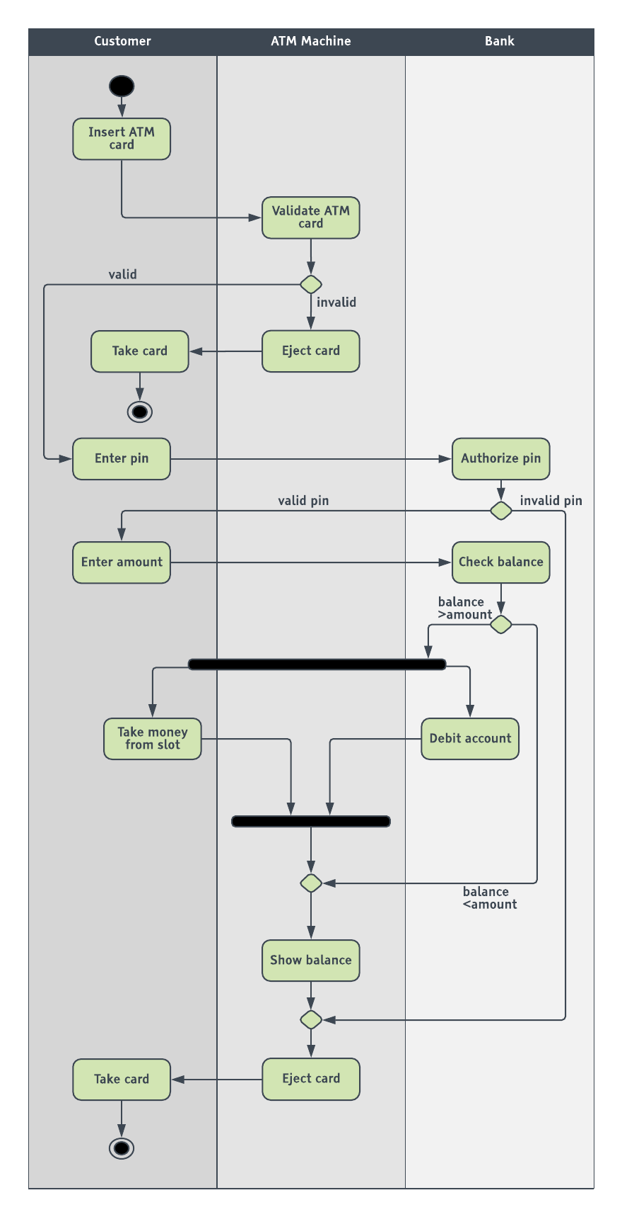
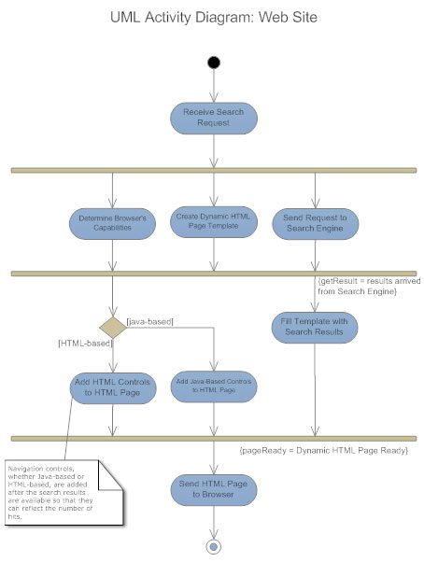
Activity Diagrams
Notes:
Activity diagrams illustrate the dynamic nature of a system by modeling the flow of control from activity to activity. An activity represents an operation on some class in the system that results in a change in the state of the system. Typically, activity diagrams are used to model workflow or business processes and internal operation

Slide 17
Textual Use Case
Description Example
Passenger
PurchaseTicket
1. Name: Purchase ticket
2. Participating actor: Passenger
3. Entry condition:
Passenger stands in front of ticket distributor
Passenger has sufficient money to purchase ticket
4. Exit condition:
Passenger has ticket
5. Flow of events:
  1. Passenger selects the number of zones to be traveled
  2. Ticket Distributor displays the amount due
  3. Passenger inserts money, at least the amount due
  4. Ticket Distributor returns change
  5. Ticket Distributor issues ticket
6. Special requirements: None.
Notes:
The textual use case description consists of 6 parts:
Unique name
Participating actors
Entry conditions
Exit conditions
Flow of events
Special requirements.

Slide 18
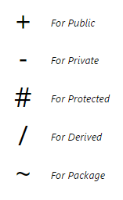
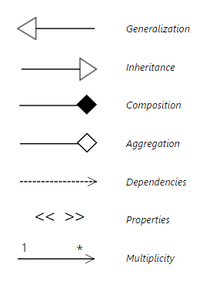
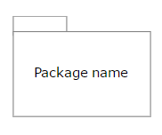
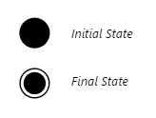
UML Diagram Symbols
There are many different types of UML diagrams and each has a slightly different symbol set.
Class diagrams are perhaps one of the most common UML diagrams used and class diagram symbols center around defining the attributes of a class. For example, there are symbols for active classes and interfaces. A class symbol can also be divided to show a class's operations, attributes, and responsibilities.
Visibility of any class members is marked by notations of:
Notes:
[2] Lines are also important symbols to denote relationships between components. Generalization and Inheritance are denoted with empty arrowheads. The composition is shown with a filled-in diamond. Aggregation is shown with an empty diamond. Dependencies are marked with a dashed line with an arrow. Using << >> allows you to indicate the properties of that dependency. Multiplicity is usually shown with a number at one end of the arrow and a * at the other.
[3] Package diagrams have symbols defining a package that looks like a folder.
[4] Activity diagrams have symbols for activities, states, including separate symbols for an initial state and a final state. The control flow is usually shown with an arrow and the object flow is shown with a dashed arrow.

