Slide 1
AI-Driven Predictive Maintenance and Asset Reliability Decision-Support System
Presenter: Malak Philippe Sadek Reiad
ARAB ACADEMY FOR SCIENCE, TECHNOLOGY AND MARITIME TRANSPORT
Graduate School of Business (GSB), Miami · Data Analytics for AI Business · Group 9226
Executive briefing · Capstone Project · Team 3
Team members
Malak Philippe Sadek Reiad · Ahmed Fawzy Mohamed Rashed · Ahmed Abd Elhakam Abd Elfattaah Zaian · Khaled Abdelnasser Morsi Amer · Ali Elraey
Instructors
Dr. Yasser Aly Yakout Shehata · Dr. Hossam Daoud · October 2026
Notes:
PRESENTER: Malak Philippe Sadek Reiad (0:30)
Good morning. I am Malak, and with me are Ahmed Rashed, Ali, Ahmed Zaian and Khaled. We are Team 3, and our capstone is an AI-driven predictive maintenance and asset reliability decision-support system for a company that runs heavy equipment, railway signalling, medical equipment, pumps and power systems.
ARABIC BRIEF (say at the end of the slide):
صباح الخير. نحن الفريق الثالث، ومشروعنا نظام لدعم قرارات الصيانة التنبؤية.

Slide 2
The decision we support: where to focus maintenance effort to cut downtime and lost production
Presenter: Malak Philippe Sadek Reiad
The problem
Four executive questions
The company records completed maintenance work, but cannot see which assets will fail next, what a failure really costs, or which job should come first.
Q1
How large is the cost of downtime compared with maintenance spending?
Decision: Budget basis
Q2
Which assets, criticality levels and strategies concentrate the loss?
Decision: Where to focus
Our decision domain
Q3
Which conditions give early warning of failure?
Condition
Failures
Work orders
Decision: When to inspect
Downtime
Economic impact
Q4
Can a model rank risk better than a simple rule?
Decision: Whether to use a watchlist
Notes:
PRESENTER: Malak Philippe Sadek Reiad (0:40)
The company records completed maintenance work, but cannot see which assets will fail next, what a failure really costs, or which job comes first. So our decision is: where should maintenance, technician and spare-parts effort go to cut downtime and lost production? We turned it into four executive questions, which the briefing answers in order.
ARABIC BRIEF (say at the end of the slide):
القرار: أين نوجّه جهد الصيانة لتقليل التوقف وخسائر الإنتاج؟

Slide 3
We started with the decision, then built measures we can trust
Presenter: Malak Philippe Sadek Reiad
1
Questions
2
Trusted measures
3
Performance
4
AI
Decision, stakeholders and eight business questions
Data checks; every KPI calculated from totals
EDA and the Power BI dashboard
Four methods, each against a simple baseline
Data checks passed
Issues we found and fixed
How we managed the project
5,000 records, 60 variables
No missing values or duplicates
Availability, MTBF and work-order rules hold
Totals match the workbook
Asset codes are not real assets
Stored MTTR column is wrong
SLA score 75.8% vs 46.1% actually met
18% of maintenance cost unexplained
One owner per work area
Weekly integration meeting
One shared set of KPI definitions
Final cross-check of all three files
Notes:
PRESENTER: Malak Philippe Sadek Reiad (0:45)
We started with the decision, then built measures we can trust. The data had no missing values or duplicates, but we found four issues, such as asset codes that are not real assets and an SLA score that overstates performance. We corrected the measures, not the data. Each member owned one area and we met weekly.
I will now hand over to Ahmed Rashed, who built our Power BI dashboard.
ARABIC BRIEF (say at the end of the slide):
تحققنا من البيانات وصححنا المقاييس. والآن أسلّم الكلمة لأحمد راشد.

Slide 4
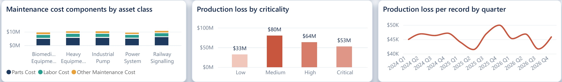
Downtime, not maintenance, is the real cost: $4.50 lost for every $1 spent
Presenter: Ahmed Fawzy Mohamed Rashed
$228.9M
$50.4M
$2,513
313 h
Production loss, 2024–2026
Maintenance cost
Cost of one downtime hour
MTBF, despite 97% availability
Dashboard, Cost & Loss page: maintenance cost components, production loss by criticality, and loss per record by quarter
$6,638 vs $30,128
92%
$41.5K–$50.0K
Repair cost vs lost output for an average failure
of maintenance money is spent after a failure (corrective work)
Loss per record in every quarter: a stable baseline to beat
Notes:
PRESENTER: Ahmed Fawzy Mohamed Rashed (1:00)
Thank you, Malak. I am Ahmed Rashed, and I will start with the headline from our dashboard.
Over three years the company spent 50.4 million dollars on maintenance but lost 228.9 million dollars of production while equipment was down. That is four and a half dollars lost for every dollar spent, and about 2,513 dollars for every hour of downtime. An average failure costs about 6,600 dollars to repair but 30,100 dollars in lost output, and 92 percent of the maintenance budget is spent after something has already failed. The dashboard strip shows loss per record staying between 41,500 and 50,000 dollars every quarter.
So the useful question is not how much we spend, but how many downtime hours we prevent.
ARABIC BRIEF (say at the end of the slide):
الخسارة الحقيقية في التوقف وليست في الصيانة: خسائر الإنتاج 228.9 مليون دولار مقابل 50.4 مليون للصيانة، وكل ساعة توقف تكلف نحو 2,513 دولارًا.

Slide 5
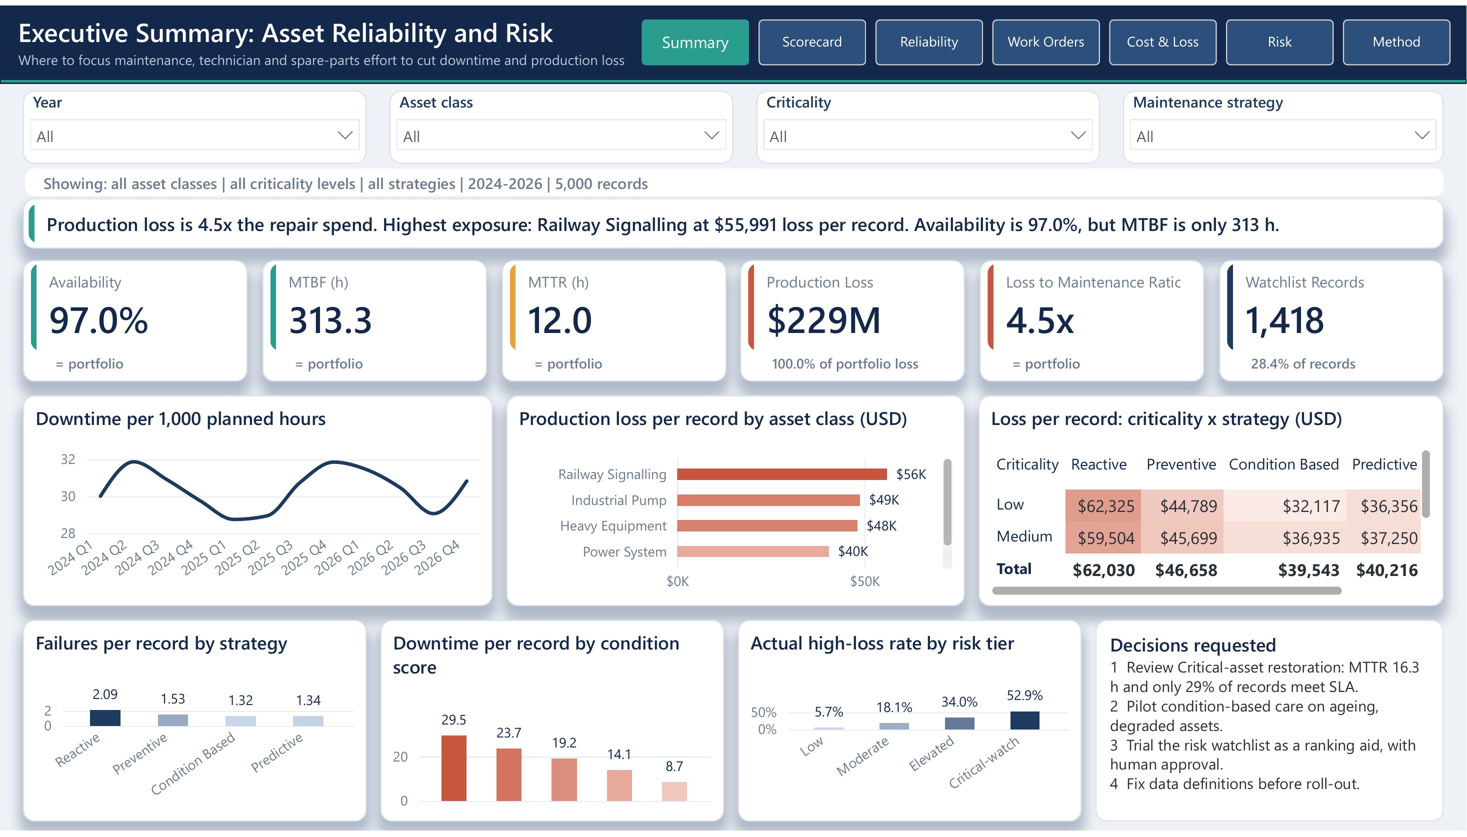
Our Power BI dashboard takes managers from the big picture to the record that needs action
Presenter: Ahmed Fawzy Mohamed Rashed
Eight pages, one data model
Summary and KPI Scorecard
Reliability · Work Orders · Cost & Loss
Risk: model watchlist and exception list
Method: definitions and data notes
Drill-through to one asset class
Live demo path
Filter Criticality = Critical
Read the criticality × strategy matrix
Drill through Railway Signalling
Open the Risk page
Filters for year, asset class, criticality and strategy on every page. Data is embedded in the PBIX file.
Notes:
PRESENTER: Ahmed Fawzy Mohamed Rashed (2:00)
Let me show you how managers can explore this. I built the dashboard in Power BI as one data model with eight pages, shared filters for year, asset class, criticality and strategy, and a drill-through page.
Live demo: on the Summary page, the KPI cards compare any selection with the whole fleet. If I filter to Critical assets, repair time rises to 16.3 hours and only 29 percent meet the service target. The matrix shows that critical assets under reactive maintenance are the most expensive group. Right-clicking Railway Signalling opens the drill-through page with its records ranked by loss. Finally, the Risk page gives planners the model's watchlist. All rates are calculated from totals, and the data is embedded in the file.
The dashboard shows where the loss sits. To explain why, I will hand over to Ali, who will take you through reliability, repair times and spare parts.
ARABIC BRIEF (say at the end of the slide):
لوحة Power BI من ثماني صفحات تنقلنا من الصورة العامة إلى السجل الذي يحتاج إلى إجراء. والآن أسلّم الكلمة لعلي ليشرح الموثوقية وأوقات الإصلاح وقطع الغيار.

Slide 6
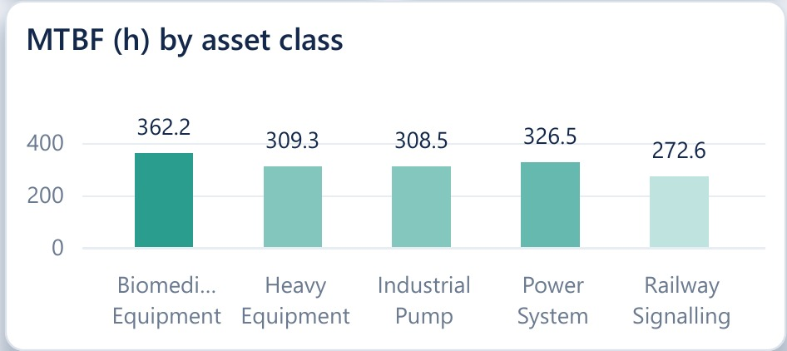
Critical assets do not fail more often, but take 16.3 hours to repair
Presenter: Ali Elraey
Dashboard, Reliability page: MTBF by asset class
320 h
+5.2 h
≈2,660 h/yr
≈$6.7M/yr
MTBF of critical assets: the same as other tiers (307–317 h)
longer repair per critical failure than other tiers (16.3 vs 11.1 h)
extra critical downtime: 508 failures a year × 5.2 h
production lost to slow critical repairs, at $2,530 per critical hour
Notes:
PRESENTER: Ali Elraey (1:30)
Thank you, Ahmed. I am Ali, and my part is reliability, measured by MTBF, the average running time between failures, and MTTR, the average time to repair.
By asset class, Railway Signalling is the weakest, with an MTBF of 273 hours, 25 percent below Biomedical Equipment at 362 hours. But the most important finding is about critical assets. We expected them to fail more often, but they do not: their MTBF is 320 hours, the same as the other tiers. The difference is repair time: 16.3 hours per failure against about 11, and only 29 percent of their jobs meet the service target, against about half for the others.
In numbers: 508 critical failures a year, each taking 5.2 hours longer, add about 2,660 hours of downtime, roughly 6.7 million dollars of lost production every year. So for critical assets the lever is faster repair, not fewer failures.
ARABIC BRIEF (say at the end of the slide):
الأصول الحرجة لا تتعطل أكثر من غيرها، لكن إصلاحها يستغرق 16.3 ساعة، ما يضيف نحو 2,660 ساعة توقف و6.7 مليون دولار سنويًا.

Slide 7
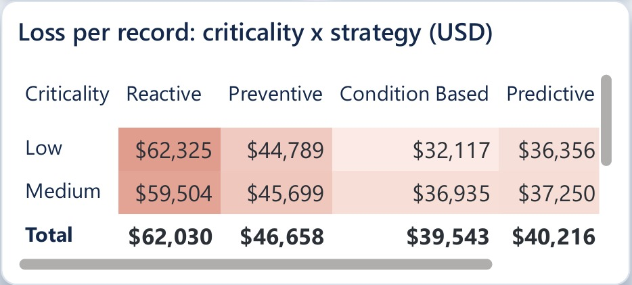
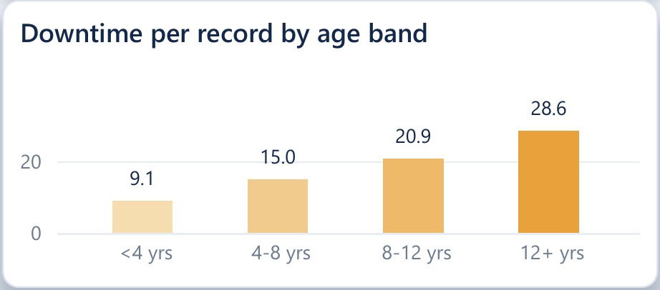
Reactive care and ageing assets drive the loss, and critical assets get the least spare parts
Presenter: Ali Elraey
Dashboard, Summary page: loss per record by criticality × strategy
Dashboard, Reliability page: downtime per record by asset age
2.09 vs 1.32
$12.3K vs $9.4K
$15–17K
9.0¢ vs 12.6¢
failures per record: reactive vs condition-based (+58%)
maintenance cost per record: reactive is not even cheaper to maintain
extra loss per reactive record after adjusting for age, condition, criticality and class
parts per $1 of loss for critical assets; +$0.81M a year closes the gap
Notes:
PRESENTER: Ali Elraey (1:30)
Two more patterns. First, maintenance strategy. Reactive maintenance, fixing only after failure, loses about 62,000 dollars per record against about 40,000 for condition-based care. Because strategies are not assigned at random, we adjusted for age, condition, criticality and class, and the gap is still 15 to 17 thousand dollars. Reactive records also fail 58 percent more often and cost more to maintain, about 12,300 dollars against 9,400. The worst group is critical assets under reactive care, at almost 90,000 dollars per record. Second, age: assets older than 12 years have three times the downtime of new ones.
From the procurement side, critical assets receive only 9 cents of spare parts for every dollar of loss, against 12.6 cents for the rest. Closing that gap would cost about 0.8 million dollars a year, and it pays for itself if it prevents about 320 hours of critical downtime. These are associations in synthetic data, so we propose trials, not fleet-wide changes.
These patterns raise a natural question: can we see the risky jobs before they fail? For that, I will hand over to Ahmed Zaian, who will explain how we used AI.
ARABIC BRIEF (say at the end of the slide):
الصيانة التفاعلية هي الأعلى تكلفة، والأصول القديمة تتوقف ثلاثة أضعاف، والأصول الحرجة تحصل على أقل نصيب من قطع الغيار. والآن أسلّم الكلمة لأحمد زيان ليشرح استخدامنا للذكاء الاصطناعي.

Slide 8
We used AI only where it answers a business question, and tested it fairly
Presenter: Ahmed Abd Elhakam Abd Elfattaah Zaian
TRAIN · Jan 2024 – Aug 2025 · 3,340 records
TEST · Sep 2025 – Dec 2026 · 1,660
Models are always judged on a later period they have never seen, using only information known before the job starts.
Method | Business question | Baseline | Result
Risk classification | Which jobs need review first? | Rate by class × criticality | Clearly better
Downtime regression | How long will downtime be? | Class × criticality average | Slightly better
Clustering | Which assets need different care? | Stability check | Descriptive only
Forecasting | How much downtime to plan for? | Last value, trend | Average is best
Leakage rule: we excluded downtime, cost and the supplied Asset Health Index, which already contains the outcome.
Notes:
PRESENTER: Ahmed Abd Elhakam Abd Elfattaah Zaian (1:00)
Thank you, Ali. I am Ahmed Zaian, and my part is automation and the use of AI. We chose methods only where they answer a business question, and we judged each one against a simple baseline.
To make the test fair, we trained on the first 20 months and tested on the last 16 months, which the models never saw. We also used only information a planner has before a job starts; for example, we excluded the supplied health index because it already contains the outcome. We tested four methods: a risk classification, a downtime regression, a clustering of asset profiles and a simple forecast.
ARABIC BRIEF (say at the end of the slide):
اخترنا أساليب الذكاء الاصطناعي لأنها تجيب عن أسئلة عمل، وقارنا كل نموذج بخط أساس بسيط مع تقسيم زمني ومنع تسرب البيانات.

Slide 9
Not every model added value, and we report that openly
Presenter: Ahmed Abd Elhakam Abd Elfattaah Zaian
Downtime regression
Condition clustering
Quarterly forecast
Error 10.2 h vs 11.8 h for the baseline
Ageing, degraded groups lose ~2× per record
Long-run average error 2.5% vs 3.8% (last value)
Too imprecise for single jobs; not used
Stable but weakly separated; descriptive only
Downtime is stable; plan on the average
Two principles we kept
A model that adds little value is still a valid finding. · Predicting risk is not the same as saving money.
Notes:
PRESENTER: Ahmed Abd Elhakam Abd Elfattaah Zaian (0:55)
Let me be honest about three of these methods. The downtime regression improved the error only from 11.8 to 10.2 hours, which is not precise enough for single jobs. The clustering found stable groups, with ageing, degraded assets losing about twice as much, but the groups are not very distinct. And for forecasting, a simple long-run average beat the trend model.
As the brief says, a model that adds little value is still a valid finding, and predicting risk is never the same as saving money.
ARABIC BRIEF (say at the end of the slide):
بعض النماذج لم تضف قيمة كبيرة، وهذه نتيجة صحيحة أيضًا؛ والتنبؤ بالمخاطر لا يعني تحقيق وفورات.

Slide 10
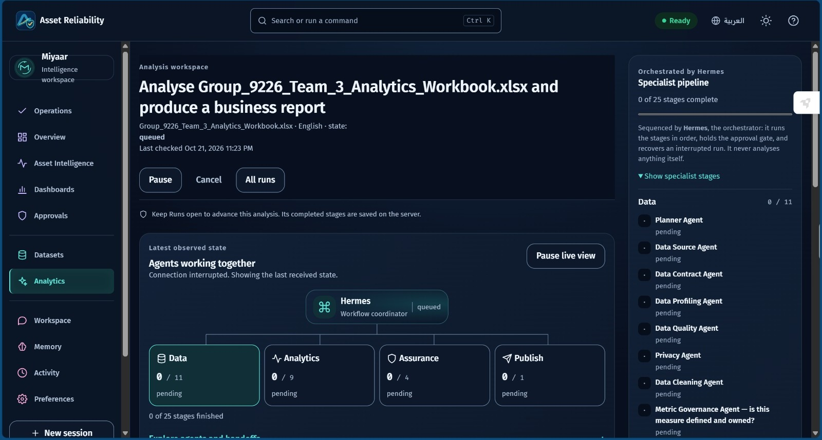
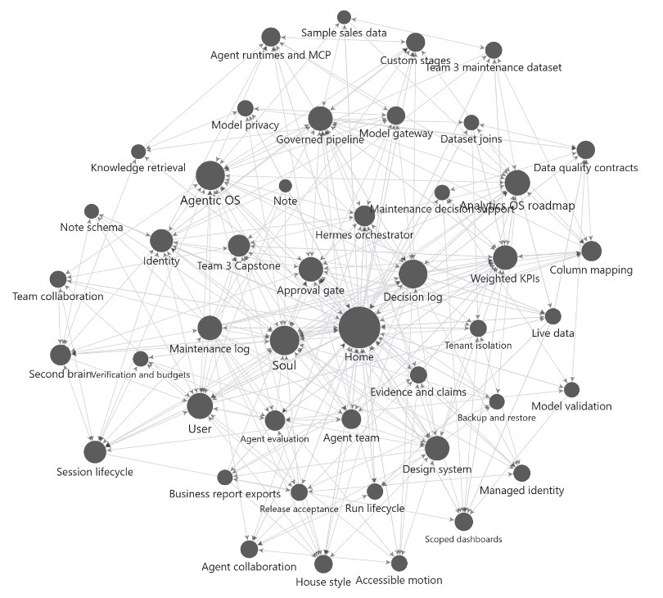
From analysis to automation: a prototype that repeats the work with human approval
Presenter: Ahmed Abd Elhakam Abd Elfattaah Zaian
How it works
Hermes runs specialist agents in four groups: data, analytics, assurance, publish
Same KPI definitions as our dashboard
Every figure is calculated, never written by a language model
Nothing is published without human approval
Our project knowledge base: decisions, KPIs and agent rules linked together
Agent pipeline run on our analytics workbook, orchestrated by Hermes
Prototype only: the online demo uses sample data. It supports our analysis; it does not replace it.
Notes:
PRESENTER: Ahmed Abd Elhakam Abd Elfattaah Zaian (1:05)
To make this analysis repeatable, we also built a working prototype called Asset Reliability, described in a separate appendix. An orchestrator called Hermes runs specialist agents in four groups: data, analytics, assurance and publishing. They check the data, calculate the same KPIs as our dashboard and draft a report. Every figure is calculated, never written by a language model, and nothing is published until a person approves it. The online demo uses sample data; it supports our analysis and does not replace it.
The one method that clearly added value is the risk classification. I will now hand over to Khaled, who built the risk model and the financial case, and who will take us through to our recommendations.
ARABIC BRIEF (say at the end of the slide):
طورنا نموذجًا أوليًا يحوّل التحليل إلى عملية متكررة مع موافقة بشرية قبل النشر. والآن أسلّم الكلمة لخالد ليعرض نموذج المخاطر والجدوى المالية والتوصيات.

Slide 11
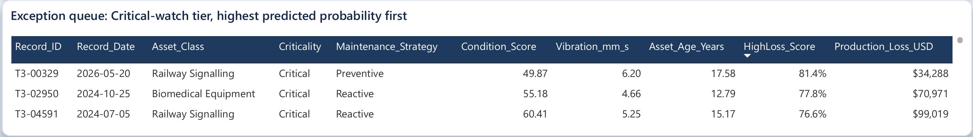
The risk model ranks high-loss jobs better than a simple rule: 0.73 vs 0.61
Presenter: Khaled Abdelnasser Morsi Amer
$99.8M of $228.9M
loss sits in the 1,418 watchlist records (28% of records, 44% of loss)
~50% false alarms
in the top tier, so a person approves every change in priority
Dashboard, Risk page: exception queue. Top jobs are critical, 13–18 years old, with condition scores below 61 and high vibration.
Notes:
PRESENTER: Khaled Abdelnasser Morsi Amer (1:05)
Thank you, Ahmed. I am Khaled. The risk model predicts which jobs will become high-loss events, the top 20 percent of losses. On the unseen period it scores 0.73, where 0.5 is a coin flip, against 0.61 for a simple rule; a more complex model did no better, so we kept the simple, explainable one.
In the highest tier, 53 percent of jobs became high-loss, against 20 percent overall. The watchlist holds 28 percent of records but 44 percent of all loss, about 99.8 million dollars, and the exception queue shows the jobs it flags first: critical, 13 to 18 years old, with low condition scores. About half of the top alerts are false alarms, so a person must approve every change in priority.
ARABIC BRIEF (say at the end of the slide):
نموذج المخاطر يتفوق على القاعدة البسيطة (0.73 مقابل 0.61)، وقائمة المراقبة تحمل 44% من الخسائر، مع موافقة بشرية.

Slide 12
Financial simulation: three levers, three scenarios, built from our own data
Presenter: Khaled Abdelnasser Morsi Amer
36,530 h
$92.1M
$2,513
$342
Downtime per year (baseline)
Production loss per year
Value of one downtime hour
Cost of one inspection (6.5 h × $52.69)
Lever | Conservative | Expected | Optimistic
1. Faster critical repairs: share of MTTR gap closed | 25% | 50% | 75%
with spares uplift to 12.6¢ per $ of loss | 50% | 100% | 100%
2. Reactive records moved to condition-based | 25% | 50% | 75%
share of the $16.6K adjusted gap achieved | 50% | 75% | 100%
3. Watchlist high-loss events prevented | 10% | 20% | 30%
Baseline = 2024–2025 annual run-rate. Costs from the dataset only. Three years, 10% discount rate. Critical and reactive jobs removed from lever 3 to avoid double counting.
Notes:
PRESENTER: Khaled Abdelnasser Morsi Amer (0:50)
What is all this worth? I built a financial simulation from the dataset itself. The baseline is a typical year: about 36,500 downtime hours and 92 million dollars of production loss. We simulated three levers: faster critical repairs with extra spare parts, moving reactive work to condition-based care, and inspecting watchlist jobs. All costs come from the data, for example 342 dollars per inspection, and we ran conservative, expected and optimistic scenarios over three years at a 10 percent discount rate.
ARABIC BRIEF (say at the end of the slide):
بنينا محاكاة مالية من البيانات بثلاث روافع وثلاثة سيناريوهات.

Slide 13
Expected result: about 2,770 downtime hours and $6.6M net saved per year
Presenter: Khaled Abdelnasser Morsi Amer
2,766 h
$6.6M
Downtime avoided per year (7.6%)
Net benefit per year (range $2.9–11.3M)
Expected scenario | Hours / yr | Cost / yr | Net / yr | Payback
Critical repairs + spares | 1,332 | $0.81M | $2.56M | 2.9 mo
Reactive → condition-based | 792 | $0.00M* | $2.47M | immediate*
Watchlist inspections | 642 | $0.09M | $1.53M | 0.6 mo
Total | 2,766 | $0.89M | $6.56M | 1.4 mo
3-year NPV at 10%: $16.3M expected ($7.2M–$28.1M). Spares pay back if repair time closes 12% of the gap; inspections if they prevent about one event a year.
*No extra cost visible in the data. Estimates on synthetic data, not achieved savings; sensors and programme costs excluded.
Notes:
PRESENTER: Khaled Abdelnasser Morsi Amer (1:05)
In the expected scenario the three levers avoid about 2,766 downtime hours a year, 7.6 percent of today's downtime. After costs, the net benefit is about 6.6 million dollars a year and the three-year NPV about 16.3 million, with a range of 2.9 to 11.3 million a year. Faster critical repairs is the biggest lever, about 2.6 million net with a three-month payback, and the watchlist costs only 90 thousand dollars of inspections. These are estimates on synthetic data, not achieved savings.
With the evidence and the financial case in place, I will hand back to Malak, who will present our recommendations and the decision we are asking for.
ARABIC BRIEF (say at the end of the slide):
نتجنب نحو 2,766 ساعة توقف سنويًا بصافي منفعة 6.6 مليون دولار. والآن أعيد الكلمة إلى ملاك لعرض التوصيات.

Slide 14
Six recommendations, each with evidence, an owner and a KPI
Presenter: Malak Philippe Sadek Reiad
1
Speed up critical repairs
≈1,330 h/yr
2
Trial condition-based care
≈790 h/yr
Queue priority, protected spares, escalation
Older, worn assets; start with critical × reactive
Owner: Planners + Procurement
Owner: Reliability engineers
3
Trial the risk watchlist
≈640 h/yr
4
Fix data definitions
Enabler
Run alongside planning; a person approves
Asset codes, costs, one SLA measure, MTTR
Owner: Reliability lead
Owner: KPI lead + Finance
5
Budget on downtime
1% ≈ $0.9M/yr
6
Reserve for large events
Risk control
Value proposals at $2,513 per hour
Use P90 loss $120K, not the $57K mean
Owner: Finance + Director
Owner: Finance controller
Hours are expected-scenario estimates from the simulation and remain unvalidated until a controlled trial confirms them.
Notes:
PRESENTER: Malak Philippe Sadek Reiad (0:40)
Thank you, Khaled. Bringing it together, we make six recommendations, each with an owner: speed up critical repairs, trial condition-based care on older assets, trial the watchlist with human approval, fix the data definitions, budget on downtime hours, and set reserves for large events. Recommendations 1, 4 and 6 need little investment and can start immediately; 2 and 3 should begin as controlled trials, with budget released only if downtime falls against a control group.
ARABIC BRIEF (say at the end of the slide):
ست توصيات لكل منها مسؤول ومؤشر أداء.

Slide 15
Next steps: act now, prove it in six months, then decide on scale
Presenter: Malak Philippe Sadek Reiad
0–30 days Act now
1–3 months Prove it
3–6 months Decide
Review critical work orders
Agree data definitions
Set P90 reserve policy
Watchlist alongside planning
Trial and control groups
Spares uplift for critical assets
Compare trial vs control
Go / no-go on watchlist
Budget on downtime hours
Decision requested today
Approve recommendations 1, 4 and 6 now, and fund a six-month controlled trial of condition-based maintenance and the risk watchlist, judged on downtime hours avoided against a control group.
Thank you. We welcome your questions.
Notes:
PRESENTER: Malak Philippe Sadek Reiad (0:25)
Our request today: approve recommendations 1, 4 and 6 now, and fund a six-month controlled trial judged on downtime hours avoided. On behalf of Team 3, thank you; we welcome your questions.
ARABIC BRIEF (say at the end of the slide):
نطلب الموافقة على التوصيات 1 و4 و6 وتمويل تجربة لستة أشهر. شكرًا لكم.

