Slide 1

COMP229 – Web Application Development Restaurant Registration System This project empowers restaurant owners to create personalized profiles, manage menus, and accept online reservations. The user-friendly interface, secure authentication, and real-time notifications enhance the dining experience. Customers can provide feedback through a review system, while administrators oversee multiple restaurants via an efficient dashboard. Leveraging React.js, Redux, Node.js, and MongoDB, this project modernizes the restaurant industry, fostering digital transformation and seamless operations.
Team Members - Akashkumar Parekh (301356589)
Chintan Patel (301361215)
Shivam Kaushik (301363333)
Gurpreet Kaur (301367758)
Alireza Farkhondeh (301282447)
Parth Savjani (301314290)

Slide 2
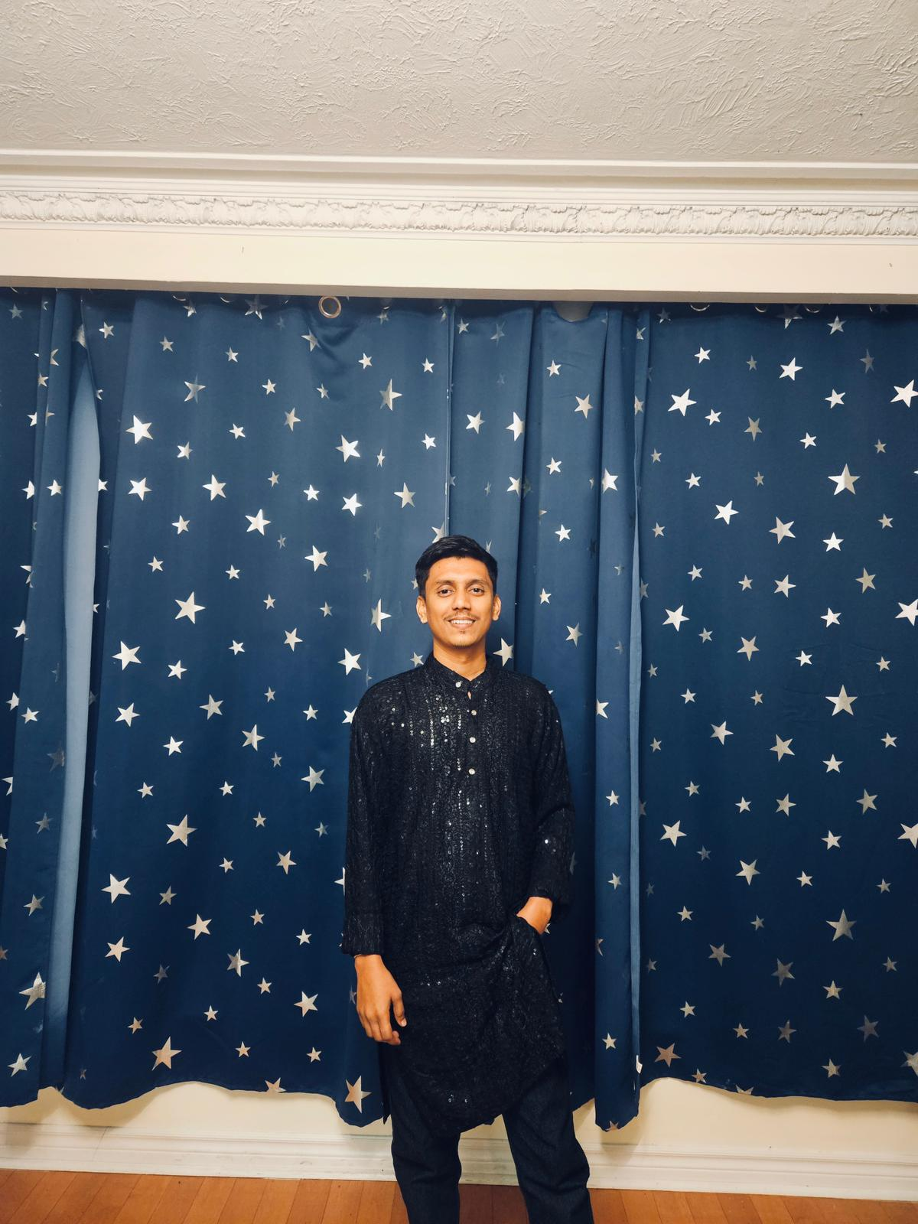
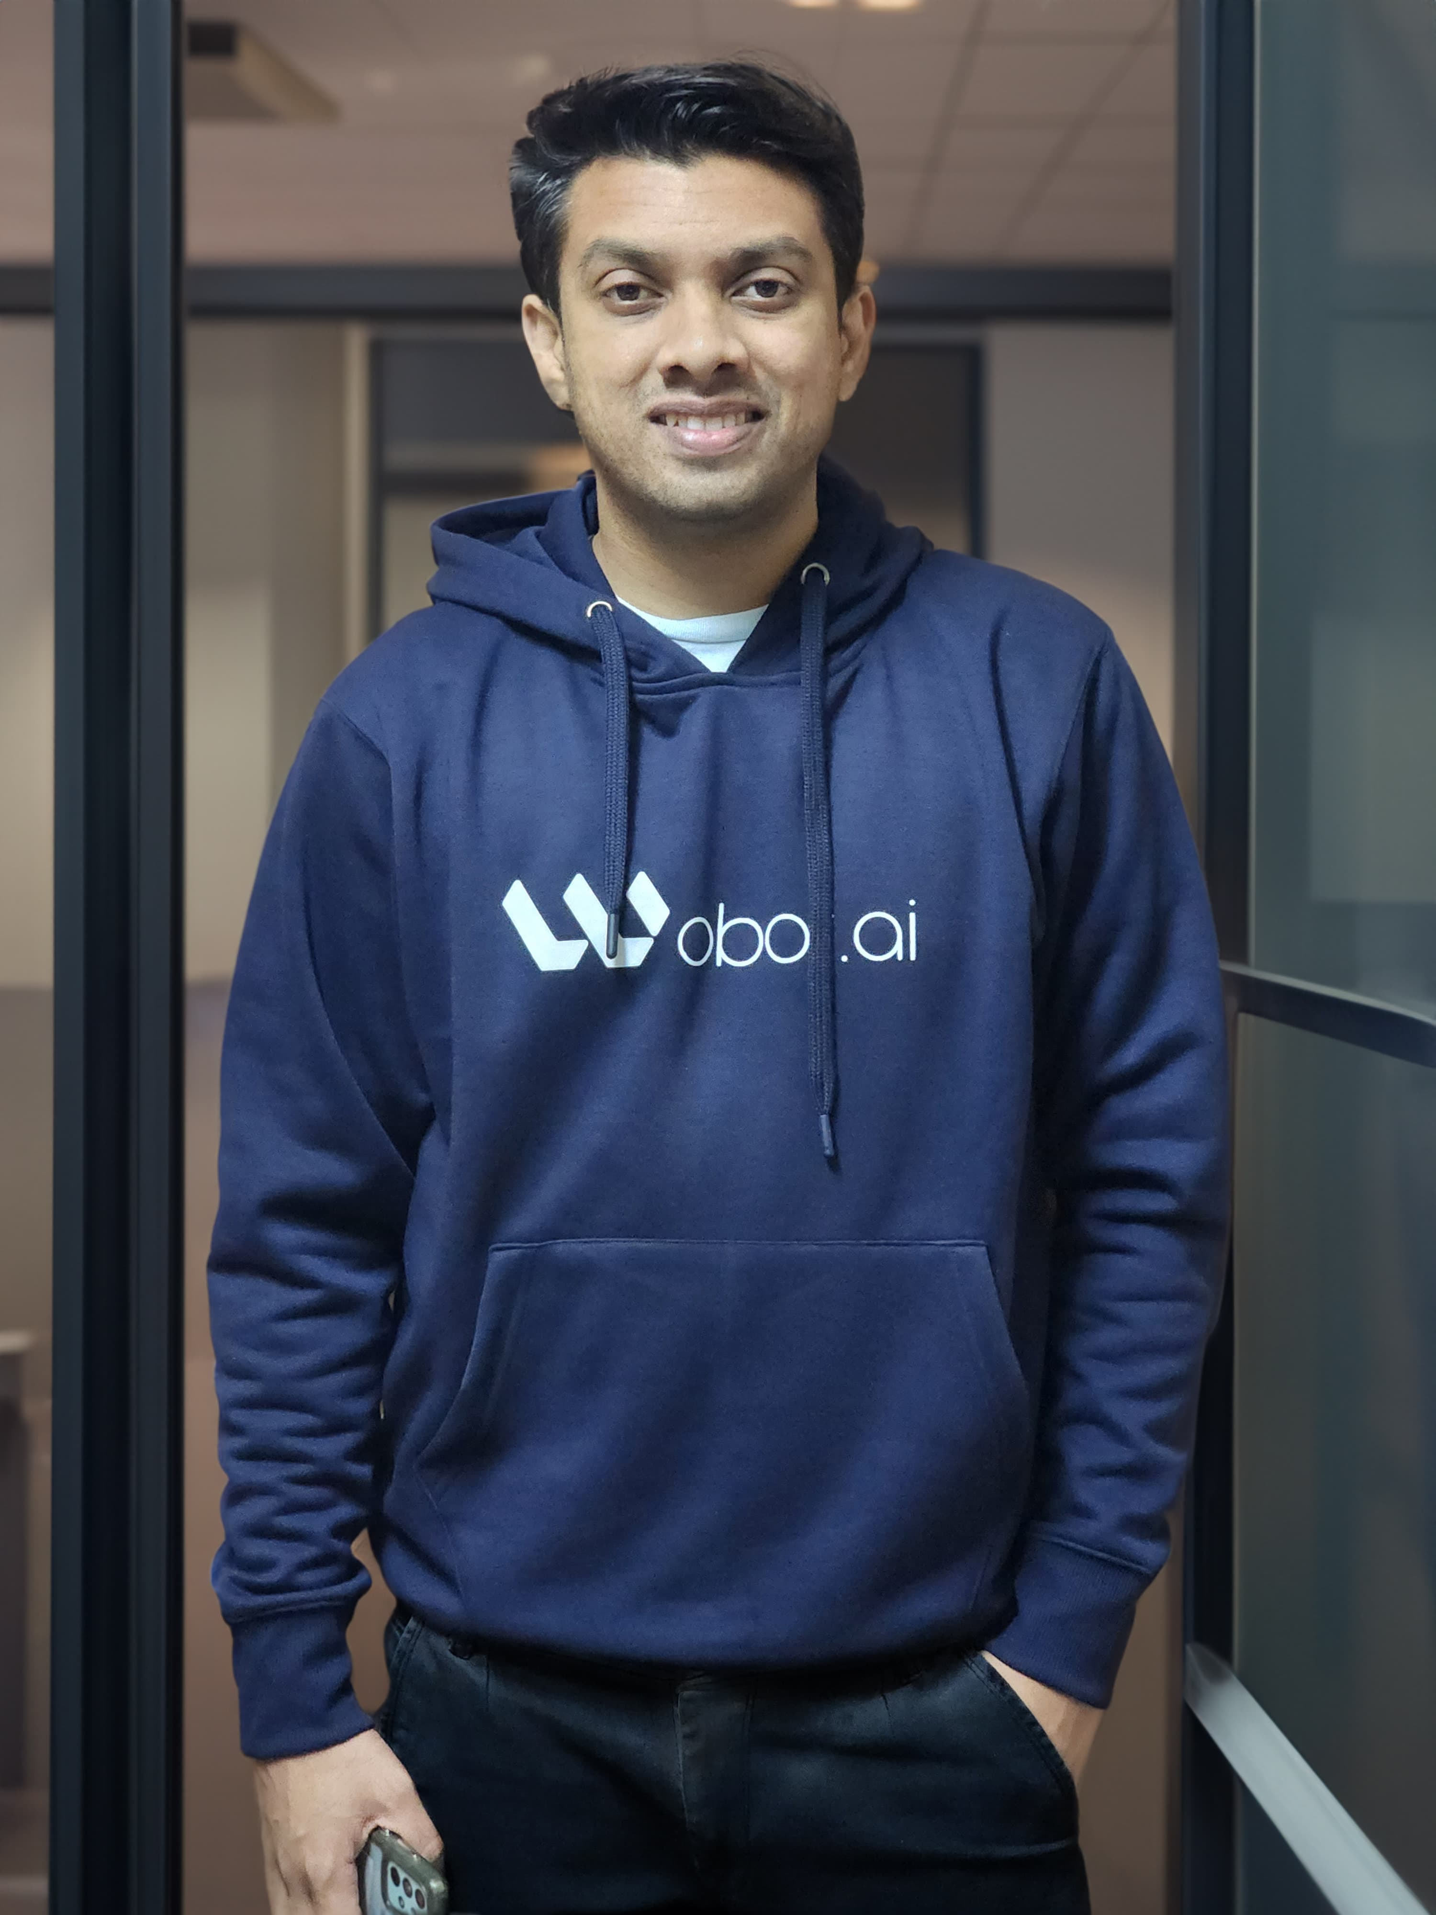


Akashkumar Parekh – I have made the oral view of project and some crud operations related to project.
Chintan Patel – I have made the UI portion and help in some crud operations.
Shivam Kaushik – I have find the landing page and implemented in project as a landing page.
Gurpreet Kaur – I have made the logo and inserted in the navbar.

Slide 3


Parth Savjani – I have fetch the all the records from the database.
Alireza Farkhondeh – I have made the some UI portions in table portions and formatted the folders.

