Slide 1


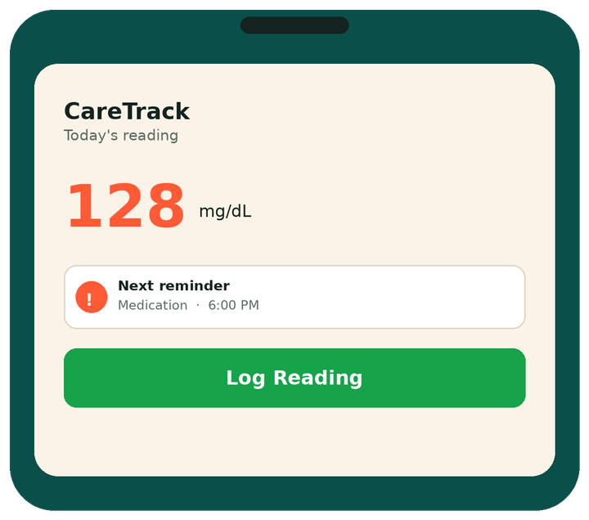
CareTrack
Never miss the
weeks in between.
Built with React, Node, Express & Supabase — no app install required.
Automated follow-up and chronic disease tracking built for local clinics.
HACKATHON 2026 · TEAM CARETRACK
Notes:
1

Slide 2
THE PEOPLE BEHIND IT
Our Team
A
Ahmad Zulfiqar
F
Fatima Ghafoor
A
Alisha Javed
TEAM LEADER
TEAM MEMBER
TEAM MEMBER
03015979771
03066994040
03049844656
ahmadzulifqarali098@gmail.com
fatimagafoor005@gmail.com
alishajaved177@gmail.com
https://www.linkedin.com/in/ahmadzulfiqarali/
https://www.linkedin.com/in/fatima-ghafoor-682498371/
https://www.linkedin.com/in/alisha-javed-b78b38362
E
Emaan Sohail
I
Ibrahim Usman
Zaid Maqsood
Z
TEAM MEMBER
TEAM MEMBER
TEAM MEMBER
03282366246
03097552323
03256498247
emaansohail321@gmail.com
ibrahiman2468@gmail.com
zaidmaqsood248@gmail.com
https://www.linkedin.com/in/emaan-sohail-226118381
https://www.linkedin.com/in/ibrahimusman56/
https://www.linkedin.com/in/m-zaid-maqsood-9ba7782b1/
02
Notes:
2

Slide 3

THE PROBLEM
The gap isn’t in the clinic —
it’s in the weeks between visits.
On their own, patients quietly fall behind — and nobody notices until the next appointment.
Chronic patients (diabetes, BP, asthma) need ongoing care between visits — not just a checkup once in a while.
Follow-ups, medication timing, and tests are easy to forget without reminders.
Small clinics have no easy way to see which patients are falling behind.
Every reading missed is a risk signal doctors never see.
Paper records and manual phone calls don’t scale for busy doctors.
03
Notes:
3

Slide 4
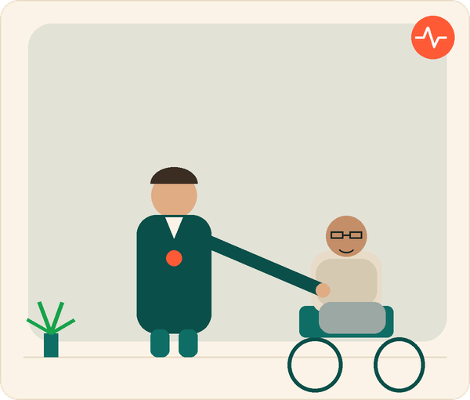




WHO CARETRACK IS FOR
Doctor and patient,
one loop.
Doctors and patients both need a way to stay connected once the visit ends. CareTrack keeps that connection alive — quietly tracking, reminding, and flagging what actually needs attention.
Doctor + patient, one loop
Visual trend history
Built for the weeks between appointments.
Automatic risk flags
No app required to log
04
Notes:
4

Slide 5

OUR SOLUTION
One live view of who needs attention.
CareTrack keeps chronic patients on track and gives doctors a live view of who needs attention.
Doctor Dashboard
Automated Reminders
Patient Self-Logging
Trend Tracking
Patient list with at-a-glance status
In-App automatic reminders for checkups, medication, readings etc
Log readings anytime, no app install
Visual history flags risk early
05
Notes:
5

Slide 6
HOW IT WORKS
A loop that keeps building.
1
2
3
4
5
Register
Remind
Log
Flag
Act
Doctor adds patient + schedule
Auto reminders before due dates
Patient logs their own readings
System flags risk or missed care
Doctor follows up in time
The loop repeats — every reading and visit builds a longer, more useful patient history.
06
Notes:
6

Slide 7


WHAT MAKES US DIFFERENT
Built for local clinics, not hospitals.
Existing tools (hiCare, Medisafe, mySugr) are enterprise-grade and app-only.
EXISTING APPS
CARETRACK
Requires app install
Browser-based — no install needed
Manual review of every patient file
Dashboard auto-flags at-risk patients
One-off reminders, easy to forget
Automated cron reminders — checkup, meds, tests, readings
Enterprise / hospital pricing
Built for small, local clinics
07
Notes:
7

Slide 8





TECH STACK
Simple, proven tools — built to ship fast.
React
Node.js
Supabase
Twilio
Recharts
Frontend UI & patient/doctor screens
Backend API & reminder scheduling
Patient, reading & appointment data
Automated WhatsApp reminders
Patient trend visualizations
08
Notes:
8

Slide 9
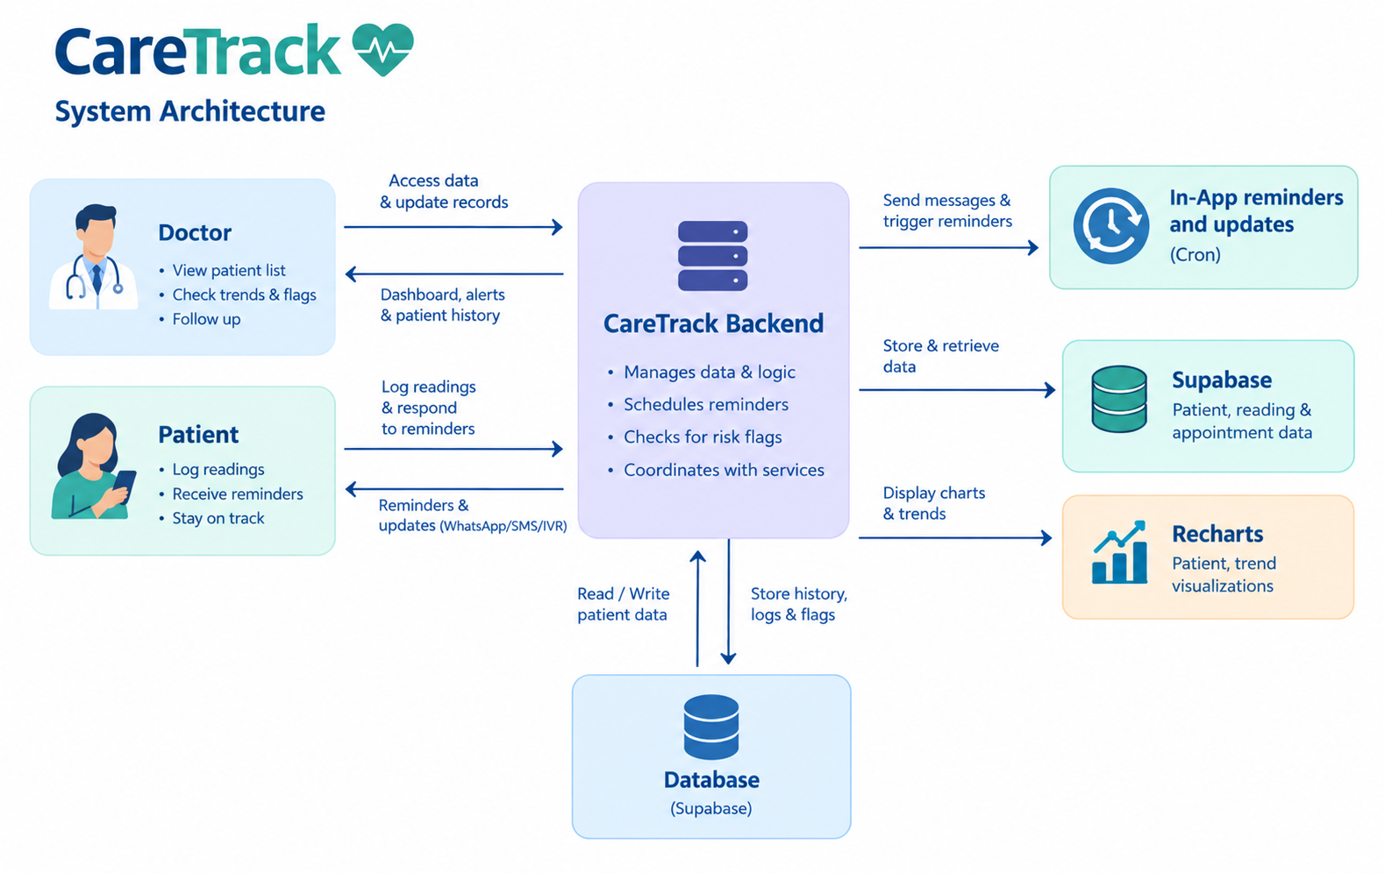


09
Notes:
9

Slide 10

WHERE THIS GOES NEXT
What’s next for CareTrack.
Every roadmap item builds on the same core loop — more signal, more reach, more languages.
Risk Prediction
Family Care Circle
Flag patients before problems escalate, using trend history
Alert a family member if a patient misses follow-up
WhatsApp, Voice Reminders
Pharmacy Integration
Urdu, Punjabi, Pashto & Sindhi voice reminders
Automatic medication refill reminders
09
Notes:
9

Slide 11


CareTrack
Thank you.
CareTrack — never miss a follow-up.
Try the live demo
https://github.com/ahmadzulfiqar001/CareTrack
Notes:
10

