Slide 1
UML 2.0 Brief
Anh H Mai
Notes:
1

Slide 2
Outline
Introduction
Diagrams
Use Cases
Activity Diagrams
Class Diagrams
Object Diagrams
Sequence Diagrams
Timing Diagrams
Composite Diagrams
Package
State Diagrams
Deployment Diagrams
Practices (in Agile)
Notes:
2

Slide 3
INTRODUCTION
UML 2.0 UML
Notes:
3

Slide 4
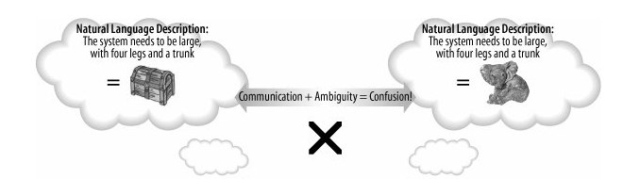
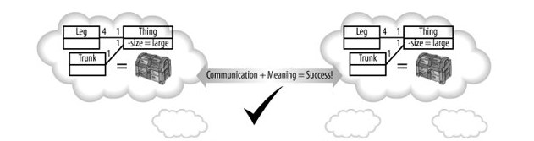
INTRODUCTION
The system needs to be large with four legs and a trunk
Notes:
4

Slide 5
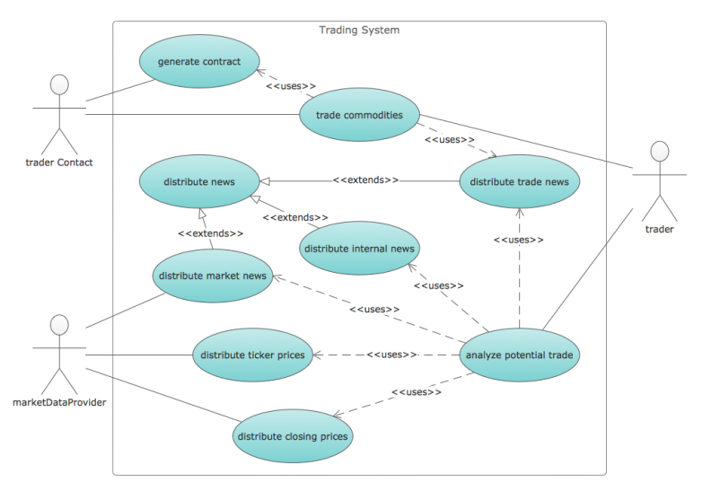
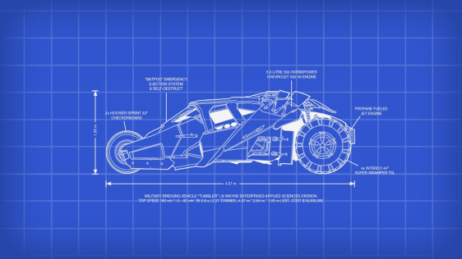

INTRODUCTION
UML 1.x
Humans.
UML 2.x
Computer Aided Systems Engineering (CASE)
Model Driven Architectures (MDAs)
Platform Independent Models (PIMs)
Platform Specific Models (PSMs)
Notes:
5

Slide 6
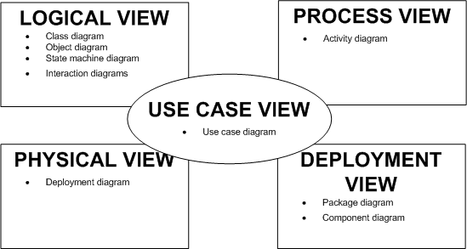
INTRODUCTION
Kruchten's 4+1 view model
Use case view: functionality of the system from the perspective of the outside world.
Logical view: abstract descriptions of a system's parts.
Process view: visualize what must happen within your system.
Development view: how parts are organized into modules and components.
Physical view: how the abstract parts map into the final deployed system.
Notes:
6

Slide 7
DIAGRAMS
UML 2.0 UML
Notes:
7

Slide 8
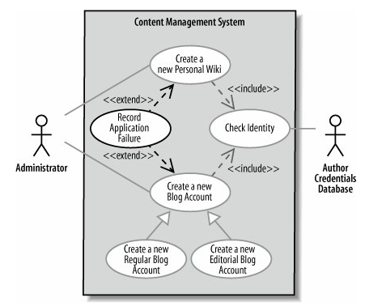
USE CASES
Use Case: Interactions between your system and users or other external systems.
Actors: a black box. Must interact with your system.
Communication Lines: show that actor is involved in a use case, not to imply an information exchange or that the actor starts the use case.
<<include>> : supports reuse between use cases
<<extend>> : similar to the <<include>>, but that this reuse was optional and dependent either on a runtime/ system decision.
Notes:
8

Slide 9
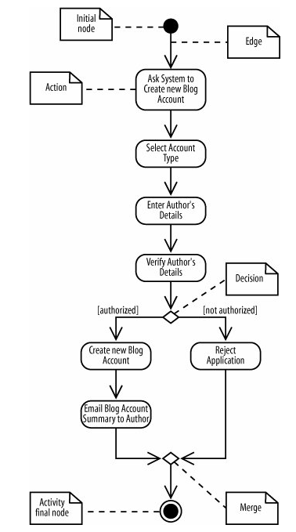
ACTIVITY DIAGRAMS
Activity: Sequential and parallel activities within your system.
Decision node: analogous to an if-else statement in code.
Merge node: marks the end of the conditional behavior.
Initial node: marks the start of the activity
Actions
Path: show the flow of activities
Final node: marks the end of the activity.
Notes:
9

Slide 10
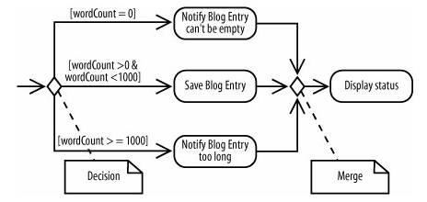
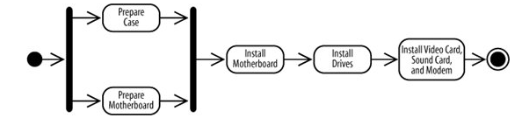


ACTIVITY DIAGRAMS
Decisions & Merges
Fork &Join
Time Events
Notes:
10
The incoming edge to the time event means that the time event is activated once.

Slide 11
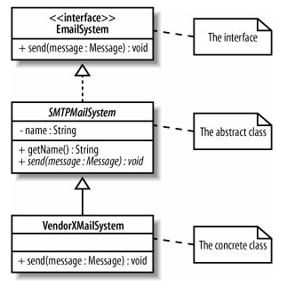
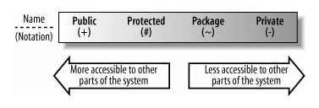
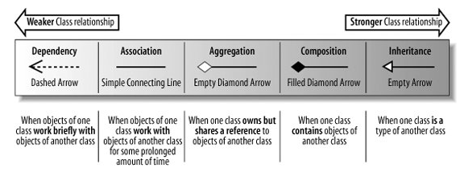
CLASS DIAGRAMS
Visibility
Class Relationships
Notes:
11

Slide 12
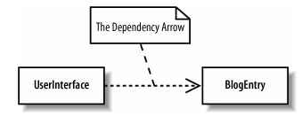
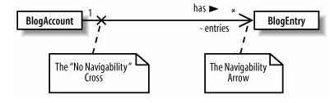
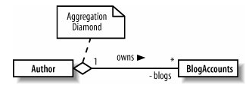
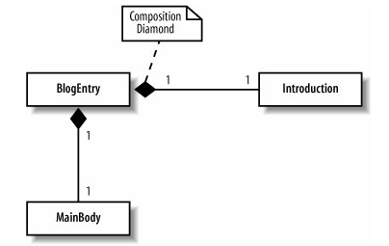
CLASS DIAGRAMS
Dependency: a class needs to know about another class to use objects of that class.
Association: a class will actually contain a reference to an object, or objects, of the other class in the form of an attribute.
Aggregation: a stronger version of association and is used to indicate that a class actually owns but may share objects of another class.
Composition: even stronger relationship than aggregation, although work in very similar ways.
Notes:
12

Slide 13
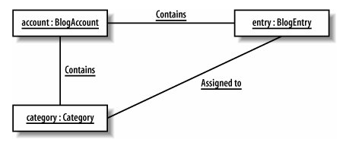
OBJECT DIAGRAMS
Describe how the objects within the system would work together in a particular scenario.
Object: Object instances of the classes.
Links: show that the two objects can communicate with each other. If you create a link between two objects, there must be a corresponding association between the classes.
Notes:
13

Slide 14
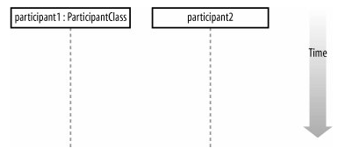
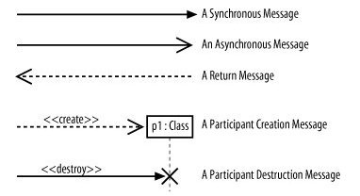
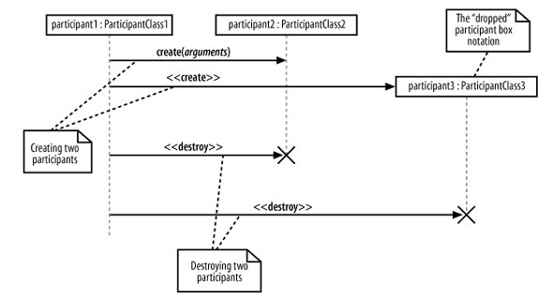
SEQUENCE DIAGRAMS
Captures the order of interactions between parts of a system.
Participant
Time: is all about ordering, not duration
Messages:
Notes:
14

Slide 15
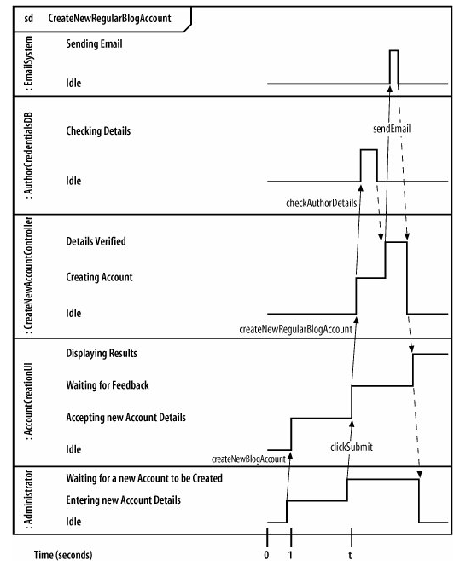
TIMING DIAGRAMS
Describes when the event is invoked, how long it takes for another participant to receive the event, and how long the receiving participant is expected to be in a particular state.
States
Time
Events, Messages
Timing Constraint Formats
Notes:
15

Slide 16
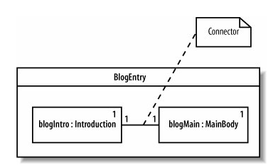
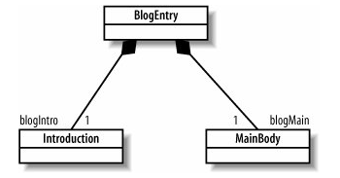
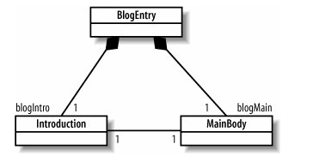
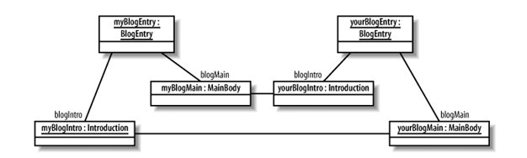
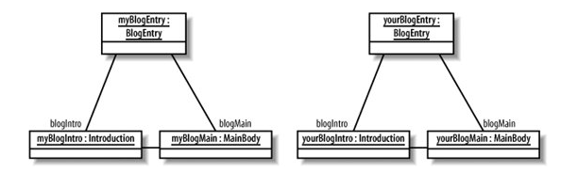
COMPOSITE DIAGRAMS
Model how objects work together inside a class, or how objects achieve a goal.
Notes:
16

Slide 17

COMPONET DIAGRAMS
Describes components within your system and the interfaces they use to interact with each other.
Component: an encapsulated, reusable, and replaceable part of software
Provided Interfaces: A component's provided interface describes the services provided by the component.
Required Interfaces: declares the services a component will need.
Notes:
17

Slide 18
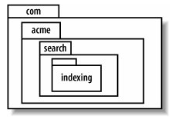
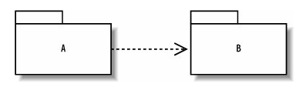
PACKAGES DIAGRAMS
The hierarchical organization of groups of classes and components.
Package Dependency
If an element in package A uses an element in package B, then package A depends on package B,
Avoiding:
Cyclical package dependencies
Depending in the direction of stability
Notes:
18
Depending in the order of stability means that a package should depend only on packages more stable than itself. An unstable package depends on many other packages; a stable package depends on few packages. Studying package diagrams can help you spot potentially vulnerable designs resulting from the core packages of your system (such as those containing interfaces) depending on unstable packages.

Slide 19
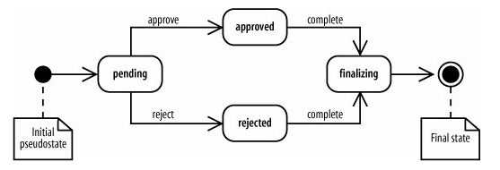
STATE DIAGRAMS
The state of an object throughout its lifetime and the events that can change that state.
State: a condition of being at a certain time.
Initial state
Final state
Transition: a change of states
Notes:
19
using a declarative style
in the absence of mutable shared state

Slide 20
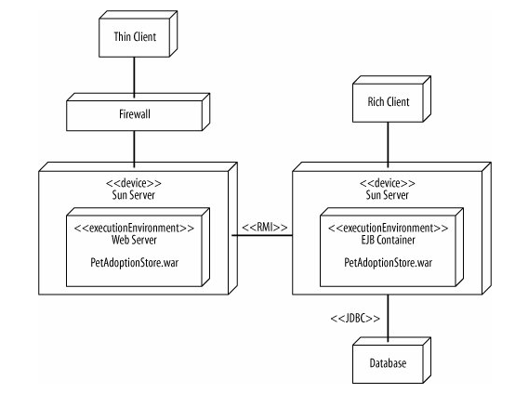
DEPLOYMENT DIAGRAMS
The physical view of your system, how software gets assigned to hardware and how the pieces communicate.
Artifacts: physical files that execute or are used by your software (.exe, .jar, .dlls, .java, .xml, .properties)
Node: hardware or software resource that can host software or related files.
Notes:
20

Slide 21
PRACTICES
UML 2.0 UML
Notes:
21

Slide 22
UML in Agile Practice
“We do not use UML BECAUSE
we are agile”
Notes:
22

Slide 23
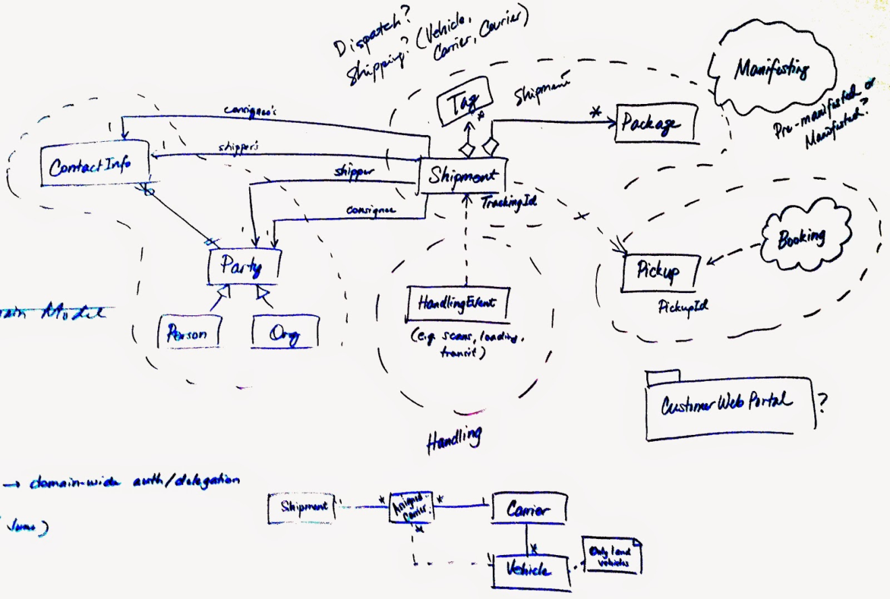
UML in Agile Practice
Start point to collate
Shouldn't be a delivered artifact.
Don't over use it/abuse it
Focus on the real issue.
Notes:
23

Slide 24
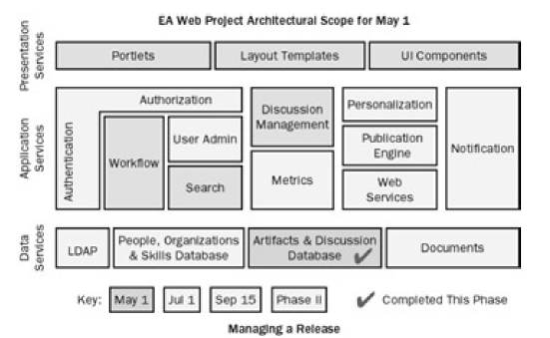
INTERIM REPORTS
A cleaned-up version of the system architecture diagram
Post on the wall of the team room.
Synchronized with Sprint review dates & progress. Ex:
Blue represented the first milestone.
Light blue for partially completed
Dark blue for completed
Notes:
24

Slide 25
REFERENCES
UML 2.0 UML
Notes:
25

Slide 26
REFERENCES
Learning UML 2.0 - By Kim Hamilton, Russell Miles
Agile Project Management with Scrum – by Ken Schwaber
Notes:
26

Slide 27
Q&A
UML 2.0 UML
Notes:
27

Slide 28
THANK YOU !
UML 2.0 UML
Notes:
28

