Slide 1
MIND Twin AI: Multiphysics Informed Digital-Twin for Fault Localization in Induction Motor using AI
8th IEEE International Conference “Big Data, Knowledge and Control Systems Engineering” (BdKCSE'2023)
02-03 November, 2023
Amina Bashir (National University of sciences and technology Pakistan)
Muhammad Ahmed Mohsin(National University of sciences and technology Pakistan)
Muhammad Jazib (Pakistan Institute of Engineering and Applied Sciences Pakistan)

Slide 2
Introduction
The aim is to design a Multiphysics-informed hybrid DT for fault detection and localization in TIM.
Multiphysics-informed hybrid modeling approach enhances the interpretability of AI classifiers, improving real-time fault localization in TIM
Enabling the high-fidelity dynamic system to act as a virtual sensor exhibiting real-time capabilities
BIG DATA ALONE IS NOT ENOUGH
Digital Twins must incorporate the predictive power, interpretability, and domain knowledge of physics-based models

Slide 3

Digital Twins
set of virtual information constructs that mimics the structure, context, and behavior of an individual/unique physical asset. It is dynamically updated with data from its physical twin throughout its lifecycle and informs decisions that realize value.

Slide 4
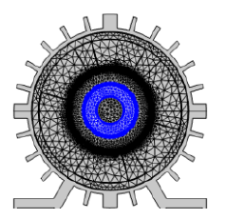
Mathematical and computational foundation for digital twin
Data Driven Modeling
Design Optimization and Parameter Tuning
Less Computational Time for Simulation
Robust Physics Driven High-Fidelity Modeling
Data Sparsity in Real Time Data
Data Acquisition of Healthy and Faulty Motors
Pitching the Data in to AI Models
Reduced Order Modeling
Physics Driven Modeling
Figure presenting Mesh Solver configuration of 2D induction
motor

Slide 5
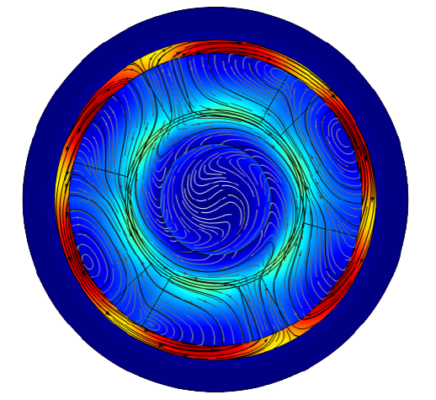



What is a physics-based Model?
A representation of Governing Laws of Nature that innately embeds the concepts of time space and causality
Solving a Physics Based Model
Figure presenting Magnetic flux density norm for healthy motor calculated using given equations
Boundary Equation+ Initial Conditions+ Loading Conditions + System Parameters

Slide 6
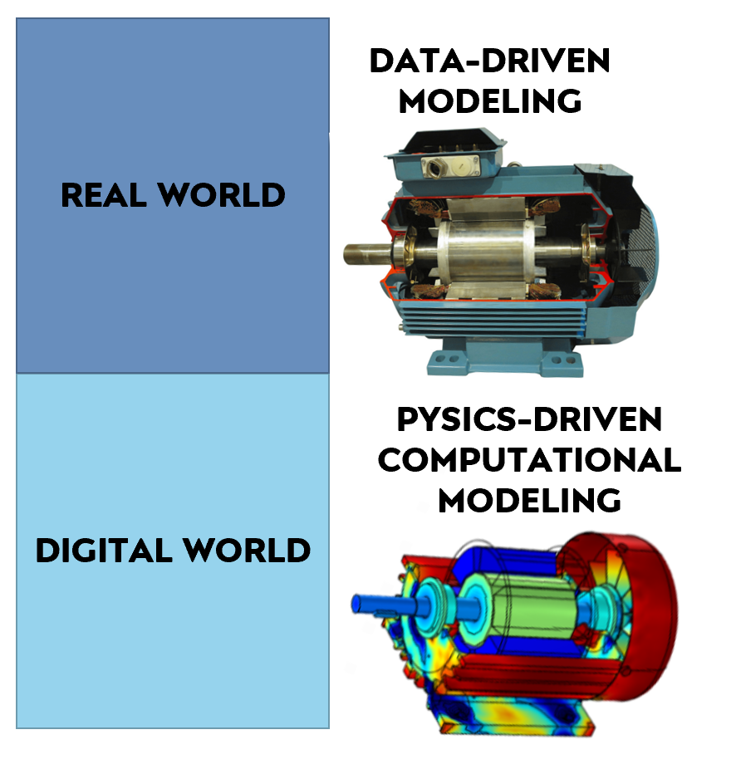
WHY Hybrid DIGITAL TWIN?
Enhancing both Data and Physics Driven Modeling
Provides Better Accuracy for Fault Localization in ML Classifiers
Hybrid DT efficiently deals with the Data Sparsity and Data Mis-interpretablility

Slide 7
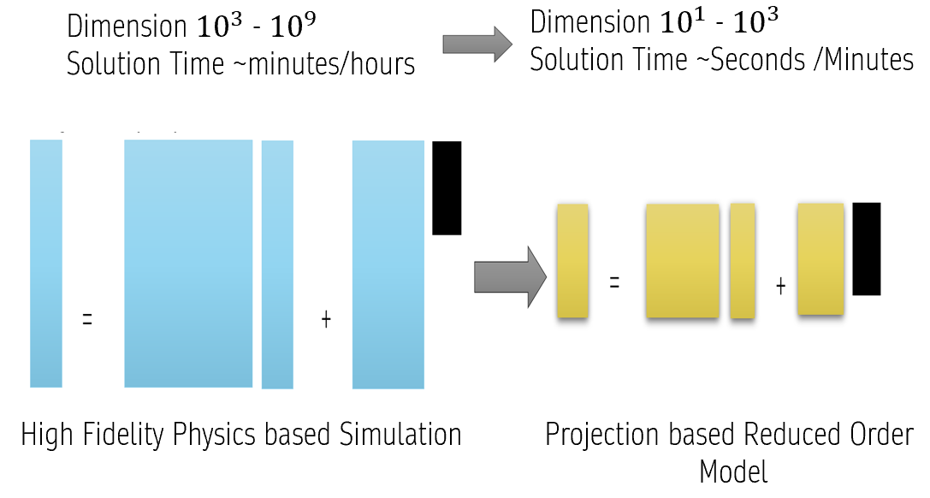
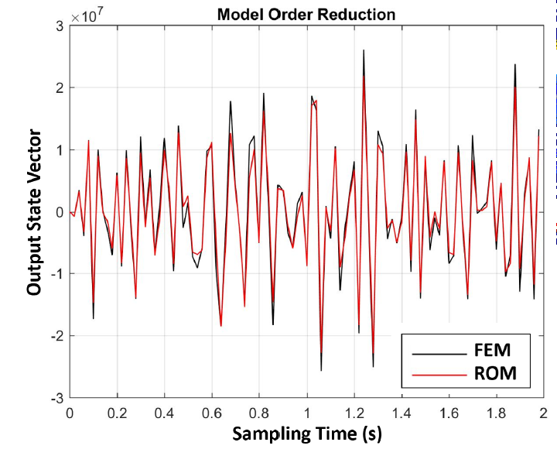
REDUCED ORDER MODELS ARE CRITICAL ENABLERS FOR PREDICTIVE DIGITAL TWIN

Slide 8
FRAMEWORK FOR HYBRID DT
Managing Data Sparsity and Skewness
Design Optimization
Sparse Non-Linear Optimization utilized for Parameter Tuning
Set the Angular Speed of the Model in Steady State
Generating Synthetic Data in COMSOL Multiphysics Software
Synthetic Minority Oversampling Technique SMOTE Employed to deal class imbalance
Feature Fusion
Feature Fusion achieved using CCA Canonical Corelation Analysis
Data Fusion of Synthetic and Real time Data creating Hybird DT

Slide 9
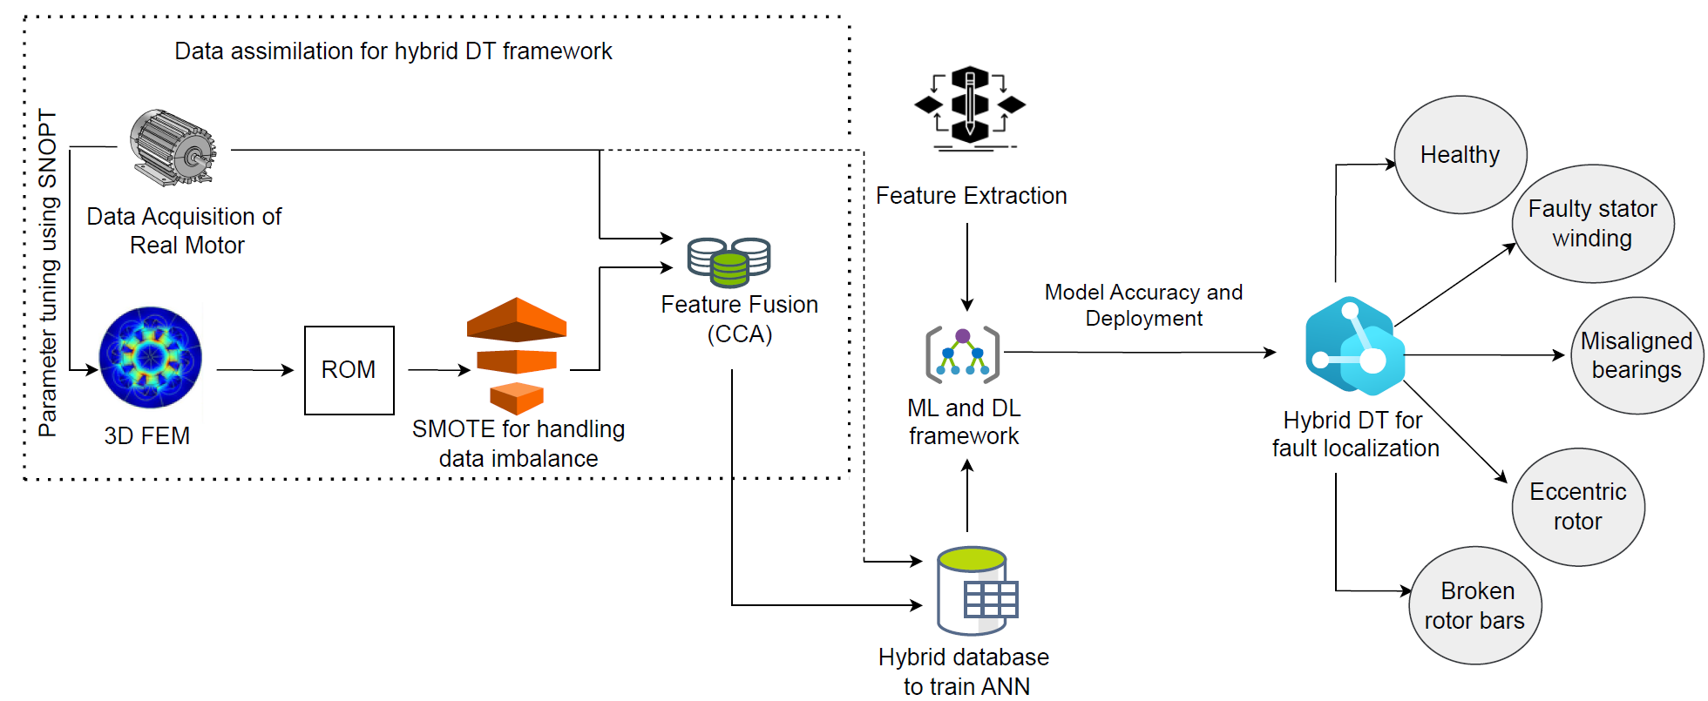
Working Methodology

Slide 10
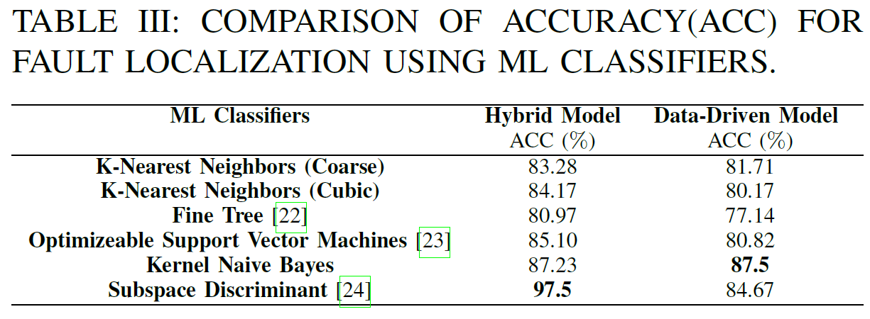
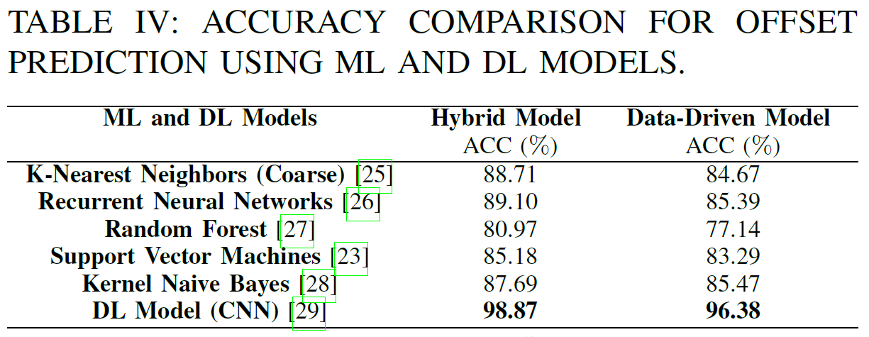
Quantitative Results
ML Classifier Fault Localization Based Comparison
Off set Prediction using ML and DL Models

Slide 11
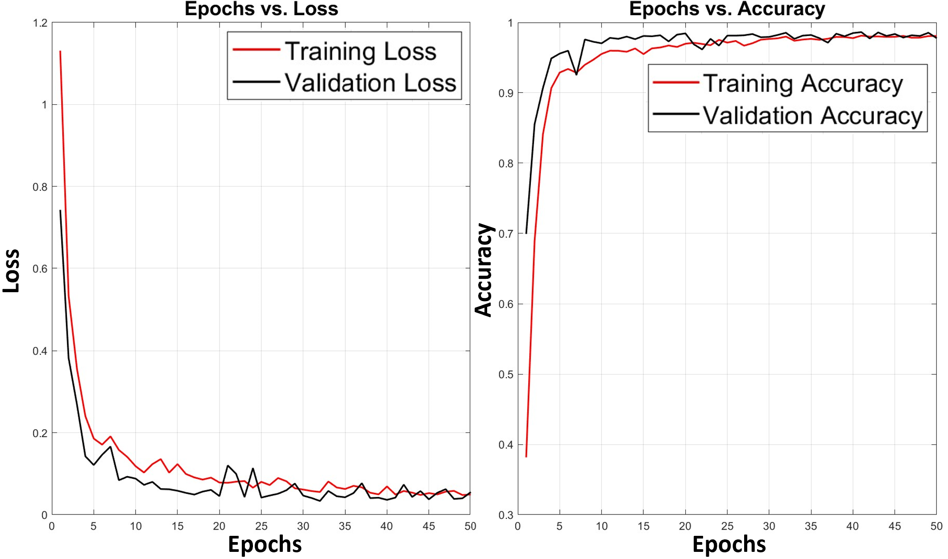
Loss and Accuracy Curves for Offset Prediction

Slide 12
Predictive Modeling for Complex Systems at large scale
Decisions demand a Predictive window on the feature
Verification validation and uncertainty quantification
Achieving the levels of reliability and robustness needed for certified high- consequence decision making
Data, Models and decisions across multiple scales
An integrated framework for calibration, data assimilation uncertainty quantification optimization planning and control
Scalable Algorithms for updating ,prediction and Control Incorporating Physics based modeling data driven learning and state of the art computational science
Optimal Sensing Strategy
Integrating Sensor Design and optimal Experimental Design
1
2
Challenges for predictive digital twins FOR COMPLEX SYSTEMS ACROSS SCIENCE, MEDICINE, ENGINEERING
3
4
5

Slide 13
FUTURE WORK
Future works involve incremental ML and parallel computing approaches, enabling dynamic updates of DT as new data becomes available.
Further advancements can be made by exploring other methodologies to bridge the gap between physics-driven and data-driven modeling.
Data fusion techniques can also be used to model combinations of multiple faults within a particular TIM.

Slide 14
References
X. Liang, M. Z. Ali, and H. Zhang, “Induction motors fault diagnosis using finite element method: A review,” IEEE Transactions on Industry Applications, vol. 56, no. 2, pp. 1205–1217, 2020.
P. K. Ghosh, P. K. Sadhu, R. Basak, and A. Sanyal,“Energy efficient design of three phase induction motorby watercyclealgorithm,” Ain Shams Engineering Journal,vol. 11, no.4pp.11391147,2020.
S. Kocman and S. Nowak, “Analysis of the stator winding fault ofinduction motor using comsol multiphysics,” in 2019 20th InternationalScientific Conference on Electric Power Engineering (EPE), 2019, pp.1–6.
D. Wu, J. Wang, H. Wang, H. Liu, L. Lai, T. He, and T. Xie,“An automatic bearing fault diagnosis method based on characteristicsfrequency ratio,” Sensors, vol. 20, no. 5, p. 1519, 2020.
M. A. Hearst, S. T. Dumais, E. Osuna, J. Platt, and B. Scholkopf, “Supportvector machines,” IEEE Intelligent Systems and their applications,vol. 13, no. 4, pp. 18–28, 1998.
G. Biau, “Analysis of a random forests model,” The Journal of Machine Learning Research, vol. 13, pp. 1063–1095, 2012.

Slide 15
Thank you

