Slide 1

GridFS
Ahmed Nasr

Slide 2
Was ist GridFS?
Treiber Spezifikation!
FS … File System
2 Collections
Files (metadata)
Chunks (max 16 MB)
BSON-Format

Slide 3
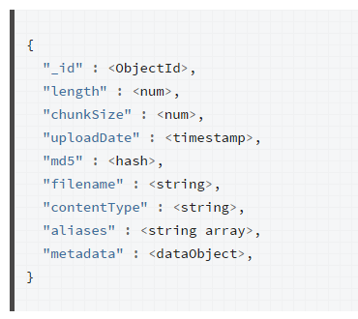
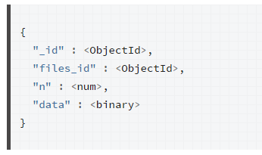
Collections
fs.files
FS.CHunks
https://docs.mongodb.com/manual/core/gridfs/

Slide 4
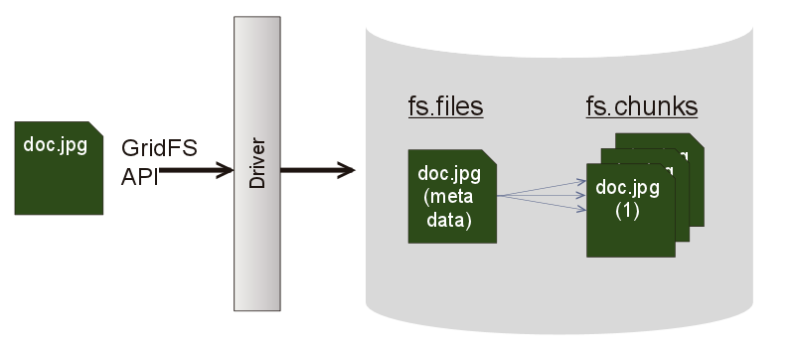
Architektur
http://s3.amazonaws.com/info-mongodb-com/_com_assets/blog/gridfs1.png

Slide 5
Demo

Slide 6
Danke!
@ahmdNasr

Slide 7
Quellen
https://docs.mongodb.com/manual/core/gridfs/

