Slide 1

Altiq Hardware
Ad hoc requests; data insights presentation

Slide 2
Introduction
Atliq Hardware, a prominent manufacturer of computer hardware based in India and serving a global clientele, seek insights of its product sales to drive informed decision-making.

Slide 3
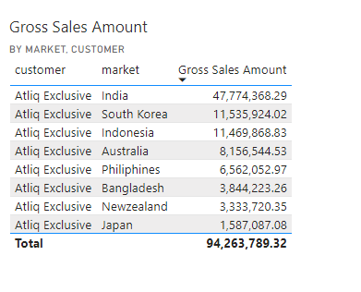
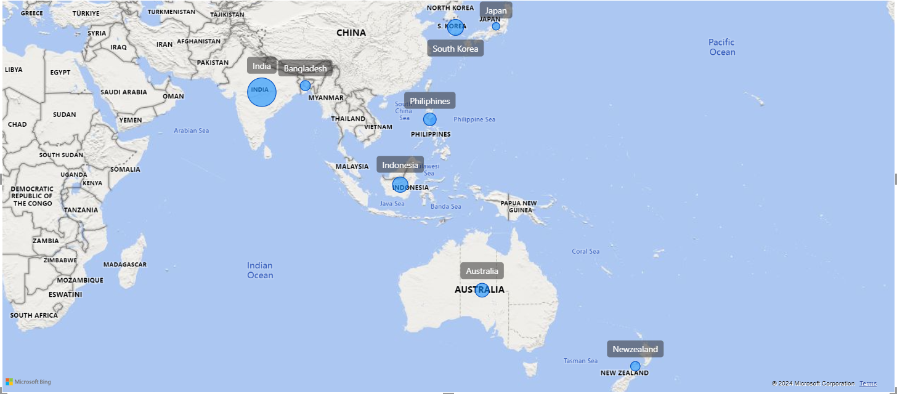
Q1. Provide the list of markets in which customer "Atliq Exclusive" operates its business in the APAC region
Insights
India emerges as the top market for Atliq Exclusive in the Asia Pacific region, leading in Gross Sales among eight countries. It is followed by South Korea, Indonesia, Australia, and others.

Slide 4
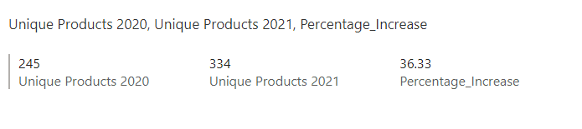
Q2. What is the percentage of unique product increase in 2021 vs. 2020
Insights
There's been a notable 36.33% increase in the number of unique products from 2020 to 2021.

Slide 5
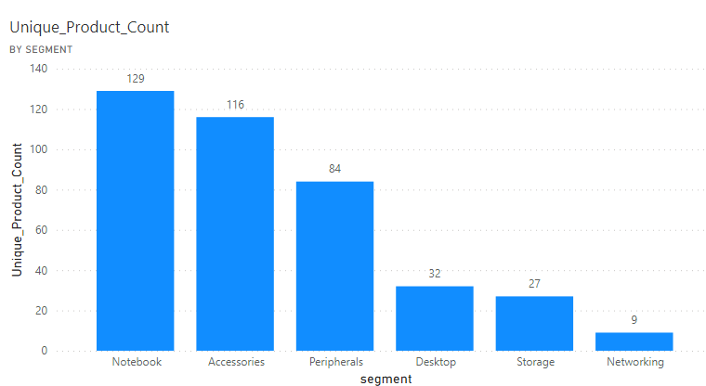
Q3. Provide a report with all the unique product counts for each segment and sort them in descending order of product counts.
Insights
There is however an opportunity for Atliq hardware to explore current trends and consumer needs, particularly in the Networking and Storage segments.

Slide 6
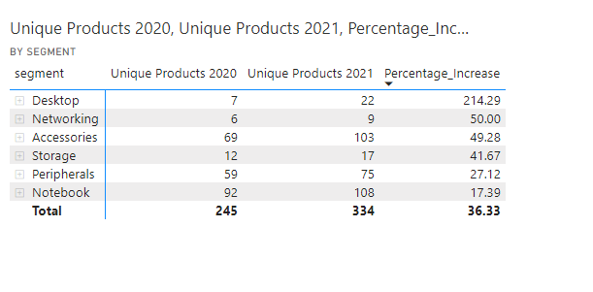
Q4. Which segment had the most increase in unique products in 2021 vs 2020?
Insights
The Desktop segment witnessed the most significant comparative increase in its product offerings during the 2021 fiscal year

Slide 7
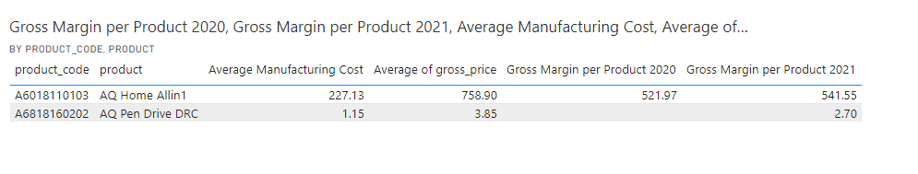
Q5. Get the products that have the highest and lowest manufacturing costs.
Insights
AQ Home Allin1 Gen2 commands the highest manufacturing cost, it also achieves a substantial gross margin of 541.55 for the 2021 fiscal year contrasting with AQ Pen Drive DRC's lower margin of 2.70, reflecting differing market dynamics and pricing strategies

Slide 8
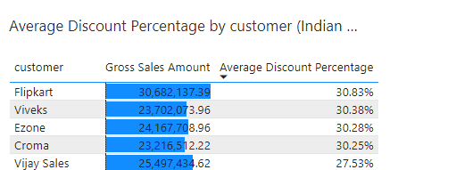
Q6. Generate a report which contains the top 5 customers who received an average high ‘pre_invoice_discount_pct’ for the fiscal year 2021 and in the Indian market.
Insights
Flipkart, boasting the highest average discount, also leads in sales figures. This indicates that the company's strategy of offering discounts to customers is proving to be effective.

Slide 9
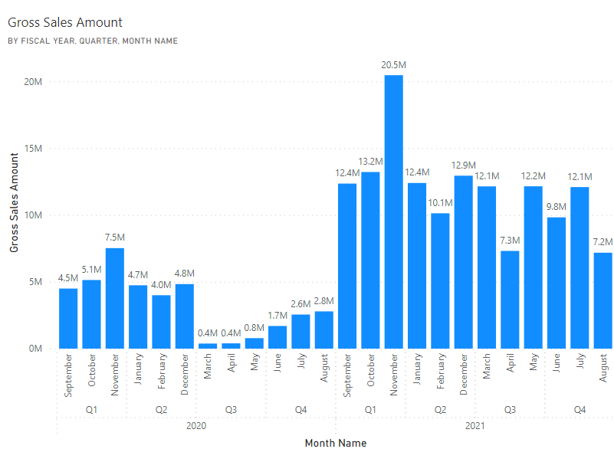
Q7. Get the complete report of the Gross sales amount for the customer “Atliq Exclusive” for each month.
Insights
Atliq hardware could consider introducing products to capitalize on the summer season. Despite the pandemic, overall sales have shown consistent growth compared to the pre-pandemic year.

Slide 10
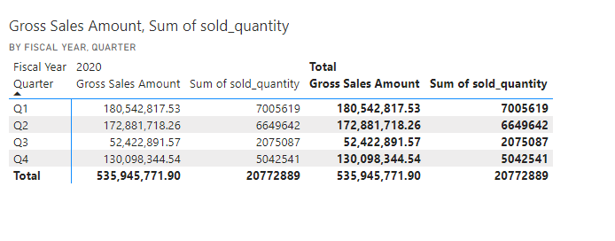
Q8. In which quarter of 2020, got the maximum ‘total_sold_quantity’
Insights
In fiscal year 2020, Q3 recorded the lowest sales volume. Considering the typical decrease in computer hardware demand during the summer, Atliq Hardware could explore products like waterproof speakers to boost sales during this period

Slide 11
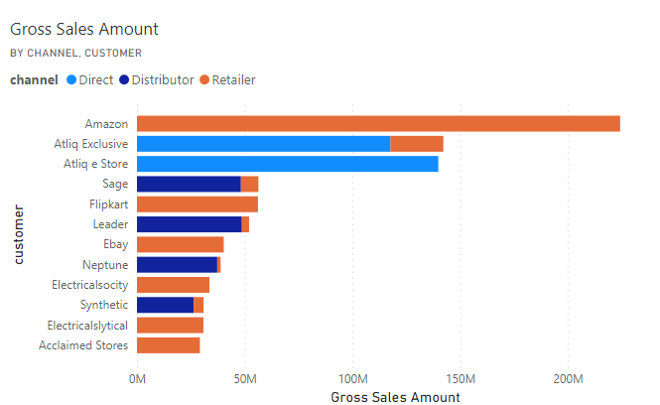
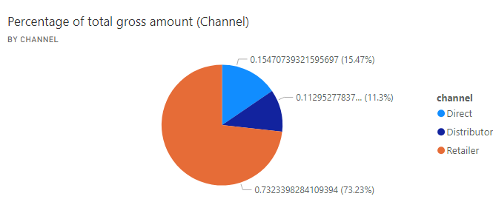
Q9. Which channel helped to bring more gross sales in the fiscal year 2021 and the percentage of contribution
Insights
In fiscal year 2021, the retail sector dominated the gross sales amount, with Amazon contributing significantly to the bulk of these sales. Conversely, Atliq Exclusive generated the majority of its revenue through direct channels.

Slide 12
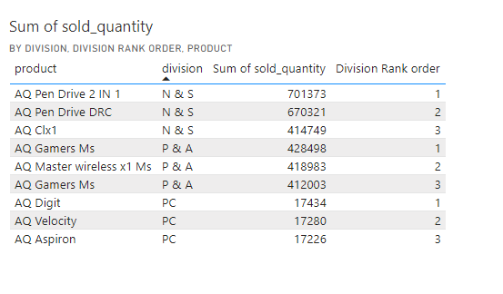
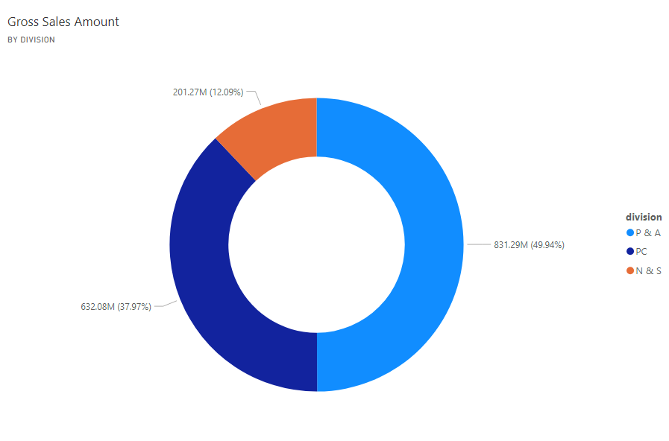
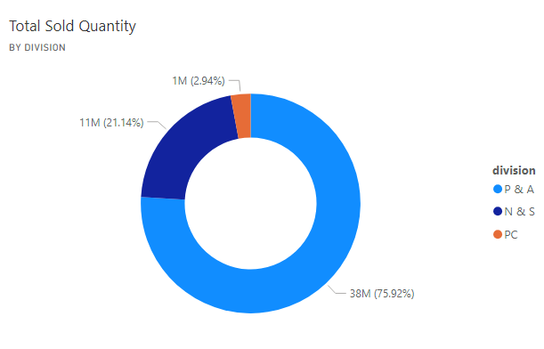
Q10. Get the Top 3 products in each division that have a high ‘total_sold_quantity’ in the ‘fiscal_year’ 2021
Insights
While the P & A division accounts for the highest quantities sold and revenue, the highest grossing individual products belong to the N & S divisions. Despite lower sales volumes, the PC division still contributes 37.97% of all gross sales.

Slide 13
Key takeaways
In the fiscal year 2021, Atliq Hardware demonstrated robust performance by launching a remarkable array of 102 new products. Notably, Peripherals and Accessories emerged as the primary revenue drivers, closely trailed by PC offerings.
The PC division emerged as the flagship performer, contributing a significant 38% share to the total sales revenue, despite constituting a mere 3% of the overall product volume sold. This underscores the division's pivotal role in the company's sales ecosystem.
A strategic adjustment in discount rates presents an avenue to amplify gross sales figures. By fine-tuning discount structures, we can aim to incentivize customers towards higher purchasing volumes, thereby enhancing overall revenue streams.
Recognizing the untapped potential in the e-commerce realm, there lies a compelling opportunity to amplify sales figures by forging partnerships with new e-commerce platforms. Leveraging competitive discounting strategies within this domain holds promise for augmenting e-commerce sales trajectory.

