Slide 1
Fantasy Football Client
Ron Weber & Asheq Ahmed

Slide 2
What is Fantasy Football?
Fantasy Football is a predictive game that follows professional football in the US
At the beginning of the football season, a group of people will arrange a Fantasy Football league, in which they each form a team made up of NFL players.
Points for your fantasy team are based in the game statistics of the players on it.
Each week, each fantasy team will go up against a different fantasy team.

Slide 3
What is Fantasy Football?
Many clients available online
Large Market
In the news: DraftKings & FanDuel with billions in dollar transactions.
Who doesn't enjoy a predictive game?
It's kind of like the Stock market, except much more meaningless

Slide 4
Fantasy Team
mysql> select * from FantasyTeam;
+-------------+-----------------+
| userName | email |
+-------------+-----------------+
| Asheq | ara47@case.edu |
| Tekin | gxo3@case.edu |
| Connamacher | hsc21@case.edu |
| Kamil | kxt147@case.edu |
| Lewicki | msl88@case.edu |
| Mehmet | mxk331@case.edu |
| Meral | mxo2@case.edu |
| Rabinovich | mxr136@case.edu |
| Ron | rdw62@case.edu |
| Liberatore | vxl11@case.edu |
+-------------+-----------------+

Slide 5
Fantasy Team
mysql> select * from FantasyTeam;
+-------------+-----------------+
| userName | email |
+-------------+-----------------+
| Asheq | ara47@case.edu |
| Tekin | gxo3@case.edu |
| Connamacher | hsc21@case.edu |
| Kamil | kxt147@case.edu |
| Lewicki | msl88@case.edu |
| Mehmet | mxk331@case.edu |
| Meral | mxo2@case.edu |
| Rabinovich | mxr136@case.edu |
| Ron | rdw62@case.edu |
| Liberatore | vxl11@case.edu |
+-------------+-----------------+

Slide 6
Fantasy Team
mysql> select * from FantasyTeam;
+-------------+-----------------+
| userName | email |
+-------------+-----------------+
| Asheq | ara47@case.edu |
| Tekin | gxo3@case.edu |
| Connamacher | hsc21@case.edu |
| Kamil | kxt147@case.edu |
| Lewicki | msl88@case.edu |
| Mehmet | mxk331@case.edu |
| Meral | mxo2@case.edu |
| Rabinovich | mxr136@case.edu |
| Ron | rdw62@case.edu |
| Liberatore | vxl11@case.edu |
+-------------+-----------------+
Teams compete against another team in a Matchup once a week.
+------+-------------+--------+------------+--------+
| week | userName1 | score1 | userName2 | score2 |
+------+-------------+--------+------------+--------+
| 1 | Asheq | 0.00 | Ron | 0.00 |
| 1 | Tekin | 0.00 | Meral | 0.00 |
| 1 | Connamacher | 0.00 | Kamil | 0.00 |
| 1 | Lewicki | 0.00 | Mehmet | 0.00 |
| 1 | Rabinovich | 0.00 | Liberatore | 0.00 |
+------+-------------+--------+------------+--------+

Slide 7
Fantasy Team
mysql> select * from FantasyTeam;
+-------------+-----------------+
| userName | email |
+-------------+-----------------+
| Asheq | ara47@case.edu |
| Tekin | gxo3@case.edu |
| Connamacher | hsc21@case.edu |
| Kamil | kxt147@case.edu |
| Lewicki | msl88@case.edu |
| Mehmet | mxk331@case.edu |
| Meral | mxo2@case.edu |
| Rabinovich | mxr136@case.edu |
| Ron | rdw62@case.edu |
| Liberatore | vxl11@case.edu |
+-------------+-----------------+
Teams compete against another team in a Matchup once a week.
Scores populate at the end of the NFL week.
+------+-------------+--------+------------+--------+
| week | userName1 | score1 | userName2 | score2 |
+------+-------------+--------+------------+--------+
| 1 | Asheq | 84.00 | Ron | 96.20 |
| 1 | Tekin | 91.00 | Meral | 101.50 |
| 1 | Connamacher | 86.00 | Kamil | 98.00 |
| 1 | Lewicki | 120.00 | Mehmet | 91.00 |
| 1 | Rabinovich | 100.00 | Liberatore | 94.00 |
+------+-------------+--------+------------+--------+

Slide 8
Fantasy Roster
NFL (National Football League) consists of 32 professional teams, 53 players each.
Prior to the season, each Fantasy Team selects a roster of 15 players from the pool of professional players belonging to positions of Quarterback, Running Back, Wide Receiver & Tight End. (QB, RB, WR, TE)
~50 QB's, ~150 RB's, ~150 WR's, ~80 TE's of consequence.
A fantasy roster may start a maximum of 1 QB, 2 RB's, 3 WR's and 1 TE. The rest are *bench* players. You may interchange them if need be.

Slide 10
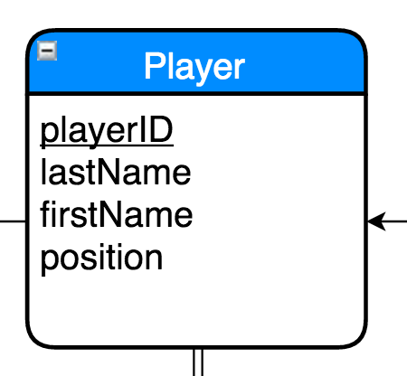
Players
playerID int(4) not null, is the primary Key
lastName varchar(20) not null,
firstName varchar(20) not null
position enum(‘QB’, ‘RB’, ‘WR’,‘TE’)
playerID → (lastName, firstName, position)

Slide 11
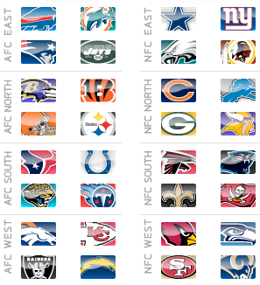
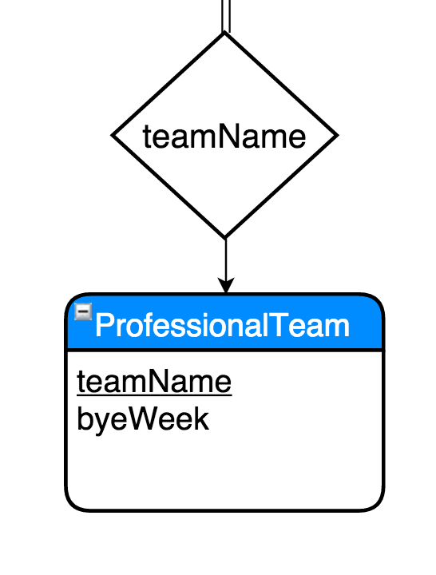
Players come from ProfessionalTeams
teamName varchar(30) Primary Key
byeWeek int(2) not null
teamName → (byeWeek)

Slide 12
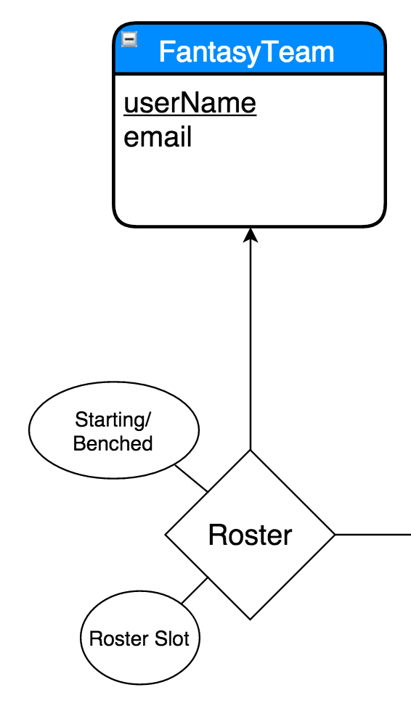
Roster players for your *own* team!
FantasyTeam
userName varchar(20) Primary Key
email varchar(30) NOT NULL
userName →(email)
Rostered
start int(1) between 0 and 1
rosterSlot enum ('QB,'RB1','RB2','WR1','WR2','TE1', 'FLEX','BN1','BN1','BN1','BN1','BN1','BN1','BN1','BN1')
Primary Key (playerID)
Foreign Key playerID REFERENCES Player(playerID)
Foreign Key userName REFERENCES FantasyTeam(userName)
playerID → start, rosterSlot, userName

Slide 13
Example Roster (Ron's Fantasy Team)
+-------+------------+----------+----------+
| start | rosterSpot | playerID | userName |
+-------+------------+----------+----------+
| 1 | RB | 14691 | Ron |
| 1 | TE | 67281 | Ron |
| 1 | WR | 62547 | Ron |
| 1 | WR | 94447 | Ron |
| 1 | WR | 43142 | Ron |
| 1 | QB | 38776 | Ron |
| 1 | RB | 24505 | Ron |
| 0 | RB | 33269 | Ron |
| 0 | RB | 51980 | Ron |
| 0 | RB | 31240 | Ron |
| 0 | RB | 89067 | Ron |
| 0 | TE | 89354 | Ron |
| 0 | QB | 44066 | Ron |
+-------+------------+----------+----------+

Slide 14
Example Roster (Ron's Fantasy Team)
Natural Join with Player name/ID
+-------+----------+--------------+------------+----------+----------+
| start | lastName | firstName | rosterSpot | playerID | userName |
+-------+----------+--------------+------------+----------+----------+
| 1 | Blount | LeGarrette | RB | 14691 | Ron |
| 1 | Ertz | Zach | TE | 67281 | Ron |
| 1 | Hopkins | DeAndre | WR | 62547 | Ron |
| 1 | Brown | Antonio | WR | 94447 | Ron |
| 1 | Diggs | Stefon | WR | 43142 | Ron |
| 1 | Carr | Derek | QB | 38776 | Ron |
| 1 | Johnson | Chris | RB | 24505 | Ron |
| 0 | Forte | Matt | RB | 33269 | Ron |
| 0 | Starks | James | RB | 51980 | Ron |
| 0 | West | Charcandrick | RB | 31240 | Ron |
| 0 | Mathews | Ryan | RB | 89067 | Ron |
| 0 | Barnidge | Gary | TE | 89354 | Ron |
| 0 | Dalton | Andy | QB | 44066 | Ron |
+-------+----------+--------------+------------+----------+----------+

Slide 15
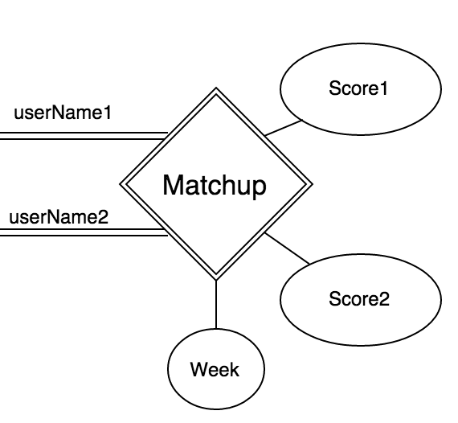
Matchup
week int(2) not null,
userName1 varchar(20) not null
userName2 varchar(20) not null
Score1 numeric(5,2) not null
Score2 numeric(5,2) not null
Primary Key(week, userName1)
Foreign Key userName1 REFERENCES FantasyTeam(userName)
Foreign Key userName2 REFERENCES FantasyTeam(userName)
week, userName1 → score1, userName2, score2
Score is produced by compiling statistics scored by starting players on the corresponding roster.
Score formula is determined by a setting in the Java Client.

Slide 16
Matchup
week int(2) not null,
userName1 varchar(20) not null
userName2 varchar(20) not null
Score1 numeric(5,2) not null
Score2 numeric(5,2) not null
Primary Key(week, userName1)
Foreign Key userName1 REFERENCES FantasyTeam(userName)
Foreign Key userName2 REFERENCES FantasyTeam(userName)
week, userName1 → score1, userName2, score2
+------+-------------+--------+------------+--------+
| week | userName1 | score1 | userName2 | score2 |
+------+-------------+--------+------------+--------+
| 1 | Asheq | 84.00 | Ron | 96.20 |
| 1 | Tekin | 91.00 | Meral | 101.50 |
| 1 | Connamacher | 86.00 | Kamil | 98.00 |
| 1 | Lewicki | 120.00 | Mehmet | 91.00 |
| 1 | Rabinovich | 100.00 | Liberatore | 94.00 |
+------+-------------+--------+------------+--------+

Slide 17
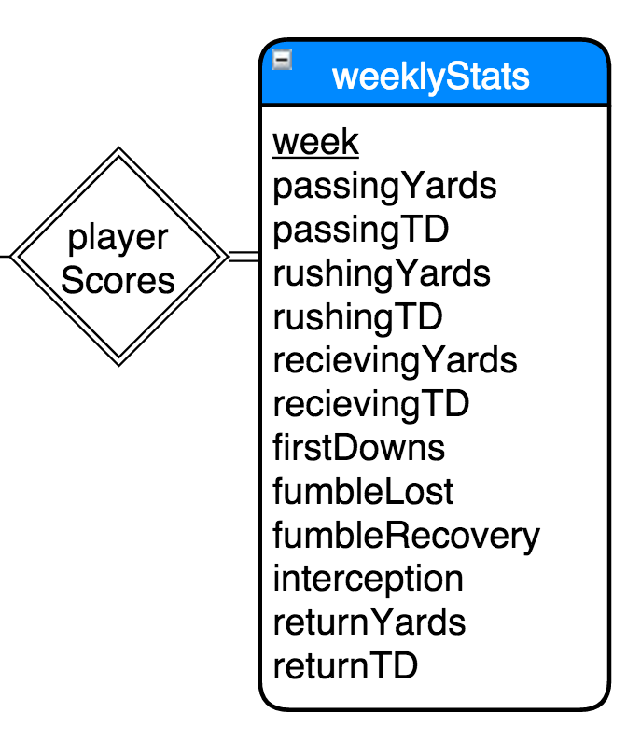
Statistics
playerID int(5) not null
week int(2) not null
passingYards numeric(4,1) a
rushingYards numeric(4,1) b
recievingYards numeric(4,1) c
returnYards numeric(4,1) d
passingTD int(1) e
rushingTD int(1) f
recievingTD int(1) g
returnTD int(1) h
interception int(1) i
firstDown int(1) j
fumbleLost int(1) k
fumbleRecovery int(1) l
Primary Key (playerID, week)
Foreign Key playerID REFERENCES Player(playerID)
playerID, week → a, b, c, d, e, f, g, h, i, j, k, l

Slide 19
Some Queries

Slide 20
Find the Leader in Week 1 Passing Yards
+----------+-----------+---------+
| lastName | firstName | passYds |
+----------+-----------+---------+
| Rivers | Philip | 403 |
+----------+-----------+---------+
SELECT lastName, firstName, passYds
From Player Natural Join playerScores
WHERE passYds IS NOT NULL
AND week=1
ORDER BY passYds DESC
LIMIT 1;

Slide 21
List the winning teams from week 1.
+------------+----------+
| winner | winScore |
+------------+----------+
| Lewicki | 120.00 |
| Rabinovich | 100.00 |
| Ron | 96.20 |
| Meral | 101.50 |
| Kamil | 98.00 |
+------------+----------+
SELECT userName1 as winner, score1 as winScore
FROM Matchup
WHERE week=1 AND score1>score2
UNION
(SELECT userName2, score2
FROM Matchup
WHERE week=1 AND score2>score1)
+------+-------------+--------+------------+--------+
| week | userName1 | score1 | userName2 | score2 |
+------+-------------+--------+------------+--------+
| 1 | Asheq | 84.00 | Ron | 96.20 |
| 1 | Tekin | 91.00 | Meral | 101.50 |
| 1 | Connamacher | 86.00 | Kamil | 98.00 |
| 1 | Lewicki | 120.00 | Mehmet | 91.00 |
| 1 | Rabinovich | 100.00 | Liberatore | 94.00 |
+------+-------------+--------+------------+--------+

Slide 22
Which professional teams are Ron's players from? How many belong to each team?
SELECT teamName, COUNT(teamName)
FROM (FantasyTeam NATURAL JOIN Rostered NATURAL JOIN Player)
WHERE userName='Ron'
GROUP BY teamName
ORDER BY count(teamName) DESC;
+----------+-----------------+
| teamName | COUNT(teamName) |
+----------+-----------------+
| PHI | 2 |
| NWE | 1 |
| PIT | 1 |
| ARI | 1 |
| KAN | 1 |
| CHI | 1 |
| OAK | 1 |
| MIN | 1 |
| CIN | 1 |
| GNB | 1 |
| HOU | 1 |
| CLE | 1 |
+----------+-----------------+

Slide 23
Find Ron's Opponent's Roster for Week 1
SELECT playerID, position, lastName, firstName
FROM (Player P NATURAL JOIN Rostered R), FantasyTeam Opponent, Matchup M
WHERE M.userName1 = 'Ron' AND
M.userName2 = Opponent.userName AND
Opponent.userName = R.userName AND
M.week = 1
UNION
(SELECT playerID, position, lastName, firstName
FROM (Player P NATURAL JOIN Rostered R), FantasyTeam Opponent, Matchup M
WHERE M.userName2 = 'Ron' AND
M.userName1 = Opponent.userName AND
Opponent.userName = R.userName AND
M.week = 1);
+----------+----------+----------+-----------+
| playerID | position | lastName | firstName |
+----------+----------+----------+-----------+
| 11117 | QB | Luck | Andrew |
| 32207 | RB | Woodhead | Danny |
| 46913 | RB | Spiller | C.J. |
| 51729 | TE | Bennett | Martellus |
| 62811 | WR | Tate | Golden |
| 64066 | WR | Crabtree | Michael |
| 68795 | RB | Sproles | Darren |
| 69879 | WR | Robinson | Allen |
| 75762 | RB | Stewart | Jonathan |
| 87515 | RB | Anderson | C.J. |
| 92584 | WR | Cooks | Brandin |
| 95972 | QB | Smith | Alex |
+----------+----------+----------+-----------+

Slide 24
Find Ron's Opponent's Starting Roster
SELECT playerID, position, lastName, firstName
FROM (Player P NATURAL JOIN Rostered R), FantasyTeam Opponent, Matchup M
WHERE M.userName1 = 'Ron' AND
M.userName2 = Opponent.userName AND
Opponent.userName = R.userName AND
M.week = 1 AND start=1
UNION
(SELECT playerID, position, lastName, firstName
FROM (Player P NATURAL JOIN Rostered R), FantasyTeam Opponent, Matchup M
WHERE M.userName2 = 'Ron' AND
M.userName1 = Opponent.userName AND
Opponent.userName = R.userName AND
M.week = 1 AND start=1);
+----------+----------+----------+-----------+
| playerID | position | lastName | firstName |
+----------+----------+----------+-----------+
| 32207 | RB | Woodhead | Danny |
| 51729 | TE | Bennett | Martellus |
| 62811 | WR | Tate | Golden |
| 64066 | WR | Crabtree | Michael |
| 69879 | WR | Robinson | Allen |
| 75762 | RB | Stewart | Jonathan |
| 95972 | QB | Smith | Alex |
+----------+----------+----------+-----------+

Slide 25
Find players who scored statistically
select firstName, lastName, passYds, rushYds, recYds, retYds, passYds + rushYds + recYds + retYds as totalYds from playerScores Natural Join Player where week=11 AND passYds IS NOT NULL
-> UNION
-> (select firstName, lastName, passYds, rushYds, recYds, retYds, passYds + rushYds + recYds + retYds as totalYds from playerScores Natural Join Player where week=11 AND rushYds IS NOT NULL)
-> UNION
-> (select firstName, lastName, passYds, rushYds, recYds, retYds, passYds + rushYds + recYds + retYds as totalYds from playerScores Natural Join Player where week=11 AND recYds IS NOT NULL)
-> UNION
-> (select firstName, lastName, passYds, rushYds, recYds, retYds, passYds + rushYds + recYds + retYds as totalYds from playerScores Natural Join Player where week=11 AND retYds IS NOT NULL);
+--------------+----------+---------+---------+--------+--------+----------+
| firstName | lastName | passYds | rushYds | recYds | retYds | totalYds |
+--------------+----------+---------+---------+--------+--------+----------+
| Derek | Carr | 169 | 8 | NULL | NULL | NULL |
| Andy | Dalton | 315 | 34 | NULL | NULL | NULL |
| Alex | Smith | 253 | 33 | NULL | NULL | NULL |
| Chris | Johnson | NULL | 63 | 2 | NULL | NULL |
| Charcandrick | West | NULL | 16 | 48 | NULL | NULL |
| Danny | Woodhead | NULL | 7 | 9 | NULL | NULL |
| James | Starks | NULL | 14 | 30 | NULL | NULL |
| Golden | Tate | NULL | 2 | 73 | 48 | NULL |
| Jonathan | Stewart | NULL | 102 | 12 | NULL | NULL |
| C.J. | Anderson | NULL | 59 | 13 | NULL | NULL |
| Stefon | Diggs | NULL | NULL | 66 | NULL | NULL |
| Martellus | Bennett | NULL | NULL | 26 | NULL | NULL |
| DeAndre | Hopkins | NULL | NULL | 118 | NULL | NULL |
| Michael | Crabtree | NULL | NULL | 50 | NULL | NULL |
| Zach | Ertz | NULL | NULL | 12 | NULL | NULL |
| Darren | Sproles | NULL | NULL | 38 | 6 | NULL |
| Allen | Robinson | NULL | NULL | 113 | NULL | NULL |
+--------------+----------+---------+---------+--------+--------+----------+

Slide 26

Next: Scrape Data from the Internet

Slide 27
Details
MySQL Server version: 5.6.26 MySQL Community Server (GPL)
Copyright © 2000, 2015, Oracle and/or its affiliates. All rights reserved.
Client developed using Java Version 1.8.0_20, Copyright © 2015 Oracle and/or its affiliates. All rights reserved.
Scraping API developed using Selenium ChromeDriver 2.20, Chromium project.
Ran on this 13" Macbook Pro with Retina Display, running Mac OS X 10.10.5.

