Slide 1
Journal Client
Soon to be made by Asheq, ara47

Slide 2
Journal Client
Make a note of something

Slide 3
Journal Client
Make a note of something
Have that thing show up later

Slide 4
Journal Client
Make a note of something
Have that thing show up later
Have that thing show up on other devices

Slide 5
I’ve seen this before

Slide 6
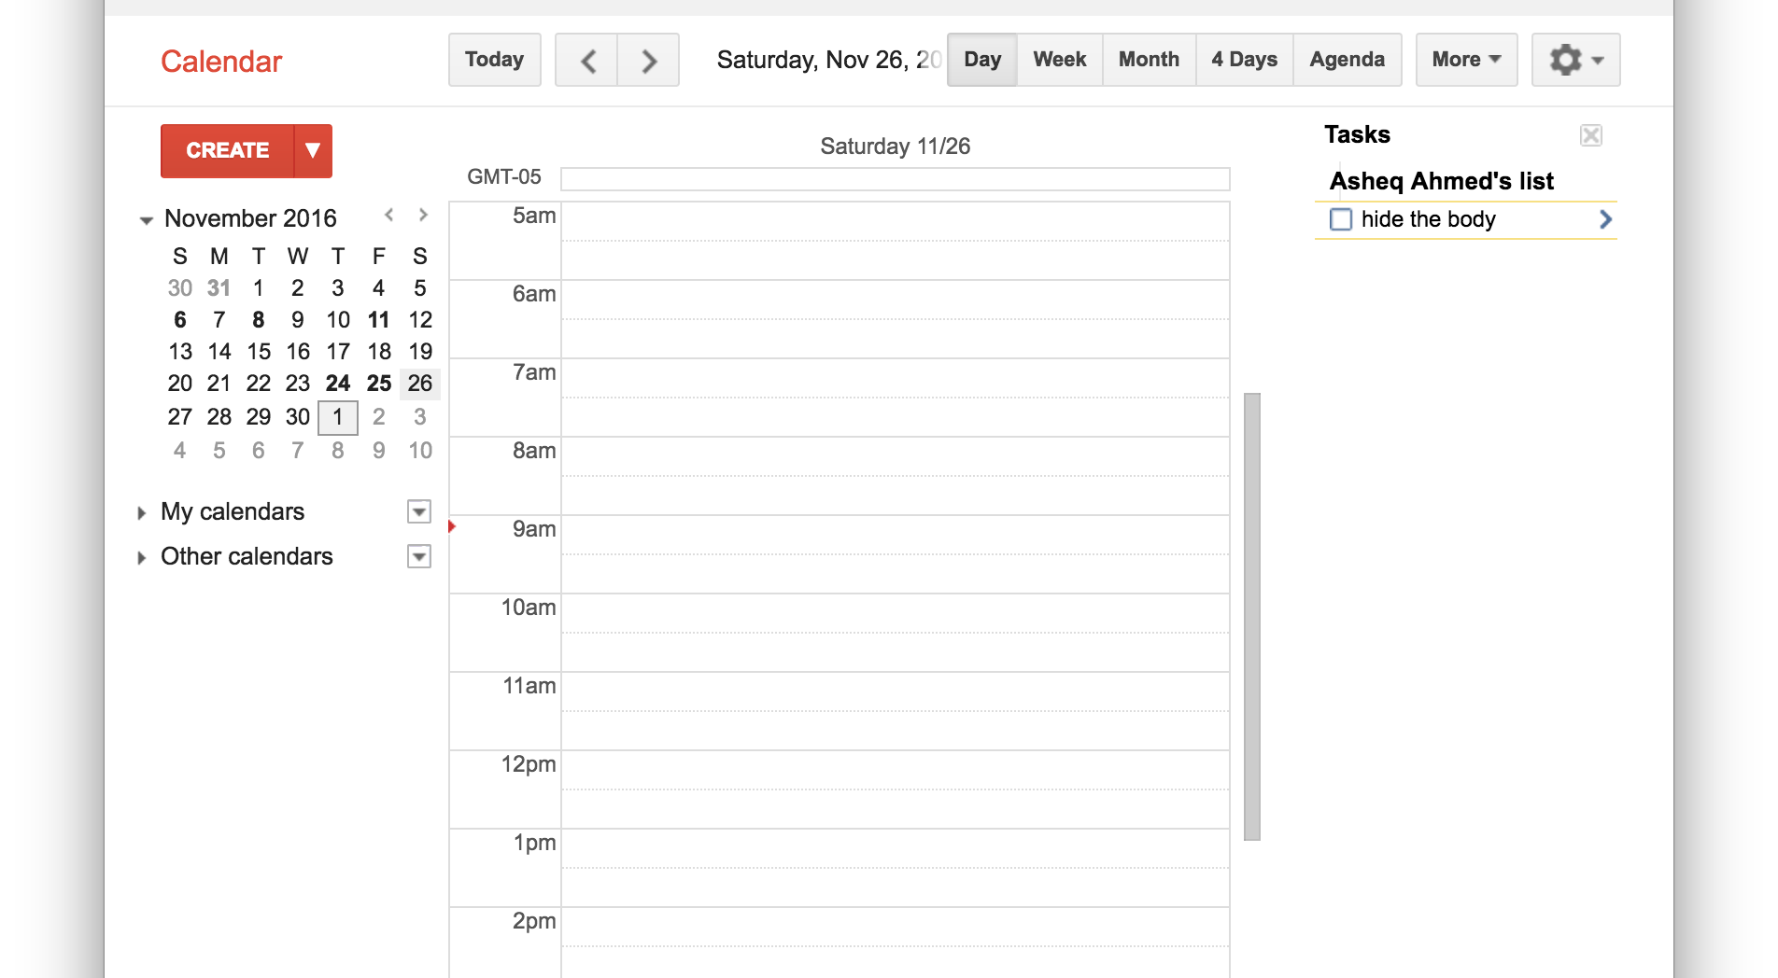
I’ve seen this before

Slide 7
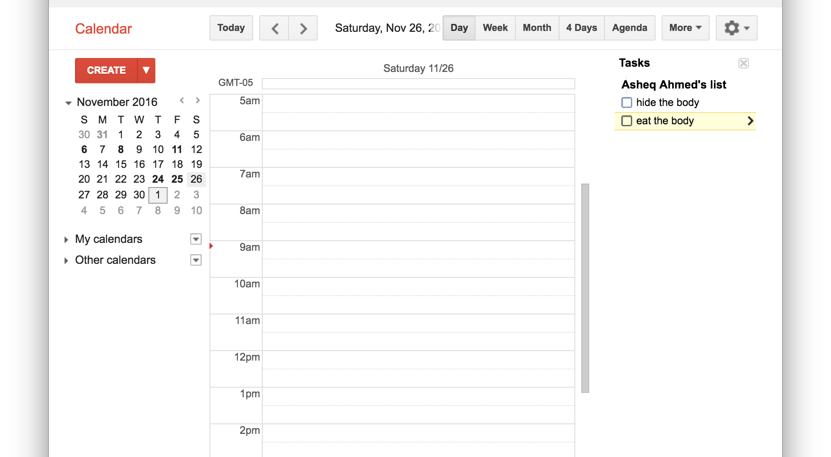
I’ve seen this before

Slide 8

I’ve seen this before

Slide 9
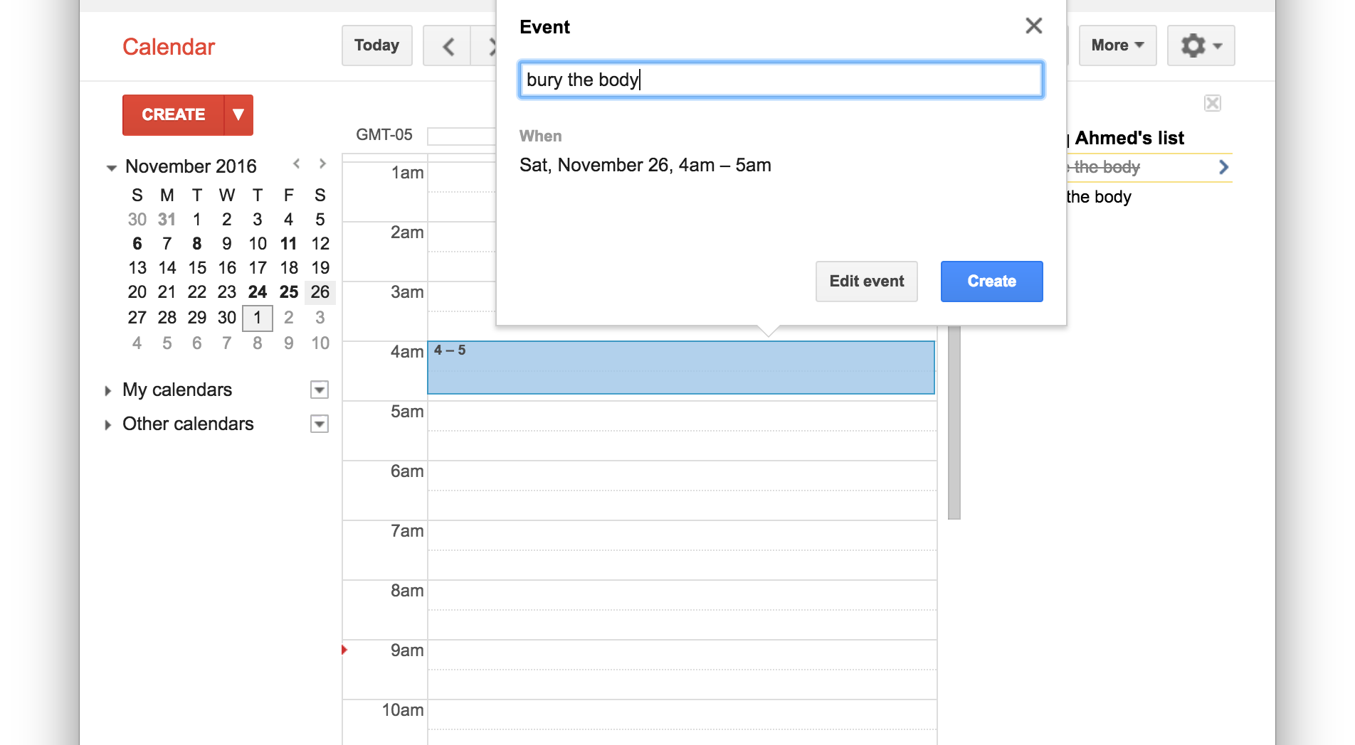
I’ve seen this before

Slide 10
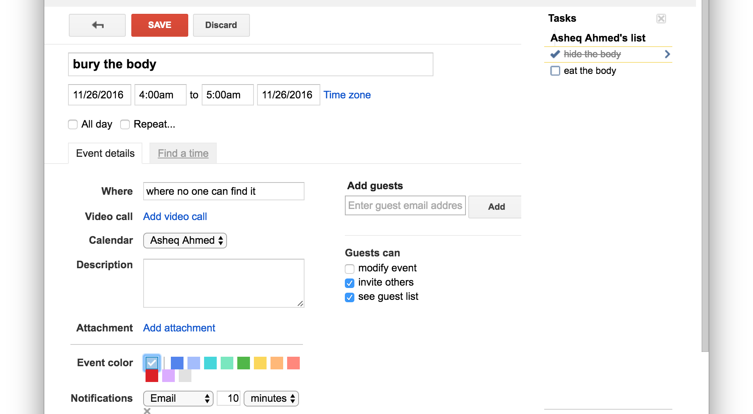
I’ve seen this before

Slide 11
I’ve seen this before
Google Tasks and Calendar already do this
Can also sync a text document to Dropbox
Can email yourself things to do
Can tattoo a todo list on your forehead

Slide 12
I’ve seen this before
This is an opportunity to try it myself!
Each journal entry handled by a thread
Flexibility to add functionality to an entry
Lets me get more familiar with threads

Slide 13
Make a Journal Entry

Slide 14
Make a Journal Entry

Slide 15
Make a Journal Entry
<Task>
Buy Chloroform

Slide 16
Make a Journal Entry
<Task>
Buy Chloroform
pthread_create(…)//<tid=1>
Sprintf(ptr, “\nBuy Chloroform”);
Journal.addTodo(“Buy Chloroform”);

Slide 17
Make a Journal Entry
<Task>
Buy Chloroform
pthread_create(…)//<tid=1>
Sprintf(ptr, “\nBuy Chloroform”);
Journal.addTodo(“Buy Chloroform”);
<Calendar>
Wake up at 4am 11/28/16
pthread_create(…)//<tid=2>
Sprintf(ptr, “\nWake up at 4am”);
Journal.addCal(new Date(11,28,16);

Slide 18
Make a Journal Entry

Slide 19
Make a Journal Entry
216.3.128.12 port 4321
<Task>
Buy Chloroform
<Calendar>
Wake up at 4am 11/28/16
<Task>
Get Shovel
<Task>
Dig hole
<Task>
Fill hole

Slide 20
Make a Journal Entry
216.3.128.12 port 4321
<Task>
Buy Chloroform
<Task>
Buy Chloroform
<Calendar>
Wake up at 4am 11/28/16
<Task>
Get Shovel
<Task>
Dig hole
<Task>
Fill hole

Slide 21
Make a Journal Entry
216.3.128.12 port 4321
<Task>
Buy Chloroform
<Task>
Buy Chloroform
<Calendar>
Wake up at 4am 11/28/16
<Calendar>
Wake up at 4am 11/28/16
<Task>
Get Shovel
<Task>
Dig hole
<Task>
Fill hole

Slide 22
Make a Journal Entry
216.3.128.12 port 4321
<Task>
Buy Chloroform
<Task>
Buy Chloroform
<Calendar>
Wake up at 4am 11/28/16
<Calendar>
Wake up at 4am 11/28/16
<Task>
Get Shovel
<Task>
Get Shovel
<Task>
Dig hole
<Task>
Fill hole

Slide 23
Make a Journal Entry
216.3.128.12 port 4321
<Task>
Buy Chloroform
<Task>
Buy Chloroform
<Calendar>
Wake up at 4am 11/28/16
<Calendar>
Wake up at 4am 11/28/16
<Task>
Get Shovel
<Task>
Get Shovel
<Task>
Dig hole
<Task>
Dig hole
<Task>
Fill hole

Slide 24
Make a Journal Entry
216.3.128.12 port 4321
<Task>
Buy Chloroform
<Task>
Buy Chloroform
<Calendar>
Wake up at 4am 11/28/16
<Calendar>
Wake up at 4am 11/28/16
<Task>
Get Shovel
<Task>
Get Shovel
<Task>
Dig hole
<Task>
Dig hole
<Task>
Fill hole
<Task>
Fill hole

Slide 25
Make a Journal Entry
216.3.128.12 port 4321
<Task>
Buy Chloroform
<Task>
Buy Chloroform
<Calendar>
Wake up at 4am 11/28/16
<Calendar>
Wake up at 4am 11/28/16
<Task>
Get Shovel
<Task>
Get Shovel
<Task>
Dig hole
<Task>
Dig hole
<Task>
Fill hole
<Task>
Fill hole

Slide 26
Make a Journal Entry
216.3.128.12 port 4321
<Task>
Buy Chloroform
<Task>
Buy Chloroform
<Calendar>
Wake up at 4am 11/28/16
<Calendar>
Wake up at 4am 11/28/16
<Task>
Get Shovel
<Task>
Get Shovel
<Task>
Dig hole
<Task>
Dig hole
<Task>
Fill hole
<Task>
Fill hole

Slide 27
Make a Journal Entry
216.3.128.12 port 4321
<Task>
Buy Chloroform
<Calendar>
Wake up at 4am 11/28/16
<Calendar>
Wake up at 4am 11/28/16
<Task>
Get Shovel
<Task>
Get Shovel
<Task>
Dig hole
<Task>
Dig hole
<Task>
Fill hole
<Task>
Fill hole

Slide 28
Make a Journal Entry
216.3.128.12 port 4321
<Calendar>
Wake up at 4am 11/28/16
<Calendar>
Wake up at 4am 11/28/16
<Task>
Get Shovel
<Task>
Get Shovel
<Task>
Dig hole
<Task>
Dig hole
<Task>
Fill hole
<Task>
Fill hole

Slide 29
Data shared by public port/socket
{
“task”: {
“id”: 001
“type”: 1 //todo
“content”: “Buy chloroform”
“status”: 0
}
“task”
{
“id”: 002
“type”: 2 //calendar
“content”: “Wake up at 4am”
“date”: {
“month”: 11,
“day”:28,
“year”:16}
“status”: 0
}
}

Slide 30
Data shared by public port/socket
Why JSON?

Slide 31
Data shared by public port/socket
Why JSON?
If I wanted to communicate between the client and server using a RESTful API, JSON is easy to send.
Its flexible.

Slide 32
What else needs to be done?

Slide 33
What else could be done?
Finish watching Gilmore Girls, get back to programming
Make a Calendar GUI for calendar
Export the calendar items to Google Calendar or iCal

