Slide 1
Implementation and Analysis of Parallel Graph Algorithms Using MPI/OpenCL, OpenMP, and METIS Project Phase#1
Ahmed Ateeb
22i-1079
Faizan Shahid
22i-1235
Muneeb Ur Rehman
22i-1017

Slide 2
“A Parallel Algorithm Template for Updating Single-Source Shortest Paths in Large-Scale Dynamic Networks” Arindam Khanda, Sriram Srinivasan, Sanjukta Bhowmick, Boyana Norris, Sajal K. Das Published: IEEE Transactions on Parallel and Distributed Systems, Vol. 33, No. 4, April 2022
Research Paper

Slide 3
1. Introduction to the Problem 2. Key Contributions of the Paper 3. Overview of the Algorithm Template 4. Implementation Details on Platforms 5. Experimental Results 6. Our Proposed Parallelization Strategy - MPI for Inter-Node Communication - OpenMP/OpenCL Parallelism - METIS for Graph Partitioning 7. Conclusion and Future Directions
Contents

Slide 4
Introduction to the Problem
Single Source Shortest Path (SSSP)
Compute shortest paths from a source vertex to all other vertices in a graph.
Dynamic Networks
Graphs where structure changes over time (edge insertions/deletions).
Challenges
Traditional SSSP algorithms assume static graphs.
Large-scale networks (millions of vertices, billions of edges) require scalable solutions.
Frequent updates in dynamic networks make computation from scratch inefficient.
Motivation
Leverage power of parallel algorithms to update SSSP in dynamic networks, adaptable to various platforms (CPU, GPU).

Slide 5
Key Contributions of the Paper
Novel Parallel Framework
Identify and process affected subgraphs only
Platform independent design for CPU and GPU architectures
Implementations
Shared Memory (OpenMP)
GPU (CUDA) using Vertex Marking Functional Blocks
Performance Analysis
Up to 8.5x speedup on GPU vs. Gunrock (recomputation from scratch algorithm).
Up to 5x speedup on shared-memory vs. Galois (recomputation from scratch algorithm).
Scalability
Handles large-scale networks with asynchronous updates.

Slide 6
Overview of the Algorithm Template
~ Two-Step Approach
Step 1 – Identify Affected Subgraphs
Process edge changes (insertions/deletions) in parallel.
Mark affected vertices without synchronization.
Edge Deletion: Disconnect vertices if edge is in SSSP tree.
Edge Insertion: Update distances if new path is shorter.

Slide 7
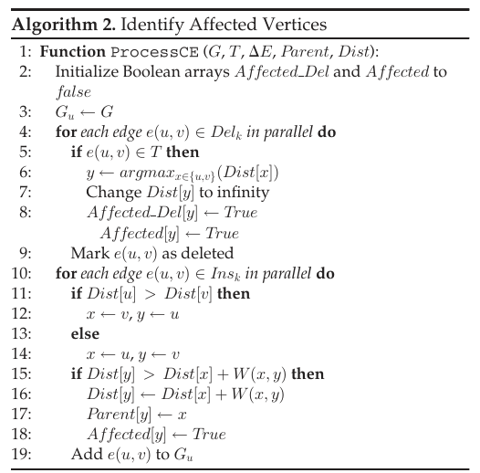
Overview of the Algorithm Template
~ Two-Step Approach
Step 1 – Identify Affected Subgraphs
For deleted edges set, first check if the edge is in spanning tree
Check which vertex in edge is parent, subsequently change the distance of child to infinity and mark as affected
Perform a similar marking as affected for each edge in inserted edge set

Slide 8
Overview of the Algorithm Template
~ Two-Step Approach
Step 2 – Update Affected Subgraphs
Recompute shortest paths for affected vertices.
Iterative method to converge to minimum distances.
Asynchronous updates to reduce synchronization.

Slide 9
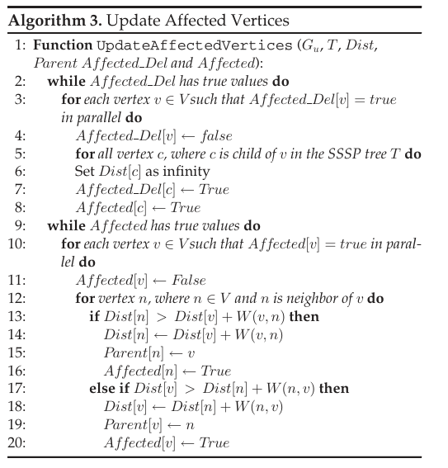
Overview of the Algorithm Template
~ Two-Step Approach
Step 2 – Update Affected Subgraphs
For each affected vertex due to deletion, mark the neighbors in subtree as affected
Each vertex’s subtree is checked by a separate thread in parallel
For each affected vertex, recompute shortest distances for its subtree, again parallelizing the process

Slide 10
Implementation Details on Platforms
Shared Memory (OpenMP)
Processes edge deletions then insertions in parallel.
Asynchronous updates with configurable synchronization levels.
Batch processing to improve load balancing and reduce memory hotspots.
Uses C++ and OpenMP for parallelism.

Slide 11
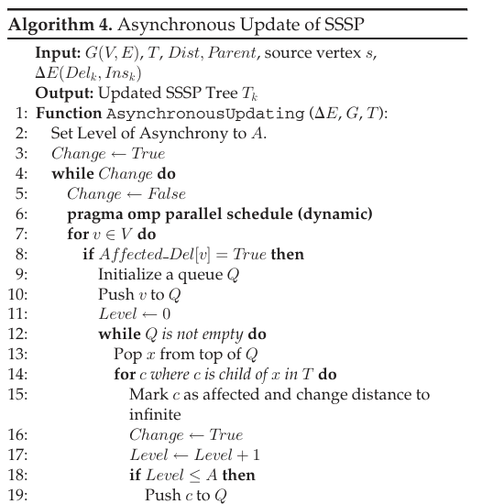
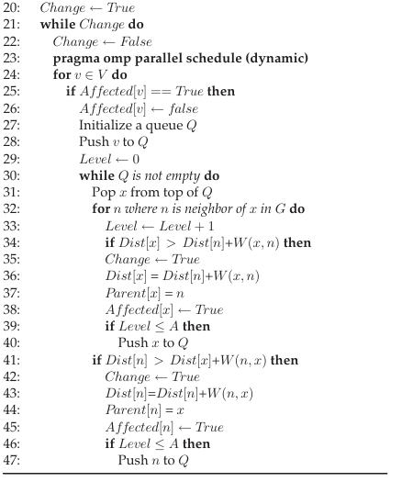
Implementation Details on Platforms
Shared Memory (OpenMP)

Slide 12
Implementation Details on Platforms
Shared Memory (OpenMP)
How is thread synchronization achieved?
Instead of locking Dist[v] with a mutex, threads write updates directly. If two threads update Dist[v] simultaneously, one update may be overwritten, but the iterative process ensures the correct (lower) distance is eventually applied.
Threads synchronize only at the end of each iteration via Change flag to check if any update occurred

Slide 13
Implementation Details on Platforms
Shared Memory (OpenMP)
Why better than using mutex locks?
Iterative updates allow all threads to work concurrently. Mutexes may cause serialization
Lower Overhead: Synchronization at iteration boundaries (or after depth d) is less costly than per-update locks
Scalability: Locks scale poorly with increasing threads (e.g., contention on mutexes).
Iterative updates scale better, as shown in the paper’s results (up to 5x speedup vs. Galois).

Slide 14
Implementation Details on Platforms
Shared Memory (OpenMP)
How are race conditions handled?
Race conditions (e.g., two threads updating Dist[v]) are harmless because:
Updates are monotonic as Dist[v] is only reduced, so incorrect overwrites are corrected in later iterations.
The iterative process ensures all neighbors are rechecked, catching any missed updates.

Slide 15
Implementation Details on Platforms
GPU (CUDA)
Uses Compressed Sparse Row (CSR) format for graph storage.
Vertex Marking Functional Blocks (VMFB) for parallel execution:
ProcessIns, ProcessDel, DisconnectC, ChkNbr functions.
Grid-Stride Loops for handling large operand arrays.
Manages race conditions without explicit locks.

Slide 16
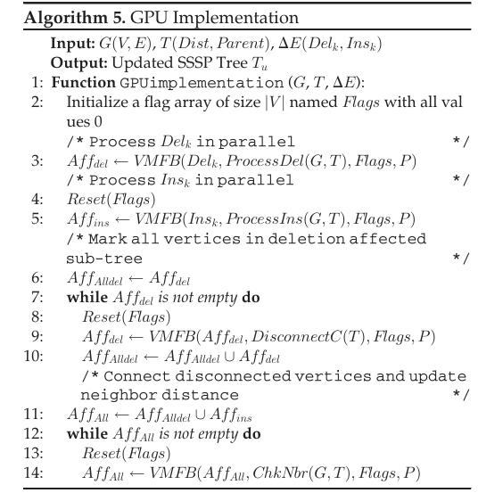
Implementation Details on Platforms
GPU (CUDA)
Each phase is divided into a Functional Block
A VMFB has three steps
Vertex Marking: Here each CUDA thread is allocated an operand array element (can be array of edges)
Synchronization: Acts as a global barrier
Filter: The filter step identifies and stores all marked vertices in an array without duplication. Moreover, this operation reduces the redundant computation due to overlapping affected subgraphs

Slide 17
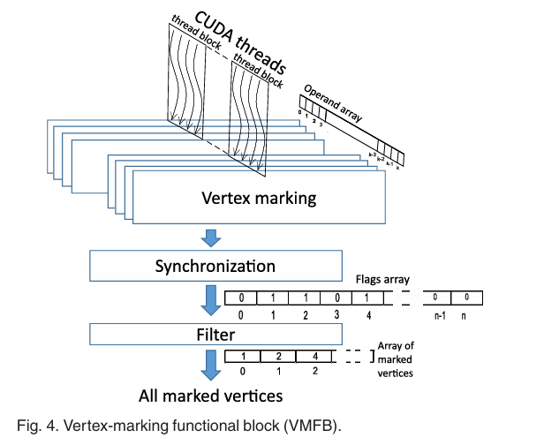
Implementation Details on Platforms
GPU (CUDA)
Illustration of the functional steps involved in a VMFB
The following VMFB functions are used:
ProcessIns()
ProcessDel()
DisconnectC()
ChkNbr()

Slide 18
Experimental Results
GPU and CPU Implementation Setup
GPU: NVIDIA Tesla V100 (32GB), AMD EPYC 7452 host.
CPU: Intel Xeon Gold 6148 (384GB RAM).
Datasets: Real-world (e.g., Orkut, LiveJournal) and synthetic (R-MAT).
Edge changes: 50M and 100M, varying insertion/deletion ratios.

Slide 19
Experimental Results
Shared Memory Implementation Results
Speedup: Up to 5x vs. Galois.
Scalability improves with more threads, but reduces if less than 15% nodes affected.
Asynchronous updates reduce execution time (Fig. 9).
Batch processing boosts performance at higher thread counts (Fig. 10).

Slide 20
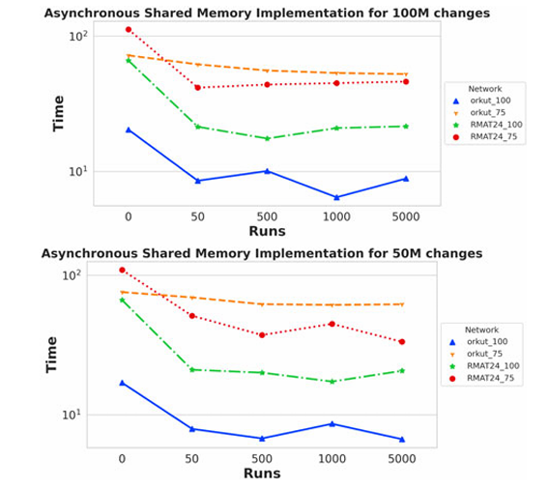
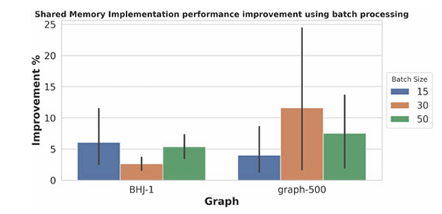
Experimental Results
Shared Memory Implementation Results

Slide 21
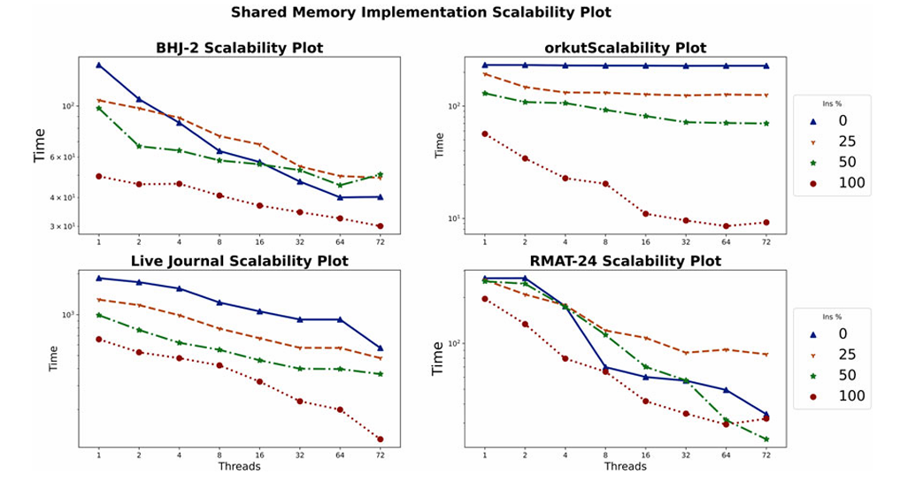
Experimental Results
Shared Memory Implementation Results

Slide 22
Experimental Results
GPU Implementation Results
Speedup: Up to 8.5x (50M changes), 5.6x (100M changes) vs. Gunrock.
Best performance when insertions ≥ 25%.
Recomputation better if deletions > 50% and changes > 50% of network.

Slide 23
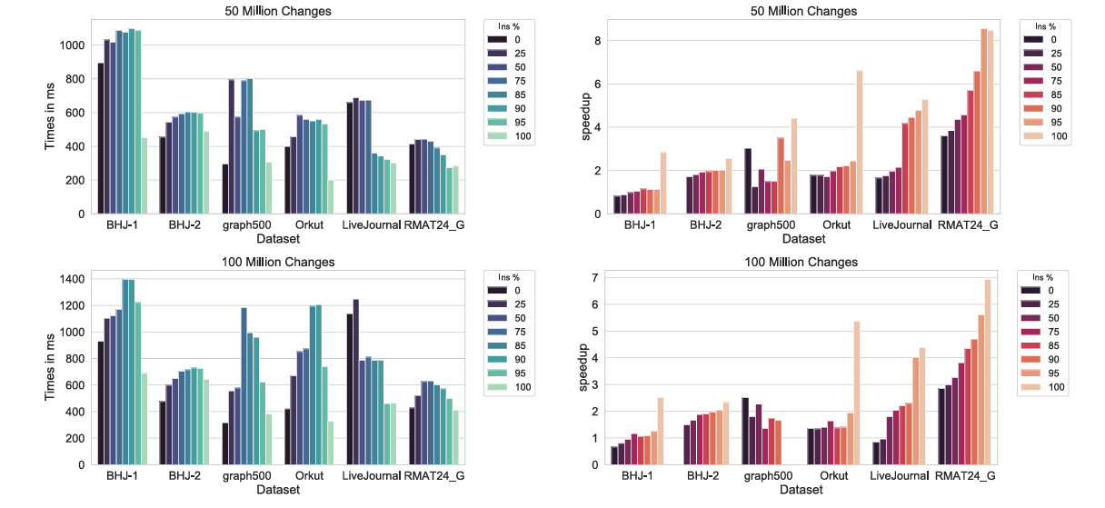
Experimental Results
GPU Implementation Results

Slide 24
Our Proposed Parallelizing Strategy for SSSP Algorithm in Dynamic Networks
MPI ~ for inter node communication
METIS ~ for graph partitioning, to be used to form subgraphs for MPI messages
OpenCL ~ for intra node parallelization on heterogenous systems (GPUs)

Slide 25
Our Proposed Parallelization strategy
MPI ~ inter-node communication
Assign each subgraph to a node, managed by an MPI process.
Broadcast edge changes to all nodes.
Identify affected vertices locally (Step 1 of algorithm).
Exchange boundary vertex information (distances, parents) during Step 2.
Use MPI_Allreduce to synchronize global convergence in iterative updates.
Minimize communication by only exchanging affected boundary vertices.
Use non-blocking sends (MPI_Isend) and receives (MPI_Irecv) to overlap computation and communication.
- **Challenges**:
- Load imbalance if affected vertices are unevenly distributed.
- High communication overhead for dense boundary regions.

Slide 26
Our Proposed Parallelization strategy
OpenCl ~ intra-node parallelization
Map VMFB to OpenCL kernels:
ProcessIns, ProcessDel, DisconnectC, ChkNbr as separate kernels.
Use work-groups to process vertices in parallel.
Store graph in CSR format in global memory.

Slide 27
Our Proposed Parallelization strategy
METIS ~ graph partitioning
Use METIS to partition graph G(V, E) into k subgraphs, where k is the number of MPI nodes
Preprocess graph to create METIS-compatible input (adjacency list).
Call METIS_PartGraphKway to generate partitions.
Assign partitions to MPI nodes.

Slide 28
Our Proposed Parallelization strategy
Integrated Parallelization Workflow
1. Initialization:
- Partition graph using METIS, distribute subgraphs to MPI nodes.
- Initialize local SSSP trees and CSR data structures.
2. Phase 1: Identify Affected Subgraphs:
- Broadcast edge changes (ΔE) via MPI.
- Process edge insertions/deletions in parallel using OpenMP/OpenCL.
- Mark affected vertices locally.

Slide 29
Our Proposed Parallelization strategy
Integrated Parallelization Workflow
3. Phase 2: Update Affected Subgraphs:
- Perform local updates using OpenMP/OpenCL kernels.
- Exchange boundary vertex distances/parents via MPI.
- Iterate until convergence, using MPI_Allreduce for global synchronization.

