Slide 1
CS3006 Parallel and Distributed Computing
FALL 2022
National University of Computer and Emerging Sciences

Slide 2
MapReduce: Simplified Data Processing on Large Clusters

Slide 3
MapReduce (Cont’d)
Inspired by LISP, MapReduce is a programming model and an associated implementation for processing and generating large data sets ( for processing huge amounts of data).
MapReduce program work in two phases, namely, i) Map and ii) Reduce
Map tasks deal with splitting and mapping of data while Reduce tasks shuffle and reduce the data.
Users specify a map function that processes a key/value pair to generate a set of intermediate key/value pairs, and a reduce function that merges all intermediate values associated with the same intermediate key

Slide 4
The run-time system takes care of the details of partitioning the input data, scheduling the program’s execution across a set of machines, handling machine failures, and managing the required inter-machine communication.
This allows programmers without any experience with parallel and distributed systems to easily utilize the resources of a large distributed system

Slide 5
MapReduce: Programming Model
The computation takes a set of input key/value pairs, and produces a set of output key/value pairs.
The user of the MapReduce library expresses the computation as two functions: Map and Reduce

Slide 6
MapReduce: Programming Model
Map, written by the user, takes an input pair and produces a set of intermediate key/value pairs
Map: (input shard) → intermediate(key/value pairs)
Automatically partition input data into M shards
The MapReduce library groups together all intermediate values associated with the same intermediate key I and passes them to the Reduce function

Slide 7
MapReduce: Programming Model
The Reduce function, also written by the user, accepts an intermediate key I and a set of values for that key
It merges together these values to form a possibly smaller set of values.
Typically just zero or one output value is produced per Reduce invocation
Reduce: intermediate(key/value pairs) → result files
Input: key & set of values
Merge these values together to form a smaller set of values
Reduce workers are distributed by partitioning the intermediate key space into R pieces using a partitioning function (e.g., hash(key) mod R)
The user specifies the # of partitions (R) and the partitioning function

Slide 8
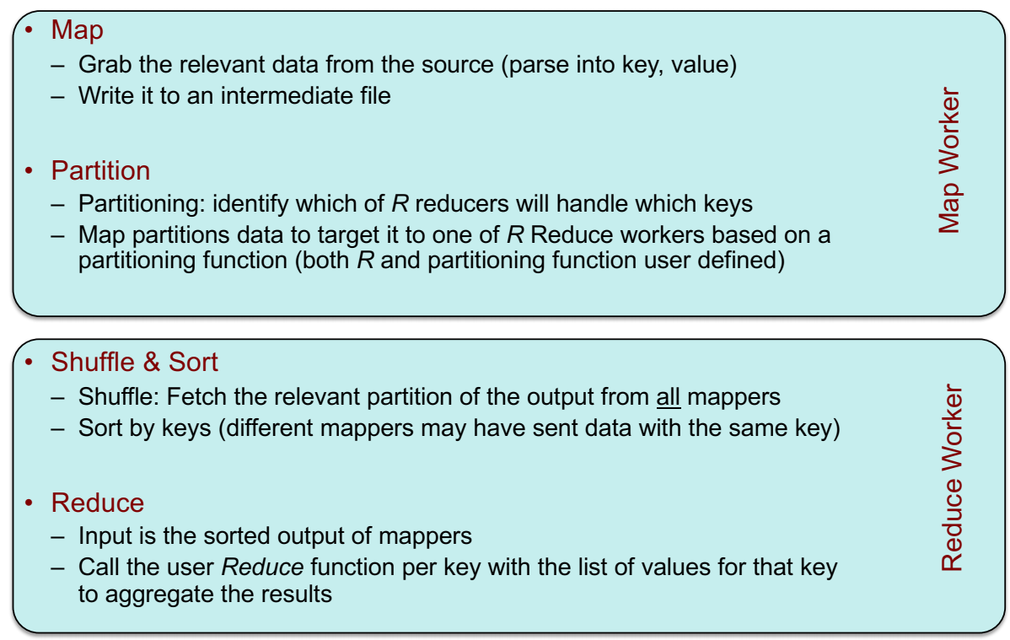
MapReduce: What happens in between..

Slide 9
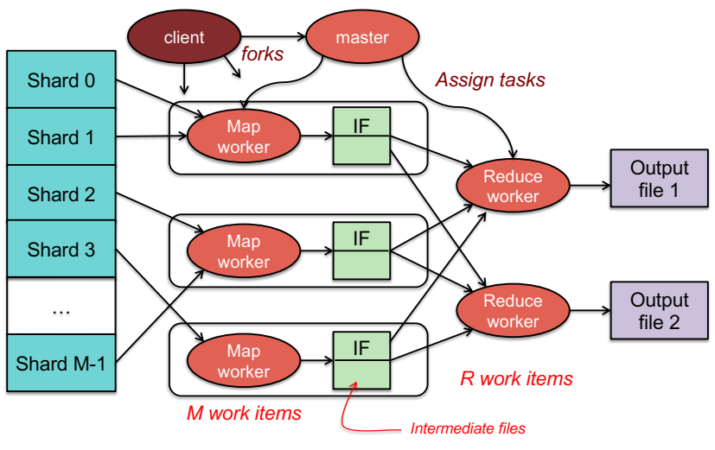

Slide 10
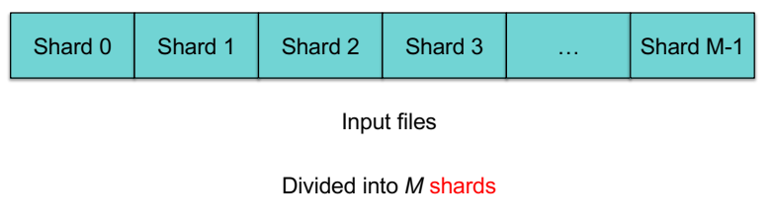
Step 1: Split input files into chunks (shards)
Break up the input data into M pieces (typically 64 MB)

Slide 11
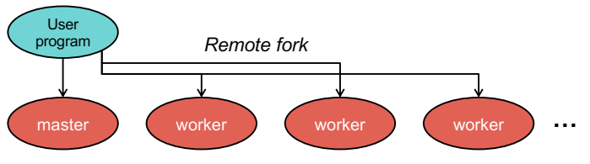
Step 2: Fork processes
Start up many copies of the program on a cluster of machines
One master: scheduler & coordinator
Lots of workers
Idle workers are assigned either:
map tasks (each works on a shard) – there are M map tasks
reduce tasks (each works on intermediate files) – there are R
R = # partitions, defined by the user

Slide 12

Step 3: Run Map Tasks
Reads contents of the input shard assigned to it
Parses key/value pairs out of the input data
Passes each pair to a user-defined map function
Produces intermediate key/value pairs
These are buffered in memory

Slide 13
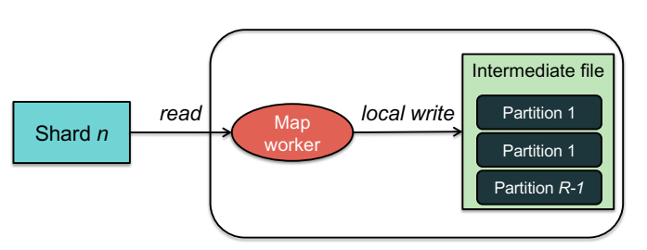
Step 4: Create intermediate files
Intermediate key/value pairs produced by the user’s map function buffered in memory and are periodically written to the local disk
Partitioned into R regions by a partitioning function

Slide 14
Step 4a. Partitioning
Map data will be processed by Reduce workers
User’s Reduce function will be called once per unique key generated by Map.
We first need to sort all the (key, value) data by keys and decide which Reduce worker processes which keys
The Reduce worker will do the sorting
Partition function
Decides which of R reduce workers will work on which key
Default function: hash(key) mod R
Map worker partitions the data by keys
Each Reduce worker will later read their partition from every Map worker

Slide 15
Step 5: Reduce Task: sorting
Reduce worker gets notified by the master about the location of intermediate files for its partition
Shuffle: Uses Remote Procedure Calls (RPCs) to read the data from the local disks of the map workers
Sort: When the reduce worker reads intermediate data for its partition
It sorts the data by the intermediate keys
All occurrences of the same key are grouped together

Slide 16
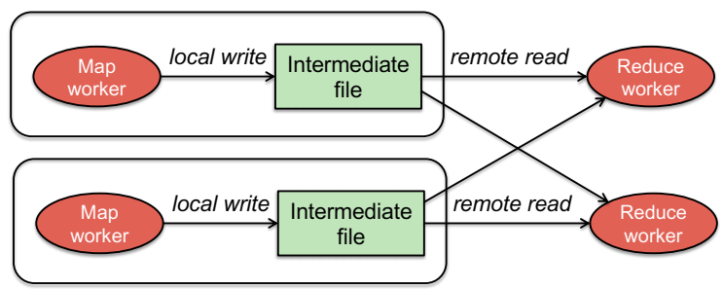

Slide 17
Step 6: Reduce Task: Reduce
The sort phase grouped data with a unique intermediate key
User’s Reduce function is given the key and the set of intermediate values for that key
< key, (value1, value2, value3, value4, …) >
The output of the Reduce function is appended to an output file

Slide 18
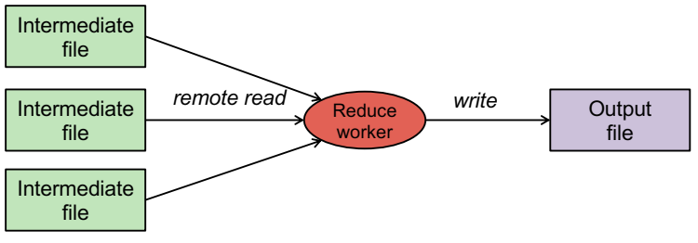

Slide 19
Step 7: Return to User
When all map and reduce tasks have completed, the master wakes up the user program
The MapReduce call in the user program returns and the program can resume execution.
Output of MapReduce is available in R output files

Slide 20
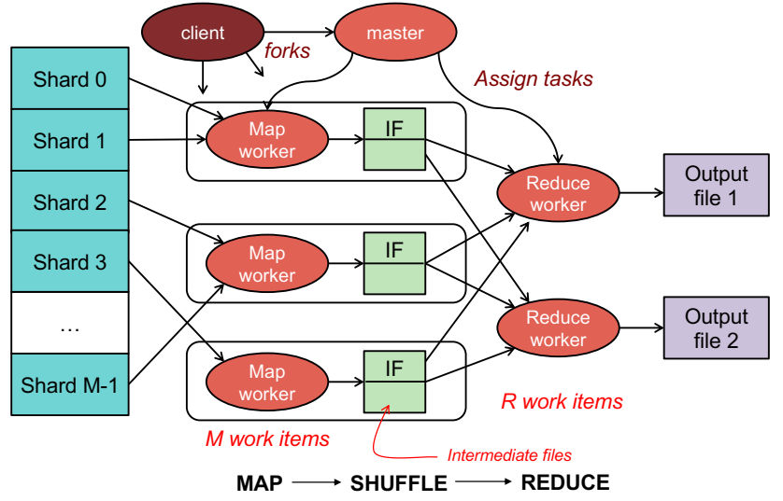

Slide 21
Example: Word Count
map(String key, String value): // key: document name // value: document contents for each word w in value: EmitIntermediate(w, "1");
reduce(String key, Iterator values): // key: a word // values: a list of counts int result = 0; for each v in values: result += ParseInt(v); Emit(AsString(result));

Slide 22
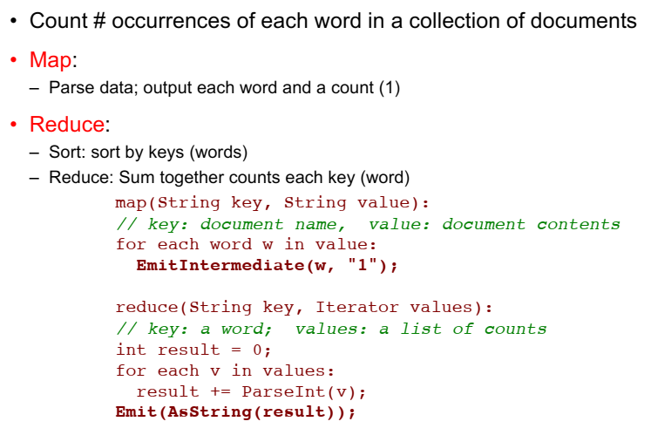

Slide 23
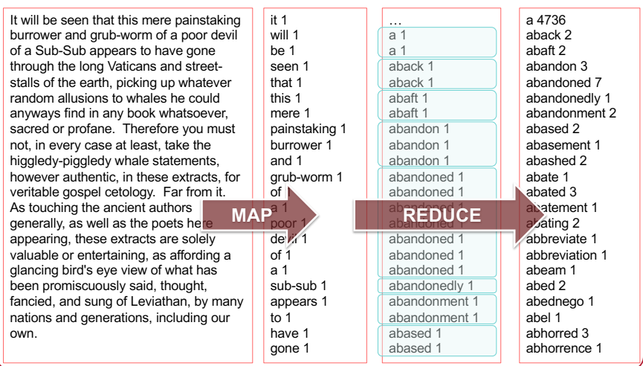

Slide 24
Fault Tolerance
Worker Failure
Master pings each worker periodically
If no response is received within a certain time, the worker is marked as failed
Map or reduce tasks given to this worker are reset back to the initial state and rescheduled for other workers
Completed map tasks are re-executed on a failure because their output is stored on the local disk(s) of the failed machine and is therefore inaccessible
When a map task is executed first by worker A and then later executed by worker B (because A failed), all workers executing reduce tasks are notified of the re-execution.
Any reduce task that has not already read the data from worker A will read the data from worker B.

Slide 25
Fault Tolerance
Master Failure
It is easy to make the master write periodic checkpoints of the master data structures
If the master task dies, a new copy can be started from the last check pointed state

Slide 26
Locality
Input and Output files
GFS (Google File System)
Bigtable
MapReduce (often) runs on GFS chunkservers
Keep computation close to the files if possible
Master tries to schedule map worker on one of the machines that has a copy of the input chunk it needs.
Notes:
Google Cloud Bigtable is a compressed, high-performance, proprietary data storage system built on Google File System, Chubby Lock Service, SSTable and a few other Google technologies
Cloud Bigtable is a sparsely populated table that can scale to billions of rows and thousands of columns, enabling you to store terabytes or even petabytes of data. A single value in each row is indexed; this value is known as the row key. Bigtable is ideal for storing very large amounts of single-keyed data with very low latency. It supports high read and write throughput at low latency, and it is an ideal data source for MapReduce operations.

Slide 27
Task Granularity
We subdivide the map phase into M pieces and the reduce phase into R pieces.
Ideally, M and R should be much larger than the number of worker machines
Having each worker perform many different tasks improves dynamic load balancing, and also speeds up recovery when a worker fails:
the many map tasks it has completed can be spread out across all the other worker machines.

Slide 28
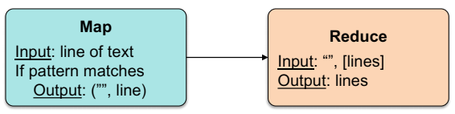
Other Examples
Distributed grep (search for words)
Search for words in lots of documents
Map: emit a line if it matches a given pattern
Reduce: just copy the intermediate data to the output

Slide 29
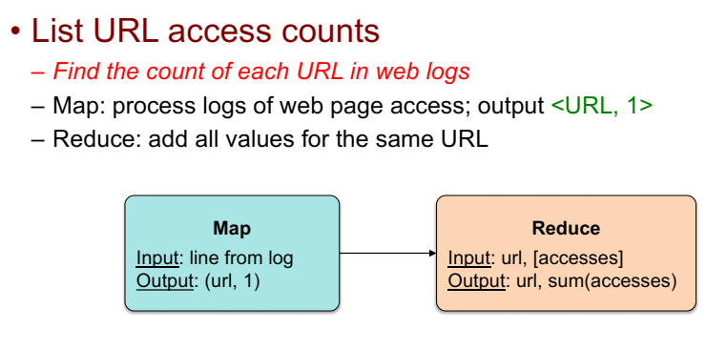

Slide 30
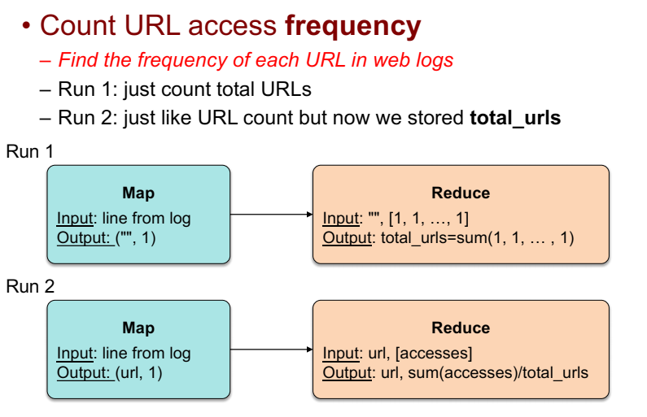

Slide 31
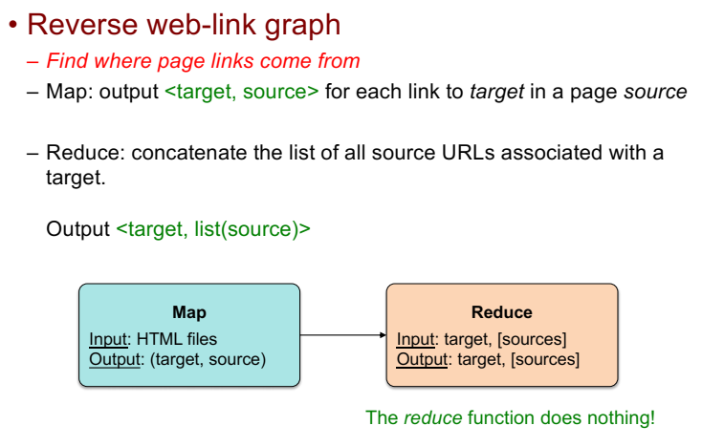

Slide 32
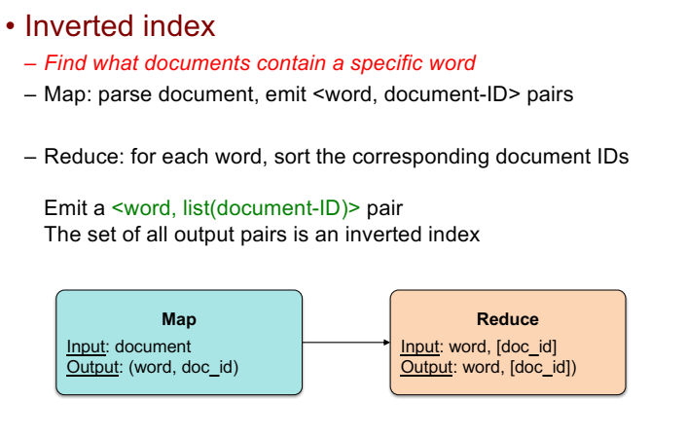

Slide 33
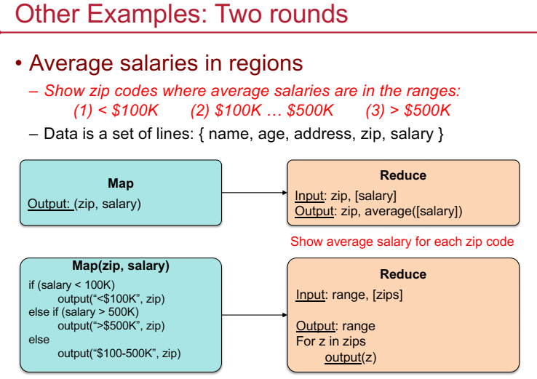

Slide 34
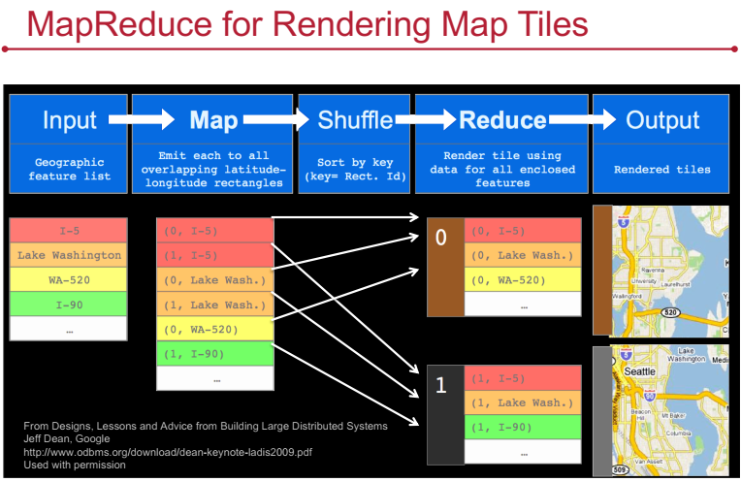

Slide 35
MapReduce Summary
Get a lot of data
Map
Parse & extract items of interest
Sort (shuffle) & partition
Reduce
Aggregate results
Write to output files

Slide 36
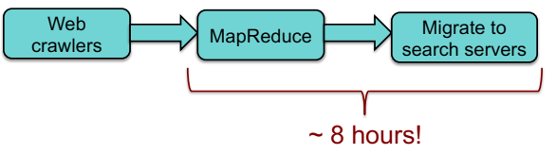
All is not Well
MapReduce was used to process webpage data collected by Google's crawlers.
It would extract the links and metadata needed to search the pages
Determine the site's PageRank
The process took around eight hours.
Results were moved to search servers.
This was done continuously

Slide 37
All is not Well
MapReduce
Batch-oriented
Not suited for near-real-time processes
Cannot start a new phase until the previous has completed
Reduce cannot start until all Map workers have completed
Suffers from “stragglers” – workers that take too long (or fail)
This was done continuously
MapReduce is still used for many Google services
Search framework updated in 2009-2010: Caffeine
Index updated by making direct changes to data stored in Bigtable
Data resides in Colossus (GFS2) instead of GFS

