Slide 1
CS3006 Parallel and Distributed Computing
Fall 2022
National University of Computer and Emerging Sciences

Slide 2
CUDA (Compute Unified Device Architecture) C and Data Parallelism

Slide 3
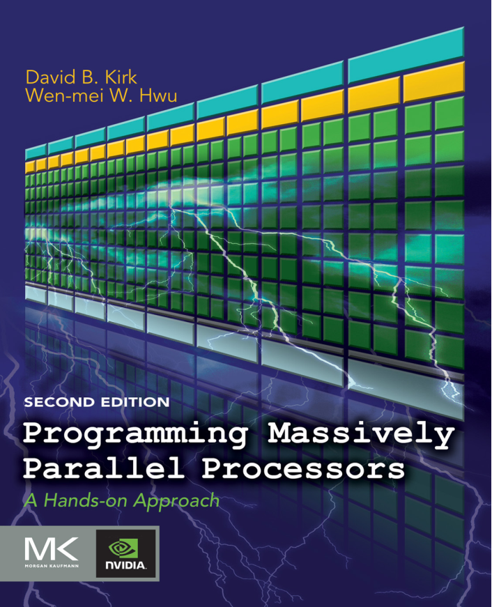
Reference Book (Chapter#3)
Programming Massively Parallel Processors
David B. Kirk
Wen-mei W. Hwu

Slide 4
Preface
We have chosen CUDA C for our code examples and exercises.
CUDA C is an extension to the popular C programming language1 with new keywords and application programming interfaces for programmers to take advantage of heterogeneous computing systems that contain both CPUs and massively parallel GPU’s.
To a CUDA programmer, the computing system consists of a host that is a traditional CPU, such as an Intel architecture microprocessor in personal computers today, and one or more devices that are processors with a massive number of arithmetic units.
A CUDA device is typically a GPU

Slide 5
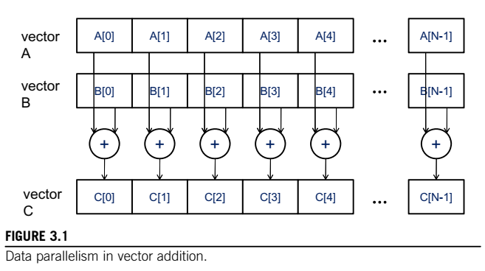
Data Parallelism
Notes:
All additions can be performed in parallel.

Slide 6
CUDA
CUDA is a parallel computing platform and programming model developed by Nvidia for general computing on its own GPUs (graphics processing units)
CUDA enables developers to speed up compute-intensive applications by harnessing the power of GPUs for the parallelizable part of the computation.
While there have been other proposed APIs for GPUs, such as OpenCL, and there are competitive GPUs from other companies, such as AMD, the combination of CUDA and Nvidia GPUs dominates several application areas, including deep learning, and is a foundation for some of the fastest computers in the world.

Slide 7
CUDA Programming Structure
The structure of a CUDA program reflects the coexistence of a host (CPU) and one or more devices (GPUs) in the computer.
Each CUDA source file can have a mixture of both host and device code.
By default, any traditional C program is a CUDA program that contains only host code
The function or data declarations for the device are clearly marked with special CUDA keywords.
These are typically functions that exhibit a rich amount of data parallelism

Slide 8
CUDA Programming Structure
Once device functions and data declarations are added to a source file, it is no longer acceptable to a traditional C compiler
The code needs to be compiled by a compiler that recognizes and understands these additional declarations
E.g. a CUDA C compiler by NVIDIA called NVCC (NVIDIA C Compiler)
The NVCC processes a CUDA program, using the CUDA keywords to separate the host code and device code.
The host code is straight ANSI C code, which is further compiled with the host’s standard C/C++ compilers and is run as a traditional CPU process.
The device code is marked with CUDA keywords for labeling data-parallel functions, called kernels, and their associated data structures

Slide 9
The device code is further compiled by a runtime component of NVCC and executed on a GPU device.
In situations where there is no device available or a kernel can be appropriately executed on a CPU, one can also choose to execute the kernel on a CPU using tools like MCUDA

Slide 10
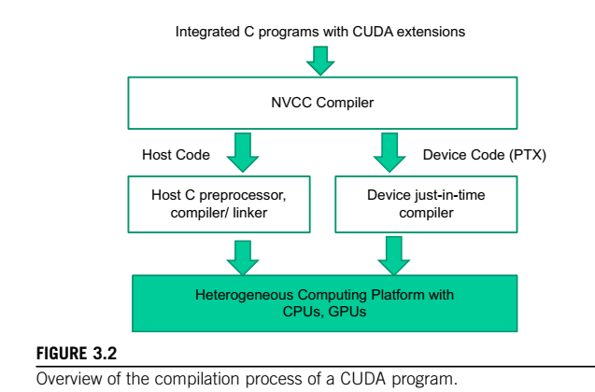

Slide 11
CUDA: Execution
The execution starts with host (CPU) execution.
When a kernel function is called, or launched, it is executed by a large number of threads on a device
All the threads that are generated by a kernel launch are collectively called a GRID
When all threads of a kernel complete their execution, the corresponding grid terminates, and the execution continues on the host until another kernel is launched.

Slide 12
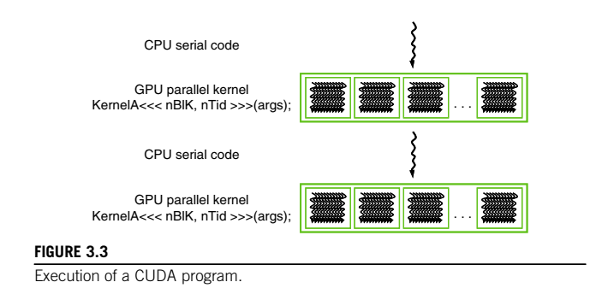
Notes:
Note that Figure 3.3 shows a simplified model where the CPU execution and the GPU execution do not overlap. Many heterogeneous computing applications actually manage overlapped CPU and GPU execution to take advantage of both CPUs and GPUs

Slide 13
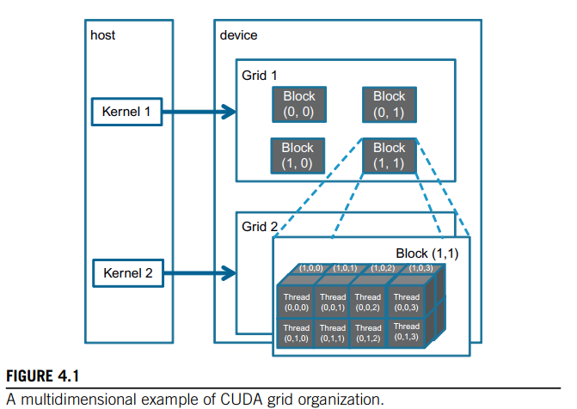

Slide 14
Launching a kernel typically generates a large number of threads to exploit data parallelism
In the vector addition example, each thread can be used to compute one element of the output vector C
In this case, the number of threads that will be generated by the kernel is equal to the vector length.
CUDA programmers can assume that these threads take very few clock cycles to generate and schedule due to efficient hardware support.
This is in contrast with traditional CPU threads that typically take thousands of clock cycles to generate and schedule.

Slide 15
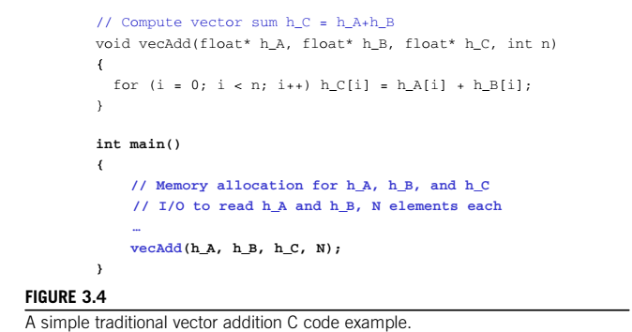
Notes:
We will prefix the names of variables that are mainly processed by the host with h_ and those of variables that are mainly processed by a device d_ to remind ourselves the intended usage of these variables

Slide 16
A VECTOR ADDITION KERNEL
A straightforward way to execute vector addition in parallel is to modify the vecAdd() function and move its calculations to a CUDA device
Notes:
Before we show the kernel code for vector addition, it is helpful to first review how a conventional CPU-only vector addition function works.

Slide 17
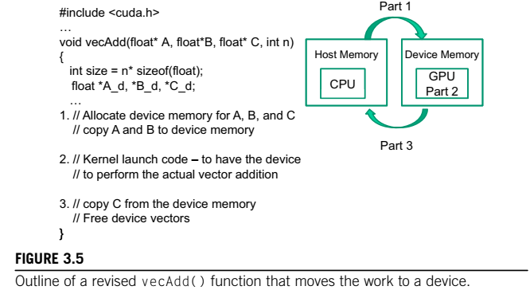

Slide 18
At the beginning of the file, we need to add a C preprocessor directive to include the CUDA.h header file
This file defines the CUDA API functions and built-in variables.
Part 1 of the function allocates space in the device (GPU) memory to hold copies of the A, B, and C vectors, and copies the vectors from the host memory to the device memory.
Part 2 launches parallel execution of the actual vector addition kernel on the device
Part 3 copies the sum vector C from the device memory back to the host memory

Slide 19
Note that the revised vecAdd() function is essentially an outsourcing agent that ships input data to a device, activates the calculation on the device, and collects the results from the device
The agent does so in such a way that the main program does not need to even be aware that the vector addition is now actually done on a device.

Slide 20
Device Global Memory Data Transfer
In CUDA, host and devices have separate memory spaces. This reflects the current reality that devices are often hardware cards that come with their own DRAM
The NVIDIA GTX480 comes with up to 4 GB of DRAM, called global memory, We will also refer to global memory as device memory
To execute a kernel on a device, the programmer needs to allocate global memory on the device and transfer pertinent data from the host memory to the allocated device memory
Similarly, after device execution, the programmer needs to transfer result data from the device memory back to the host memory and free up the device memory that is no longer needed

Slide 21
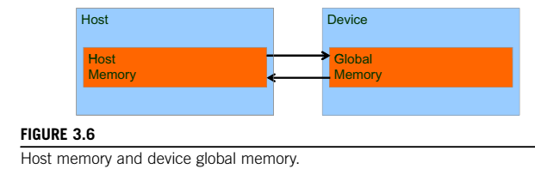
The CUDA runtime system provides Application Programming Interface (API) functions to perform these activities on behalf of the programmer

Slide 22
The CUDA runtime system provides API functions for managing data in the device memory
For example, Parts 1 and 3 of the vecAdd() function in Figure 3.5 need to use these API functions to allocate device memory for A, B, and C; transfer A and B from host memory to device memory; transfer C from device memory to host memory; and free the device memory for A, B, and C
Function cudaMalloc() can be called from the host code to allocate a piece of device global memory for an object
After the computation, cudaFree() is called with pointer d_A as input to free the storage space for the A vector from the device global memory

Slide 23
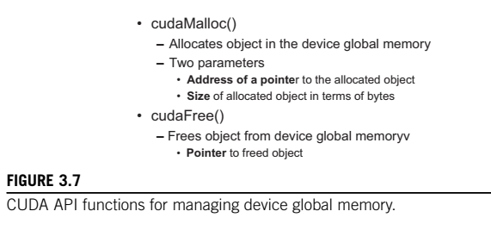
Notes:
The address of the pointer variable should be cast to (void **) because the function expects a generic pointer;

Slide 24
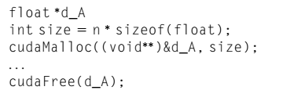
The addresses in d_A, d_B, and d_C are addresses in the device memory.
These addresses should not be dereferenced in the host code
They should be mostly used in calling API functions and kernel functions
Part 3 in Figure 3.6 can be completed with the cudaFree() calls for d_B and d_C

Slide 25
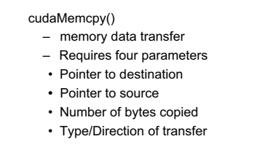
Once the host code has allocated device memory for the data objects, it can request that data be transferred from host to device.
Notes:
cudaMemcpy() cannot be used to copy between different GPUs in multiGPU systems

Slide 26
void vecAdd(float* A, float* B, float* C, int n) { int size = n * sizeof(float); float *d_A, *d_B, *d_C;
cudaMalloc((void **) &d_A, size); cudaMemcpy(d_A, A, size, cudaMemcpyHostToDevice); cudaMalloc((void **) &B_d, size); cudaMemcpy(d_B, B, size, cudaMemcpyHostToDevice); cudaMalloc((void **) &d_C, size);
// Kernel invocation code – to be shown later
... cudaMemcpy(C, d_C, size, cudaMemcpyDeviceToHost); // Free device memory for A, B, C cudaFree(d_Ad); cudaFree(d_B); cudaFree (d_C); }
Fig 3.9 A more complete version of vecAdd()

Slide 27
KERNEL FUNCTIONS AND THREADING
In CUDA, a kernel function specifies the code to be executed by all threads during a parallel phase.
Since all these threads execute the same code, CUDA programming is an instance of the well-known SPMD (single program, multiple data) parallel programming style
When a host code launches a kernel, the CUDA runtime system generates a grid of threads that are organized in a two-level hierarchy
grid is organized into an array of thread blocks

Slide 28
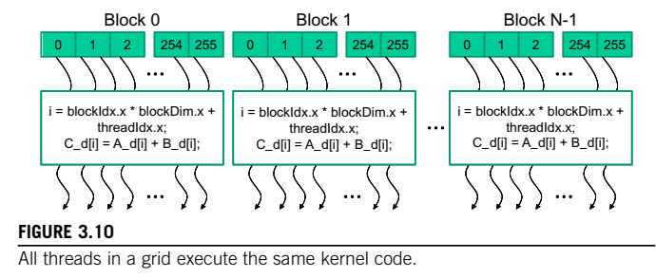
Notes:
All blocks of a grid are of the same size; each block can contain up to 1,024 threads

Slide 29
The number of threads in each thread block is specified by the host code when a kernel is launched.
The same kernel can be launched with different numbers of threads at different parts of the host code
For a given grid of threads, the number of threads in a block is available in the blockDim variable
Each thread in a block has a unique threadIdx value.
This allows each thread to combine its threadIdx and blockIdx values to create a unique global index for itself with the entire grid

Slide 30
a data index i is calculated as i = blockIdx.x * blockDim.x + threadIdx.x
Since blockDim is 256 in our example:
the i values of threads in block 0 ranges from 0 to 255, block 1 range from 256 to 511, and block 2 range from 512 to 767.
Since each thread uses i to access d_A, d_B, and d_C, these threads cover the first 768 iterations of the original loop
By launching the kernel with a larger number of blocks, one can process larger vectors

Slide 31
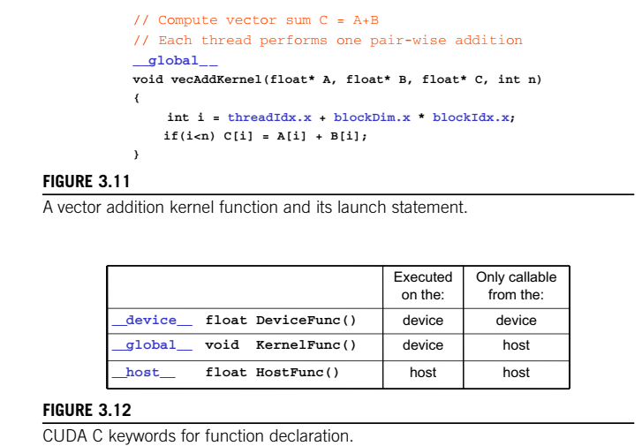

Slide 32
Note that one can use both __host__ and __device__ in a function declaration.
This combination tells the compilation system to generate two versions of object files for the same function.
One is executed on the host and can only be called from a host function. The other is executed on the device and can only be called from a device or kernel function
There is an automatic (local) variable i in Figure.
In a CUDA kernel function, automatic variables are private to each thread

Slide 33
A quick comparison between Figure 3.4 and Figure 3.11 reveals an important insight for CUDA kernels and a CUDA kernel launch.
The kernel function in Figure 3.11 does not have a loop that corresponds to the one in Figure 3.4.
Readers should ask where the loop went. The answer is that the loop is now replaced with the grid of threads.

Slide 34
When the host code launches a kernel, it sets the grid and thread block dimensions via execution configuration parameters.
The configuration parameters are given between the <<< and >>> before the traditional C function arguments
The first configuration parameter gives the number of thread blocks in the grid
The second specifies the number of threads in each thread block

Slide 35
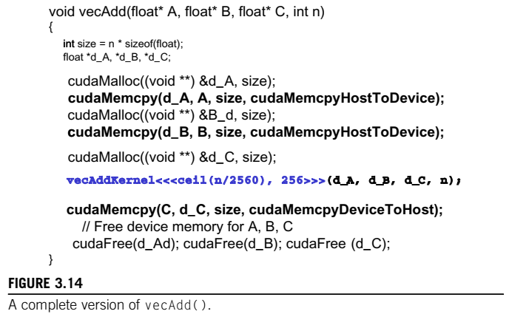
Notes:
The exact organization of a grid is determined by the execution configuration parameters (within ,, , and .. .) of the kernel launch statement.
The first execution configuration parameter specifies the dimensions of the grid in number of blocks. The second specifies the dimensions of each block in number of threads

