Slide 1
What is Express?
Express is a fast, unopinonated and minimalist web framework for Node.js Express is a “server-side” or “back-end” framework. It is not comparable to client-side frameworks like React, Angular and Vue. It can be used in combination with those frameworks to build fullstack applications.

Slide 2
Why use Express?
Makes building web applications with Node.js MUCH easier.
Used for both server rendered apps as well ass API/Microservices.
Extremely light, fast and free.
Full control of request and response.
By far the most popular Node framework.
Great to use with client side frameworks as its all JavaScript.

Slide 3
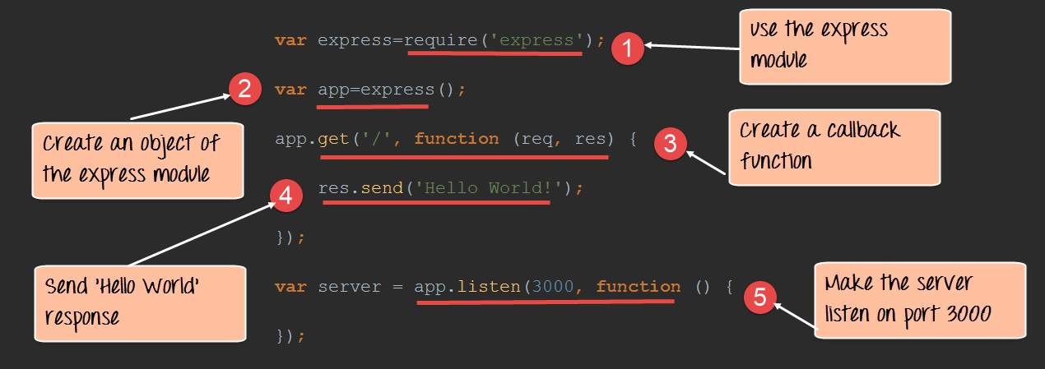
Basic server syntax

Slide 4
Code explanation:
1- In our first line of code, we are using the require function to include the "express module."
2- Before we can start using the express module, we need to make an object of it.
3-Here we are creating a callback function. This function will be called whenever anybody browses to the root of our web application which is http://localhost:3000 . The callback function will be used to send the string 'Hello World' to the web page.

Slide 5
4-In the callback function, we are sending the string "Hello World" back to the client. The 'res' parameter is used to send content back to the web page. This 'res' parameter is something that is provided by the 'request' module to enable one to send content back to the web page.
5-We are then using the listen to function to make our server application listen to client requests on port no 3000. You can specify any available port over here.
If the command is executed successfully, the following Output will be shown when you run your code in the browser.

Slide 6
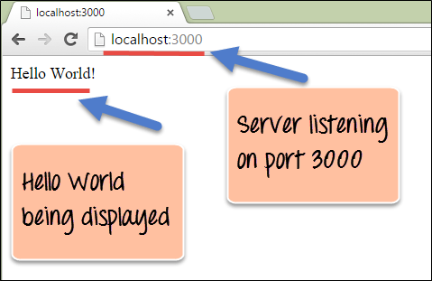
Output:

Slide 7
What are Routes?
Routing determine the way in which an application responds to a client request to a particular endpoint.
For example, a client can make a GET, POST, PUT or DELETE http request for various URL such as the ones shown below:
-http://localhost:3000/Books
-http://localhost:3000/Students

Slide 8
In the above example,
If a GET request is made for the first URL, then the response should ideally be a list of books.
If the GET request is made for the second URL, then the response should ideally be a list of Students.
So based on the URL which is accessed, a different functionality on the webserver will be invoked, and accordingly, the response will be sent to the client. This is the concept of routing.
Each route can have one or more handler functions, which are executed when the route is matched.
The general syntax for a route is shown below
app.METHOD(PATH, HANDLER)

Slide 9
1) app is an instance of the express module
2) METHOD is an HTTP request method (GET, POST, PUT or DELETE)
3) PATH is a path on the server.
4) HANDLER is the function executed when the route is matched.

Slide 10
Express Middleware
Middleware functions are functions that have access to the request and response object. Express has built in middleware but middleware also comes from 3rd party packages as well as custom middleware.
Middleware is capable of:
-Executing any code
-Making changes to the request/response objects
-End response cycle
-Call next middleware in the stack

