Slide 1
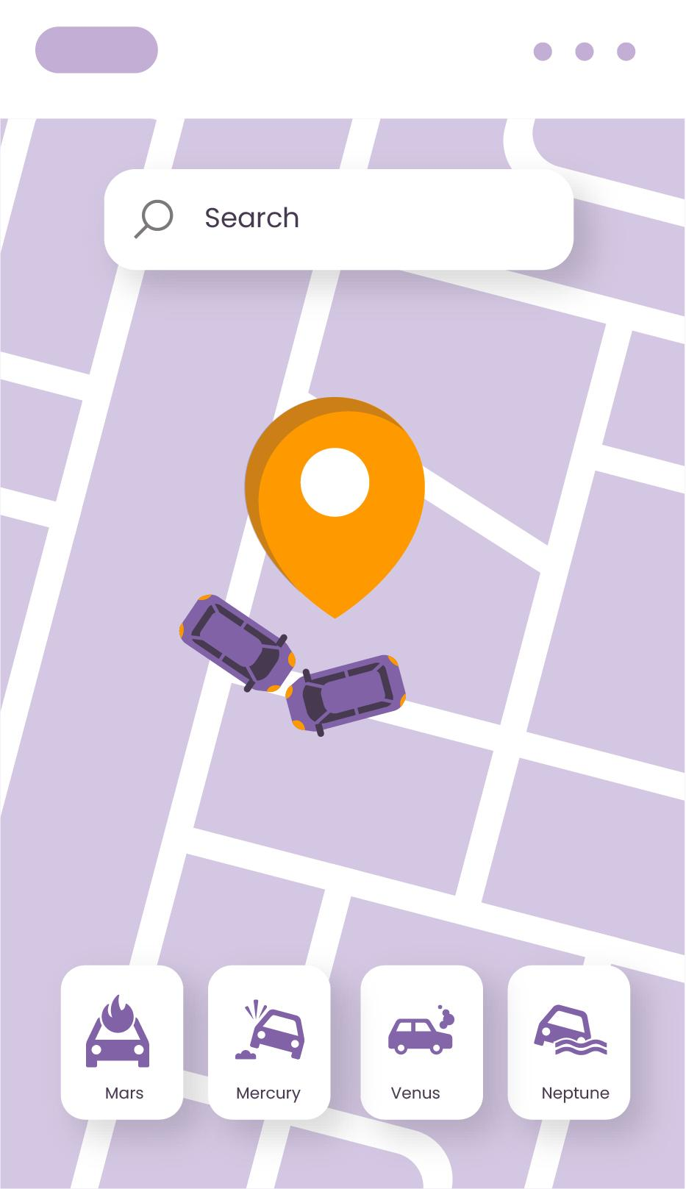
Smart Bahrain Traffic Application
REPORT!

Slide 2
Agenda
01
02
03
04
05
06
Introduction
Project aims
Problem definition
Research findings
Suggested solution
07
08
09
Targeted users
Requirement and Analysis
System design
User interface

Slide 3
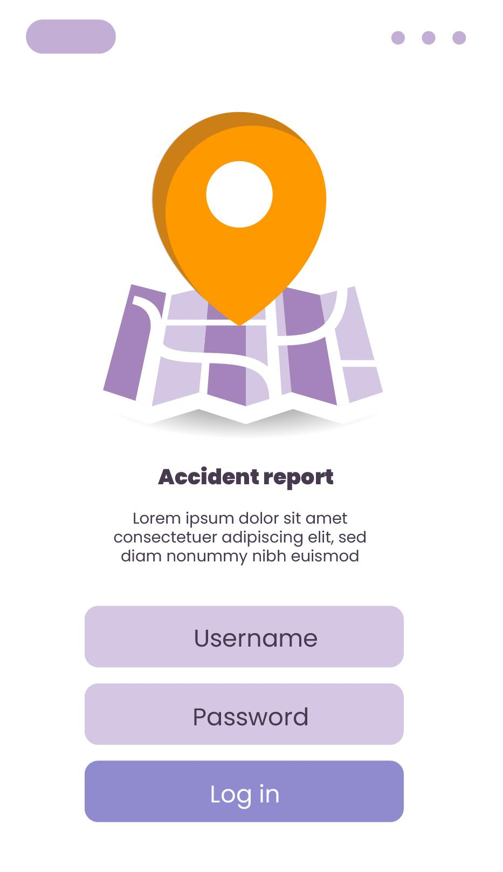
Introduction
ACCIDENT!
Traffic and parking violations reduce road safety and traffic efficiency
Many violations go unreported due to limited enforcement resources
Increasing vehicle numbers require smart, community-based solutions

Slide 4
Problem Definition
Traffic and parking violations reduce road safety and cause congestion
Limited manpower makes it difficult to monitor all areas
Manual reporting is slow and inefficient
Many violations go unreported, weakening traffic management

Slide 5
Project aims
Develop a mobile app for quick reporting of traffic and parking violations
Improve communication between citizens and traffic authorities
Enable faster and more accurate handling of reported incidents
Support digital transformation and safer, organized roads

Slide 6
Research finding
Citizen reporting systems
Citizen reporting apps enable the public to report violations using photos or videos
Common features include location tagging, evidence upload and centralized authority review
Such systems improve community participation in public safety

Slide 7
Targeted users
Targeted Customers or Beneficiaries
Citizens and Residents: Report local traffic and parking violations.
Traffic Authorities: Review reports, verify evidence and take action.
Policy Makers: Use data to identify issues and improve regulations.
Organizations: Promote road safety and responsible driving.

Slide 8
Requirement Elecitation
Requirements identified through:
Personal observations of traffic and parking issues in Bahrain.
User experiences shared by residents and friends.
Analysis of existing systems.
Literature review of similar apps (Traffic Prahari in India, Saudi Balady)
highlighted key features:
Evidence upload (images/videos)
Report tracking
Efficient authority review

Slide 9
Functional Requirements
User registration and secure login
Identity verification (ID, email, or phone)
Submit violation reports with details
Upload photo and video evidence
Automatic GPS location capture
Authority review and report verification
Real-time report status tracking
Status change notifications
Secure storage of reports and evidence
Rewards for confirmed reports

Slide 10
Non Functional Requirements
Performance: Fast loading and efficient report handling
Security: Encrypted data and controlled access
Usability: Simple, intuitive interface for all users
Reliability: Stable operation during peak usage
Scalability: Supports future features and violation types
Maintainability: Modular code for easy updates

Slide 11
Software Development Model
Model Used: Incremental Development Model
System developed in small, independent modules
Core features delivered and tested early
Allows continuous feedback and improvements
Reduces risk through early testing and modular development
Supports scalability, flexibility and easy maintenance

Slide 12
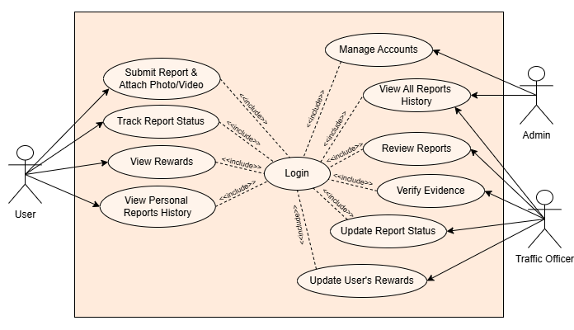
Use-Case Diagram

Slide 13
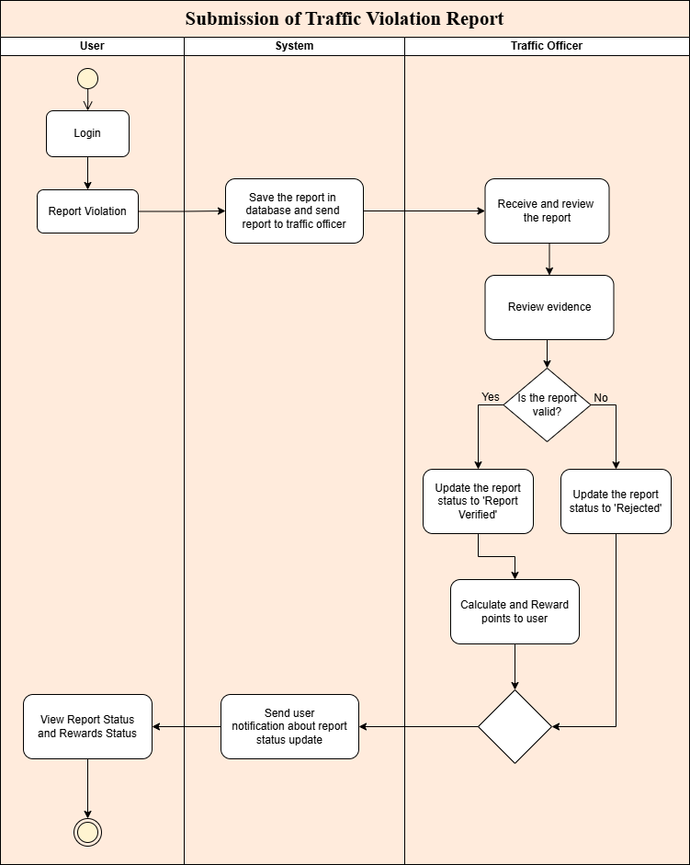
Activity Diagram

Slide 14
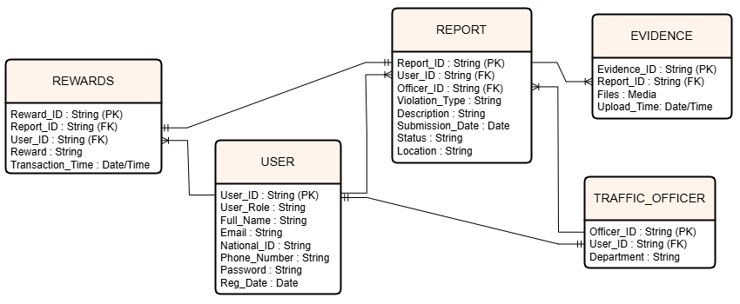
Entity Relationship Diagram

Slide 15
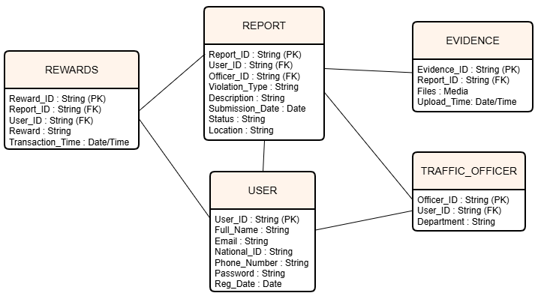
Database Diagram

Slide 16
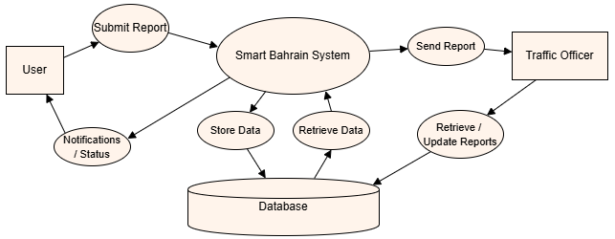
State Diagram

Slide 17
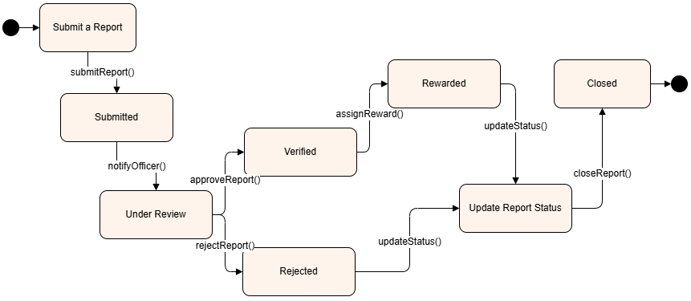
Data Flow Diagram

Slide 18
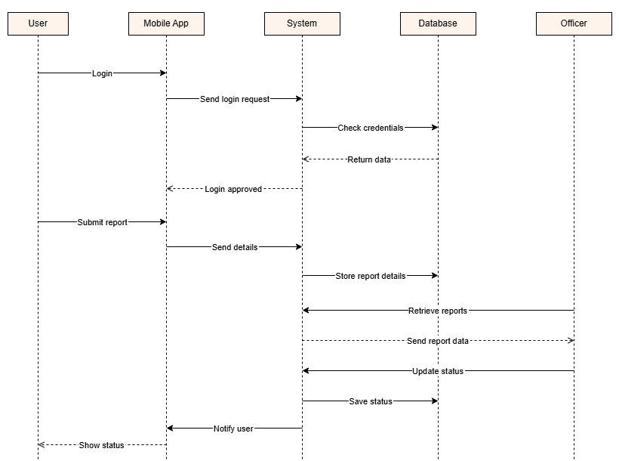
Sequence Diagram

Slide 19
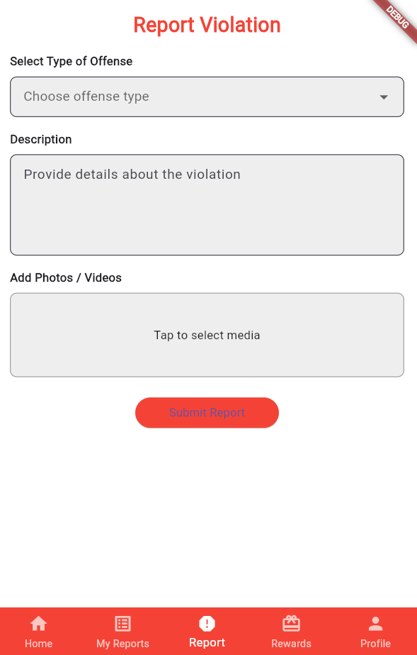
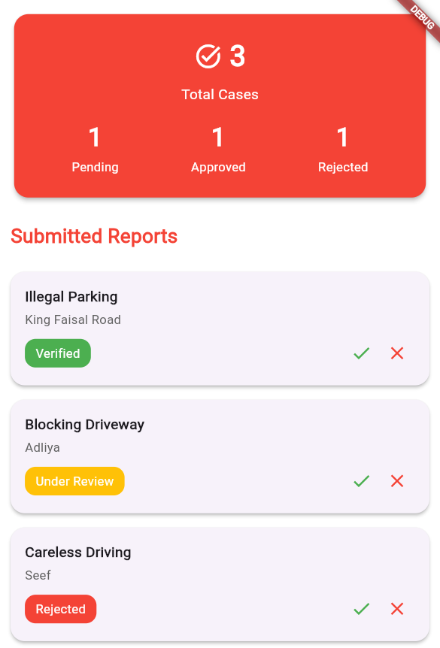
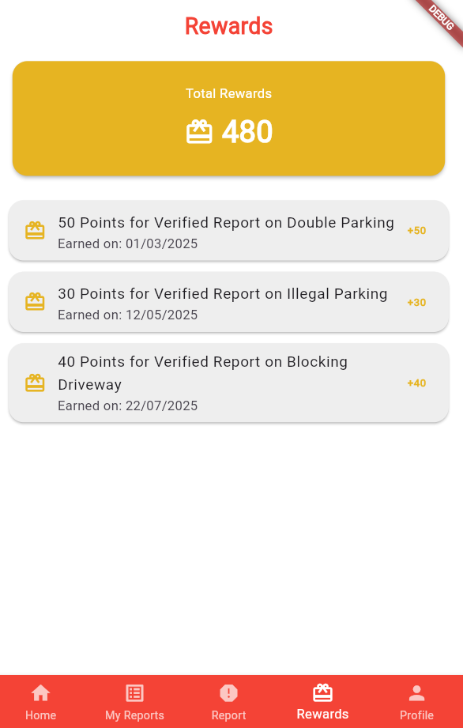
User Interface

Slide 20
THANK YOU!

