Slide 1

Explaining Rule-based Algorithms
CORRELS (Optimal Rule List)
OneR
GOSDT (Decision Tree)

Slide 2
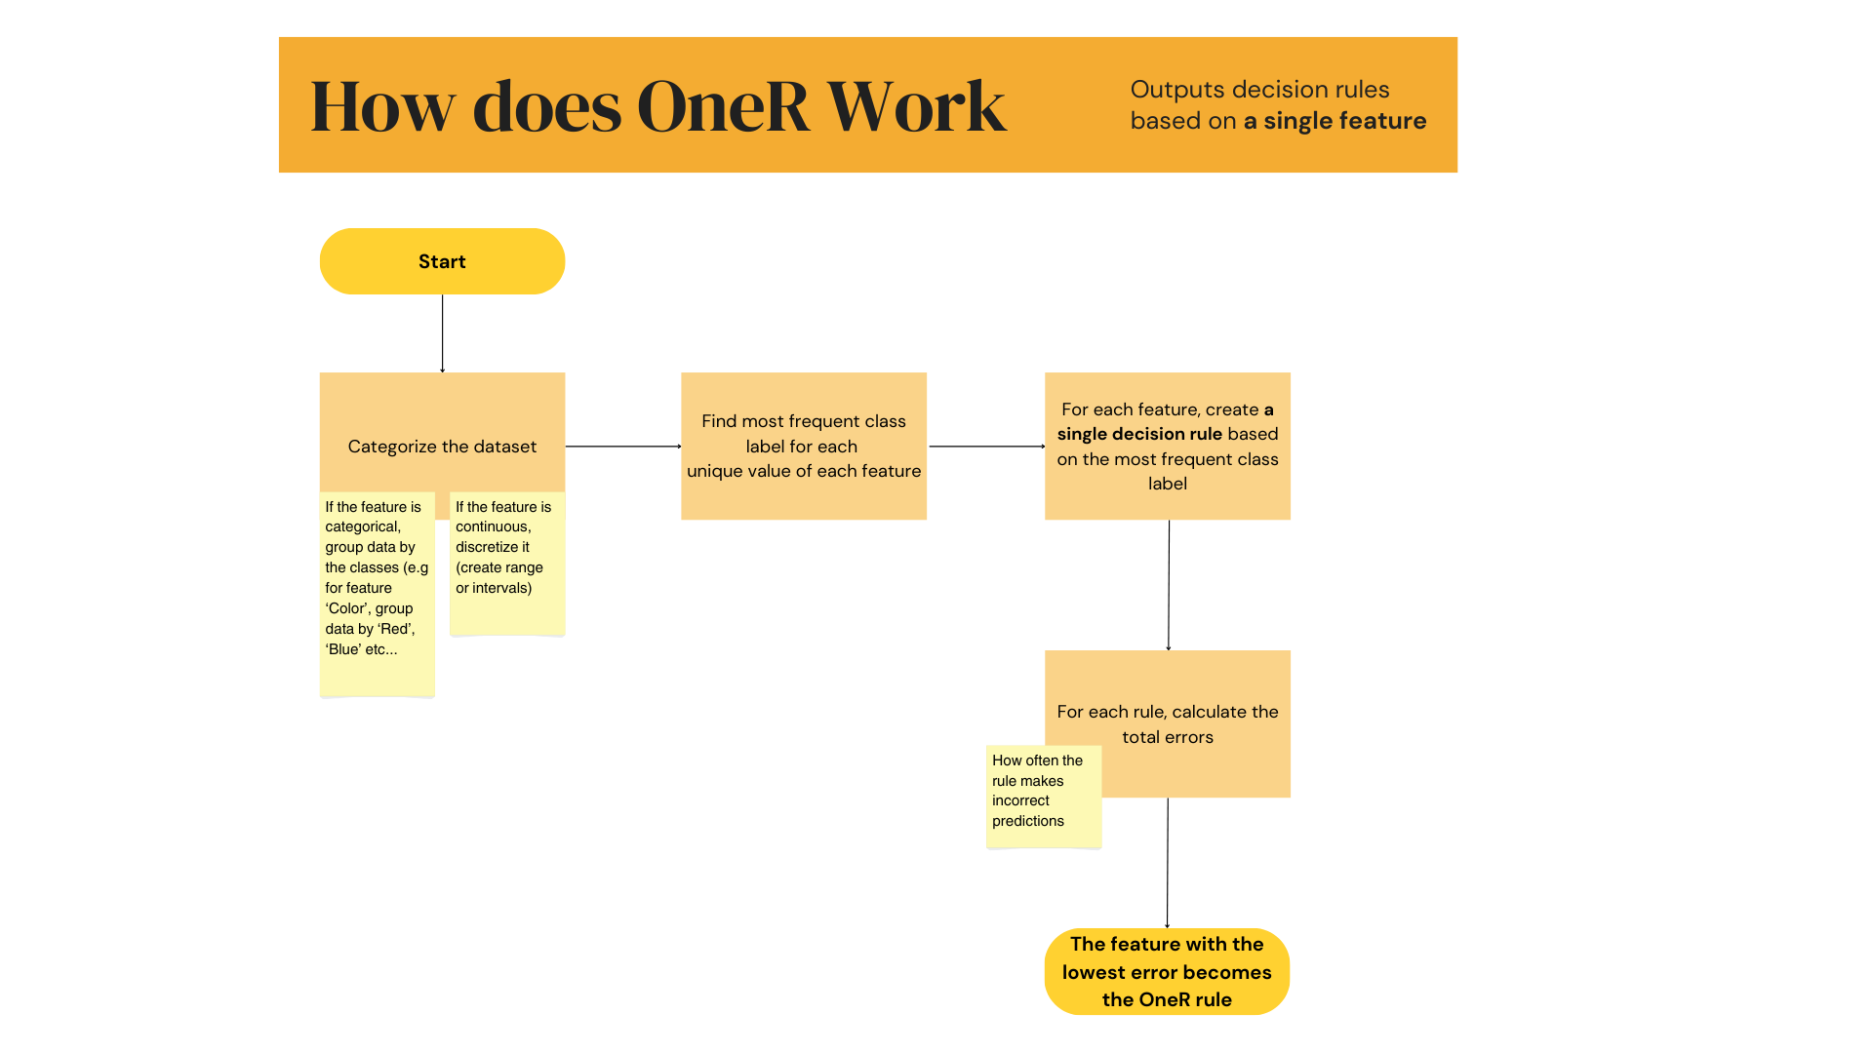
How does OneR work?

Slide 3
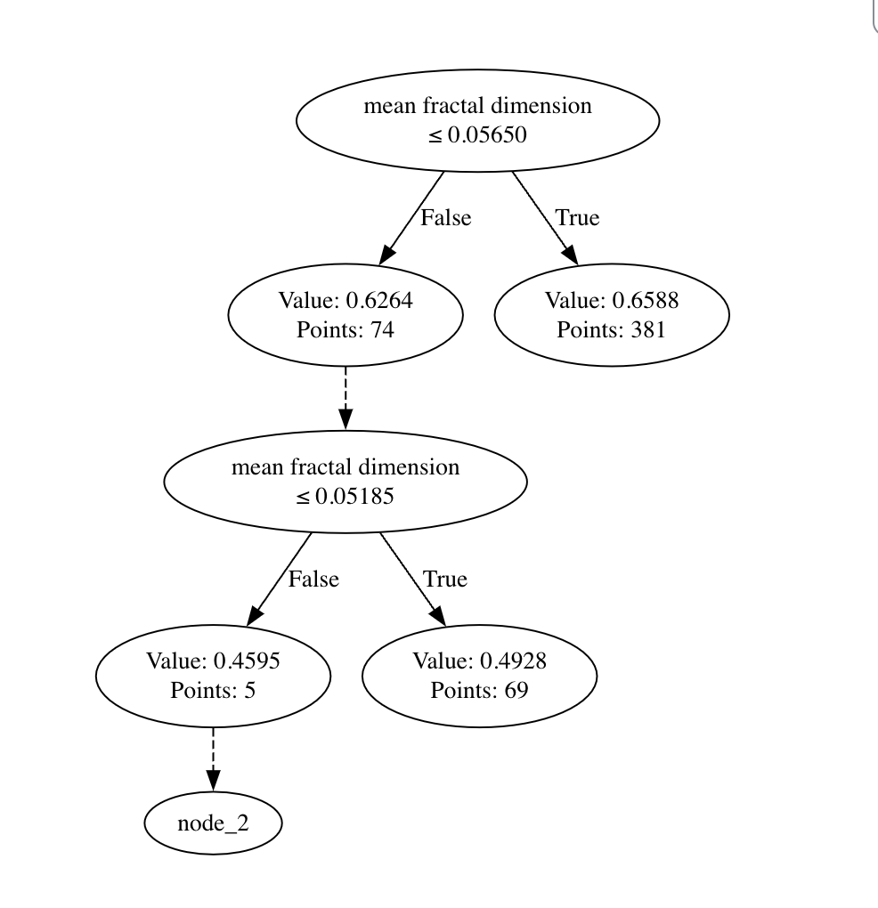
Results of fitting OneR on breast cancer dataset

Slide 4
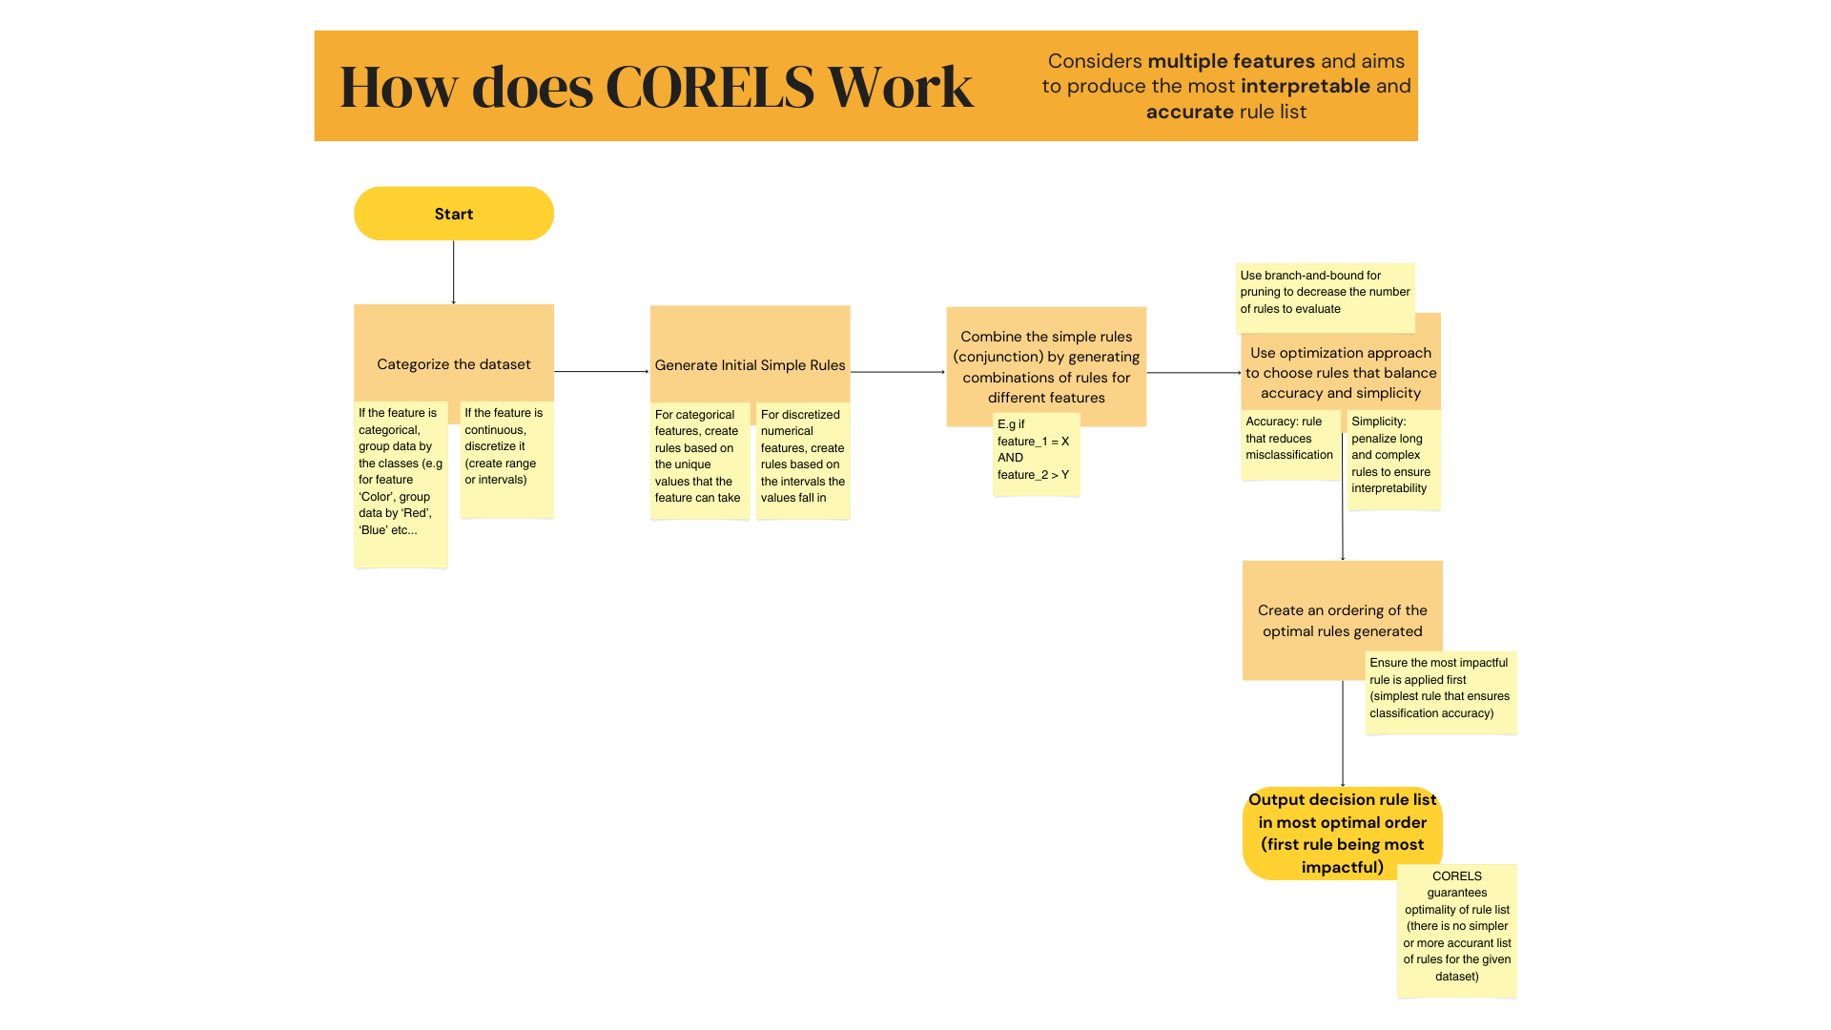
How does CORELS work?

Slide 5
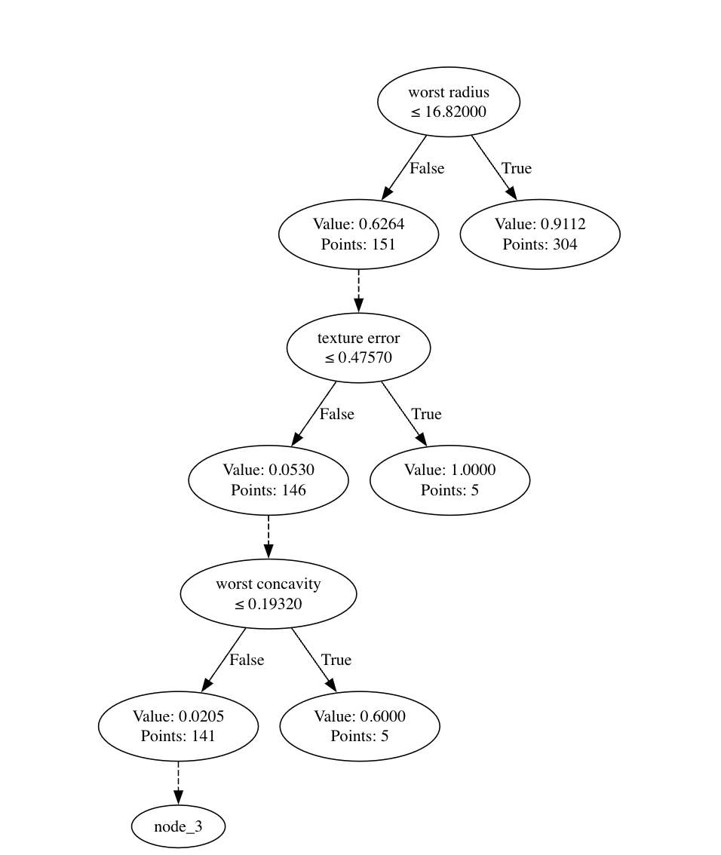
Results of fitting CORELS on the sklearn breast cancer dataset

Slide 6
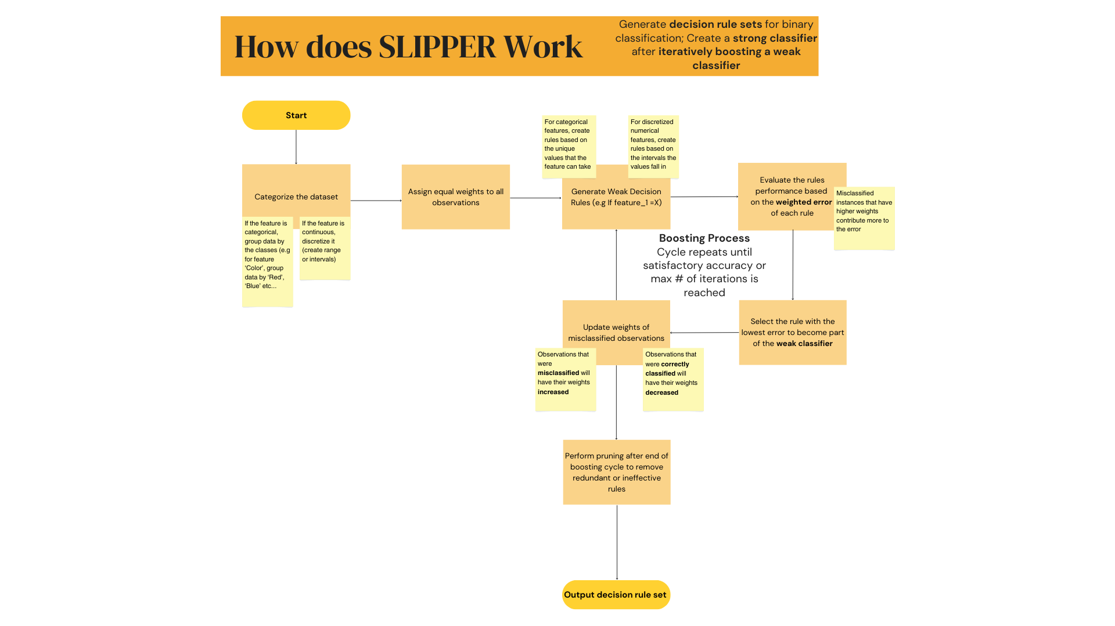
How does SLIPPER work?

Slide 7
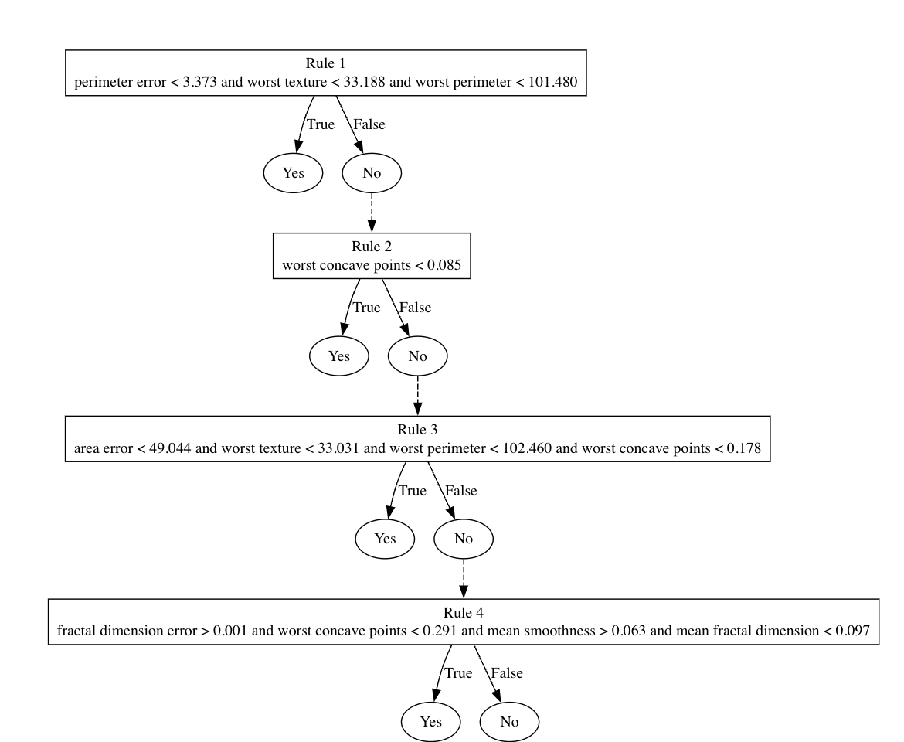
Results of using SLIPPER on the sklearn breast cancer dataset
The output was truncated as there are a lot of decision rules in the set
As we can see, some of the rules overlap to some extent (using the same feature as a condition)
This makes the output of this model a little bit harder to interpret than other models (which is the case for most decision rule sets vs. decision rule lists)

