Slide 1
VIRTUAL REALITY
IN THERAPY
Track: Social Welfare
Team name: Crewmates

Slide 2
TABLE OF CONTENTS
01.
02.
03.
04.
PROBLEM STATEMENT
SOLUTION
Prevalence, Impact, Risk
VR, Exposure Therapy
OUR APP
OUTCOME
Behavioral & Physiological Response, Assessment
Impact on Society & Future Enhancements

Slide 3

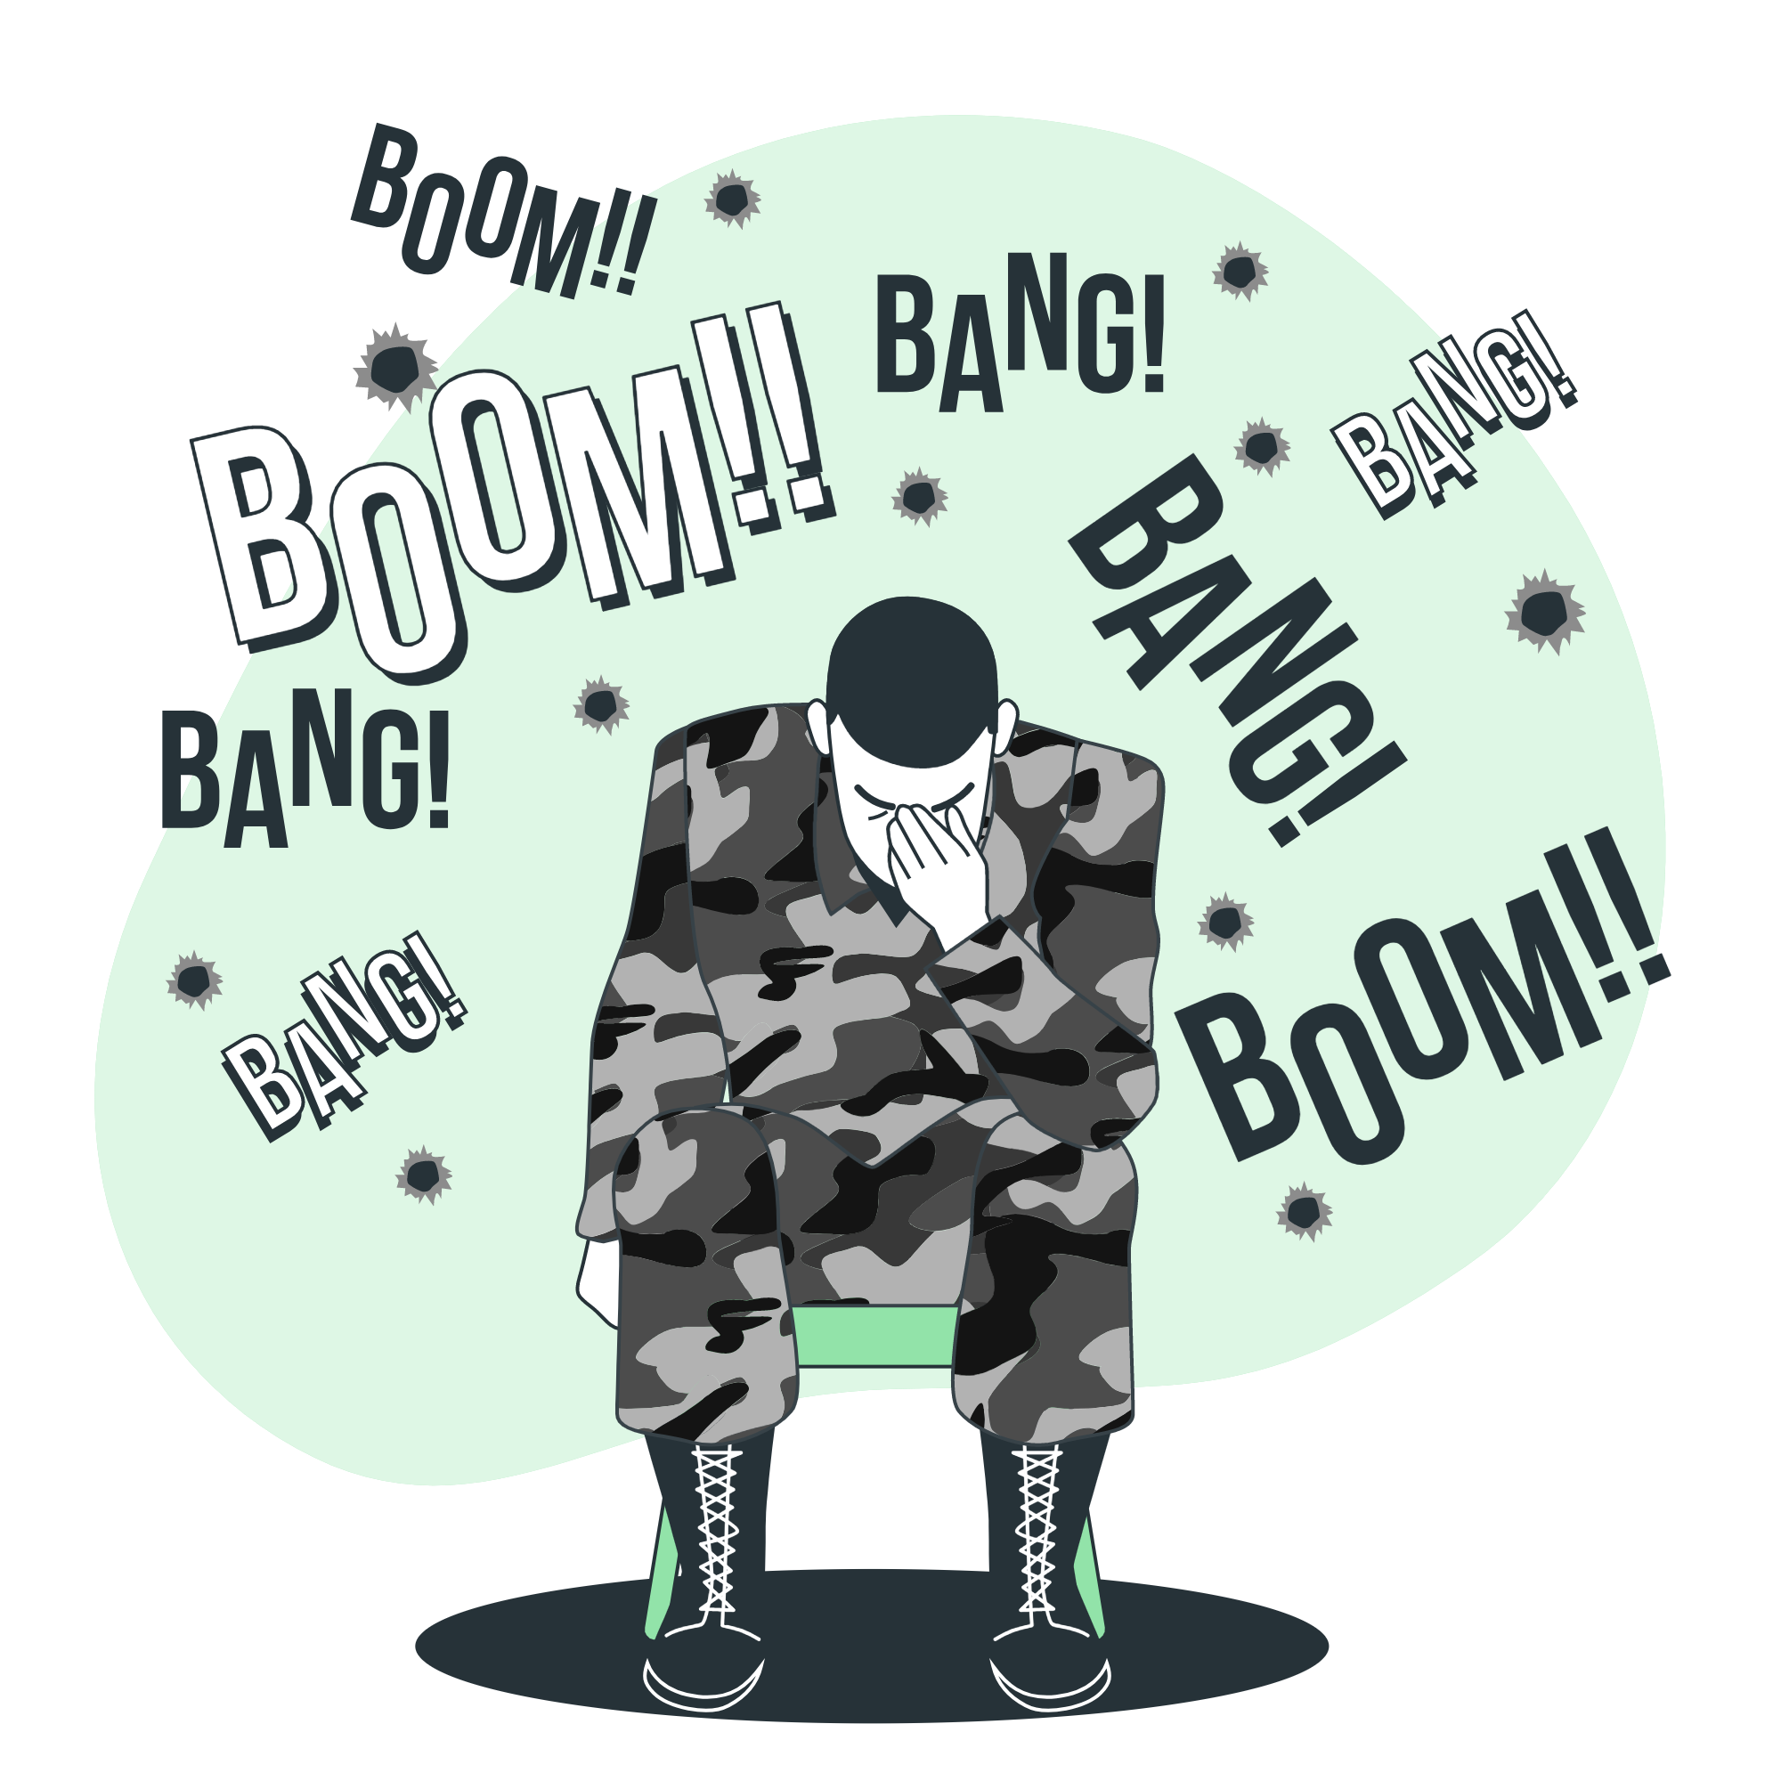

01.
PROBLEM STATEMENT
The wide prevalence of panic disorders, social anxiety, phobias and PTSD needs to be addressed in mental healthcare immediately. Primitive forms of exposure therapy used in the treatment of these disorders are incapable of reproducing controlled environments.
How can we simulate these scenarios in a contained manner?
Can we better the patients analysis using physiological assessment factors?

Slide 4
Prevalence, Impact & Risk
Phobias have been shown to be strongly related to increased risk of PTSD
2.1% people with anxiety disorders died during an average follow-up of 9.7 years.
61% of cases admitted are at least one other mental disorder
According to new research, phobias may be memories passed down through generations in DNA
The prevalence of anxiety disorders over the last year among seniors ranged from 3.6% to 17.2% ⁴
The average age of phobia onset is 7
All phobias can limit daily activities and may cause severe anxiety and depression.
An extreme irrational fear of aversion to something
4. Prevalence and Characterization of Specific Phobia Disorder in People over 65 Years Old in a Madrid Community Sample (Spain) and its Relationship to Quality of Life. Berta Ausín *, Manuel Muñoz, Miguel Ángel Castellanos and Sara García

Slide 5
Solution - Exposure Therapy
People always tend to avoid their fears as avoidance may help reduce feelings of fear for a short term but that avoidance can make the fear become even worse in the long run.
In situations like these psychologists consider exposure therapy to help the patients break the pattern of avoidance and fear.
With the advancement of VR we can help these psychologists create safe environments with the aim to expose the patients with the things they fear to controllable levels of anxiety.

Slide 6

Solution - VR
Virtual reality (VR) is a simulated experience that can be similar to or completely different from the real world
Virtual reality therapy (VRT) uses specially programmed computers, visual immersion devices and artificially created environments to give the patient a simulated experience that can be used to diagnose and treat psychological conditions that cause difficulties for patients.
In VR-based therapies, the virtual world is a means of providing artificial, controlled stimuli in the context of treatment, and with a therapist able to monitor the patient's reaction.

Slide 7
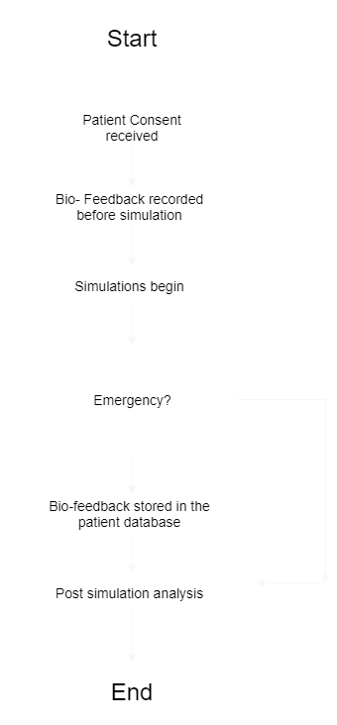
WORKFLOW
The person undergoing therapy are given an overview of the treatment and their consent for the same is received
The biometrics of the person is recorded before the therapy begins
The person is then subjected to the simulation and bio-feedback is collected
The collected data is then analyzed using various scale
The necessary modules needed for this project are the VR simulation designs for phobias with varying levels of intensity, The UI for the therapist, The bio-feedback collection and the analysis of the same.

Slide 8
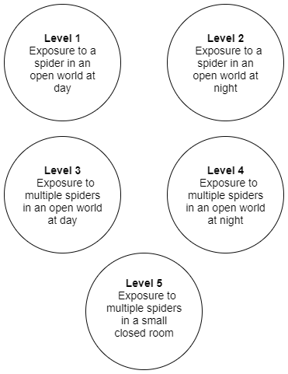
EXAMPLE - ARACHNOPHOBIA
Arachnophobia is the fear of spiders
The intensity of the simulation can be increased after each round. For arachnophobia the levels can be designed as follows:
Level 1 : Exposure to a spider in an open world at day
Level 2 : Exposure to a spider in an open world at night
Level 3: Exposure to multiple spiders in an open world at day
Level 4: Exposure to multiple spiders in an open world at night
Level 5: Exposure to multiple spiders in a closed room

Slide 9
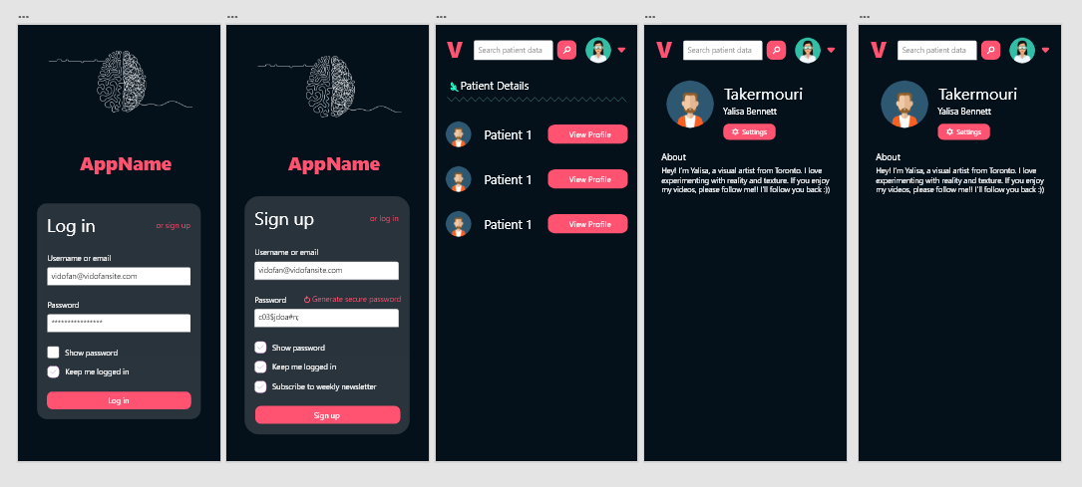
USER INTERFACE - THERAPIST’S APP

Slide 10
REFERENCES
Carlin, A. S., Hoffman, H. G., & Weghorst, S. (1997). Virtual reality and tactile augmentation in the treatment of spider phobia: a case report. Behaviour research and therapy, 35(2), 153-158.
Opdyke, D., Williford, J. S., & North, M. (1995).
Effectiveness of computer-generated (virtual reality) graded exposure in the treatment of acrophobia. Am J Psychiatry, 1(152), 626-28.
Botella, C., Baños, R. M., Perpina, C., Villa, H., Alcaniz, M. U., & Rey, A. (1998). Virtual reality treatment of claustrophobia: a case report. Behaviour research and therapy, 36(2), 239-246.
Prevalence and Characterization of Specific Phobia Disorder in People over 65 Years Old in a Madrid Community Sample (Spain) and its Relationship to Quality of Life. Berta Ausín *, Manuel Muñoz, Miguel Ángel Castellanos and Sara García
Tuna, Zeynep & Oskay, Deran. (2018). Fear of movement and its effects on hand function after tendon repair. Hand Surgery and Rehabilitation. 37. 10.1016/j.hansur.2018.05.004.

Slide 11
REFERENCES
https://www.ncbi.nlm.nih.gov/pmc/articles/PMC7233312/
https://pubmed.ncbi.nlm.nih.gov/7694917/
https://www.liebertpub.com/doi/abs/10.1089/109493103322011641
https://www.ncbi.nlm.nih.gov/pmc/articles/PMC4541947/
https://link.springer.com/article/10.1007/s11434-016-1177-9
https://www.ncbi.nlm.nih.gov/pmc/articles/PMC7233312/
https://www.ncbi.nlm.nih.gov/pmc/articles/PMC5421394/
https://www.ncbi.nlm.nih.gov/pmc/articles/PMC5082973/

