Slide 1
VIRTUAL REALITY
IN THERAPY
ROUND 2
Track: Social Welfare
Team name: Crewmates

Slide 2
TABLE OF CONTENTS
01.
02.
03.
04.
PROBLEM STATEMENT
SOLUTION
Prevalence, Impact, Risk
VR, Exposure Therapy
OUR APP
OUTCOME
Behavioral & Physiological Response, Assessment
Impact on Society & Future Enhancements

Slide 3

RECAP
Phobias and anxiety disorders need to be addressed efficiently
Primitive means of exposure is not feasible as it is not controllable
Exposure therapy can be carried out in a safe and controlled way using virtual reality
A unity scene was developed which showed the simulation for level 1 arachnophobia
The App login screen developed using Adobe XD was shown

Slide 4
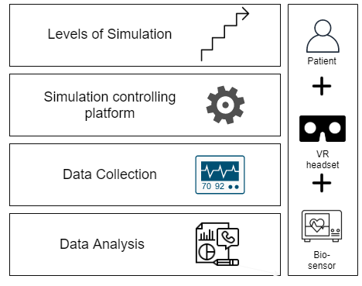
IMPLEMENTATION
There are 3 main modules for implementation which include the VR environments, The UI for the therapist and the data analysis module. All the 3 modules should be integrated for a smooth experience
The Tools Used:
Unity : Helps in gamification of the VR environment
Adobe XD : Helps in designing UI
Flutter : The flutter code generated in Adobe XD is compiled on flutter
Python : Helps in analyzing the collected data

Slide 5
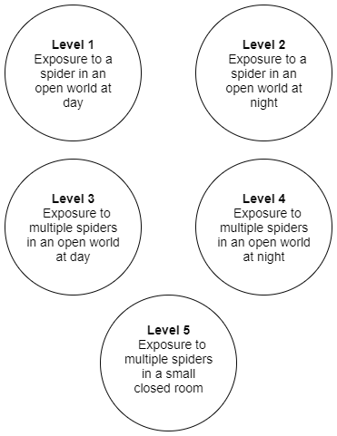
Unity : Levels of Simulations

Slide 6
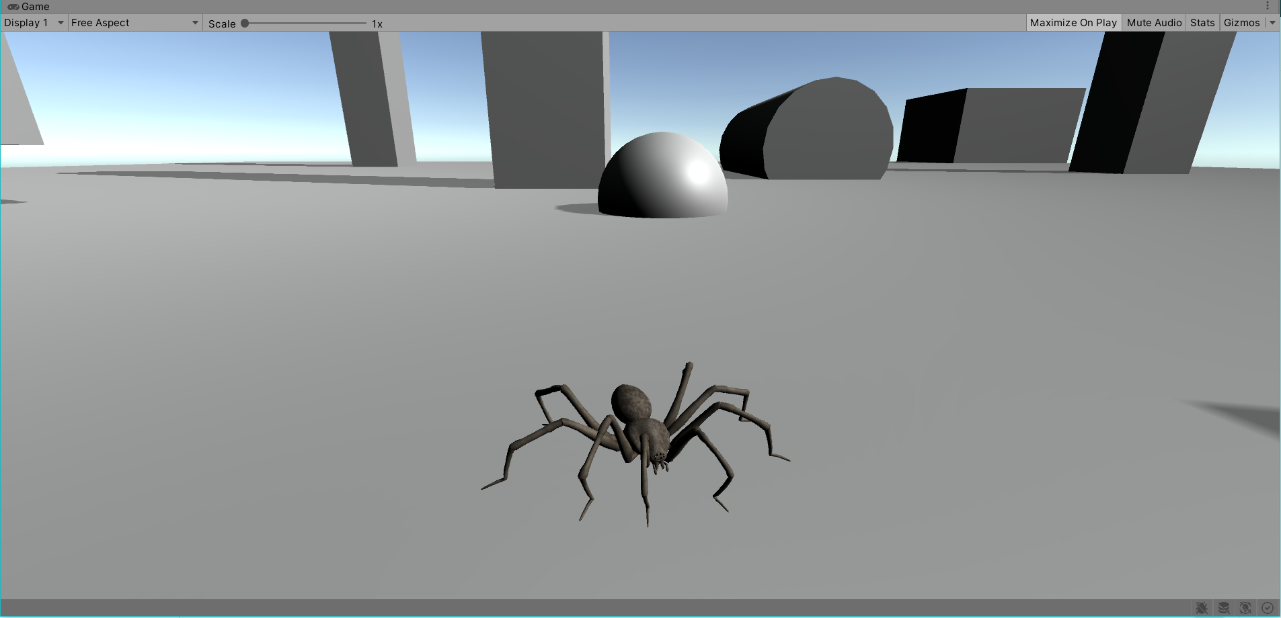
Unity : Level 1

Slide 7
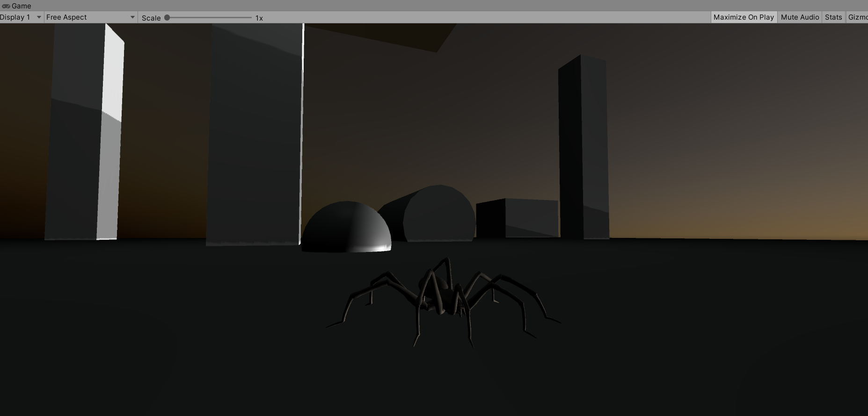
Unity : Level 2

Slide 8
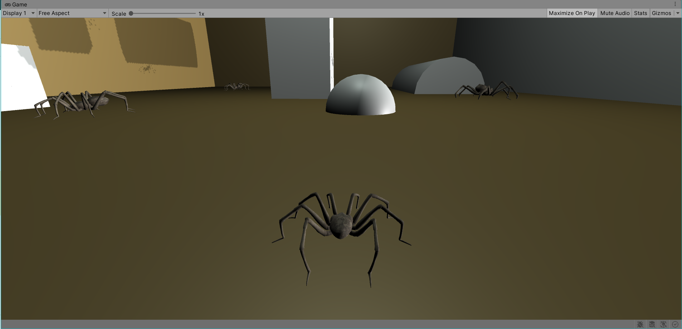
Unity : Level 5

Slide 9
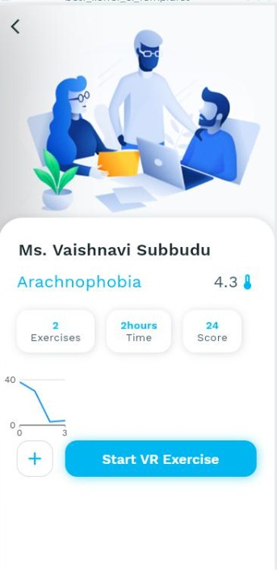
The Application
FLUTTER & FIREBASE

Slide 10
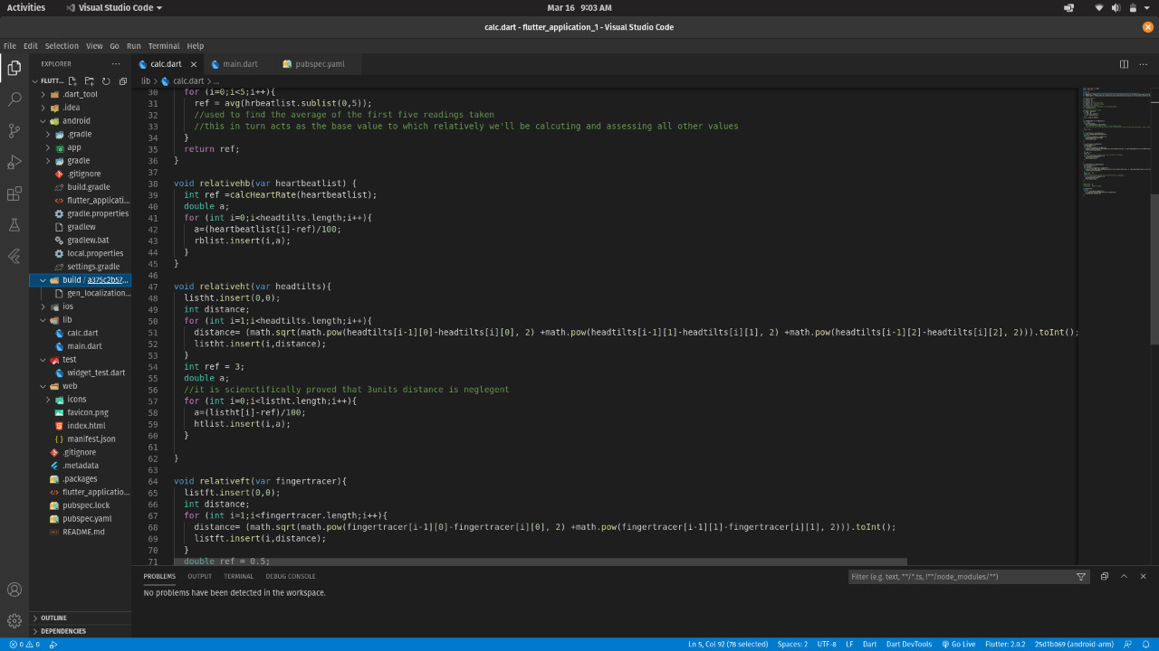
ANALYSIS

Slide 11
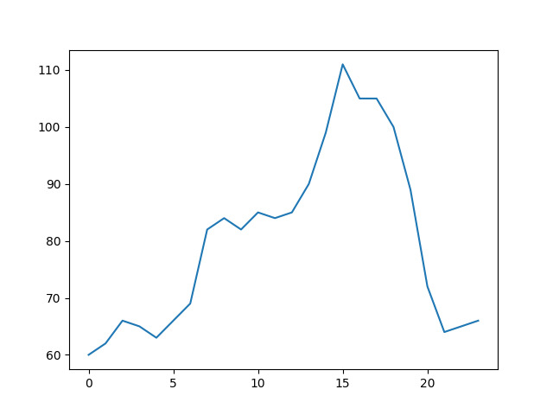
ANALYSIS IN PYTHON

Slide 12
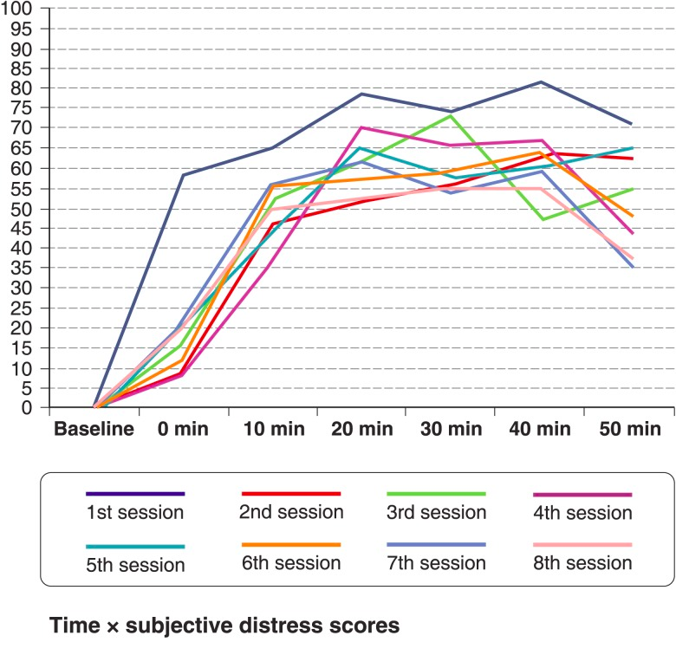
ANALYSIS IN PYTHON

