Slide 1
Pki (Public key infrastructure)

Slide 2
Agenda
What is PKI
Process for generating signed certificate
What vault introduces
lab design
Lab steps
Lab
PKI hierarchy
Considerations

Slide 3
What is PKI?
It stands for Public Key Infrastructure.
Authentication and encryption.
Issue SSL digital certificates
Managing certificate lifecycle

Slide 4
Process for generating Signed certificate
Using one of tools that’s working with X.509 certificates such as openssl to generate private key and csr certificate.
Sending the generated csr to the CA to sign it.
Import it to your key store
This process takes long time.

Slide 5
What Vault introduces
Vault PKI allows users to dynamically generate X.509 certificates quickly and on demand using single command.
Generating your private key and signed certificate directly.
Certificates auto renewal

Slide 6
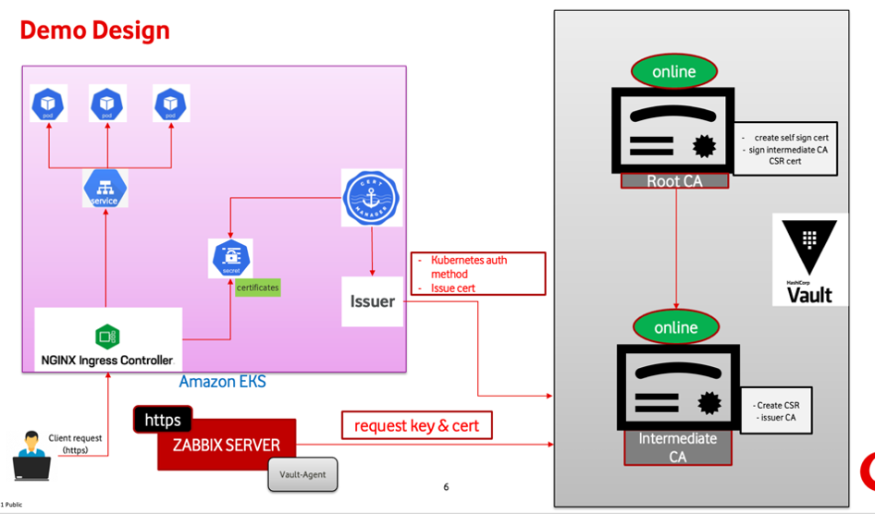

Slide 7
Lab Steps
Generate Root CA
Generate Intermediate CA
Create a Role
Request a certificate
Hardening Zabbix

Slide 8
PKI Hierarchy

Slide 9

One-Tier Hierarchy
online
- The single CA is both a root CA and an issuing CA
Root CA

Slide 10
Two-Tier Hierarchy
offline
The most recommended
Root CA
online
online
Issuing CA-1
Issuing CA-2

Slide 11
Three-Tier Hierarchy
offline
Root CA
offline
offline
Intermediate CA-1
Intermediate CA-2
online
online
online
Issuing CA-1
Issuing CA-2
Issuing CA-3

Slide 12
Considration

