Slide 1
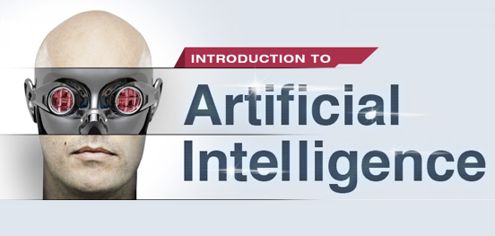

Slide 2
Min Max Algorithm

Slide 3
Min Max Algorithm
The Min-Max Algorithm:
Min-Max algorithm is applied in two player games, such as tic-tac-toe, checkers, chess, go, and so on.
There are two players involved, MAX (Computer player) and MIN (Human player). A search tree is generated, depth-first, starting with the current game position upto the end game position.

Slide 4
Min Max
The Min-Max Algorithm:
Generate tree of all possible moves
Each node holds a heuristic value (Score)
If there is a situation on the tree in which computer player wins, it would be represented by positive infinity.
If there is a situation in which Human player wins, it would be represented as negative infinity.

Slide 5
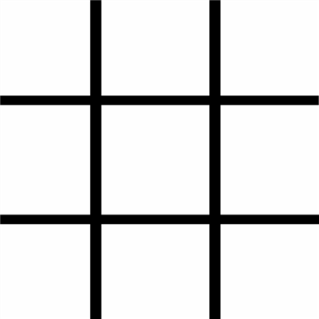
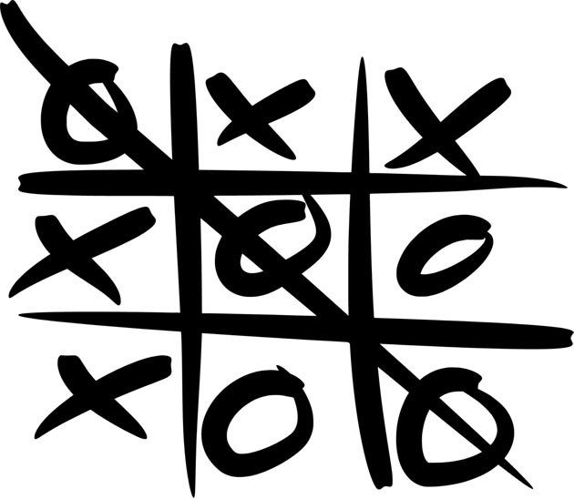
Min Max (Tic Tac Toe game)
Start
Goal

Slide 6
Min Max (Tic Tac Toe)
In Tic-Tac-Toe, a possible heuristic evaluation function for the current board position is:
+100 for EACH 3-in-a-line for computer.
+10 for EACH two-in-a-line (with a empty cell) for computer.
+1 for EACH one-in-a-line (with two empty cells) for computer.
Negative scores for opponent, i.e., -100, -10, -1 for EACH opponent's 3-in-a-line, 2-in-a-line and 1-in-a-line.
0 otherwise (empty lines or lines with both computer's and opponent's seeds).

Slide 7
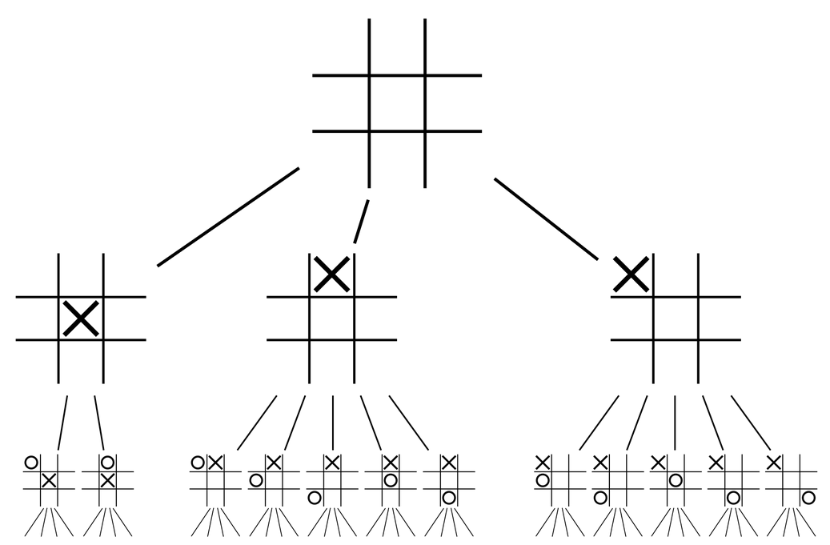
Min Max (Tic Tac Toe)
How does computer choose its next move ?

Slide 8
Min Max (Tic Tac Toe)
The algorithm evaluates The Leaf Nodes (terminating "gameover" nodes or at maximum depth of 4 as an example) using the heuristic evaluation function.
The minimizing player will choose, for each node, the minimum of its children (score).
The maximizing player chooses the maximum of the children (score).
Repeat until it reaches the root node, where it chooses the move with the maximum value.

Slide 9
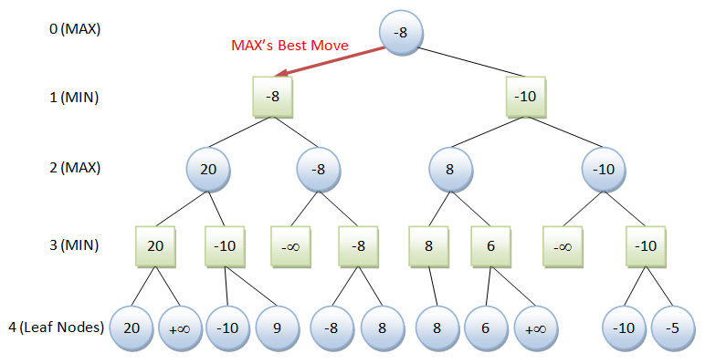
Min Max (Tic Tac Toe)
How does computer choose its next move ?

Slide 10
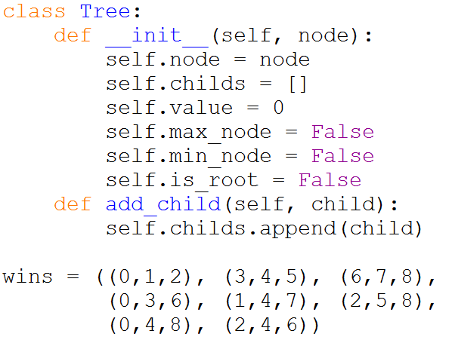
Min Max (Part of code)

Slide 11
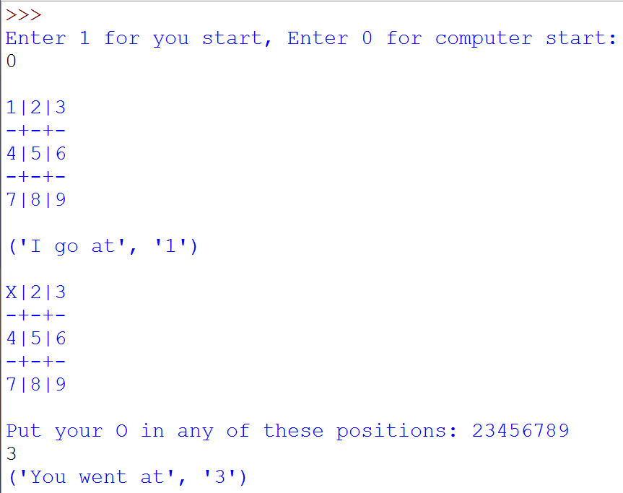
Min Max (Tic Tac Toe)

Slide 12
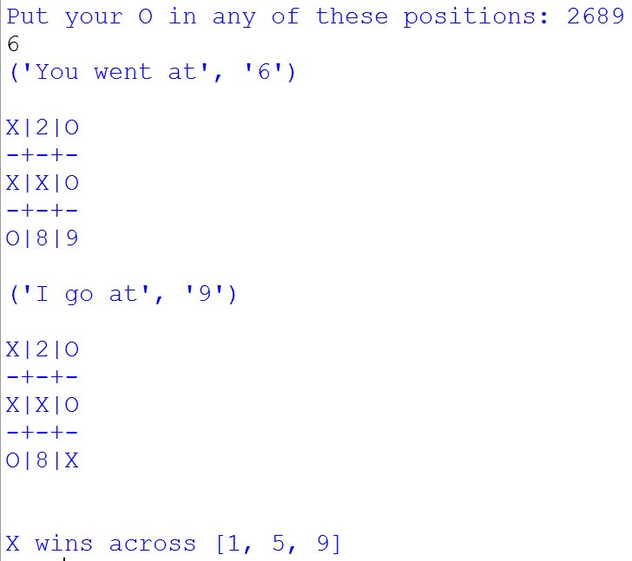
Min Max (Tic Tac Toe)
Computer Wins

Slide 13
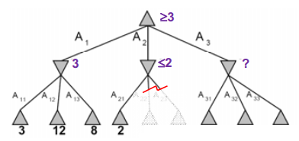
Min Max
How to reduce computation in Min Max algorithm:
Using algorithm called Alpha-Beta Pruning

Slide 14
Not in this Course

Slide 15
Not in this Course
Finite State Machine
Decision Tree (Planning)
Behavior Tree (Strategic Games)
Markov Decision Process (Uncertainty)
Semantic Network (Knowledge Representation)
Machine Learning

Slide 16
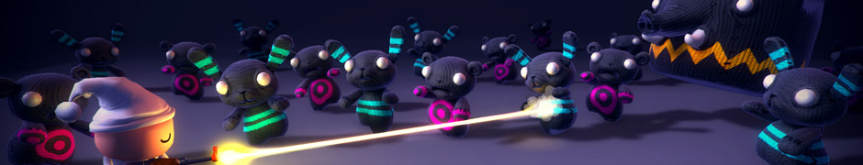
Not in this Course
Unity
http://unity3d.com/unity
http://unity3d.com/learn/tutorials

Slide 17
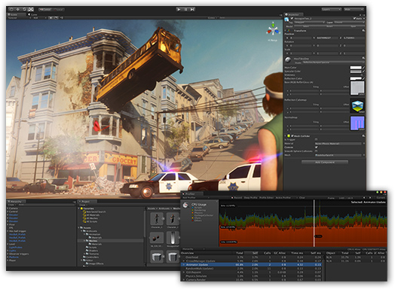
Not in this Course
Unity

Slide 18
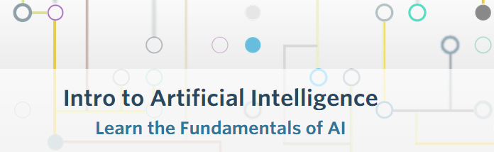
Better AI Courses
Better AI Courses:
https://www.udacity.com/course/cs271
https://www.udacity.com/course/cs373

Slide 19
Code
The complete code at
https://github.com/ahmed-elhelow/AI-class
E-mail: Ahmed.elhelow@90daraga.com

