Slide 1

Counting machine
By: Astra team

Slide 2

Team members:
Ahmed Mostafa Elshamy
Mohamed Anas Nasr
Hassan Mohamed Bahbah
Nada Ibrahim Shehata
Haiam Elsayed Emam

Slide 3

Introduction
* This project is basically about making a secured counting machine which asked for a password using the Arduino 4x4 keypad then displaying a message on LCD display.
The operation:
The user is asked to enter a password followed by '=' through the keypad.
Arduino UNO verifies the password (123456 by default) and sends UART frame to raspberry pi to start operation.
The user puts the money in front of the camera and pushes the push button to start operation.
The raspberry pi captures an image through a camera, runs an AI image classification model and calculates the amount of money.
A UART frame is sent back to Arduino UNO to display the amount of money on the LCD

Slide 4
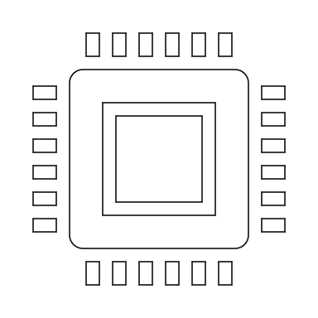
Required hardware
Arduino UNO
Raspberry Pi 3
Pi Camera
Push Button
20x4 LCD
Keypad

Slide 5

Required modules
argparse
pathlib
openCV
torch
numpy

Slide 6

Flow chart

Slide 7

Part 1: Arduino:
In repo the Arduino folder which contains files:
Demo.mp4
main.ino
app.h
app.cpp

Slide 8
Part 1: Arduino:
Libraries, Functions and Constants
1. Liquid Crystal.
2. Keypad.
LCD and Keypad
1. 20x4 LCD
2. 4x4 keypad
Password

Slide 9
Part 2: Raspberry Pi
Raspberry Pi which contains files
detect.py
custom_detect.py
best.pt
app.py

Slide 10

Part 2: Raspberry Pi
Libraries and Modules
1. The Python serial library
2. The picamera library
3. gpiozero
4. The argparse module
5. The standard library os and pathlib
6. CV2
7. torch.backends
Receive Images and transmit data

Slide 11
Project Simulation Model:

Slide 12

Conclusion
This project was designed, implemented and tested by a group of ambitious students in the faculty of engineering, Tanta University. Our system is simple and have a very low cost compared with its functionality. It is a combination of embedded systems and electronics in addition to AI & ML, which have become an important trend in technology now.

