Slide 1
Optimization

Slide 2
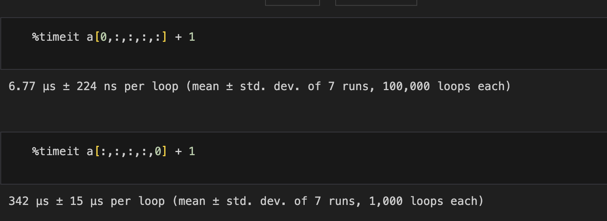
Numpy optimization

Slide 3
Array representation
arr1d: Shape (10,) array
arr2d: Shape (5,2) array

Slide 4
Why is this the case?
All arrays are continguous blocks of memory.
ND arrays are not real
They look the same as 1D arrays.
Implemented as an indexing trick back to 1D
2D: for (N,M) its:
i*M +j

Slide 5
Indexing
arr1d[4]
arr2d[2,1]
N = 5, M = 2 therefore 2*2 + 1 = 5
arr2d[0]
arr2d[1]
arr2d[2]
arr2d[3]
arr2d[4]

Slide 6
Vectorization
Vectorisation occurs when memory access is contiguous
Adjacent memory access
CPU can perform multiple calculations as it can predict the next N memory accesses
arr1d[3:7]

Slide 7
Add 128-bits of data
4 32-bit floats
2 64-bit floats

Slide 8
2D arrays
arr2d[0,:]
arr2d[:,0]
Vectorised!
Not Vectorised!

Slide 9
Conclusion
Vectorisation significantly speeds up computation
Requires continguous access of memore
Last index is the fastest access and is contiguous.
Slicing on axis before the last is faster
The first axis is always the fastest to slice

