Slide 1
Introduction to Python

Slide 2
Me
Dr. Ahmed Faris Al-Refaie
Department of Physics and Mathematics
Principal Research Fellow
Exoplanets
PhD in Molecular Dynamics
Email: ahmed.al-refaie.12@ucl.ac.uk

Slide 3
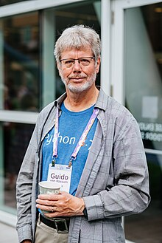
Python
Introduced in 1980 by Guido van Rossum
Dynamically Typed
Focuses on flexibility and readability
Indentation rather than braces
Actually a standard!

Slide 4
Python standard
The Python we is actually called CPython
Python implemented in C
‘Reference’ implementation
Lots of different Pythons available
PyPy – JIT compiled python
Jython – Python written in Java
IronPython– Microsoft .NET
MicroPython – Embedded systems Python (Arduino etc)
Stackless Python – Microthread implementation. (EVE Online)
Pyodide – Cpython compiled for WASM.

Slide 5
CPython
Interpreted and ‘slightly’ compiled
Interpreted meaning read line-by-line rather than executed
Compiled to byte code making it faster to read line-by-line
Massively ‘batteries included’
Standard library does a lot
Web development to cryptography.
Most non-pure libraries compiled for this version
Pure libraries only use Python
beautifulsoup
Non-pure libraries require some compiled code like C/C++/Fortran
numpy

Slide 6
Python versions
Python 1 – EOL 2000
Python 2 – EOL 2020
Python 3 – Currently updated
Latest stable version 3.12
Rule of thumb, use 2 versions down for development.
Libraries mature enough
3.10 our version of choice
Major versions are not compatible with different versions
Python 2 not compatible with Python 3 and vice versa

Slide 7
Python versions
Lower minor versions work on higher minor versions
3.8 code will work on 3.12
Opposite not the case
3.12 code may not work on 3.8
Some features may be ‘back-ported’ using __futures__ package
Each minor version has a set time before it is not supported
Security updates and bug fixes
EOL or ’End of Life’
Python 3.7 EOL June 2023
Python 3.8 EOL October 2024

Slide 8
Zen of Python
Beautiful is better than ugly.
Explicit is better than implicit.
Simple is better than complex.
Complex is better than complicated.
Flat is better than nested.
Sparse is better than dense.
Readability counts.
Special cases aren't special enough to break the rules.
Although practicality beats purity.
Errors should never pass silently.
Unless explicitly silenced.
In the face of ambiguity, refuse the temptation to guess.
There should be one, and preferably only one, obvious way to do it.
Although that way may not be obvious at first unless you're Dutch.
Now is better than never.
Although never is often better than right now.
If the implementation is hard to explain, it's a bad idea.
If the implementation is easy to explain, it may be a good idea.
Namespaces are one honking great idea – let's do more of those!
https://en.wikipedia.org/wiki/Zen_of_Python

Slide 9
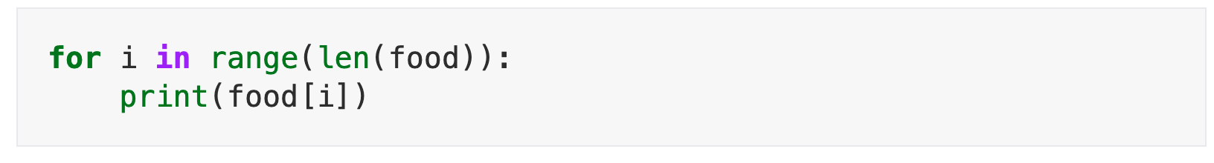
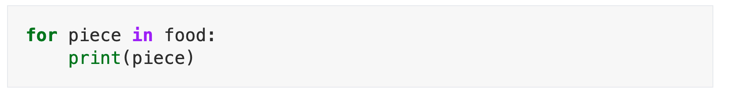
‘Pythonic’

Slide 10
Course structure
We will be using JupyterLab up until day 4.
Either Pyodide or your own install can be used
All but 2 notebooks work using pyodide.
From day 4 we will teach project development.
Last day we will build a project from scratch.
Each day except the last will have a 30 minute question session at the end.
Schedule is flexible depending on demand for certain topics.

Slide 11
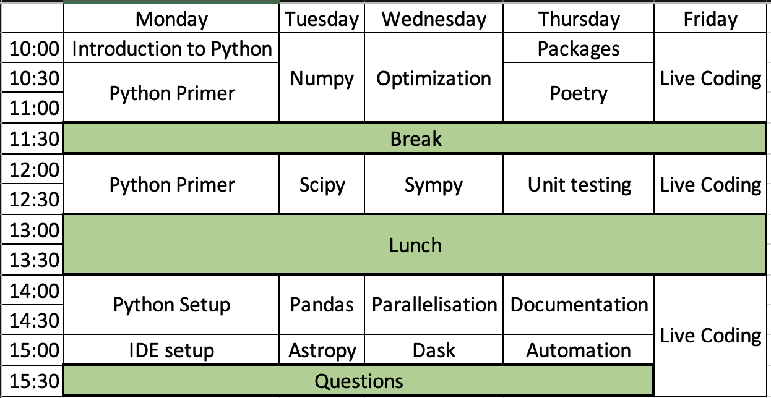
Intro
Scientific Coding
Package development

Slide 12
Course content
Course content can be found from the git:
https://github.com/ahmed-f-alrefaie/UCLPythonCourse
git clone https://github.com/ahmed-f-alrefaie/UCLPythonCourse.git
Notebooks are under content/notebooks
Lecture notes are under content/lectures

Slide 13
Lets get started!
https://ahmed-f-alrefaie.github.io/UCLPythonCourse

