Slide 1







How Can a Wellness Technology Company Play It Smart?
Ahmed Fayez
03/12/2024

Slide 2



OUTLINE
Executive Summary
Introduction
Methodology
Results
Visualization – Charts
Discussion
Findings & Implications
Recommendations

Slide 3

EXECUTIVE SUMMARY
Calorie burn trends
Most calories are burned between 7 AM and 7 PM, aligning with active daytime hours.
Sleep patterns
Most users exhibit a consistent once-per-day sleep pattern, suggesting a regular sleep routine.
Weekend sleep trends
Total sleep minutes increase on weekends, indicating longer rest periods compared to weekdays.
Activity Preferences
Users predominantly engage in light activities, with fewer instances of very high-intensity exercises, suggesting a preference for moderate effort levels.

Slide 4

INTRODUCTION
Problem
Users struggle to maintain consistent wellness routines due to lack of personalized insights.
Limited understanding of user activity, sleep, and calorie trends.
Opportunity to enhance user engagement and retention by leveraging data-driven insights.
Why This Analysis?
To uncover trends in daily activity, sleep, and calorie burn patterns.
To identify opportunities for improving Bellabeat’s product features.
To provide actionable recommendations that align with user behavior and preferences.

Slide 5

METHODOLOGY
Data collection
This Data contains personal fitness tracker from thirty fitbit users.
The data collected included minute-level output for physical activity, heart rate, and sleep monitoring. It includes information about daily activity and steps.
Data storage
The collected responses were stored in CSV files.
Data analysis
Used descriptive analytics to summarize the data.
Created visualizations (e.g., line charts, scatter plots) to represent key findings.
Tools used
Excel for data storage and initial analysis.
Python for initial analysis and data visualization.

Slide 6

Results

Slide 7
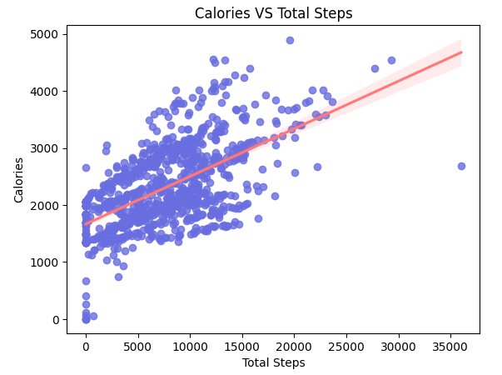
Correlation Between Calories and Steps
The chart shows a positive correlation between total steps taken and calories burned.
As users increase their step count, their calorie burn rises proportionally.
The regression line highlights a clear trend, with most data points clustered around it, indicating consistency across users.

Slide 8
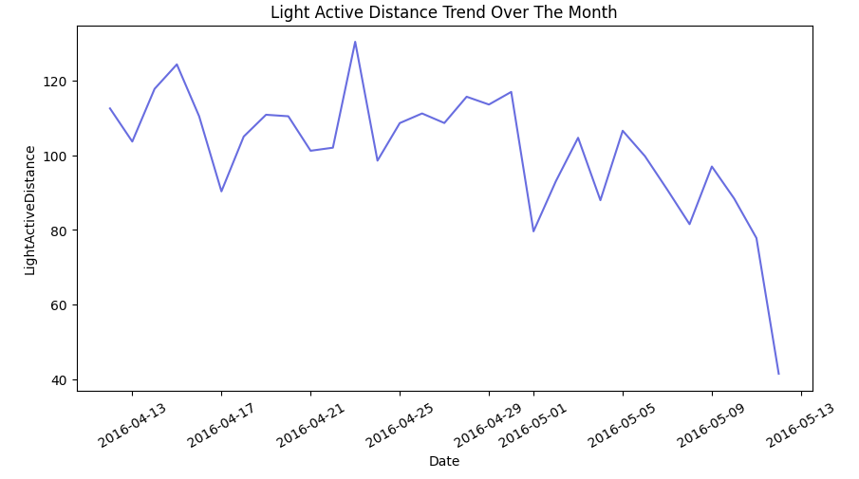
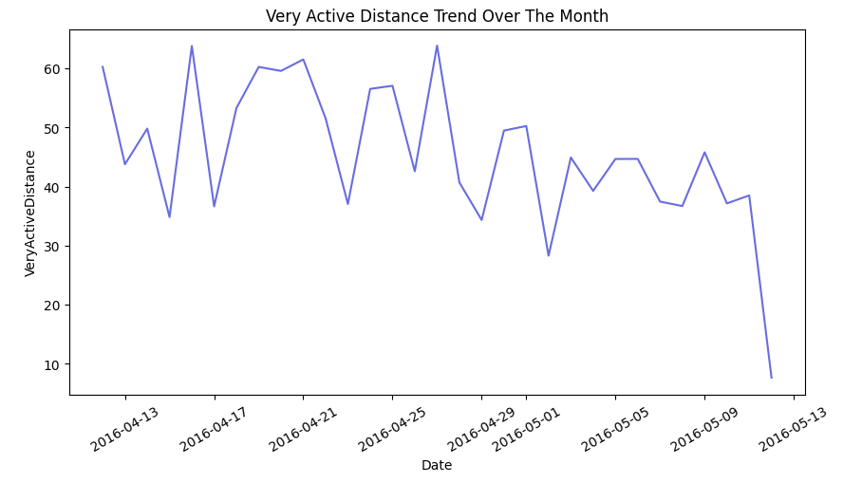
Active distance trend lines
A noticeable decline in light active distance and high active distance is observed during weekends.
This indicates that users tend to engage in less physical activity as the weekend approaches.

Slide 9
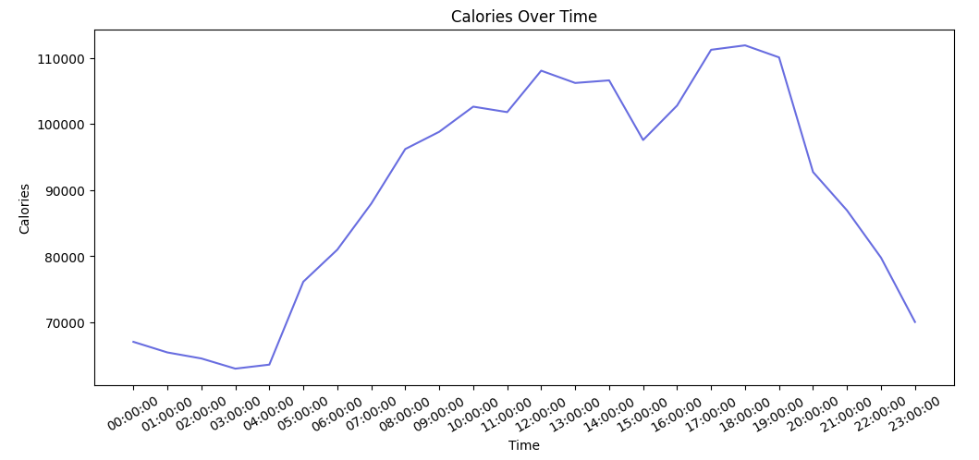
Calorie burn trends across the day
The graph shows that the majority of calorie burn occurs between 7 AM and 7 PM, reflecting typical active hours during the day. This aligns with user engagement in physical activities and daily routines during daylight hours.

Slide 10
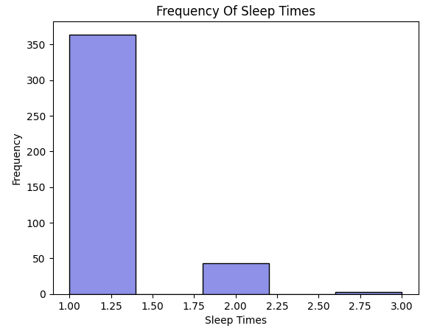
Frequency of daily sleep patterns
The frequency of sleep times shows that most users sleep once a day, indicating a regular sleep routine. Instances of sleeping twice a day are less common and sleeping three times a day is extremely rare.

Slide 11
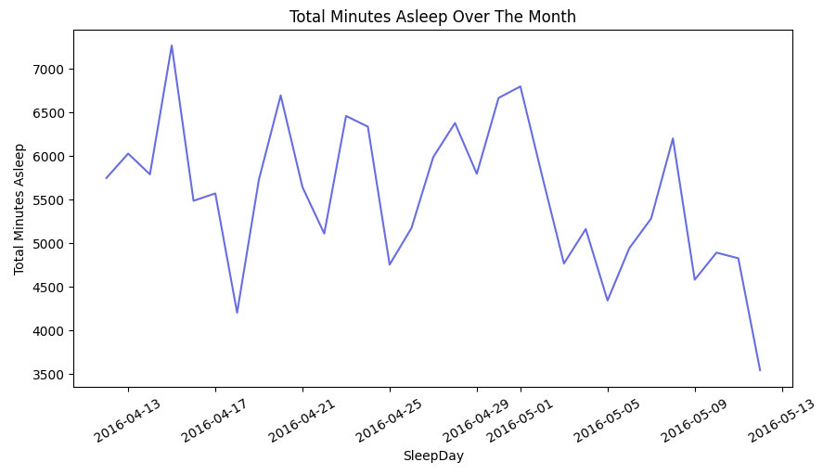
Total sleep minutes over the month
The total minutes of sleep over the month reveal that users tend to sleep more on weekends compared to weekdays. This trend suggests that users might use weekends to catch up on rest or enjoy longer sleep durations.

Slide 12

GitHub
https://github.com/ahmed-fayez-abdalla/Bellabeat

Slide 13
DISCUSSION
In this section we will discuss overall findings and implications about the charts derived from the two data files

Slide 14
OVERALL FINDINGS
Findings
Calorie Burn Over Time (7 AM - 7 PM)
Most calories are burned during the daytime, between 7 AM and 7 PM, reflecting higher activity levels during this period.
Frequency of Sleep Times
Most users sleep once per day, indicating a regular sleep routine.
Sleeping twice a day is less common, and three times a day is rare.
Total Sleep Minutes Over the Month
Users sleep more on weekends compared to weekdays, showing a preference for longer rest periods during weekends.
Activity Preferences
Users engage in light active distances more frequently, with high active distances being less common.
A noticeable decline in activity levels occurs during weekends.

Slide 15
OVERALL IMPLICATIONS
IMPLICATIONS
Calorie Burn Over Time (7 AM - 7 PM)
Bellabeat could introduce personalized activity reminders during non-peak hours (early morning or late evening) to encourage more balanced calorie burn throughout the day.
Highlight these trends in the app to help users plan their active hours effectively.
Frequency of Sleep Times
Users with irregular sleep schedules could benefit from personalized sleep coaching or reminders for a consistent sleep routine.
Insights about rare multiple sleep instances could inspire educational content about healthy sleep habits.
Total Sleep Minutes Over the Month
Encourage users to maintain consistent sleep durations throughout the week by promoting better weekday sleep hygiene.
Develop weekend sleep tips or challenges to maximize rest benefits while avoiding oversleeping.
Activity Preferences
Promote features like weekend challenges or light activity recommendations to keep users engaged during weekends.

Slide 16
Recommendations
Leverage these insights to create more personalized, timely reminders for activity and sleep.
Promote consistent sleep routines throughout the week, even during weekends.
Encourage users to stay active during weekends through engaging features like activity challenges or reminders.

