Slide 1







Technologies Survey
Ahmed Fayez
18/09/2024

Slide 2



OUTLINE
Executive Summary
Introduction
Methodology
Results
Visualization – Charts
Dashboard
Discussion
Findings & Implications
Conclusion

Slide 3

EXECUTIVE SUMMARY
Survey findings reveal
Most used programming language is JavaScript
Most used database is MySQL
Most used web framework is jQuery
Future learning interests
Top programming language professionals plan to learn is JavaScript
Significant interest in learning new frameworks and databases
Most of the respondents were men
Most of the respondents were young from 22 to 32

Slide 4

INTRODUCTION
The tech industry is constantly evolving, making it essential to stay updated on the latest tools
Our survey was conducted to understand
The commonly used programming languages, databases, and web frameworks
The tools professionals plan to learn in the upcoming year
The goal of this presentation is to analyze these trends and provide insights on current and future tool preferences

Slide 5

METHODOLOGY
Data collection
Survey data was collected from 11398 respondents
The survey included questions on the most used programming languages, databases, web frameworks, and future learning interests
Data storage
The collected responses were stored in Excel spreadsheets.
Data analysis
Used descriptive analytics to summarize the data
Created visualizations (e.g., bar charts, pie charts) to represent key findings
Tools used
Excel for data storage and initial analysis
IBM Cognos Analytics for visualization

Slide 6
RESULTS

Slide 7
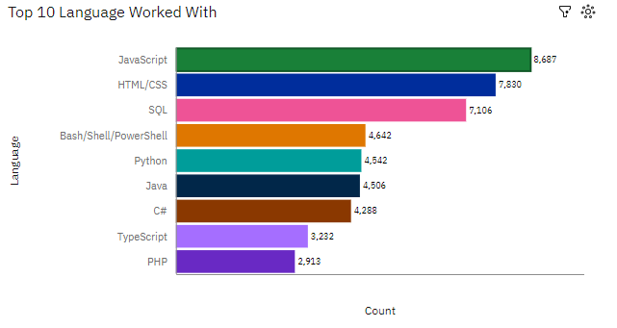
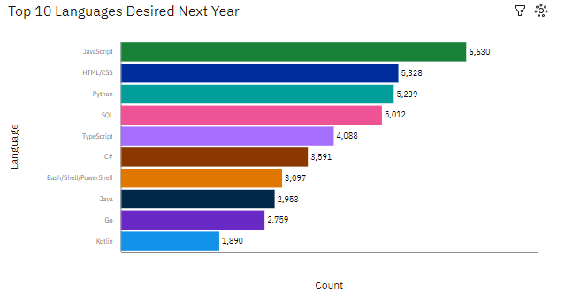
PROGRAMMING LANGUAGE TRENDS
Current Year
Next Year

Slide 8
PROGRAMMING LANGUAGE TRENDS - FINDINGS & IMPLICATIONS
Findings
JavaScript leads the list of programming languages people want to learn next year, with 6,630 respondents
HTML/CSS and Python are also highly desired, with over 5,000 respondents each showing interest
JavaScript is the most worked-with language, with 8,687 respondents, showing its dominance in both current usage and future learning goals
HTML/CSS and SQL are also highly used by professionals
Implications
JavaScript remains a key skill for the future, with high demand for learning it, indicating its continued relevance in web development and beyond
The high interest in HTML/CSS suggests that front-end development skills are still highly sought after, even as frameworks become more complex
JavaScript's dominance in both current usage and future demand implies that it will continue to be a key language for professionals
HTML/CSS and SQL being commonly worked with confirms their foundational roles in both front-end development and database management

Slide 9
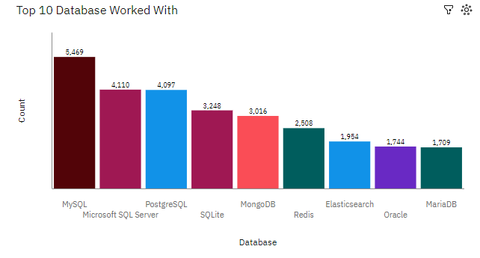
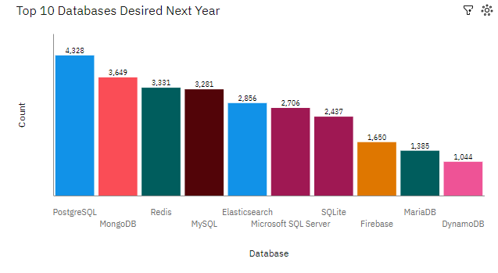
DATABASE TRENDS
Current Year
Next Year

Slide 10
DATABASE TRENDS - FINDINGS & IMPLICATIONS
Findings
MySQL is the most widely used database, indicating its popularity and versatility across various applications
SQL databases, such as MySQL, PostgreSQL, Microsoft SQL Server, and SQLite, occupy the top positions, demonstrating their continued relevance in enterprise environments
PostgreSQL is the most desired database for the next year, indicating its strong popularity and potential for continued growth
MongoDB and Redis, both NoSQL databases, rank high, suggesting a growing preference for flexible and scalable data storage solutions
Implications
MySQL's dominance suggests that its open-source nature, robust features, and widespread adoption will likely continue to drive its popularity
The prevalence of SQL databases underscores their importance in enterprise applications, particularly for structured data and transactional workloads
PostgreSQL's dominance suggests that its open-source nature, robust features, and strong community support will continue to drive its adoption
The popularity of MongoDB and Redis highlights the increasing need for flexible and scalable data models to accommodate modern application requirements

Slide 11

DASHBOARD
https://github.com/ahmed-fayez-abdalla/IBM_Project

Slide 12
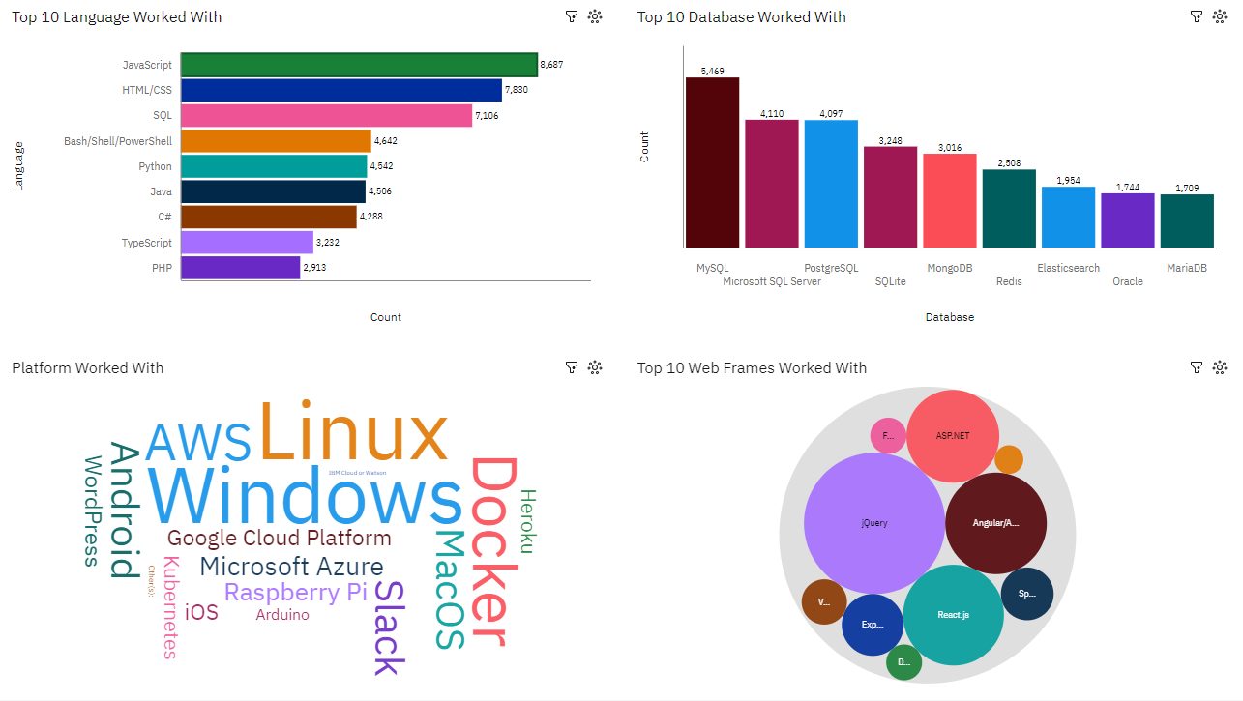
DASHBOARD TAB 1

Slide 13
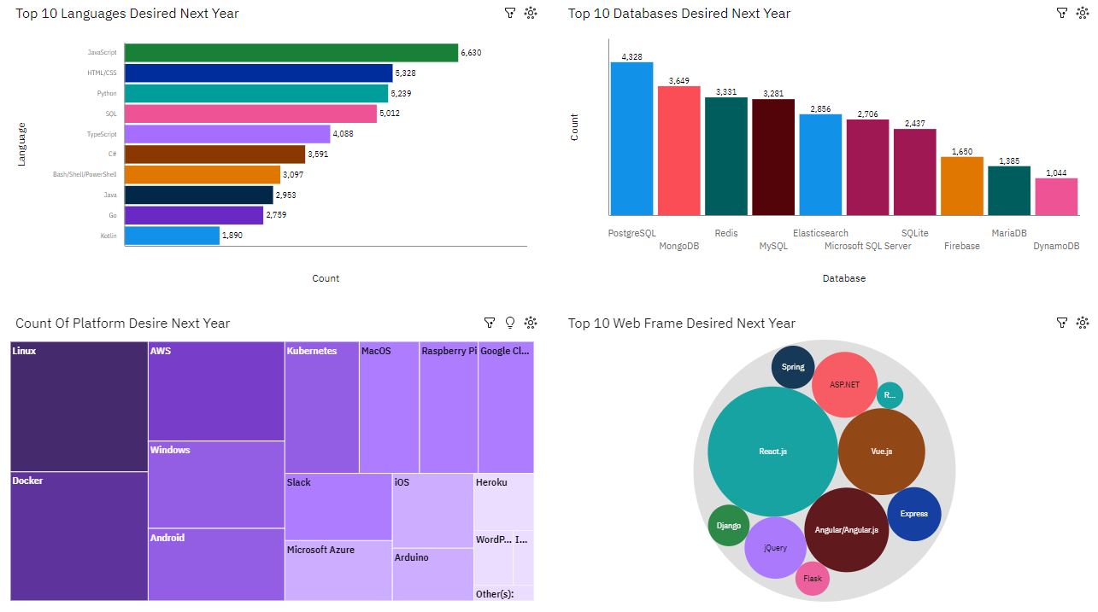
DASHBOARD TAB 2

Slide 14
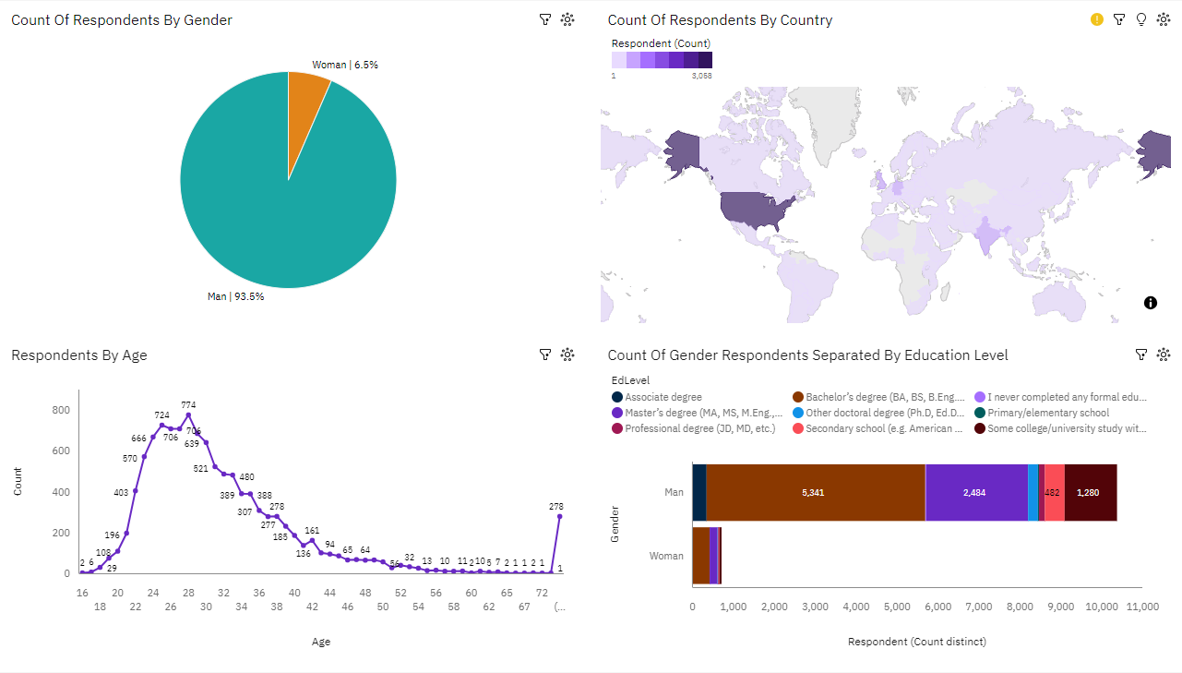
DASHBOARD TAB 3

Slide 15
DISCUSSION
In this section we will discuss overall findings and implications about the charts derived from the two data files

Slide 16
OVERALL FINDINGS & IMPLICATIONS
Findings
The commonly used languages are JavaScript, HTML/CSS, SQL, Python, and Java. JavaScript leads with 8,687 users, followed by HTML/CSS with 7,830 users
MySQL, PostgreSQL, and Microsoft SQL Server are the top databases in use, with MySQL being the most popular
AWS, Linux, and IBM Cloud or Watson are the leading platforms, indicating a strong preference for cloud-based and open-source solutions
React.js, Angular, and ASP.NET are the top web frameworks, with React.js being the most widely used
Implications
There is a strong interest in learning Python, which suggests that educational programs and training should focus on this language to meet demand
The high usage of JavaScript and React.js suggests that front-end development skills are in high demand
The gender disparity in the respondents indicates a need for initiatives to encourage more women to enter and stay in the technology field
Understanding the educational background of respondents can help tailor educational content to different levels of expertise

Slide 17

CONCLUSION
JavaScript, Python, and cloud platforms like AWS are highly prevalent in both current usage and future interest
There is a significant demand for learning Python and cloud technologies, suggesting a need for targeted educational programs
Front-end development skills, particularly in JavaScript and React.js, are in high demand
Relational database management skills are crucial, with MySQL and PostgreSQL being widely used
The gender disparity among respondents highlights the need for initiatives to encourage more women to enter and remain in the tech industry

Slide 18
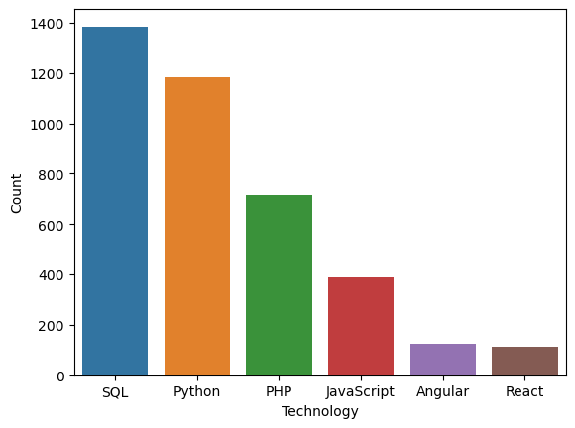
JOB POSTINGS
In Module 1 you have collected the job posting data using Job API in a file named “job-postings.xlsx”. Present that data using a bar chart here. Order the bar chart in the descending order of the number of job postings.

Slide 19
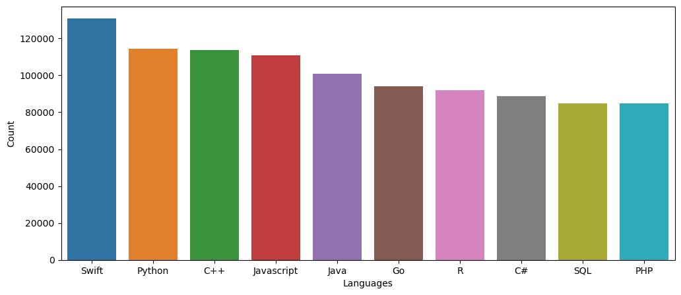
POPULAR LANGUAGES
In Module 1 you have collected the job postings data using web scraping in a file named “popular-languages.csv”. Present that data using a bar chart here. Order the bar chart in the descending order of salary.

