Slide 1




Members:
Ahmed Badr
Hassan Walid
Mokhtar Mostafa
Nouran Sayed
Peter Ashraf
Yasmeen Mohy Elden
Drive Tech

Slide 2
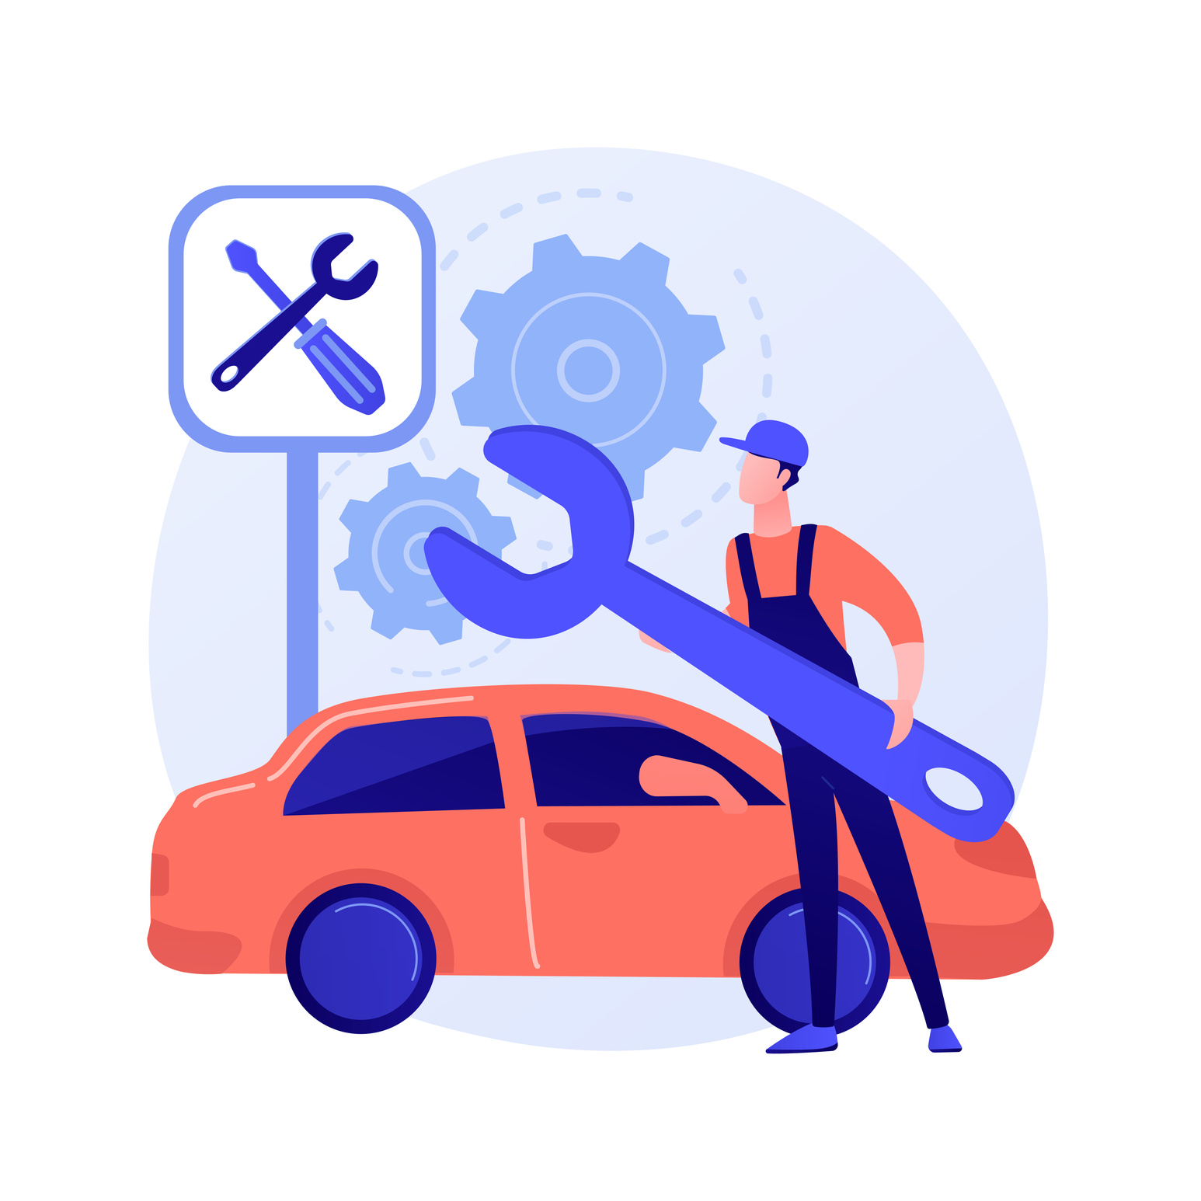
INTRODUCTION
Many people face problems when they are driving their cars such as the car suddenly stops, no fuel, there is a problem with the car battery so they need help.

Slide 3
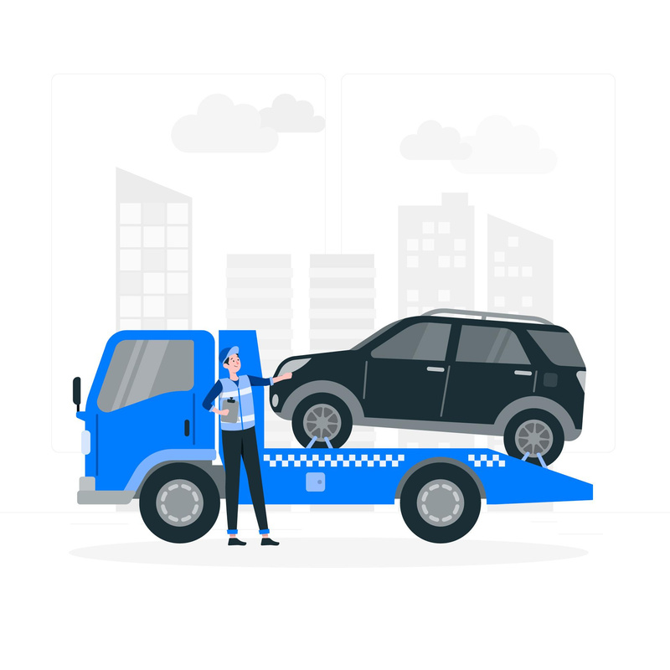
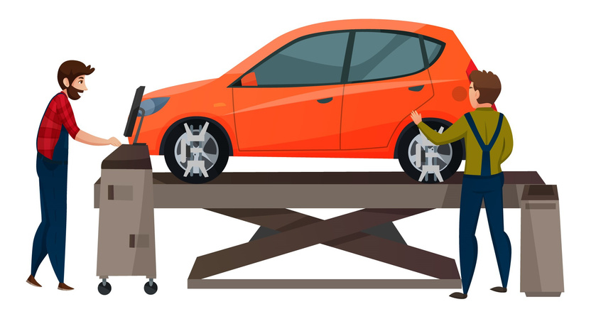
OBJECTIVE
Provide road services and consultation to people who have problems with their cars such as:
Pick up
Repair
Consultation

Slide 4




TECHNOLOGIES AND TOOLS

Slide 5
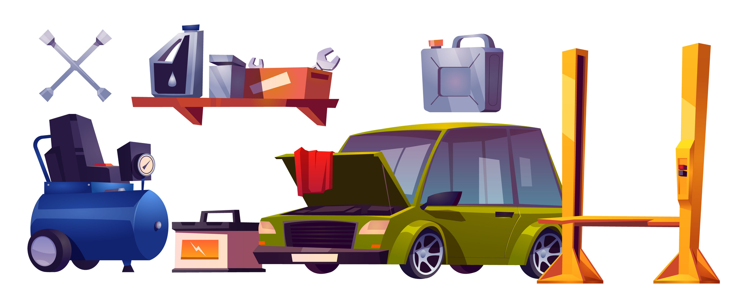
KEY FEATURES
Repair
Fuel refill.
Battery repair or replace.
Replace or fill car tires.

Slide 6

KEY FEATURES
Consultation
The user can use the chatbot on the app to ask for something related to the car.

Slide 7
KEY FEATURES
Pick up
The client can choose from the nearby providers.
The client can search for the point that he needs to be moved to.

Slide 8

KEY FEATURES
Maps
The user can get nearby Providers and choose the suitable to him
The user can track the Provider until he arrives at them

Slide 9


KEY FEATURES
Payment
The user can pay in cash or using PayPal.

Slide 10

KEY FEATURES
Rating
The user can review the app after payment using star rating.

Slide 11
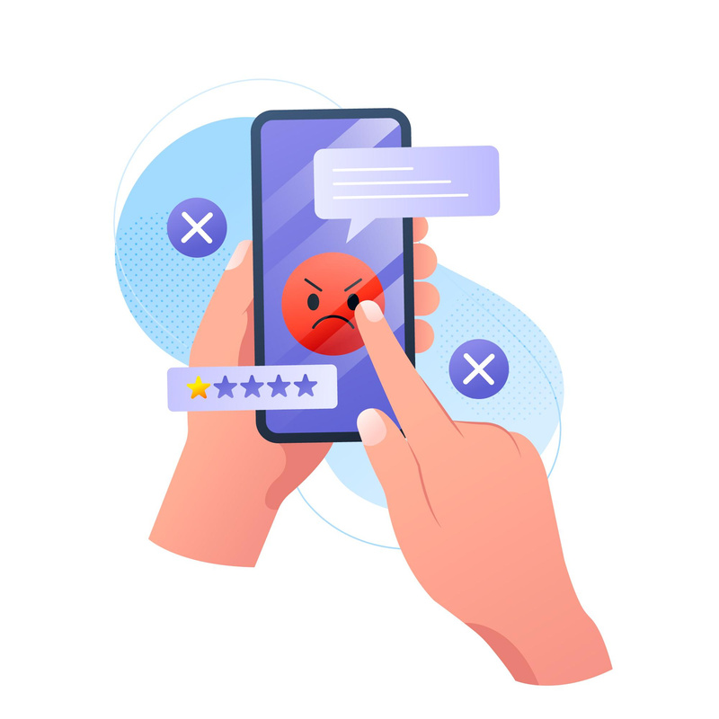
KEY FEATURES
Complaints
The user can complain about the provider if they have any complaint

Slide 12

KEY FEATURES
Admin Dashboard
Analysis
Approve the provider’s paper
Complaints panel

Slide 13

KEY FEATURES
Localization
The user can change the app language from English to Arabic and vice versa.

Slide 14
DEMO

Slide 15
FUTURE WORK
Application deployment

Slide 16
THANK YOU

