Slide 1
active learning strategies assignment2

Slide 2
introduction
Active learning (AL) is a learning model that helps improve model accuracy by selecting data points for labeling, rather than relying on randomly selected data points. AL algorithms aim to increase the accuracy of models by repeatedly selecting the most informative samples from a large, unlabeled dataset, which are then classified by an expert or the model itself.

Slide 3
setup
we apply four strategies for AL
Random sampling
margin sampling
entropy sampling
least confidence sampling
on four datasets
MNIST
Cifar10
Fashion-MNIST
SVHN

Slide 4
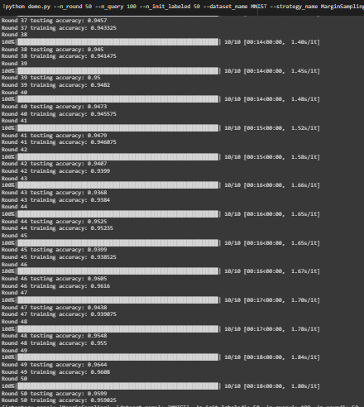
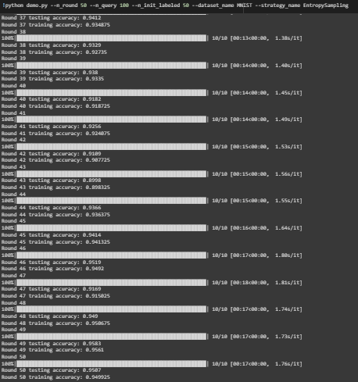
Results
MNIST
Margin Sampling Strategy Random Sampling Strategy

Slide 5
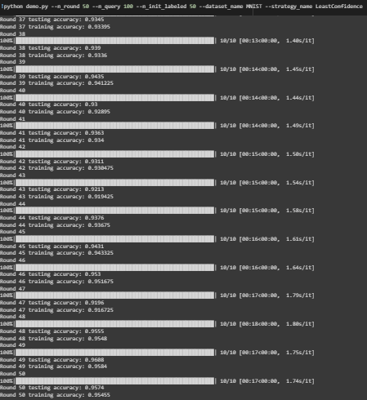
Results
MNIST
Entropy Sampling Strategy Least Confident Sampling Strategy

Slide 6
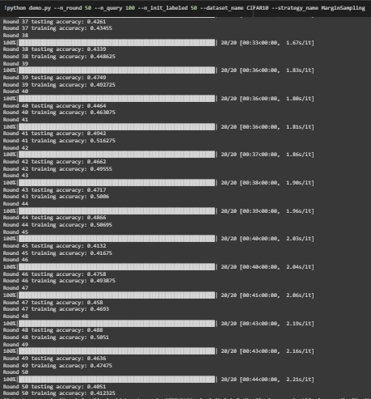
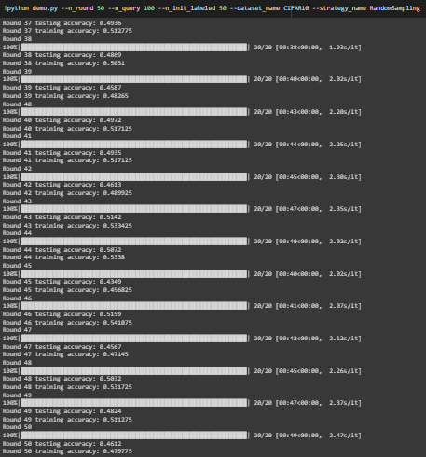
Results
Margin Sampling Strategy Random Sampling Strategy
Cifar10

Slide 7
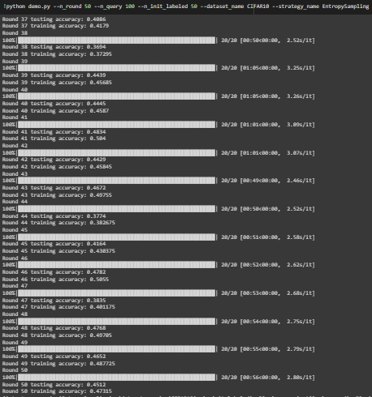
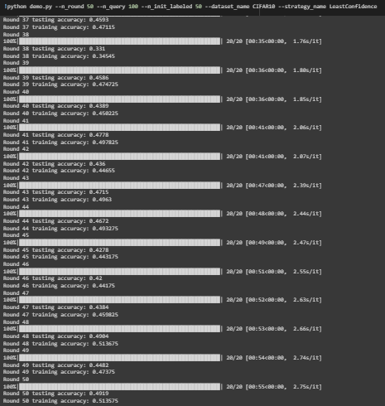
Results
Cifar10
Entropy Sampling Strategy Least Confident Sampling Strategy

Slide 8
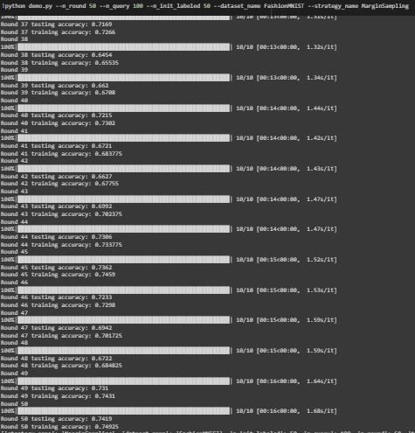
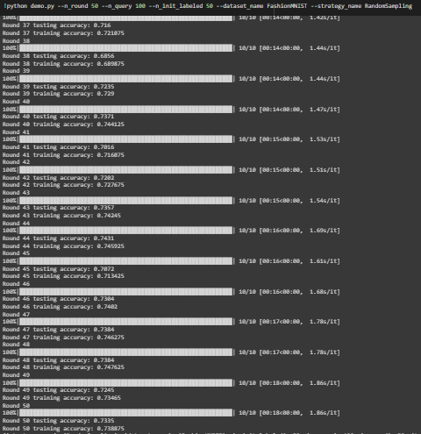
Results
Fashion-MNIST
Margin Sampling Strategy Random Sampling Strategy

Slide 9
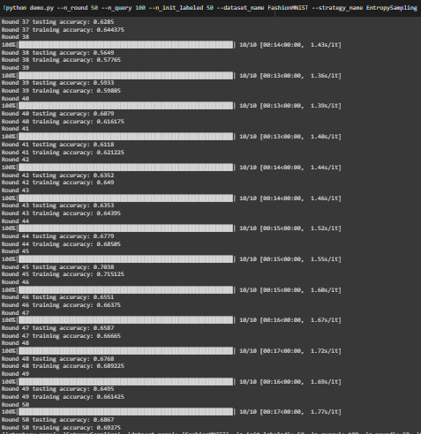
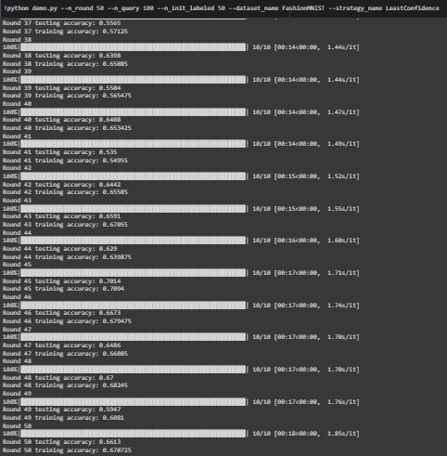
Results
Fashion-MNIST
Entropy Sampling Strategy Least Confident Sampling Strategy

Slide 10
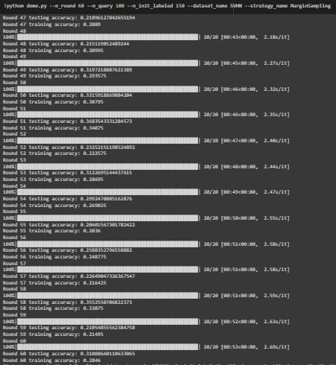
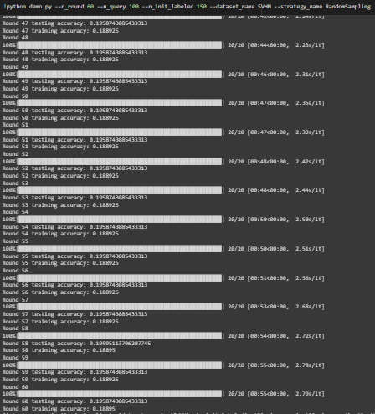
Results
SVHN
Margin Sampling Strategy Random Sampling Strategy

Slide 11
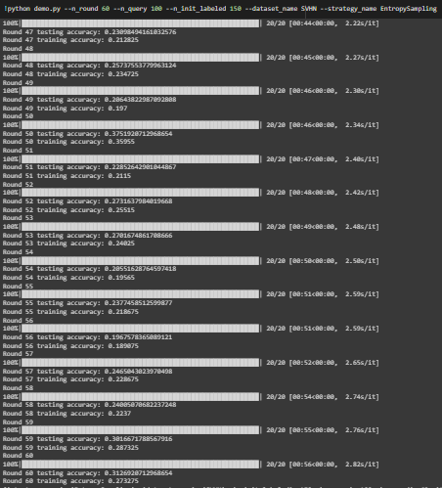
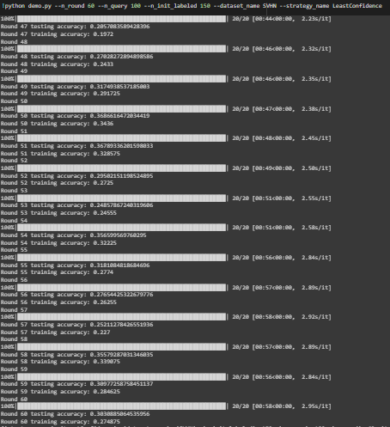
Results
SVHN
Entropy Sampling Strategy Least Confident Sampling Strategy

Slide 12
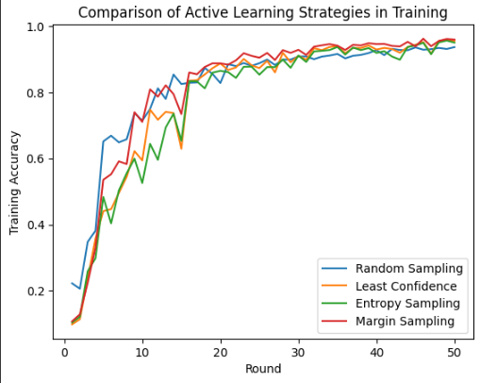
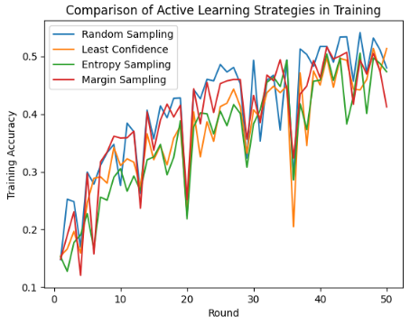
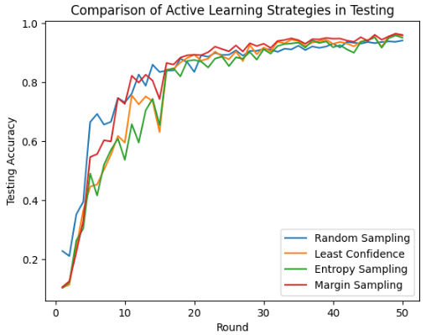
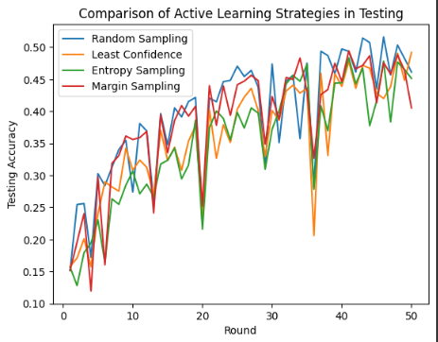
Results
Plotting the results
MNIST Cifar10

Slide 13
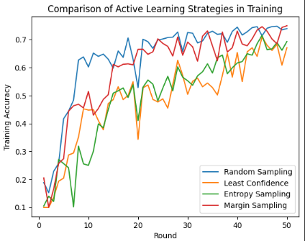
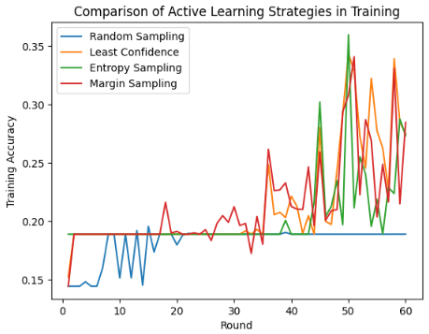
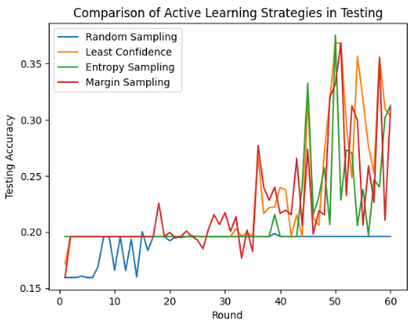

Results
Plotting the results
Fashion-MNIST SVHN

Slide 14
Discussion of the results
MNIST:
As shown in the results of MNIST dataset, Margin Sampling performed the best among the four strategies in the MNIST dataset, with a test accuracy of 95.9% after 50 rounds of querying. Margin sampling selects samples close to the decision boundary between classes, this helps the classifier to learn the boundaries between classes more accurately. Random sampling, Entropy sampling and least confidence sampling also performed well on this dataset, with test accuracy of 94.1%, 95% and 95.7%, respectively, after 50 rounds of querying. Entropy Sampling selects samples with high uncertainty, while Least Confident Sampling selects samples that have the lowest confidence scores, and Random sampling selects a subset of the samples from each class. Margin Sampling was able to identify the most informative samples for labeling, which led to the best performance.

Slide 15
Discussion of the results
Cifar10:
As shown in the results of Cifar10 dataset, Least Confident Sampling performed the best among the four strategies, with a test accuracy of 49.1% after 50 rounds of querying. It selects samples that have the lowest confidence scores. Margin Sampling, Entropy Sampling and Random sampling were performed poorly on this dataset, with a test accuracy of 40.5%, 45.1%, 46.1%, respectively, after 50 rounds of querying. Entropy Sampling selects samples with high uncertainty, while Random sampling selects a subset of the samples from each class, and Margin Sampling selects samples that are close to the decision boundary between classes.

Slide 16
Discussion of the results
Fashion-MNIST :
As shown in the results of Fashion-MNIST dataset, Margin Sampling performed the best among the four strategies, with a test accuracy of 74.1% after 50 rounds of querying. It selects samples close to the decision boundary between classes, this helps the classifier to learn the boundaries between classes more accurately. Random sampling, Entropy sampling and least confidence sampling performed poorly on this dataset, with test accuracy of 73.3%, 68.6% and 66.1%, respectively, after 50 rounds of querying. Entropy Sampling selects samples with high uncertainty, while Least Confident Sampling selects samples that have the lowest confidence scores, and Random sampling selects a subset of the samples from each class.

Slide 17
Discussion of the results
SVHN:
As shown in the results of SVHN dataset, Entropy Sampling performed the best among the four strategies, with a test accuracy of 31.2% after 60 rounds of querying. It selects samples with high uncertainty. Margin Sampling, Least Confident Sampling and Random sampling were performed poorly on this dataset, with a test accuracy of 31%, 30.3%, 19.5%, respectively, after 60 rounds of querying. Least Confident Sampling selects samples that have the lowest confidence scores, while Random sampling selects a subset of the samples from each class, and Margin Sampling selects samples that are close to the decision boundary between classes.

Slide 18
Conclusion
we evaluated four strategies for AL: Random sampling, margin sampling, entropy sampling, and least confidence sampling in four datasets: MNIST, Cifar10, Fashion MNIST and Street View House Numbers (SVHN). The results indicate that the effectiveness of these strategies varies across the dataset. Margin sampling performed best on the MNIST dataset and on the Fashion-MNIST dataset, least confidence sampling performed best on the Cifar10 dataset, and Entropy Sampling performed best on the SVHN dataset.
To improve the quality of their models, researchers should thoroughly assess various AL techniques on their datasets.

