Slide 1
active learning strategies assignment

Slide 2
introduction
Active learning (AL) is a learning model that helps improve model accuracy by selecting data points for labeling, rather than relying on randomly selected data points. AL algorithms aim to increase the accuracy of models by repeatedly selecting the most informative samples from a large, unlabeled dataset, which are then classified by an expert or the model itself.

Slide 3
setup
we apply three strategies for AL
margin sampling
entropy sampling
least confidence sampling
on three datasets
MNIST
Wisconsin breast cancer
iris

Slide 4
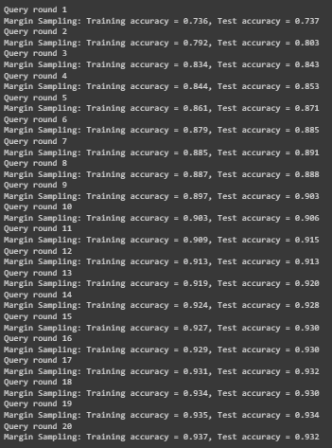
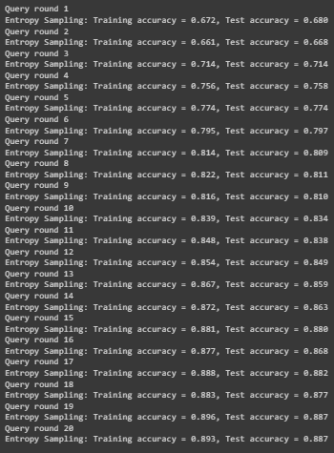
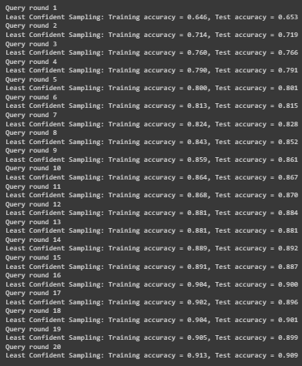
Results
MNIST
Margin Sampling Strategy Entropy Sampling Strategy Least Confident Sampling Strategy

Slide 5
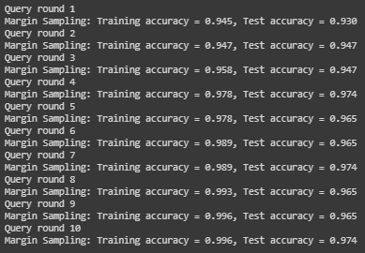
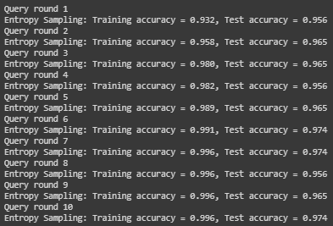
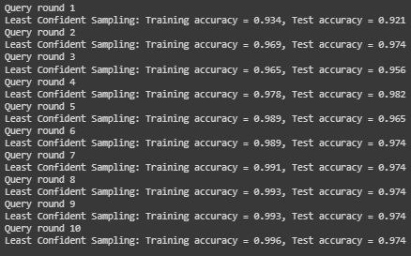
Results
Breast Cancer Wisconsin
Margin Sampling Strategy Entropy Sampling Strategy Least Confident Sampling Strategy

Slide 6
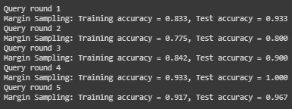
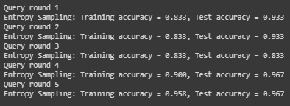
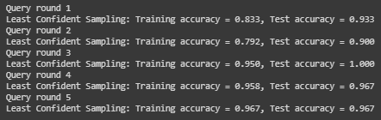
Results
Iris
Margin Sampling Strategy Entropy Sampling Strategy Least Confident Sampling Strategy

Slide 7
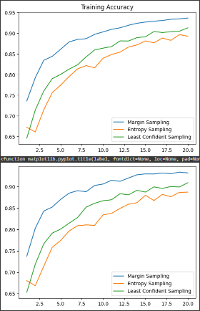
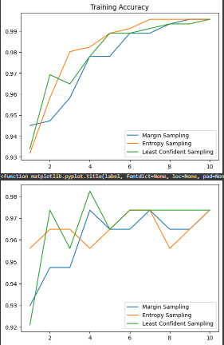
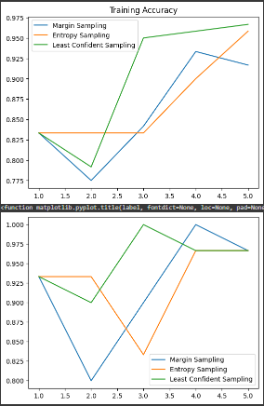
Results
Plotting the results
MNIST Breast Cancer Wisconsin Iris

Slide 8
Discussion of the results
MNIST:
Margin Sampling performed the best among the three strategies in the MNIST dataset, with a test accuracy of 93.2% after 20 rounds of querying. Entropy sampling and least confidence sampling also performed well on this dataset, with test accuracy of 88.7% and 90.9%, respectively, after 20 rounds of querying. Entropy Sampling selects samples with high uncertainty or uncertainty, while Least Confident Sampling selects samples about which the model is less confident.

Slide 9
Discussion of the results
Breast Cancer Wisconsin:
margin sampling, Entropy Sampling and least confidence sampling were performed similarly on the Wisconsin breast cancer dataset, with a test accuracy of 97.4% after 10 rounds of query. The results indicate that all three strategies are effective in identifying the most informative samples for labeling this dataset.
Iris:
margin sampling, entropy sampling and least-confidence sampling were performed in the same way on the iris dataset, with a test accuracy of about 96.7% after 5 rounds of query. The results indicate that all three strategies are effective in identifying the most informative samples for labeling this dataset.

Slide 10
Conclusion
we evaluated three strategies for AL: margin sampling, entropy sampling, and least confidence sampling in three datasets: MNIST, Wisconsin breast cancer, and iris. The results indicate that the effectiveness of these strategies varies across the data set. Margin sampling performed best on the MNIST dataset, while all three strategies performed similarly well on the Breast Cancer Wisconsin dataset and the Iris dataset.
All three methods work well at finding the most useful samples for labelling, although depending on the dataset, their effectiveness may differ. To improve the quality of their models, researchers should thoroughly assess various AL techniques on their data sets.

