Slide 1
Steganography
“a way of hiding data”
“hiding secrets in plain sight”

Slide 2
Steganography
Teem member :
Ahmed Mostafa 205067
Youssef Mostafa 205032
Amr tamer 205046

Slide 3
Agenda
What is meant by Steganography ?
What is the difference between steganography and cryptography ?
How it works ?
Hiding algorithms
Explanation of each algorithm
Related work

Slide 4

What is meant by Steganography ?
Steganography is a strategy for hiding secret information in a cover document in order to avoid attacker from predict about hidden information.
Steganography exploit cover document, for instance text, audio, picture and video to hide the secret message.

Slide 5
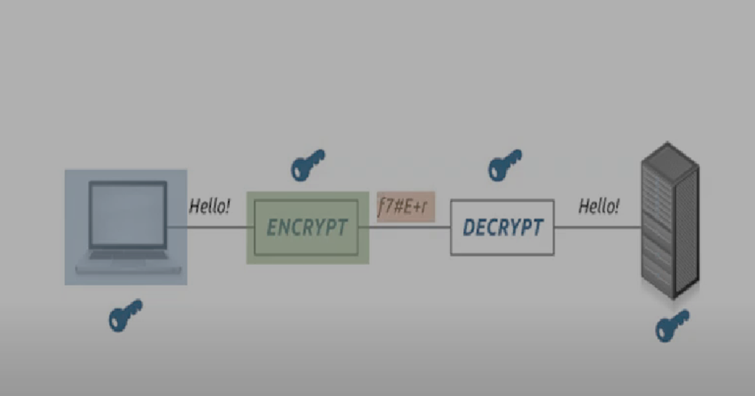
What is the difference between steganography and cryptography ?
The art of shorthand(steganography) differs from cryptography, while cryptography works on Hiding the content of the message, the art of shorthand hides the presence of another file in the message.
The principle of shorthand art technique is summarized in a nutshell in hiding data within the data, such as hiding a text message within an image, an audio file, or a video file, which is a new method used as an alternative to encryption technology known.

Slide 6
How it works ?
As for how this technology works, it is to take advantage of unimportant bits, or those that are difficult to discovered, contained within the image, audio or video file, and used to hide the inline message.
What distinguishes this type of hidden messages is that they reach their destination completely secretly, unlike Encrypted messages that although can never be deciphered without a key Encryption, it can be defined as an encrypted message.
“You don't even know that something exists, so how can you take advantage of it or destroy it?”

Slide 7
Hiding algorithms
The method we will adopt in hiding data, and there are several algorithms Accredited in shorthand, including :
1. Least Significant Bit (LSB) Algorithm.
2. Advanced Encryption Standard.
3. Watermark.
Cover file
File that ready to sent
Correct algorithm
File needs to hide

Slide 8
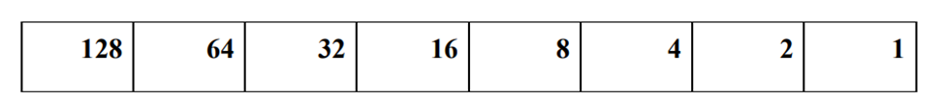

Explanation of the least significant bit algorithm:
All we are interested in here is dividing the byte into 8 bits, and knowing the least bit
important, given that the bit can only accept 0 or 1.
And the distribution of the bit values per byte, is as follows:
if we want to represent the number 65 in binary way, of course will be:
Try to change the number on the right from 1 to 0, the number will become 64 instead of 65, and try
if you change the bit on the left from 0 to 1, the number will become 193

Slide 9
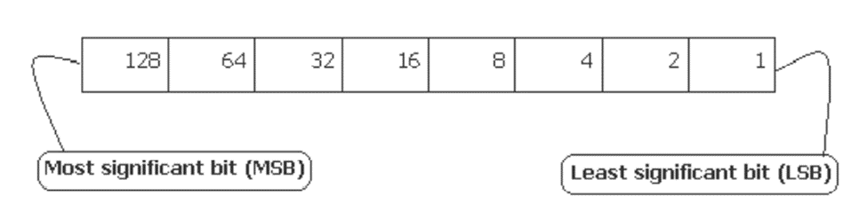
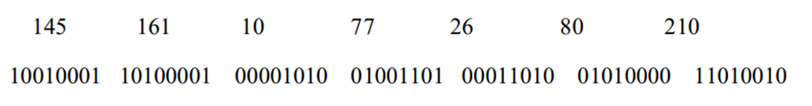
If we change this value
The effect will not be clear to the extent that the addition or change can be revealed, and add that byte
One does not represent the color value of the color image alone, but shares with it two other bytes.
❖ Suppose we have the following byte values: color values for the image elements: 145, 161, 10, 77, 26, 80, 210, note the representation of these bytes:

Slide 10
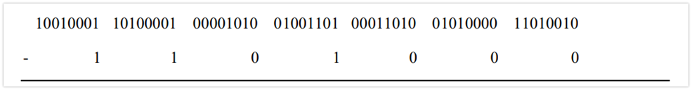
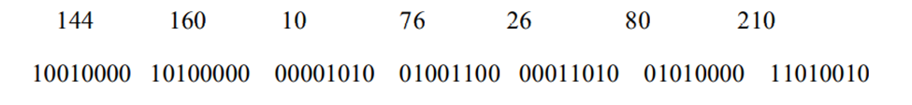
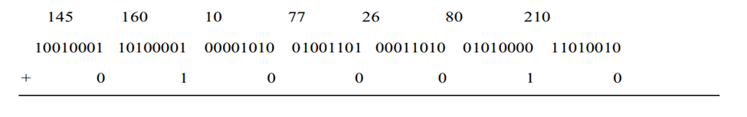
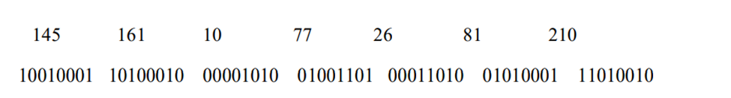
1-To prepare the least significant bit for the addition, it must be zeroed: -
3-Notice the little effect we've had so far, then add the eight bits that represent the number -66
After the replacement, the values became: 145, 162, 10, 77, 26, 81, 210, and I'm sure you noticed the very simple and inconspicuous difference in the process of hiding a character within 3 image elements.
2-Bytes values after zeroing (prepare) the least significant bit:-

Slide 11


Example
“you can’t find out the difference between them”

Slide 12
Related work to LSB
P.NO: 1
Title: Android Based Image Steganography by Ragul M | Dr. Lakshmi J. V. N
Citation: https://archive.org/details/httpswww.ijtsrd.comcomputer-sciencecomputer-security35733android-based-image-steganographyragul-m/page/n1/mode/1up
Year: 6, September-October 2020
Summary: Image steganography allows two people to communicate privately. We have created an android app using this technique to safely hide the secret image and text message in the image without worrying about human attack by protecting the image with a password. Provides protection against attackers. We use the LSB algorithm, an efficient algorithm for the Stego application. JPEG, BMP and PNG type images can be used as cover image and secret input image in our application.
This app does not change the secret information of the original image after it is hidden
Methodology: LSB algorithm

Slide 13
P.NO: 2
Title: Audio steganography based on LSB algorithm with 4D grid multi-wing hyper-chaotic system
by International Journal of Electrical and Computer Engineering (IJECE)
Citation: https://archive.org/details/10.11591ijece.v12i1.pp320-330/page/329/mode/1up
Year: 1, February 2022
Summary: This paper proposes a device to cover a mystery audio (.wav, .mp3) extraordinary period and extraordinary quantity of channels in a cowl audio/video primarily based totally on extraordinary forms of methods (LSB+4D GMWH Chaotic device). The green key supplied via way of means of 4D GMWH chaotic device will guide protection and robustness and issue of detection in opposition to hackers and attackers. This might be completed via way of means of utilising all of the video area and dividing the lengthy mystery audio into components and hiding them withinside the video.
Methodology: LSB+4D GMWH Chaotic device

Slide 14
p.NO: 3
Title: A survey on information hiding using video steganography
Citation: https://link.springer.com/article/10.1007/s10462-021-09968-0#Sec35
Year: 9 February 2021
Summary: This paper presented a survey and analysis of video steganography techniques represented in literature by classifying them according to their domains and also, based on their specific video features. Additionally, the paper also highlighted the main differences between cryptography, watermarking, and steganography. A comparative analysis of the distinct techniques has been discussed in terms of imperceptibility, robustness, and encryption. Also, some of the prominent techniques have been implemented for the experimental comparison using quality metrics PSNR, VQM, hiding capacity, and bit-rate increase. Moreover, based on the survey and experimental results a critical analysis has been done to summarize the article
Methodology: quality metrics PSNR, VQM, hiding capacity

Slide 15
p.NO: 4
Title: A New LSB-S Image Steganography Method Blend with Cryptography for Secret Communication
Citation: https://www.computer.org/csdl/proceedingsarticle/iciip/2015/07414745/12OmNzWx06O
Year:2015
Summary: In this paper, a new data hiding method is proposed which overcomes the limitation of the existing methods. In this technique first the message is encrypted with the help of transposition algorithm after that the cipher text is hidden in the gray image using our new method (LSB-S). The beauty of this method is that it, overcomes the limitation of the existing method. The data hiding capacity of proposed method is 100% as all the pixel can carry data bit. The total number of pixels in an image are 256*256 i.e.65536 and the total no of bit can be hidden are 65536. If the intruder extracts all LSB bits, he does not get the message. Also the change in the pixel value is only plus one or minus one which results good PSNR and MSE. The cover and original image were shown to number of persons
Methodology: (LSB-S).

Slide 16
p.NO: 5
Title: Cryptography and Cryptanalysis in MATLAB pp 179–190
Citation: https://link.springer.com/chapter/10.1007/978-1-4842-7334-0_14 - chapter-info
Summary: This chapter discussed the most important components of hiding information in different media files. To provide a comprehensive study (theoretical and practical) would require a book to itself. The practical implementations provided in this chapter should help you begin to see how steganography and steganalysis algorithms are designed, adjusted for real and independent scenarios, and implemented
Methodology: steganalysis algorithms design

Slide 17
Basics:
Image Steganography Using AES Algorithm:
First we have to know some basics like:
Symmetric encryption:
Each message has encrypting key which is the same key used to decrypt the message.
Asymmetric encryption:
Each message has encrypting key just for encrypting the message and decrypting key just for decrypting the message (note the encrypting key is public while the decrypting one is private).

Slide 18
Steps and types of AES
Block ciphe: (3steps)
a. converting the original message into hexadecimal.
b. splitting those hexadecimal into a number of blocks.
c. adding akey for every block(each block has a unique key).
The algorithm used to mix or add akey to the each block is AES
There are 3types of AES:
1.AES-128(use 128 bit key)
2.AES-192(use 192 bit key)
3.AES-256(use 256 bit key note: most used cause it is the fastest and most secured one)

Slide 19
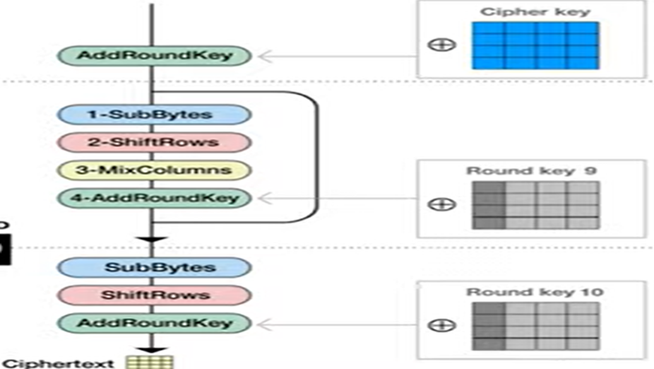
Cycle:
Cycle of encryption:
SubBytes:
We just have to get the value from the
rijndael s-box

Slide 20
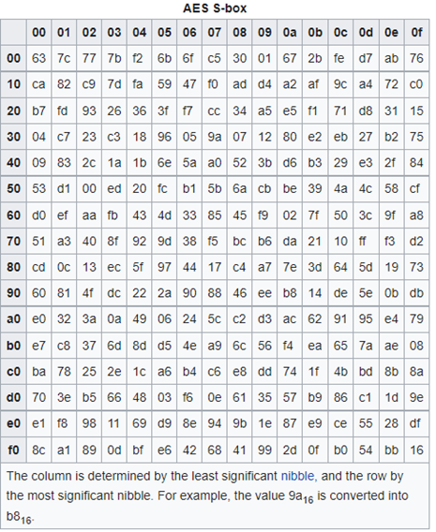
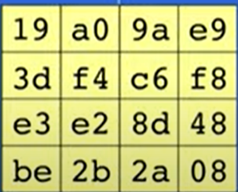
cycle
-Let’s take the first value as an example {19}
will refer to row 1 and column 9 so its going to be d4.
-Just repeat it until you just have apiece of subbsuituded piece of data.

Slide 21
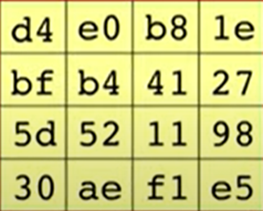
cycle
2)shift rows:
We are going to shift the rows by 0 byte for the first 1 and increment the shifting byte for every byte (0,1,2,3),as the following figure:

Slide 22
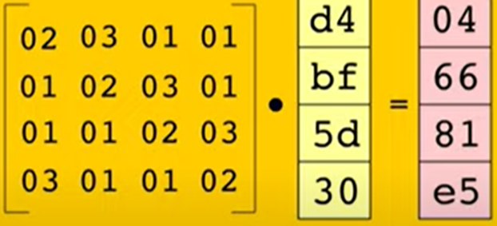
cycle
The four numbers of 1 column is going to be multiblied by rijndael’s galois field by agiven matrix.
Continue for the all columns.

Slide 23
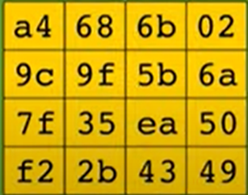
cycle
4)AddRoundKey:
You just have to take it and xor it with any produced valueas shown in the figure:
These transformations is going to be repeated 9times and atime after that doesn’t include mixcolumns transformation

Slide 24
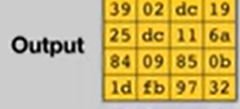
cycle
NOTE:
The round key changes for every round so that round key is a computed value based on the previous round.
And that’s the final output.

Slide 25
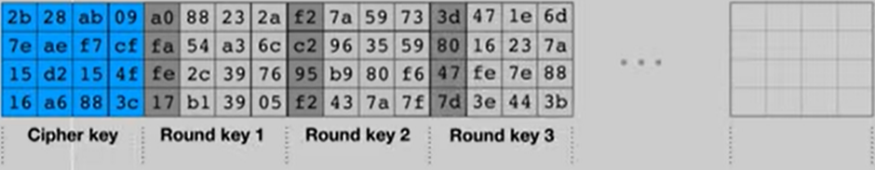
cycle
And that’s my friend’s are over view for the transforaation happened (9times and atime after that doesn’t include mixcolumns transformation).

Slide 26
Related work:
title | citation | methodology | summary
Analysis of Existing Text Hiding Algorithms for Image Steganography Using TLNUS and AES | Analysis of Existing Text Hiding Algorithms for Image Steganography Using TLNUS and AES | SpringerLink | TLNUS and AES | This paper contributed on the way of hiding the secret data in the image using steganography and encrypting the steganographic part of the image through analysis. This paper has simulated exiting algorithm, which divide the image into sub blocks by using TLNUS; instead of selecting the whole image, a part of the image has been selected and the secret message is in embedding process. Therefore, authors suggested the importance of algorithm that chosen TLNUS and AES together to solve the fundamental image transfer through steganography methods in terms of embedding and extracting process lies secret data.

Slide 27
title | citation | methodology | summary
Design, Development, and Implementation of an Image Steganography Algorithm for Encrypted (Using AES) and Non-encrypted Text into an Image | Design, Development, and Implementation of an Image Steganography Algorithm for Encrypted (Using AES) and Non-encrypted Text into an Image | SpringerLink | AES | It is performed with all four formats (PNG, JPG, BMP, GIF) using encrypted data as shown in Table 1 Resultant images after processing were of the same quality except JPG format, because in JPG format, image was distorted. Same image quality results found for both with and without encryption data experiments as shown in Table 2.

Slide 28
title | citation | methodology | summary
Digital Image Steganography Using Modified LSB and AES Cryptography | Digital Image Steganography Using Modified LSB and AES Cryptography | SpringerLink | LSB and AES | The secret information is concealed inside an image using a technique known as Image Steganography. For additional benefits, the content of the secret message is scrambled using Cryptography to avoid intrusion to unauthorised users and ensure safety during unfavourable situations. Modified LSB technique also proves to be very helpful in preserving the security of the information inside the image. There are almost negligible chances for the unauthorized users to recognise significant and noticeable changes in the stego image. The use of both the techniques gives a way to secure the information from illegal users.

Slide 29
title | citation | methodology | summary
A Hybrid Secured Approach Combining LSB Steganography and AES Using Mosaic Images for Ensuring Data Security | A Hybrid Secured Approach Combining LSB Steganography and AES Using Mosaic Images for Ensuring Data Security | SpringerLink | LSB and AES | Steganography is a technique of hiding information in digital media such as images, text, audio, etc. In this research, the proposed technique has focused on implementing the least significant bit (LSB) matching steganography algorithm. Different survey papers show that the success rate of using mosaic images as the cover media is approximately 99% comparing with approximately 50% the success of normal image in case of data hiding. Using a better version of LSB, Stego images were given more excellent peak signal-to-noise ratio (PSNR) value than other approaches when the hidden message was integrated into the mosaic image.

Slide 30
Thank you
Dr. Ahmed Moawad
Eng. Mostafa Gamal

