Slide 1
Sentiment Analysis using Python
Team member:
Ahmed Mostafa 205067
Youssef Mostafa 205032
Mohamed Fayez 205036

Slide 2
What is Sentiment Analysis
Sentiment Analysis – One of the most popular projects in the industry. Every customer facing industry (retail, telecom, finance, etc.) is interested in identifying their customers’ sentiment, whether they think positive or negative about them.
Python sentiment analysis is a methodology for analyzing a piece of text to discover the sentiment hidden within it. It accomplishes this by combining machine learning and natural language processing (NLP). Sentiment analysis allows you to examine the feelings expressed in a piece of text.
we build a binary text classifier to classify the sentiment behind the text. We use the various NLP preprocessing techniques to clean the data and utilize the LSTM layers to build the text classifier.

Slide 3
Dataset & Libraries
Dataset
The dataset contains more than 14000 tweets data samples classified into 3 types: positive, negative, neutral
Please download the dataset for python sentiment analysis project: Project Dataset
Tools and Libraries used
Python – 3.x
Pandas – 1.2.4
Matplotlib – 3.3.4
TensorFlow – 2.4.1

Slide 4
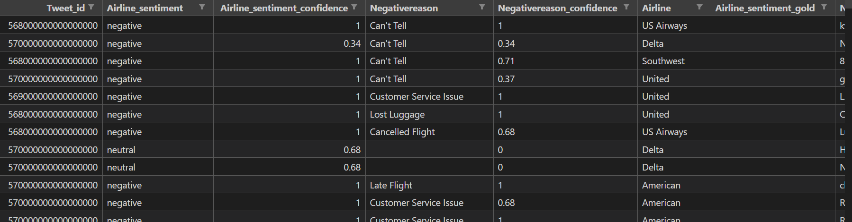
Steps to build Sentiment Analysis Text Classifier in Python
1. Data Preprocessing
As we are dealing with the text data, we need to preprocess it using word embeddings.
Let’s see what our data looks like.

Slide 5
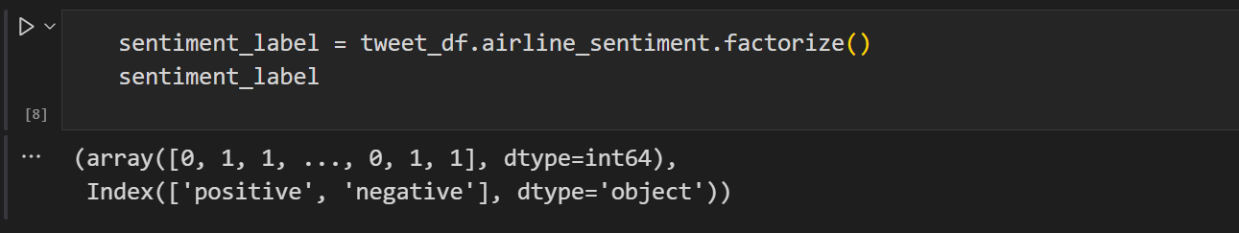
factorize
The labels for this dataset are categorical. Machines understand only numeric data. So, convert the categorical values to numeric using the factorize() method. This returns an array of numeric values and an Index of categories.
If you observe, the 0 here represents positive sentiment and the 1 represents negative sentiment.

Slide 6
Word embeddings
Now, the major part in python sentiment analysis. We should transform our text data into something that our machine learning model understands. Basically, we need to convert the text into an array of vector embeddings. Word embeddings are a beautiful way of representing the relationship between the words in the text.
To do this, we first give each of the unique words a unique number and then replace that word with the number assigned.

Slide 7
2. Build the Text Classifier
For sentiment analysis project, we use LSTM layers in the machine learning model. The architecture of our model consists of an embedding layer, an LSTM layer, and a Dense layer at the end. To avoid overfitting, we introduced the Dropout mechanism in-between the LSTM layers.
LSTM stands for Long Short Term Memory Networks. It is a variant of Recurrent Neural Networks. Recurrent Neural Networks are usually used with sequential data such as text and audio. Usually, while computing an embedding matrix, the meaning of every word and its calculations (which are called hidden states) are stored. If the reference of a word, let’s say a word is used after 100 words in a text, then all these calculations RNNs cannot store in its memory. That’s why RNNs are not capable of learning these long-term dependencies.
LSTMs on the other hand work well with such text. LSTM networks work well with time-series data.

Slide 8
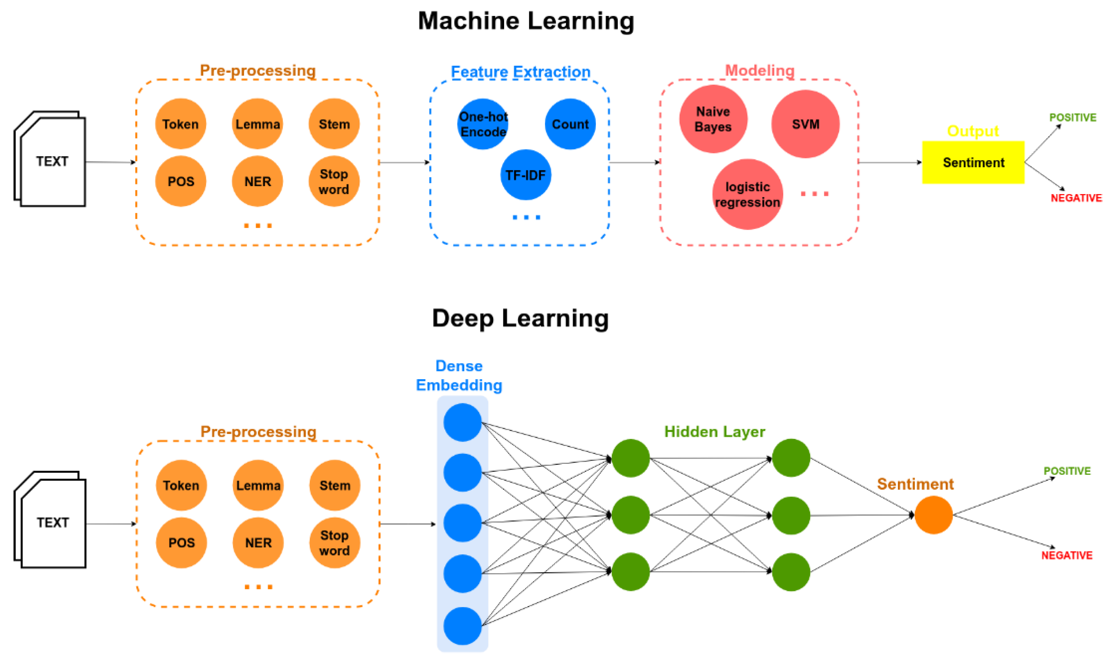
various ways to implement

Slide 9
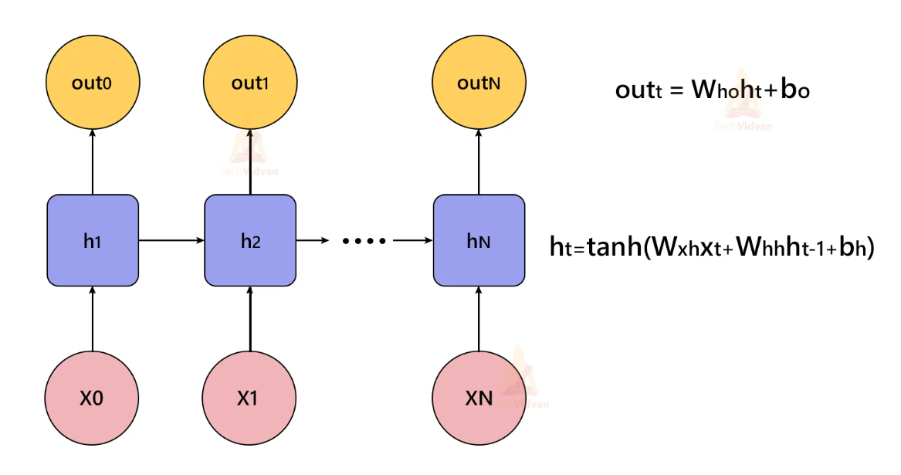
Dropout to avoid overfitting
Dropout is one of the regularization techniques. It is used to avoid overfitting. In the dropout mechanism, we drop some neurons randomly. The layer takes an argument, a number between 0 and 1 that represents the probability to drop the neurons. This creates a robust model avoiding overfitting.

Slide 10
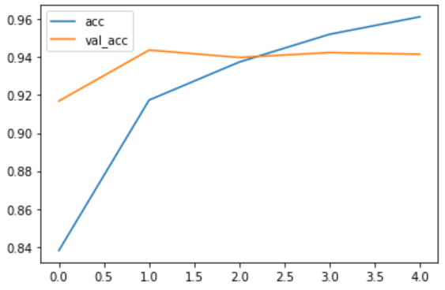
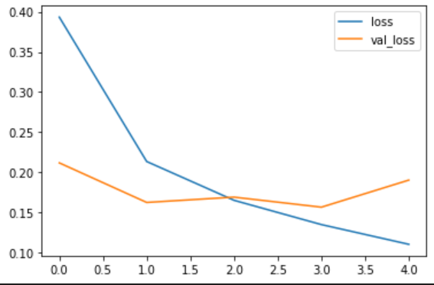
3. Train the sentiment analysis model
Train the sentiment analysis model for 5 epochs on the whole dataset with a batch size of 32 and a validation split of 20%
The python sentiment analysis model obtained 96% accuracy on the training set and 94.33% accuracy on the test set.
plot these metrics using the matplotlib.

Slide 11
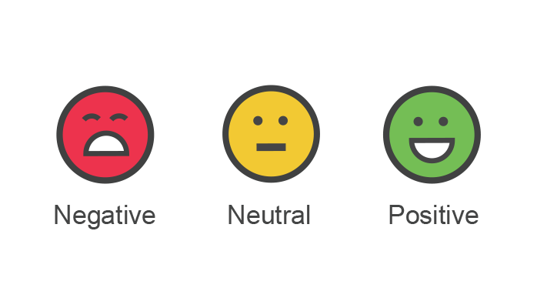
Summary
We have successfully developed python sentiment analysis model. In this machine learning project, we built a binary text classifier that classifies the sentiment of the tweets into positive and negative. We obtained more than 94% accuracy on validation.
This is an interesting project which helps businesses across the domains to understand customers sentiment / feeling towards their brands.

