Slide 1
MISUO / PERFORMANCE REPORT
MISUO
COMPANY SALES ANALYSIS
SALES
PERFORMANCE
REPORT
2024 SALES DATA · EXCEL
From raw company records to a clear,
decision-ready sales dashboard.
PRESENTED TO
PREPARED BY
MISUO Company
Ahmed Mohamed
Refaat
AN INDEPENDENT SALES ANALYTICS COURSE PROJECT

Slide 2
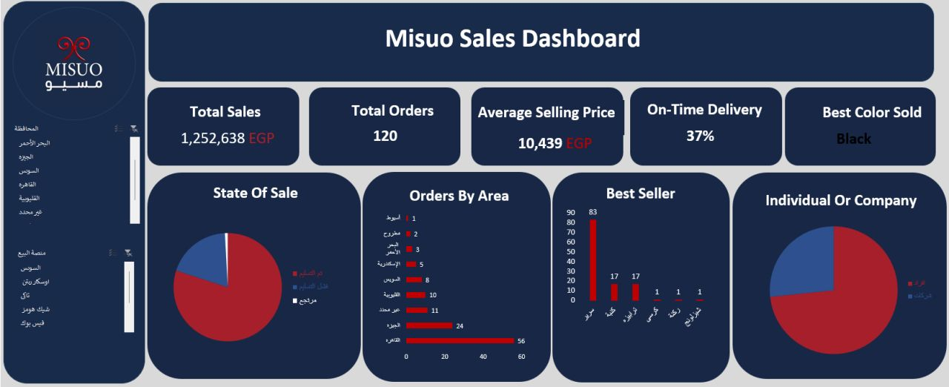
MISUO / PERFORMANCE REPORT
Project Overview
WHAT THIS DASHBOARD DOES
Turns company-provided sales records into an interactive Excel dashboard for tracking performance and supporting operational decisions.
BUSINESS QUESTIONS
How much sales value is recorded?
Which products, colors and areas lead?
Which platforms generate the most activity?
How efficiently are orders fulfilled?
MY INTERACTIVE EXCEL DASHBOARD
الهدف من المشروع كان تحويل بيانات المبيعات من شكل غير منظم إلى Dashboard واضحة، تساعد في متابعة الأداء وفهم فرص التحسين.
AHMED MOHAMED REFAAT • MISUO
PAGE 02

Slide 3
MISUO / PERFORMANCE REPORT
Data Cleaning & Preparation
FROM RAW DATA TO ANALYSIS-READY DATA
RAW DATA
PREPARED DATA
126 rows
→
120 rows
21 original columns
24 final columns
KEY ISSUES IN THE SOURCE DATA
Missing / blank fields
Some identifying and delivery fields were incomplete.
Inconsistent labels
Product, status and geographic names needed review.
Mixed date formats
Dates appeared as both text and Excel date values.
Uneven identifiers
Order IDs were sometimes missing or repeated.
CLEANING & ENRICHMENT OUTPUTS
Customer classification • Governorate extraction
Expected & actual delivery durations • On-time flag
مرحلة تجهيز الداتا كانت الأساس، لأن أي اختلاف في القيم أو التصنيفات ممكن يغيّر نتيجة التحليل بالكامل.
AHMED MOHAMED REFAAT • MISUO
PAGE 03

Slide 4
MISUO / PERFORMANCE REPORT
Transformation & Analysis Setup
AN AUDITABLE EXCEL ANALYTICS WORKFLOW
01
02
03
04
05
SOURCE
›
PREPARE
›
ENRICH
›
SUMMARIZE
›
VISUALIZE
126 raw rows
120 final rows
New columns
Pivot Tables
Dashboard
FEATURE ENGINEERING
Customer type
Classified rows into individuals and companies.
Governorate
Extracted geographic labels from addresses.
Delivery measures
Compared expected and actual delivery durations.
Delivery flag
Assigned an on-time indicator used in the dashboard.
ANALYSIS STRUCTURE
Pivot Tables summarize products, locations, platforms, customer segments, delivery states, sales amounts and dashboard KPIs.
استخدمت Pivot Tables علشان أحوّل الداتا المجهّزة لأرقام ورسومات تفاعلية تقدر الإدارة تراجعها بسهولة.
AHMED MOHAMED REFAAT • MISUO
PAGE 04

Slide 5
MISUO / PERFORMANCE REPORT
Sales & Market Performance
TOTAL SALES
TOTAL ORDERS*
1,252,638
120
EGP · all order statuses
Analyzed records, not distinct IDs
AVG. SELLING PRICE
ON-TIME FLAG
10,438.65
36.7%
EGP per analyzed record
44 positive flags / 120 records
TOP PRODUCT CATEGORIES · RECORD COUNT
Beds
83
Sofas
17
Tables
17
TOP GOVERNORATES · RECORD COUNT
Cairo
56
Giza
24
Unspecified
11
TOP SALES PLATFORMS · RECORD COUNT
Homezmart
78
Chic Homes
15
Oscar Riten
10
Most common recorded metal color: black (45 of 102 nonblank color values).
AHMED MOHAMED REFAAT • MISUO
PAGE 05

Slide 6
MISUO / PERFORMANCE REPORT
Delivery & Customer Performance
ORDER STATUS DISTRIBUTION
Delivered
Failed
Returned
96 records · 80.0%
23 records · 19.2%
1 records · 0.8%
ON-TIME DELIVERY INDICATOR
36.7%
44 of 120 analyzed records
flagged on time
INDIVIDUALS VS. COMPANIES
88 Individuals
32 Companies
Interpretation: the 36.7% rate is the share of all 120 records flagged on time; this includes non-delivered rows with a zero flag. Two delivered records lack an actual delivery date.
AHMED MOHAMED REFAAT • MISUO
PAGE 06

Slide 7
MISUO / PERFORMANCE REPORT
Key Insights & Recommendations
01
PRODUCT DEMAND
Beds lead with 83 of 120 records (69.2%).
ACTION Focus stock planning and availability checks on key bed ranges.
02
GEOGRAPHIC DEMAND
Cairo contributes 56 records (46.7%); Giza adds 24.
ACTION Prioritize delivery capacity and service monitoring in high-demand areas.
03
CHANNEL CONCENTRATION
Homezmart accounts for 78 records (65.0%).
ACTION Compare channel economics before increasing marketing investment.
04
FULFILLMENT OPPORTUNITY
96 records show delivered status; 44 are flagged on time.
ACTION Investigate delay causes and track delivered-only punctuality separately.
IMPORTANT METRIC DEFINITIONS
“120 orders” in the dashboard means 120 analyzed rows, not 120 verified unique order IDs. “Total Sales” is the sum of recorded selling prices across delivered, failed and returned statuses.
AHMED MOHAMED REFAAT • MISUO
PAGE 07

Slide 8
MISUO / PERFORMANCE REPORT
MISUO / SALES PERFORMANCE
THANK
YOU.
Questions, feedback, and opportunities
to connect are always welcome.
PREPARED BY
Ahmed Mohamed Refaat
+20 122 500 2143
ahmed5196643@gmail.com
linkedin.com/in/ahmed-mohamed-refaat-642064330
Created using Microsoft Excel · Based on prepared MISUO sales records
AHMED MOHAMED REFAAT • MISUO
PAGE 08

