Slide 1
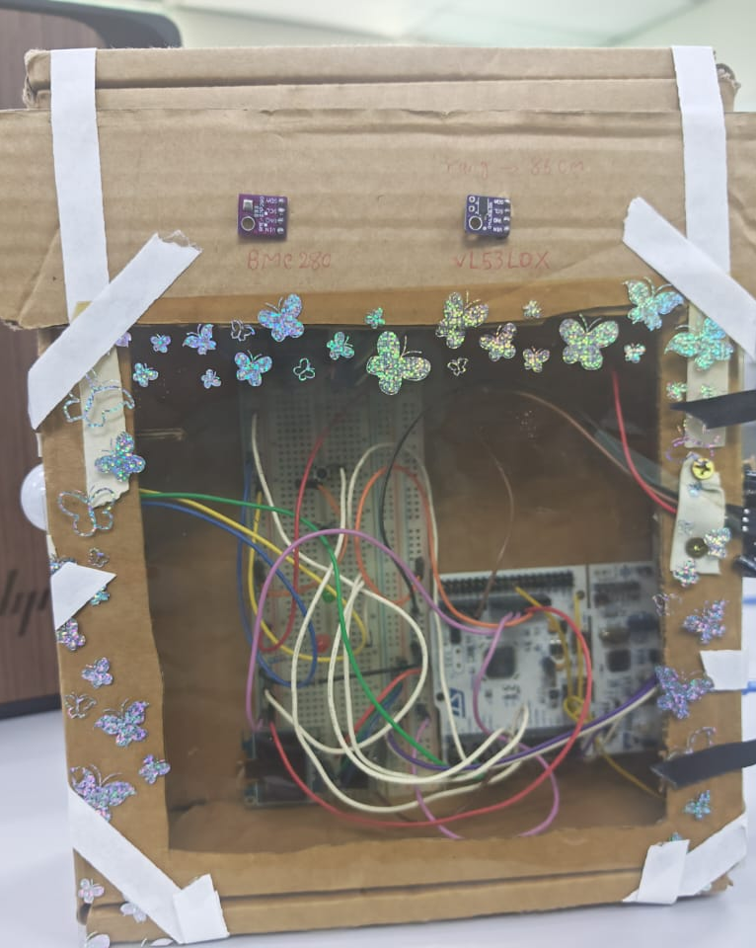
SMART CLASSROOM
OCCUPANCY AND
ENERGY MONITORING
TinyML occupancy classification on STM32 NUCLEO-L476RG
Ahmed Mohamed Abdalla Ahmed
A24KE0429
VeCAD Elite Internship 2026
Notes:
Opening: introduce the project in one sentence. This presentation takes about ten minutes, followed by a live demonstration.

Slide 2
Presentation Roadmap
02
This presentation follows the complete engineering path from the original problem to a working TinyML prototype.
01
Context and goal
Why classroom occupancy information can support energy-aware decisions.
02
Hardware and data
How the STM32 prototype collects labelled sensor records.
03
AI methodology
Features, normalisation, TensorFlow training and evaluation.
04
Embedded deployment
How the model runs on the STM32 with local feedback.
05
Evaluation and future
Current results, limitations, improvement plan and live demo.
Ten-minute presentation followed by a five-minute live demonstration
VeCAD Elite Internship 2026
Notes:
Give the audience a map before technical details. State that the presentation is ten minutes and the live demo follows immediately.

Slide 3
Why This Project?
03
A classroom needs a simple way to estimate occupancy and highlight avoidable energy use.
OUTPUT
Occupancy class
+
Energy alert
+
Local feedback
Occupancy affects how lighting and cooling are used, yet direct people counting is not required for a first energy-aware prototype.
The system estimates three practical room states: EMPTY, LOW and HIGH occupancy.
The classifier must run on an STM32 microcontroller, rather than depend on a laptop or cloud connection.
The final prototype provides a local warning when an apparently empty room still has avoidable energy use.
The goal combines occupancy estimation with practical energy awareness.
Problem statement: occupancy estimation can support energy-aware classroom decisions
VeCAD Elite Internship 2026
Notes:
Explain the project goal. Do not claim that the system controls the classroom automatically; it provides occupancy estimates and warnings.

Slide 4
Project Scope and Objectives
04
The internship brief required an end-to-end embedded AI prototype: sensing, data, training, deployment and real-time output.
Interface multiple low-cost sensors with the NUCLEO-L476RG and verify them individually.
Collect labelled EMPTY, LOW and HIGH classroom recordings under different light and air-conditioning conditions.
Prepare window-based features and train a small neural-network classifier.
Convert the trained model into an embedded INT8 network using STM32Cube.AI.
Display the estimated occupancy state locally and connect it to energy-aware warning rules.
Important scope
This is a safe low-voltage smart-building prototype.
It provides a decision-support indication; it does not connect directly to classroom mains power, lighting circuits or air-conditioning equipment.
Aligned with the VeCAD Internship Project 1 specification
VeCAD Elite Internship 2026
Notes:
Mention the full embedded-AI workflow and clarify the safe low-voltage scope. This matches the official project guideline.

Slide 5
System Architecture
05
Sensors
Feedback
2 × PIR sensors
OLED Display
Motion activity
Live values and AI result
STM32
NUCLEO-L476RG
BME280 + BH1750
LEDs + Buzzer
Temperature, humidity, light
Status and warning output
Sensor reading
Feature processing
On-board inference
VL53L0X
Serial CSV Logger
Distance context
Labelled data sessions
Hardware system and data flow
VeCAD Elite Internship 2026
Notes:
Describe the signal path: sensors feed the STM32, which displays results, logs labelled records and issues feedback.

Slide 6
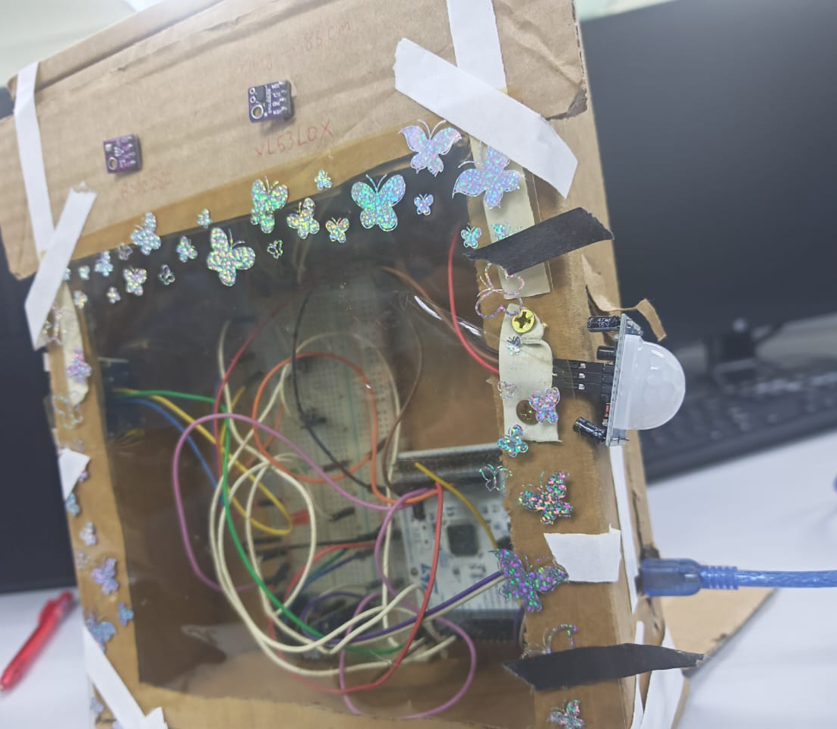
Hardware Prototype
06
The NUCLEO board, breadboard and sensors are mounted in one portable enclosure.
Two PIR sensors provide room-motion coverage from opposite directions.
BME280, BH1750, VL53L0X and OLED share the I2C bus.
Buttons select labels and start or stop data recording.
LEDs and an active buzzer provide immediate status feedback.
Design choice
The prototype prioritises sensor testing and explainable behaviour before a final enclosure design.
Working prototype
Integrated STM32 multi-sensor prototype
VeCAD Elite Internship 2026
Notes:
Show the real prototype. Point out the two PIR positions and the modules on the front/top of the enclosure.

Slide 7
Hardware Interfaces and Development Tools
07
The project combines one shared I2C sensor bus with independent GPIO inputs and outputs.
I2C bus: PB8 / PB9
GPIO and firmware control
BME280: temperature, humidity and pressure
BH1750: ambient light in lux
VL53L0X: distance measurement
SSD1306: OLED display output
2 PIR modules: motion inputs
2 buttons: label selection and start/stop
LEDs and active buzzer: status feedback
USB UART: diagnostics and CSV logging
STM32CubeIDE generated the MCU initialisation and HAL drivers. TensorFlow trained the model, then STM32Cube.AI generated the embedded AI network.
I2C, GPIO, UART, STM32CubeIDE, TensorFlow and STM32Cube.AI
VeCAD Elite Internship 2026
Notes:
This slide helps the committee see that you used more than an AI model: it is a complete embedded-system integration.

Slide 8
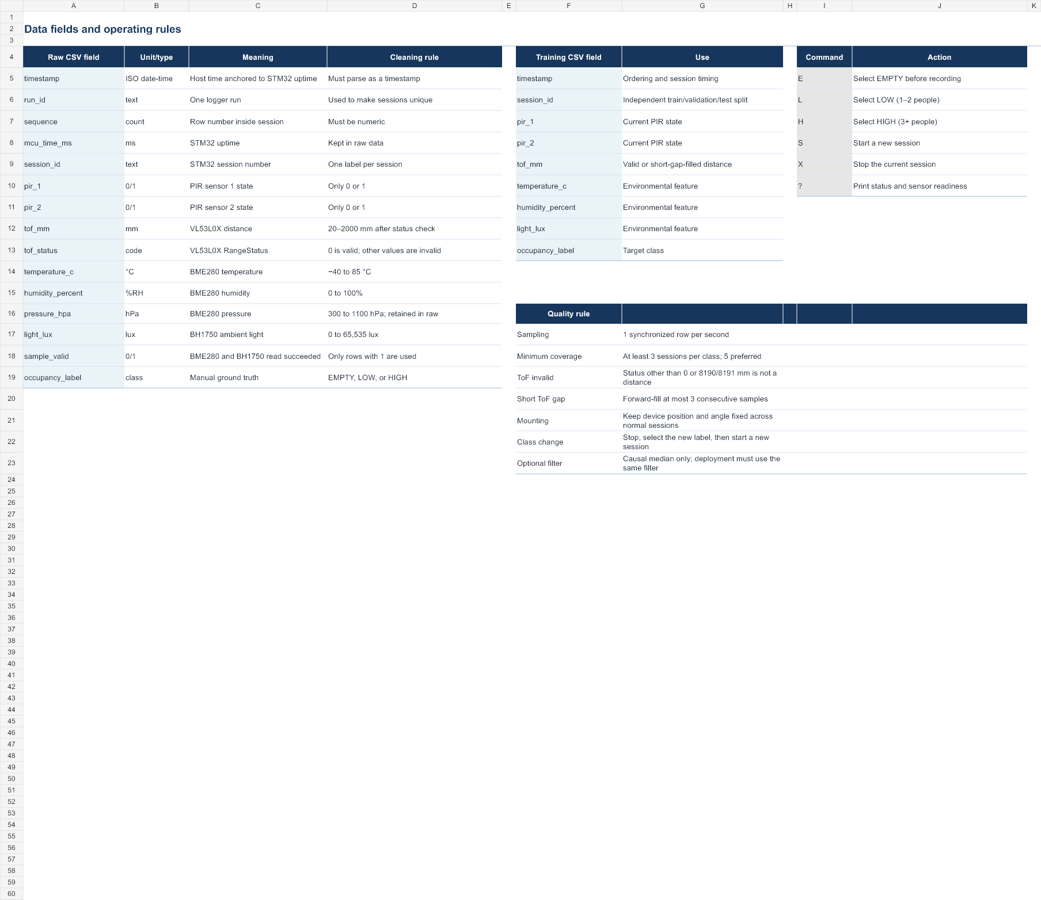
Data Collection and Labelling
08
The STM32 writes labelled rows through the serial port. A Python logger stores each session as CSV.
Labels: EMPTY, LOW and HIGH occupancy.
Conditions include lighting and air-conditioning changes.
Transition rows at the beginning and end of sessions were removed before training.
6,479
1,221
3
valid sensor readings
overlapping AI windows
occupancy classes
Each CSV row keeps the time, PIR data, environmental readings, validity status and selected occupancy label.
Labelled CSV sessions form the AI training dataset
VeCAD Elite Internship 2026
Notes:
Explain that the labels were selected before recording. The PC was used only to log the data; the final model later runs on the STM32.

Slide 9
Dataset Preparation and Quality Control
09
Raw data is not sent directly to the model. It is checked, cleaned and converted into consistently labelled time windows.
1
Session review
2
Transition removal
3
Validity filtering
Verify the selected occupancy label and confirm the room condition for each recording.
Remove start and end rows that include button presses, entry movement or leaving the test area.
Retain records with usable sensor values and preserve the original session identity.
4
Window generation
5
Recording-level split
Build overlapping 30-sample windows and calculate one set of features per window.
Keep recordings separated across train, validation and test subsets to reduce leakage.
Data preparation creates a fairer and more realistic model evaluation
VeCAD Elite Internship 2026
Notes:
Explain why removing transition rows matters. Emphasise that train, validation and test are separated by recording, not random individual lines.

Slide 10
PIR Feature Window
10
PIR outputs describe motion at one instant. The model needs a short history of activity.
30 latest PIR samples
6 motion
features
AI
result
PIR 1
PIR 2
Window ≈ 30 seconds
A new result is produced every 5 samples, approximately every 5 seconds, after the first window is full.
Why this matters: the model classifies activity over time instead of reacting to a single PIR event.
Feature engineering for motion-based occupancy classification
VeCAD Elite Internship 2026
Notes:
Define the 30-sample window and the five-sample update. Explain that this makes PIR measurements more useful for occupancy estimation.

Slide 11
Six PIR Features Used by the AI Model
11
The neural network receives six numerical summaries of the latest 30-second motion window -
not the raw PIR values alone.
1
PIR 1 active ratio
2
PIR 2 active ratio
Fraction of window samples where PIR 1 was HIGH.
Fraction of window samples where PIR 2 was HIGH.
3
Any-PIR active ratio
4
Both-PIR active ratio
Fraction of samples where at least one PIR detected motion.
Fraction of samples where both PIRs were HIGH together.
5
PIR 1 rising edges
6
PIR 2 rising edges
Number of LOW-to-HIGH transitions from PIR 1.
Number of LOW-to-HIGH transitions from PIR 2.
Ratios describe how long motion was present; rising edges describe how often activity started.
Together, they give the AI a richer motion pattern.
Feature order is identical during training and on the STM32
VeCAD Elite Internship 2026
Notes:
Read the six features clearly. This slide is important because it explains exactly what the AI receives.

Slide 12
Normalisation and INT8 Quantisation
12
The same feature-processing steps are applied during offline training and during live STM32 inference.
1. Raw features
2. Normalise
3. INT8 input
Different numerical scales:
ratios 0 to 1,
rising-edge counts 0 to 29.
normalised =
(feature - training mean)
÷ training standard deviation
Convert the normalised values to signed 8-bit integers for the compact deployed model.
Why normalise? It prevents a larger-scale feature, such as a rising-edge count, from dominating a small ratio feature just because of its numeric magnitude.
Why INT8? It reduces the deployed model to 3,616 bytes while preserving the recorded test accuracy.
Training statistics are stored in the embedded feature-processing code
VeCAD Elite Internship 2026
Notes:
Explain normalisation in plain language: it places each input on a comparable scale. Then explain that INT8 makes the embedded model very small.

Slide 13
TensorFlow Neural Network
13
A compact neural network classifies the six PIR features into three occupancy classes.
Input
Hidden 1
Hidden 2
Output
6 features
16 ReLU neurons
8 ReLU neurons
EMPTY
LOW
HIGH
Training uses separate train, validation and test subsets. Early stopping selected the best point before overfitting increased.
275
49
300
trainable parameters
epochs completed
maximum epochs allowed
Keras model: 6 inputs, 16 and 8 hidden neurons, 3 Softmax outputs
VeCAD Elite Internship 2026
Notes:
Explain the model at a high level. ReLU is the activation used in the hidden layers. Softmax converts the final values into three class probabilities.

Slide 14
Training Method and Model Selection
14
The model was trained and evaluated using separate recordings so the final test result represents unseen sessions.
Training
Validation
Test
659 windows
306 windows
256 windows
Used to learn model weights. Class weighting reduces the effect of uneven class counts.
Observed during training to choose the best model point and prevent overfitting.
Held back until the end for an unbiased final accuracy and F1 measurement.
Maximum: 300 epochs • Optimiser: Adam (learning rate 0.001) • Batch size: 32 • Loss: sparse categorical crossentropy
Early stopping monitored validation loss. It stopped after 49 epochs and restored the best weights because further training no longer improved validation performance.
Early stopping protects the model from unnecessary training and overfitting
VeCAD Elite Internship 2026
Notes:
Explain the three dataset splits. Then explain the 49 epochs: 300 was only the maximum; early stopping ended training when validation loss stopped improving.

Slide 15
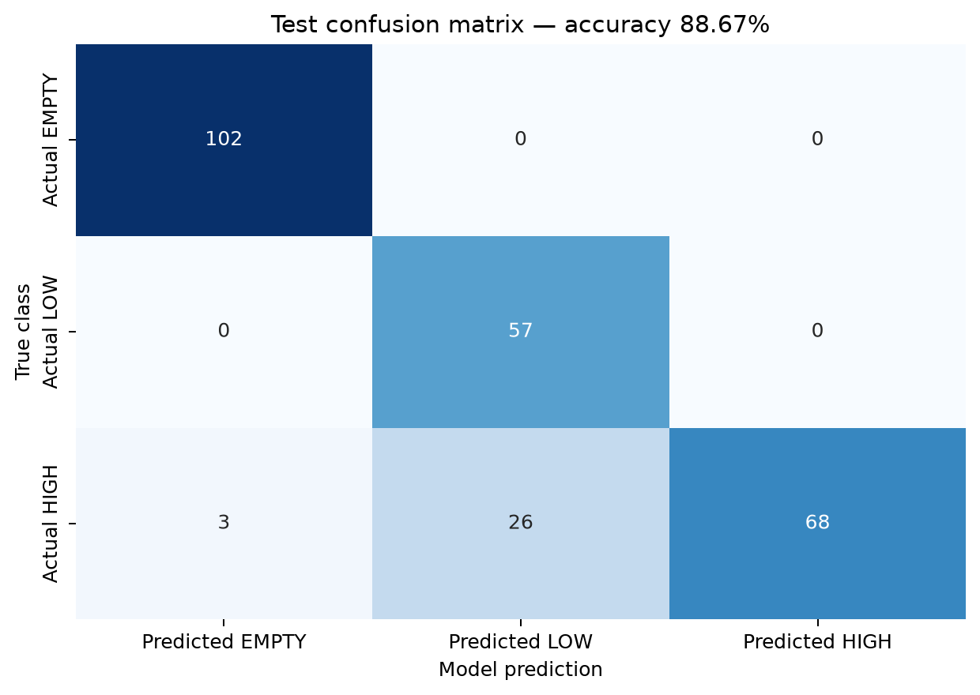
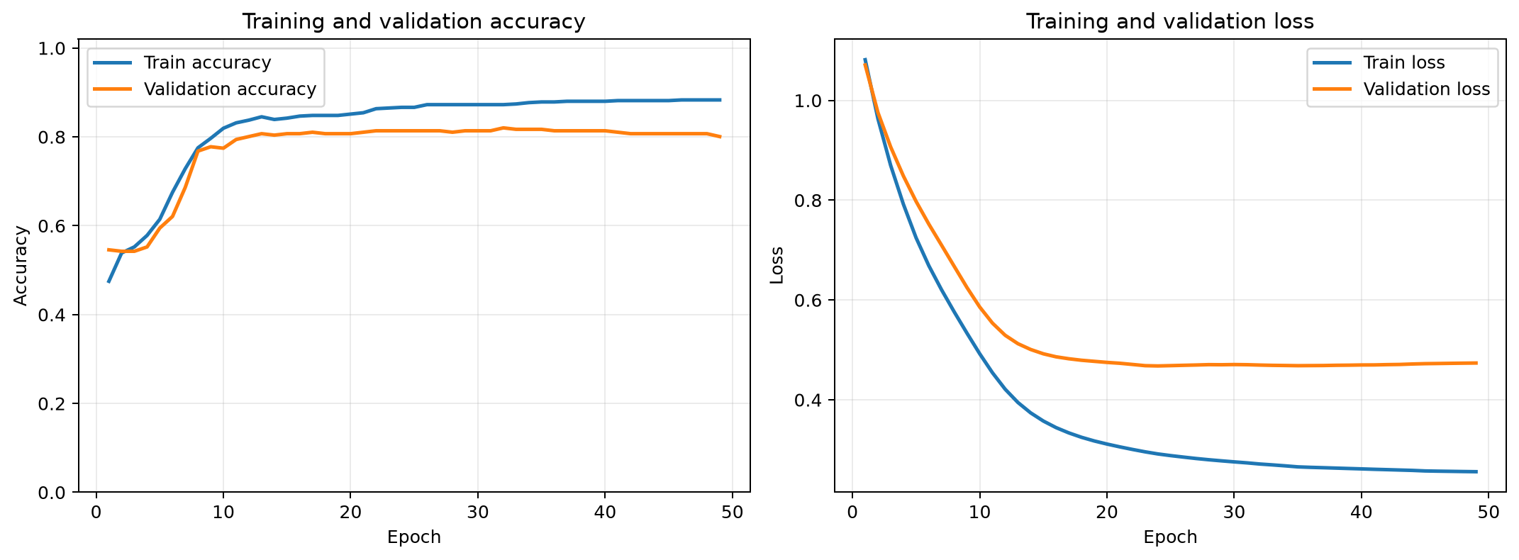
Training Results
15
Interpretation
EMPTY and LOW have strong separation. HIGH remains the main class to improve with more varied recordings.
88.67%
87.47%
3,616 B
test accuracy
macro F1 score
INT8 model size
Float and INT8 models recorded the same test accuracy
VeCAD Elite Internship 2026
Notes:
State the accuracy and explain the practical interpretation. Be transparent: HIGH has more room for improvement, so the project includes a clear next step.

Slide 16
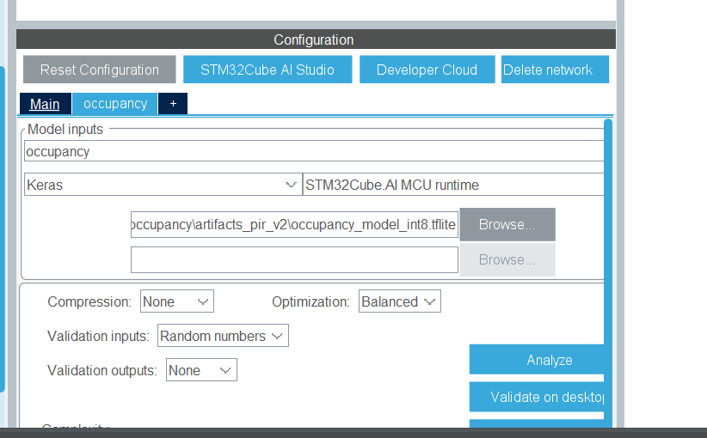
STM32Cube.AI Deployment
16
The trained model was converted from a TensorFlow model into embedded C code for the NUCLEO-L476RG.
Deployment path
Keras model
INT8 TensorFlow Lite
STM32Cube.AI analysis
Generated C network
STM32CubeIDE integration
The generated files include network weights, data parameters and inference functions used by the STM32 application.
X-CUBE-AI generated an embedded inference network from the INT8 TFLite model
VeCAD Elite Internship 2026
Notes:
Explain that training happens on the computer, while inference happens on the microcontroller. Mention the generated C files are integrated into the CubeIDE project.

Slide 17
Embedded Firmware: From Sensor Read to AI Result
17
STM32CubeIDE builds the complete application: peripheral drivers, sensor sampling, feature calculation, AI inference and user feedback.
Data-collection main loop
AI inference path
Buttons_Update();
Buzzer_Update();
if (one_second_elapsed) {
Sample_AllSensors();
Output_DataRow();
}
if (new_window_ready) {
Compute(features);
Normalize(features);
Quantize_INT8(input);
OccupancyAI_Run(input, output);
Select_best_class(output);
}
The first block is taken from the main firmware structure. The second shows the inference sequence implemented by the occupancy feature and AI helper modules.
Important: the same window, feature order, normalisation values and INT8 conversion used during training must also be used on the STM32.
Main firmware coordinates sampling; helper modules provide repeatable feature and AI processing
VeCAD Elite Internship 2026
Notes:
Walk from left to right. This is the key code slide: it shows that this is an embedded application, not a model running only in a notebook.

Slide 18
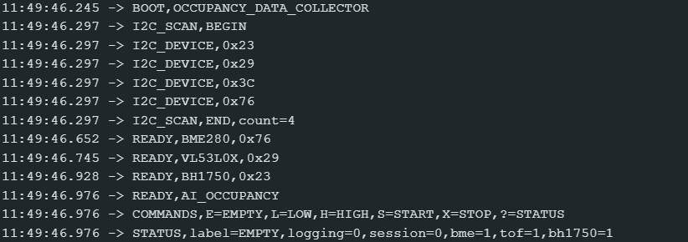
Live System Behaviour
18
On-board inference
After the first 30-sample window, the AI output updates every 5 seconds.
The serial monitor prints the class, confidence and three probabilities.
The OLED, LEDs and buzzer provide immediate local feedback.
Boot scan confirms the four I2C devices before the AI model starts.
Energy-aware rules
When the AI reports EMPTY and the measured light remains high for a sustained period, the system issues a warning. Environmental readings support additional room-status alerts.
AI occupancy output plus rule-based energy feedback
VeCAD Elite Internship 2026
Notes:
Use this slide before the demo. Explain the AI class output and the energy warning without promising automatic switching of room equipment.

Slide 19
Energy-Aware Feedback Logic
19
The AI model estimates occupancy. Rule-based logic uses that result together with environmental sensors
to create understandable warnings.
AI Occupancy
BH1750 Light
Local Warning
EMPTY
with confidence
Lux remains above
configured threshold
Buzzer + OLED/LED
energy-saving reminder
A sustained condition is required before a warning. This avoids reacting to a single momentary light reading or one uncertain AI result.
BME280 temperature and humidity readings can support additional comfort or energy-status alerts,
but they are not presented as direct evidence of the number of people.
AI occupancy is combined with transparent, explainable environmental rules
VeCAD Elite Internship 2026
Notes:
This is not part of the neural network. Explain that it is a rule-based layer that uses the AI result and the measured room state.

Slide 20
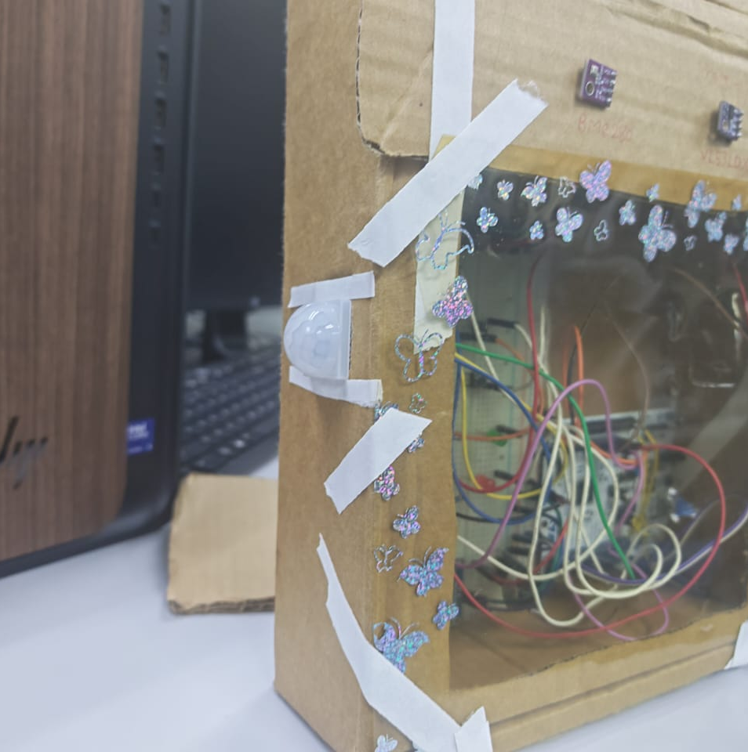
Engineering Decisions and Limitations
20
What testing showed
PIR detects motion, so a person who remains very still can appear as EMPTY.
VL53L0X gives useful close distance data but its narrow field of view and observed range do not cover the full room.
The deployed model therefore uses validated PIR features, while BH1750 and BME280 support energy-aware rules.
Next iteration
Add the third PIR for wider coverage, collect a new labelled dataset, then compare the new model against the validated two-PIR baseline.
Observed limitations guide the next development cycle
VeCAD Elite Internship 2026
Notes:
Be confident here: recognising a limitation is an engineering result. Explain why VL53L0X was not forced into the current AI model.

Slide 21
Future Development Vision
21
The current two-PIR model is the validated baseline. Future work should improve coverage and robustness through measured iteration, not assumptions.
PIR 3 coverage
Retrain and compare
Install the third PIR to cover a blind area, then repeat all key EMPTY, LOW and HIGH recordings.
Build a new three-PIR feature set and compare its accuracy, F1 score and false-empty behaviour against the current baseline.
Sensor fusion study
Practical enclosure
Evaluate distance and environmental features only when new data proves that they improve generalisation.
Move from the cardboard prototype to a neat fixed enclosure with safer cable management and permanent mounting.
Future work: improve the evidence, then retrain and evaluate again
VeCAD Elite Internship 2026
Notes:
This slide is your future vision. Do not say PIR 3 is already part of the validated result. It is the next engineering iteration.

Slide 22
Project Outcome
A complete TinyML prototype from sensing and data logging
to embedded AI inference.
LIVE
DEMO
Integrated multi-sensor STM32 prototype with local feedback.
Labelled real-world CSV data collected and prepared for machine learning.
INT8 occupancy classifier deployed on the STM32 with 88.67% test accuracy.
Energy-aware warning logic connected to the AI EMPTY state.
1. System boot
2. Motion classes
3. Empty-room alert
Thank you
Notes:
Close the presentation. Transition immediately to the five-minute live demo: boot scan, occupancy result, then energy-warning behaviour.

